Slide 1
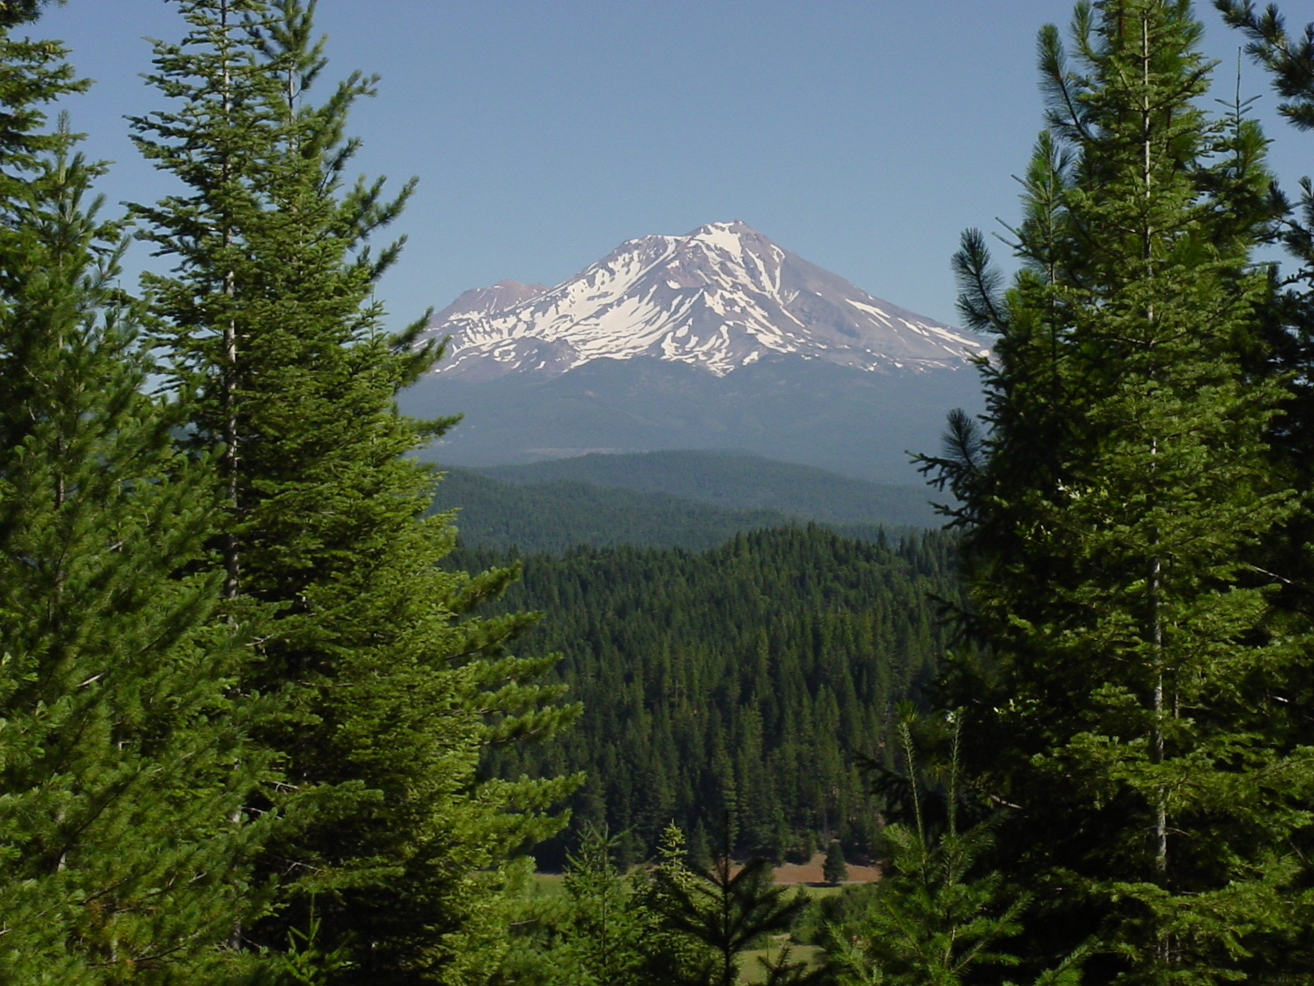
2014 Forest Vegetation Conference
Carl Yingst
Shasta County Department of Agriculture/W&M
cyingst@co.shasta.ca.us

Slide 2
Pesticide Applications
Property Operator Obtains an:
Operator Identification Number
or
Restricted Materials Permit
If not the property operator - PCA, Authorized Representative (employee)

Slide 3
Authorized
Representative

Slide 4
Information Needed
Pest Control Businesses
Pesticides to be used
Site Information
Crop, Acreage, Legal Description Restricted Materials for that Site
Map

Slide 5
PCO
Sites
Pesticides

Slide 7
Application of a Pesticide to a Resrticted Material to a Unit
Hire a PCO
Written recommendation (Location, Date Pesticide, Rate, Precautions, Sensitive Sites)
Copy of Permit to PCO

Slide 8
PCO to apply Weedone LV 4 EC to a Unit
Written Recommendation
Copy of the Permit
Notice of Intent

Slide 9
Notification Requirements
Pest Control Business Notifies (orally or written)
Grower/Property Operator
Date
Location
Pesticide , EPA Reg#, Active Ingredient
REI
Posting if Required
Precautions from the Label
Ample Time for Subsequent Notifications

Slide 10
Notification Requirements
Grower Notifies (orally or written)
Employees
Sub Contractors
Others Likely to Enter Treated Area
Date of the Scheduled Application
Location and Description of the Field/Site
Instructions Not to Enter

Slide 11
Notification Requirements
PCO
Grower/Operator
Employees,
Sub Contractors
Others Who May Enter Area
Not Required If:
Posted
Persons will not Enter Within ¼ Mile

Slide 12
Posting Required if:
Required by Pesticide Labeling
Unless Area Controlled So No Employee Within
¼ Mile
REI is Greater Than 7 Days
Greenhouse Applications

Slide 13
Notice of Completed Applications
PCB Notifies Property Operator 24 Hours After Application is Completed.
Location – Site Number
Pesticide , EPA Reg #, Active Ingredient
Date and Hour of Completion
REI and Pre-Harvest Interval

Slide 14
Pesticide Application
CA Restricted Material (2,4-D)
NOI Required at Least 24 Hours Prior to the Application
Caution Material

Slide 15
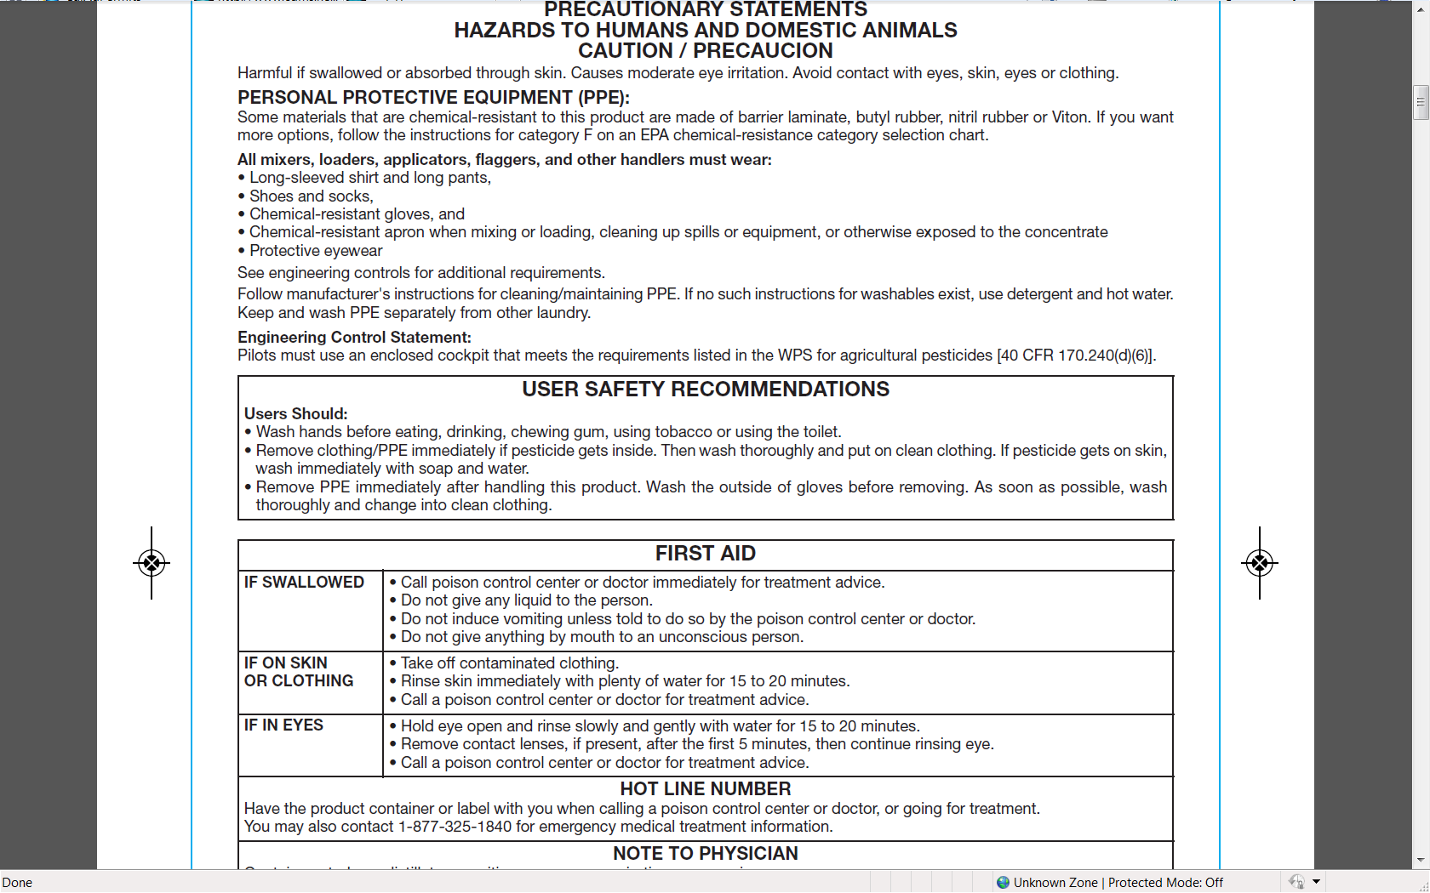

Slide 16
PPE Required
Long Sleeve Shirt, Long Pants, Shoes & Socks
Protective eyewear
Protective Gloves (Cat. F on EPA Chart)
Chemical Resistant Apron – Mix-Load, Spills, Concentrate

Slide 17
EPA/DPR Glove Category Chart

Slide 18
Employee Application Other Requirements
Label PPE
One Pint of Eyewash Carried on the Person
At the Mix-Load Site and Not More Than ¼ Mile from Other Handlers
Soap, Sufficient Water, Single Use Towels
Clean Coveralls

Slide 19
PCO to Apply Forest Garlon XRT
Not CA Restricted
No NOI Required

Slide 20
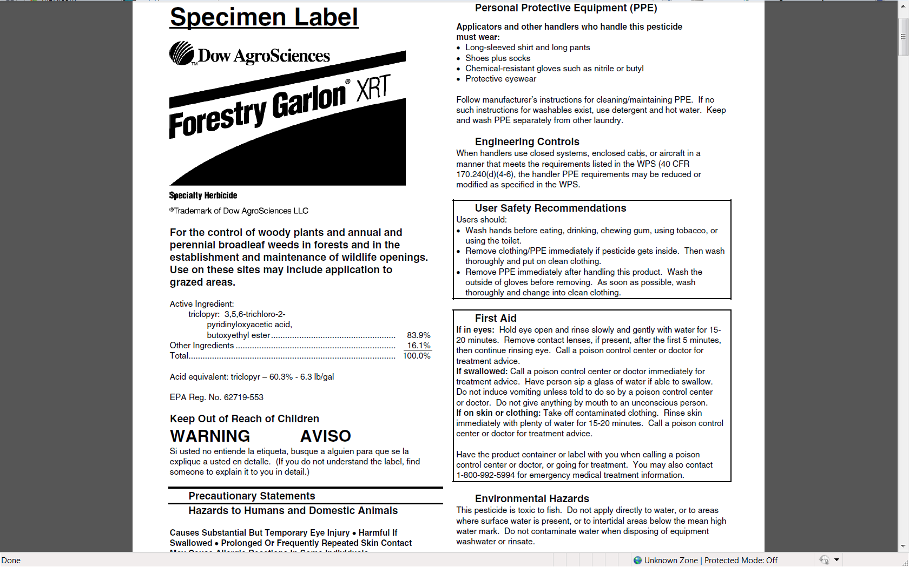
PPE
Forest Use Label
Active Ingredient: Triclopyr
Signal Word
“Warning”

Slide 21
Not CA Restricted “Warning” Pesticide
Label Personal Protective Equipment Required
Long Sleeve Shirt, Long Pant, Shoes & Socks
Chemical Resistant Gloves
Protective Eyewear
Employee Required PPE
Coveralls

Slide 22
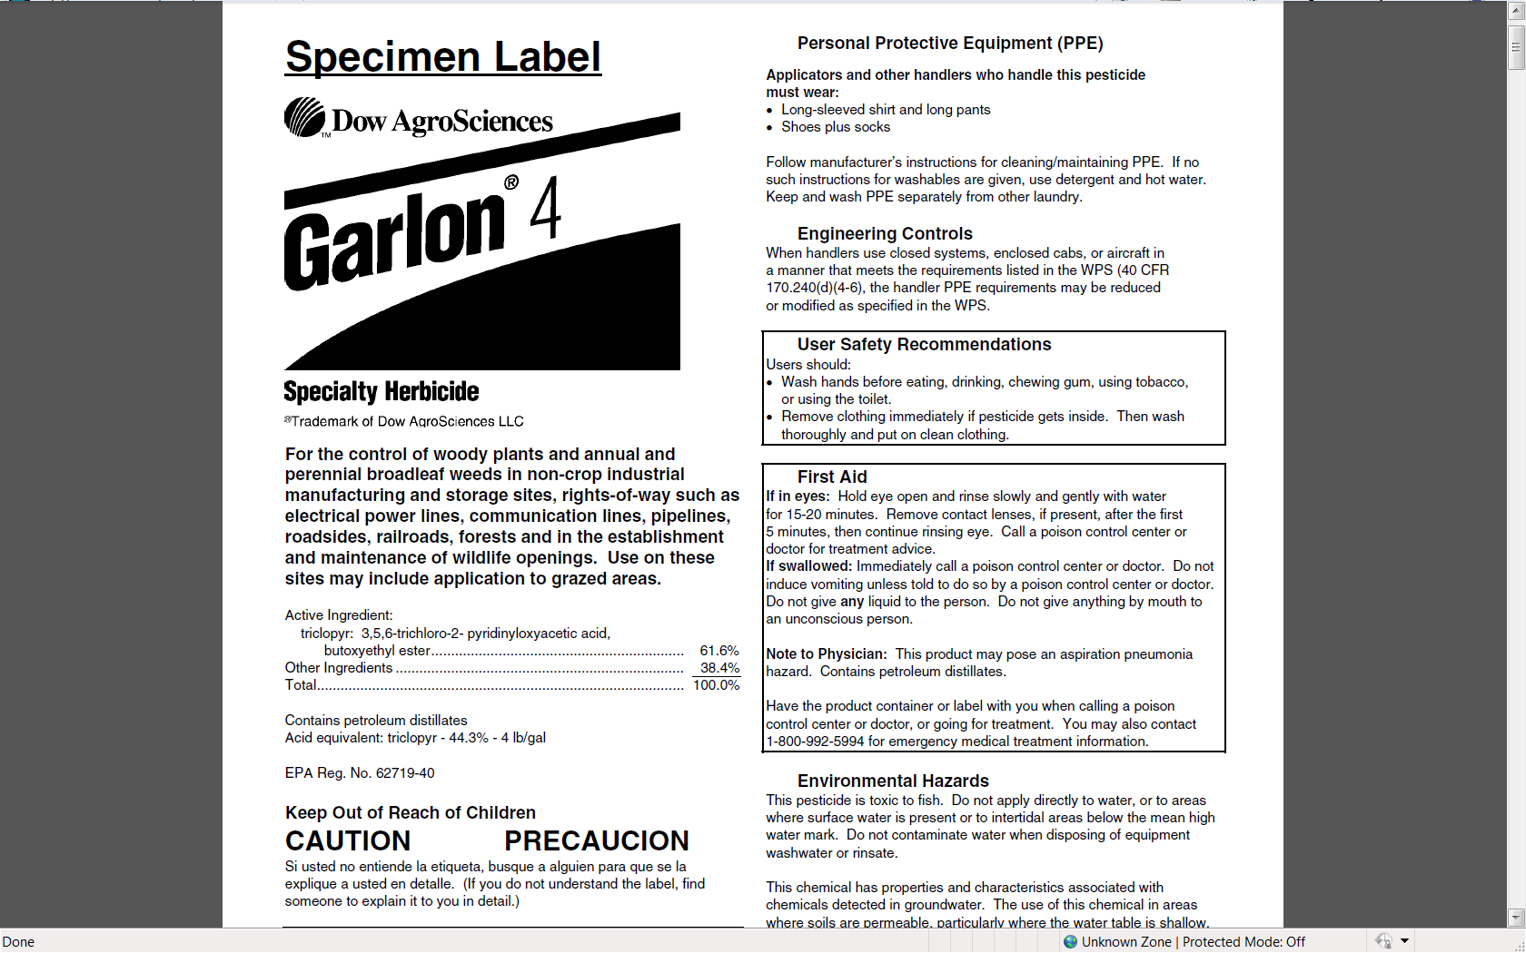
PPE Required
Forest Use Label
Active Ingredient
Triclopyr
Signal Word
“Caution”

Slide 23
Not CA Restricted “Caution” Pesticide
Label Personal Protective Equipment Required
Long Sleeve Shirt & Long Pants
Shoes & Socks
Employee Required PPE
Protective Eyewear
Protective Gloves

Slide 24
CA Restricted Not Restricted Not Restricted
Caution Warning Caution
Employee PPE Required
Long sleeve shirt Long Sleeve Shirt Long Sleeve Shirt
Long Pants Long Pants Long Pants
Protective Eyewear Protective Eyewear Protective Eyewear
Protective Gloves Protective Gloves Protective Gloves
Apron Coveralls

Slide 25
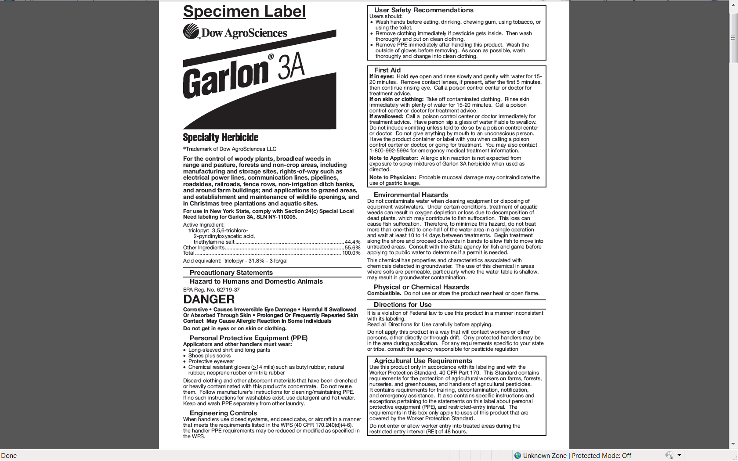
Forest Use Label
Active Ingredient
Triclopyr
Signal Word
“Danger”

Slide 26
Label Required Personal Protective Equipment
Long Sleeve Shirt, Long Pants
Shoes & Socks
Protective Eyewear
Chemical Resistant Gloves (>14mil)
Employee PPE
Coveralls

Slide 27
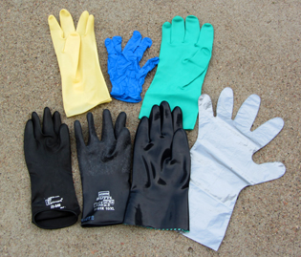
4 mil
5 mil
14mils

Slide 28
Caution Warning Danger
Employee Requirements
Label PPE Label PPE Label PPE
Protective Eyewear Coveralls Coveralls
Protective Gloves Eyewash (1 Pint) Eyewash (1 Pint)

Slide 29
Employer Responsibilities
Assure Employees are Trained
Provide All Required Personal Protective Equipment
Assure Employees are Provided with Proper Decontamination Facilities
Provide a Safe Work Place and Assure Safe Work Practices, Regulations, and Pesticide Product Labeling Requirements are Complied With

Slide 30
Importance of Following the Pesticide Label and Using Common Sense

Slide 31
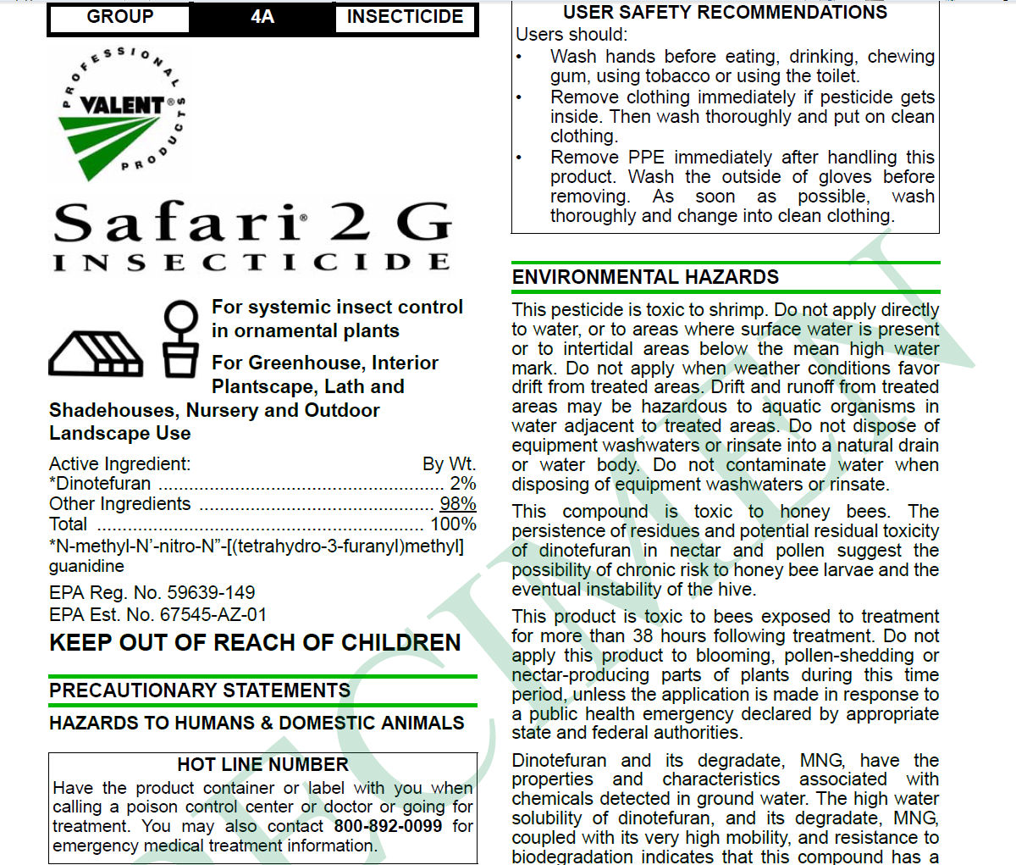
Neonictinoid
Toxic to bees
Do not apply to Blooming Plants
Oregon put a 180 Day Ban on use of Safari (Dinotefuran) US EPA Reviewing Effects on Bees

Slide 32
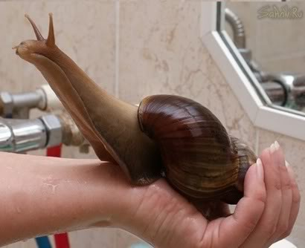
African
Giant
Snail
Questions?

