Slide 1
Prescribed Fire as a Vegetation Management Tool
Good Fires Prevent Bad Fires
Ben Newburn
USDA, Forest Service
Vegetation Management Solutions
Enterprise Unit – Washington Office

Slide 2
Fire Happens
Fire is a good servant but a terrible master.
-Aesop’s Fables-
Notes:
Fire has always been a fixture on the landscape; helping to shape vegetation regimes and it has acted as a cleansing tool in nature for millennia. It is not realistic to think that we will be able to replace this role with our management actions without including the use of fire. Studies have shown that historically speaking stands where much more resilient to fire throughout the west with substantially less high severity fire present on the landscape. This is due to many factors including frequent occurrence of low to moderate intensity fire during the dry summer period that were self-regulated. Due to unnatural fuel build-up following decades of successful fire suppression we now see more high intensity fire.

Slide 3
Low Stress Planning
NEPA/CEQA compliance is normally easier than mechanical treatments.
For federal units many exemptions and protocols are in place with SHPO, FWS, others
Water Board waivers are easy to obtain and generally are a non-issue.
Less risk to litigation from those opposed to active forest management.
Notes:
Environmental groups and other potential litigants generally feel that the use of prescribed fire is similar to a natural process and do not object as strongly as with mechanical treatments.
Many concerns from specialists are covered by exemptions, less stringent survey protocols, etc.

Slide 4
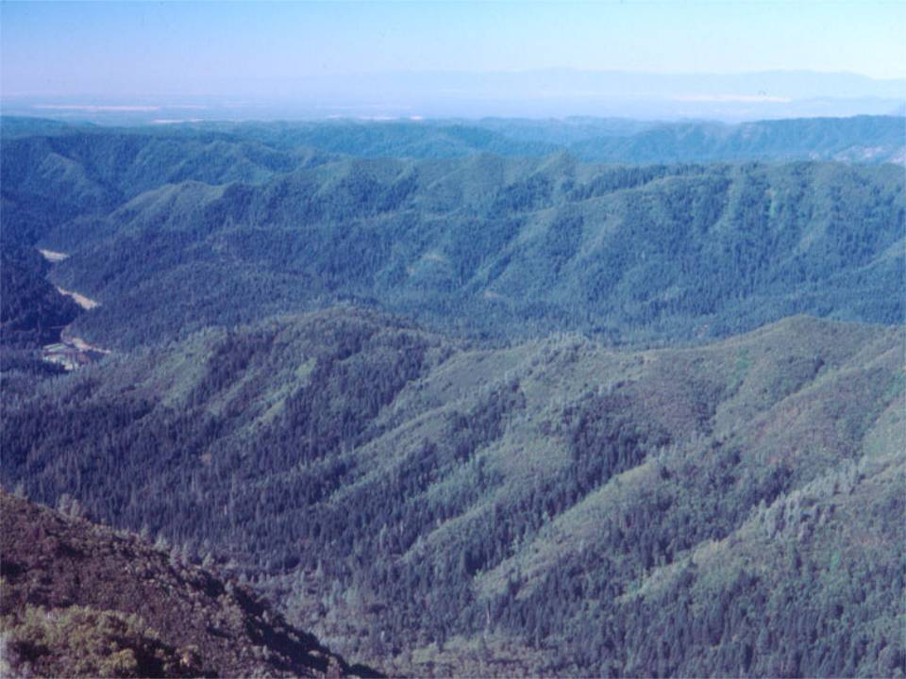
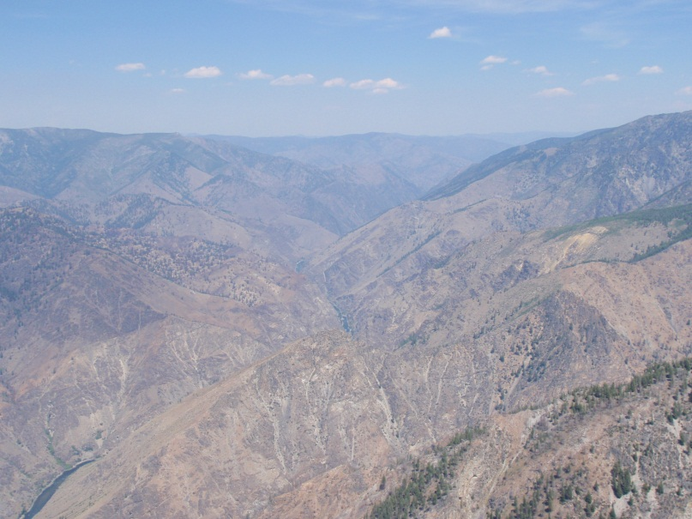
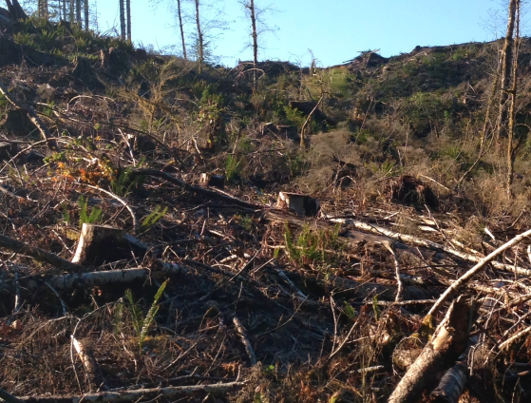
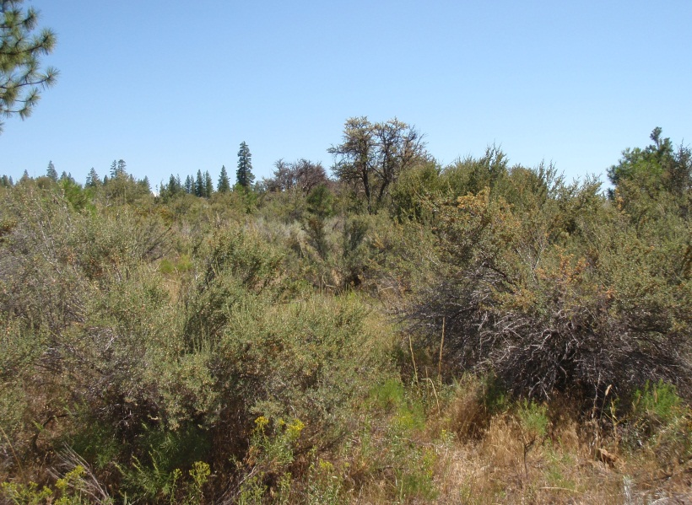
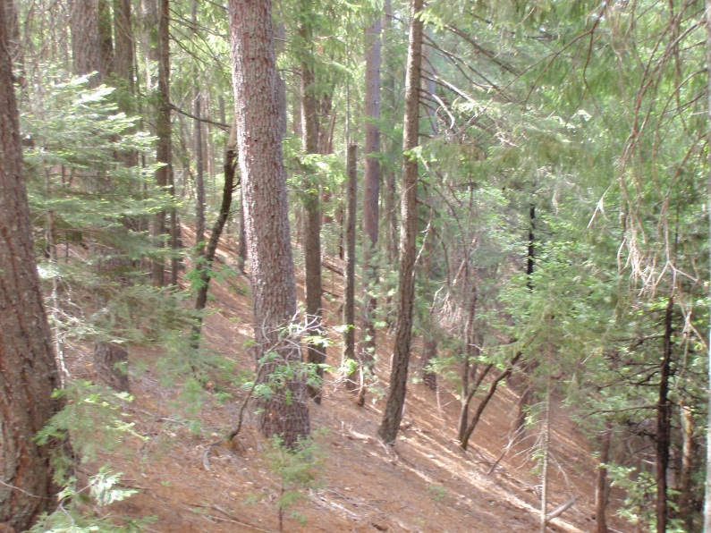
Rx Fire as a Versatile Tool
Notes:
Prescribed fire is able to be used on any site. Steep slopes that limit mechanical treatments, varying vegetation types and access are some of the strong points for the use of fire. Often times natural breaks can be used to hold fire rather than traditional containment lines. Site preparation in late winter and early spring is a prime example of this where exposed fuels will often become available before the more sheltered fuels in surrounding stands allowing for fire spread to be checked.

Slide 5
It can be used independently or in conjunction with other treatments.
Unmanaged Stands
Thinned Stands
Notes:
Prescribed fire is one of the most flexible treatment types, allowing it’s application to be tailored to the stand/site to meet the desired objectives with or without other treatments proceeding it.

Slide 6
Anywhere on the Map
Slope limitations that affect mechanical treatments are prime places to use prescribed fire.
Locations with soil and hydrologic concerns often aren’t a problem with prescribed fire.
Many habitat considerations view fire as a light handed treatment or as a natural occurrence and is allowed to be applied more broadly than mechanical treatments.
Notes:
It is not confined by conditions that limit mechanical treatments and others such as slope limitations, many soil and hydrological standards or even access issues. Riparian set backs and other constraints are not applied to most prescribed fire uses.

Slide 7
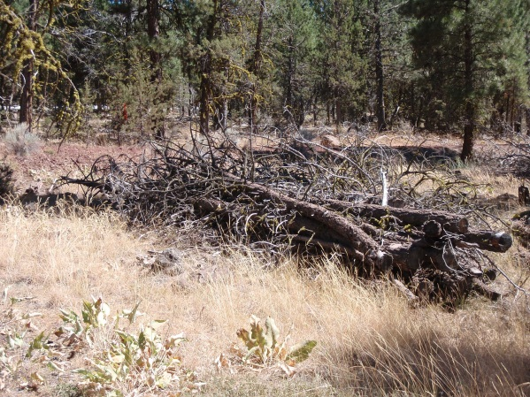
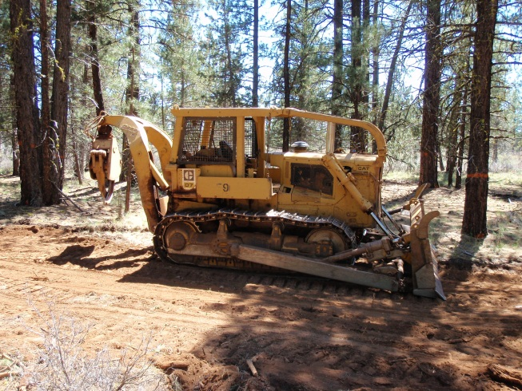
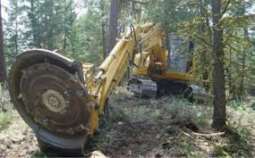
Implementation for $50-250/acre.
Mastication @ $400-1,000/acre
Dozer/Grapple Piling @ $300- 600/acre
Hand Thinning/Piling @ $250-600/acre
Notes:
Prescribed fire is often implemented much cheaper than non-revenue generating mechanical treatments, sometimes less than $50/acre. An economy of scale can drive this as low as $10/acre.

Slide 8
The Use of Rx Fire
An efficient and effective method for treating surface fuels.
Various Forms of Prescribed Fire:
Underburning/Broadcast
Pile Burning
Jackpot Burning
Notes:
As previous presenters has stated the treatment of surface fuels is one of the most important factors in creating a fire resilient stand.
Many forms of prescribed fire exist. Today we’ll talk about only a couple.
Underburning and broadcast burning is the burning of naturally occuring fuels across the landscape and activity fuels that have accumulated after management actions.
Pile burning is the burning of piled material resulting from management actions.
Jackpot burning is a mixture of the two where concentrations exist but piles have not necessarily been created through management action.

Slide 9
Site Preparation With Fire
Returns nutrients to the soil for trees to utilize.
Provides improved access across the site.
Removes competing vegetation before planting.
Starts the stand off with reduced fuel loadings to create resiliency.
Notes:
For both clearcuts and retention cuts prescribed fire can help reduce the activity fuels left over from harvest activities and most importantly reduce surface fuel loading. Even if the non-merchantable material is yarded there is still a significant amount of 1-hr, 10-hr and even 100-hr fuels left after harvest that needs to be treated to create a fire resilient landscape.
Following a wildfire, salvage logging often leaves larger diameter fuels behind, again even with YUM yarding, and fine fuel loadings can recovery quickly with scorched needles adding to natural needle fall. Planting sites with an annual grass might be an inexpensive way to help get fire to spread so these larger fuels can be consumed.
Again, it is easier to build fire resilient stands if it is started at the earliest stages and then maintained. The number of entries and cost of those entries goes down dramatically compared to treating larger diameter fuels that result from a more mature stand.

Slide 10
Plantation Treatments
Residual fuels left in a plantation can be detrimental to the young stand when fire occurs.
Prescribed fire is more successful in a young stand that has seen fire.
Notes:
When slash and other excessive fuels are left on site it can make it difficult to implement prescribed fire until the stand is matured and mechanical treatments take place. This is expensive and risky.
Should a wildfire occur during these stages of the stand both vegetation and soil severity is likely to be high. This includes treatments that re-arrange fuels such as chipping and masticating which create heavy surface fuel loadings.
Even if the larger diameter fuels are treated (normally by mechanical means) the remaining surface fuels are often enough to generate enough fire behavior during a wildfire to cause significant crown scorch and mortality.
Burning in these young stands takes careful attention to the prescription and burning under cool conditions. Things to consider in the prescription include some things we typically don’t think about for fire behavior such as soil moisture and species phenology (budding and root activity) as well as air temperature, wind and live fuel moisture.

Slide 11
Building a Prescription
Fuel moisture, wind speed/direction, humidity and air temperature are the common drivers in a prescribed fire prescription.
Other variables might be just as important for young stands and site preparation.
Soil and Duff Moisture
Live to Dead Ratio
Fuel Compaction (Packing Ratio)
Surface Area to Volume Ratio
Fuel Bed Depth
Notes:
Live fuel moisture plays a critical role in determining a prescription for plantations. Higher live fuel moisture values correlate to reduced crown scorch, lower levels of mortality and less fuel available to burn in general.
Winds can work both as a negative prescription value by helping to spread fire and increase intensity and as a positive prescription value by dissipating heat that otherwise leads to crown scorch and possibly mortality.
Soil and duff moisture relates to the amount of surface fuels that will be available to burn and the char depth that occurs. Dry soils will allow for fire to consume a majority, if not all, of the surface fuels (increased residence time) resulting in a loss of organic matter, the possibility of damaging the soil (hydrophobicity and nutrient fixing), increased mortality from root and bole heating and will lead to erosion issues.
Live to Dead Ratio relates to the overall fuel loading. A high dead fuel loading can produce the energy needed to cure live fuels even when their moisture values are high.
Packing Ratio can give an indication of residence time when compared with dead fuel moisture. Long residence times have been shown to cause mortality due to root and bole damage.
Surface area to volume ratio defines the average fuel particle size. The smaller the particle the easier it is to ignite (requiring less energy to dry and reach temperature of combustion) and the more compact the fuel bed can be.
Fuel bed depth in young stands is important because the stand normally has a rather short height to live crown so it takes less heat to create scorch given the shorter distance that the fire has to affect.

Slide 12
How to Treat Surface Fuels?
Prescribed Fire!
Fire severity and mortality has been shown to be substantially reduced when surface fuels are treated.
Graham et al. (1999)
Vailant et al. (2009)
Prichard and Peterson (2010)

Slide 13
First Step or Second Step
Prescribed fire can be used at any point in the management of a stand.
It’s easier to maintain a fire resilient stand if you start at the beginning.
Notes:
Fire can be applied at any point in the development of a stand; from site prep before planting through to site maintenance of a well managed stand.
If a stand is being managed for a more natural appearance and growth pattern then it might make sense to apply prescribed fire first followed by thinning the mortality and unwanted portions of the residual stand.
If a stand is being managed for producing a specific value then mechanical or other treatments to protect these values could occur before burning.
Younger stand produce less needle cast leading to the build-up of surface fuels making it easier to start at this younger age class rather than wait until the stand matures and the surface fuels have become greater. Care needs to be given to young stands by burning under a cooler prescription.

Slide 14
Making more burn days.
Starting with Rx Fire
Reducing Fuels First
Notes:
Untreated stand on the right. How easy would it be to meet objectives of a prescribed fire here with what you see?
Note the surface fuel loading, imagine the depth of the bark sluff around the pine and what effect that would have if it burned during a dry summer when soil moisture is low.
With the open stand like the one on the left has many more opportunities during a prescribed fire season to implement? Wouldn’t this be a lot easier to keep fire on the ground and control it not to mention to move around in?
Note that the surface fuel loading is still an issue. It still needs fire.
The opportunities to apply fire successfully increase when combined with other treatments. A natural stand that has been thinned and had the fuel loading reduced has a large “burn window” than a natural stand that has not been visited by fire. A well balanced strategy of treatments works best.

Slide 15
Firing Techniques Matter
Dots Grow Together
Strips Are Fast
Notes:
Firing techniques matter significantly in the type of fire behavior observed and the resulting fire effects. Something as little as igniting fire on the uphill/down wind side of a tree will greatly influence scorch, consumption and other factors compared to the other side of the tree. Depending on the objectives firing patterns can be adjusted to meet the need.

Slide 16
Aerial Ignition
Plastic Sphere Dispenser
Heli-Torch
Notes:
Aerial ignition allows for quick and efficient ignition of larger landscapes but the trade off is that ignitions are more casual than ground ignitions.

Slide 17
Timing Sequences Count
Firing patterns can be used to mitigate containment issues and meet the objectives.
Notes:
The sequence in which a site/unit is ignited can greatly influence control issues and objectives being meet. A great example of this is lighting clear cuts by buffering the sides and top with a black line and then allowing it to pull together from the flanks to create convection and keep the fire from spotting into adjacent stands.

Slide 18
Keep It In Shape
Prescribed fire is an inexpensive maintenance tool.
It can be used to treat all aspects of the fuel spectrum.
Greatly improves suppression efficiency.
Notes:
Prescribed fire is an optimal tool for site maintenance once fire resiliency has been reached.
Studies have shown that keeping surface fuels reduced minimizes crown scorch and mortality greater than mechanical treatments.

Slide 19
The Down Side to Rx Fire
Risk and liability can inhibit it’s use.
Air quality restrictions can reduce the opportunities for implementation.
Preference to use logical containment features that are not always available.
Managers acceptance of unpredictability.
Socio-political concerns can impede our ability to apply fire.

Slide 20
Risk vs. Reward
Prescribed fire is not an exact science.
Acceptance of some variability and randomness is needed for success.
Careful planning and execution can do a lot to mitigate the risks.
Notes:
Prescribed fire is as much an art as it is a science. The control over selecting what trees to remove or how much consumption occurs is not easy to dictate. Generally speaking, where mechanical treatments can use marking to guide removal in somewhat of a surgical way; prescribed fire is a bit more of a broad brush stroke. Mitigations can be put in place to limit certain unwanted events through prescription design, limiting implementation time frames or pre-treating values that may be exposed.
Be wary of success in a prescribed fire program. It can lead to complacency and over-confidence so that risks are underestimated. On the other hand, a recent failure can haunt an person or organization and make them risk adverse.

Slide 21
Liability
The law applies differently from state to state and from organization to organization.
Federal Tort Claims Act (FTCA) allows the federal agency to protect employees.
Notes:
First a disclaimer, I am not a lawyer and I do not give the pretenses of providing legal advise.
Some states, particularly in the southeast, have laws that allow for private entities to conduct prescribed fire with negligence as the measure of fault. That’s not true of most western states including California.
Federal and state employees in California are protected as long as their actions are not deemed negligent or outside of the scope of employment which is considered a “breach of employment”. This does not relieve the government of it’s responsibility but simply keeps the employee from facing the brunt of charges/claims that may be brought against them in the event of a negative outcome.

Slide 22
Share Risk and Liability
The use of agreements allows for mutual benefit and sharing of resources.
Wyden Amendment (Public Law 109-54 Sec. 434)
Cost/Share Agreements
Interagency Cooperation
Sharing the risk and liability in prescribed fire will greatly reduce the chance for negative outcomes.
Notes:
The Wyden Amendment (Public Law 109-54, Section 434) authorizes the Forest Service to enter into cooperative agreements to benefit resources within watersheds on National Forest System lands. Agreements may be with willing Federal, Tribal, State, and local governments, private and nonprofit entities, and landowners to conduct activities on public or private lands for the following purposes:
• Protection, restoration, and enhancement of fish and wildlife habitat and other resources,
• Reduction of risk for natural disaster where public safety is threatened, or
• A combination of both.
Cost/Share Agreements allow for entities, including the federal government, to share in the cost of doing projects across boundaries or with other entities on public lands when there is a benefit to the government and the cost of the project is shared by all parties through the involvement of money, resources or other means to accomplish the project.
Interagency cooperation occurs at many levels with federal, state and local agencies. Through this cooperation the ability to leverage the rules/policies of these agencies comes into play where one government may not have a mechanism to accomplish a specific administrative task but another does and it is shown as a benefit to those involved. When federal agencies are involved Cal FIRE often looks more favorably on a project.
Sharing risk/liability across the fence line will allow for many of the concerns caused by the liability of fire to be abated and allows for fire to be applied to the landscape as it naturally wants to rather than using administratively determined factors.

Slide 23
Take Away Message
Prescribed fire is one of the only tools that can manage all aspects of the fuel complex needed to create a fire resilient stand.
Prescribed fire comes in all shapes and sizes and can be implemented at just about any time in the management of a stand.
By combining efforts to apply prescribed fire on the landscape the risk and liability associated is shared and reduced.

Slide 24
Questions? Discussion.

