Slide 1
Restricted Materials Permit Process
35th Annual
Forest Vegetation Management Conference
Joe Moreo
California Agriculture Commissioner

Slide 2
Introduction
Joseph Moreo
Agricultural Commissioner
Sealer of Weights and Measures
Modoc and Lassen Counties
202 W. 4th ST
Alturas, CA 96101
susiephilpott@co.modoc.ca.us

Slide 3
Several Steps to Certification & Restricted Material Permit Process
1. Certification
Private applicator certification
new exams for 2013
PCA/PCO/QAL Licenses
administered by DPR
continuing education requirements
courses must be approved by DPR
2. Obtain Restricted Materials Permit
3. Provide Notice(s) of Intent to the County Agricultural Commissioner
4. Submit Pesticide Use Reports- job/monthly

Slide 4
New Private Applicator Certificate Examination
70 Questions on:
CA Pesticide Laws and Regulations
Pesticide Safety
Pesticide Label and Labeling
Pesticide Emergencies
Equipment Calibration
Mixing and Applying Pesticides
Pest Identification
Employer/ Employee Responsibilities
80 Questions on recertification exam

Slide 5
Private Applicator Certificate Exam
Must pass with at least a 70%
Certification is valid for a 3 year period
Reference and Study Guide is available:
http://www.ipm.ucdavis.edu/IPMPROJECT/pesttrain.html

Slide 6
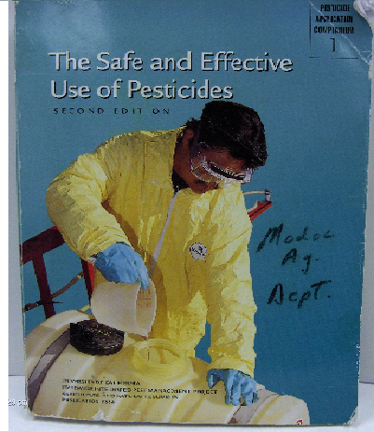
PCA/PCO/QAL/QAC
License and exams administered by DPR
Must register with agricultural commissioner in the county where you preform pest control
PCA recommendation must be in writing and available at job site

Slide 7
Restricted Materials Permit

Slide 8
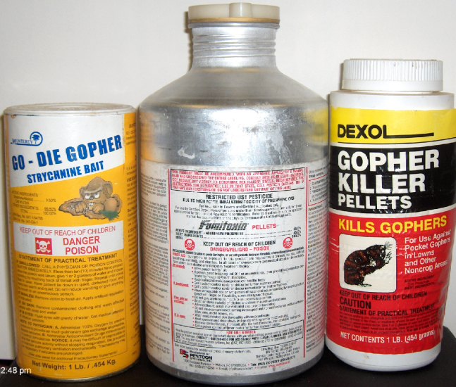
Restricted Materials Permit
Permit must be on file before possession or use of restricted materials
Commonly used restricted materials used in Forestry:
Rodenticides: All Dead Rodents should be disposed of properly to protect non-target species
Aluminum phosphide (Phostoxin/Fumitoxin) for gophers and ground squirrels burrow fumigation
Strychnine bait for below ground bait application only
Zinc phosphide bait for voles by ground or air
Boomers/mountain beavers? (Aplodontia rufa)

Slide 9
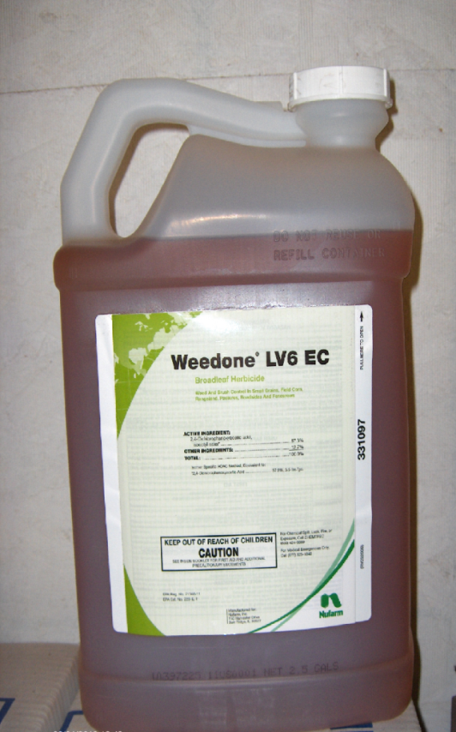
Restricted Materials Permit
Herbicides
2,4-D
GWPAs- treated as a restricted material
Triazines (Atrazine)
Diuron (Diurex)
Hexazinone (Velpar)

Slide 10
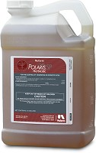
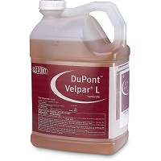
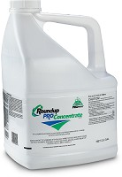
Non-restricted materials Permit required?
Herbicides
Isopropylamine Salt of Imazapyr (Polaris SP)
Glyphosate (Roundup)
Hexazinone (Velpar)
Fungicides
Sodium tetraborate decahydrate (Sporax)
Can be purchased with operator ID number

Slide 11
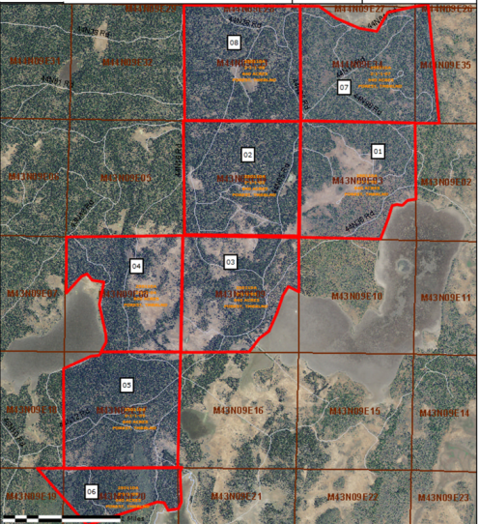
Restricted Materials Permit
Map
Acreage
Current Year’s site IDs
Site can not be over 640 acres
Permits may be issued for multiple years for perennial crops (forestry/timber) varies by county

Slide 12
Notice of Intent
Notify (phone , fax, email, etc.) Ag Commissioner’s Office 24 hours before applying restricted use pesticides
Site ID Number from map
Chemical Rate
Method (air, ground, etc..)
Date
Applicator

Slide 13
Pesticide Use Reports
Should be filed within 7 days or monthly summary (sporax)
Location (section, township, range)
Application method
Permittee/property owner
Permit number/operator ID
Site identification number (must agree with permit)
Total acres or units
Date of Application
Acreage or Units Treated
Commodity (timber)
Product Manufacturer and name of product
EPA or California Registration Number from Label
Total Product Used
Rate of application and dilution
Electronic use reporting – currently a work in progress

Slide 14
Employers responsibility
Employers must train employees every year PRIOR to work
Records MUST be kept on file with:
Copies of pesticide safety training materials
Signed and dated by employees
Permits
Use reports
Label etc.
Must be kept for current year and two years prior.
Failure to keep adequate records is a VIOLATION!

Slide 15
http://www.cdpr.ca.gov/
Enforcement and worker safety publications
Compliance assistance handouts for employers
Employee safety leaflets (Pesticide Safety Information Series)
Pesticide injuries and illnesses (annual summaries)
Restricted materials list
Worker Health and Safety Branch publications search (publications with “HS” or “HSA” number)

Slide 16
WEEDS OF MODOC COUNTY
"A" RATED
Bearded Creeper Crupina vulgaris
Dalmation toadflax Linaria genistifolia ssp.dalmatica
Diffuse knapweed Centaurea diffusa
Halogeton Halogeton glomeratus
Leafy spurge Euphorbia esula
Musk thistle Carduus nutans
Perennial sowthistle Sonchus arvensis
Plumeless thistle Carduus acanthoides
Scotch thistle Onopordum acanthium
Spotted knapweed Centaurea maculosa
Squarrose knapweed Centaurea squarrosa
Yellowspine thistle Cirsium ochrocentrum
"C" RATED
Bull Thistle Cirsium vulgare
Dodder Cuscuta ssp
Field bindweed Convolvulus arvensis
Klamathweed Hypericum perforatum
Medusahead Taeniatherum caput-medusae
Poison hemlock Conium maculatum
Pheasant eye Adonis aestivalis
Puncturevine Tribulus terrestris
Russian thistle Salsola tragus
Yellowstar thistle Centaurea solstitialis
"B" RATED
Austrian fieldcrest Rorippa austriaca
Canada thistle Cirsium arvense
Dyer's woad Isatis tinctoria
Globe-podded hoarycress Cardaria pubescens
Heart-podded hoarycress Cardaria draba
Jointed goatgrass Aegilops cylindrica
Mediterranean sage Salvia aethiopis
Perennial peppercress Lepidium latifolium
Purple mustard Chorispora tenella
Quackgrass Elytrigia repens
Russian knapweed Acroptilon repens
Klamath County Oregon
Commissioners approved 2014 noxious weed list

Slide 17
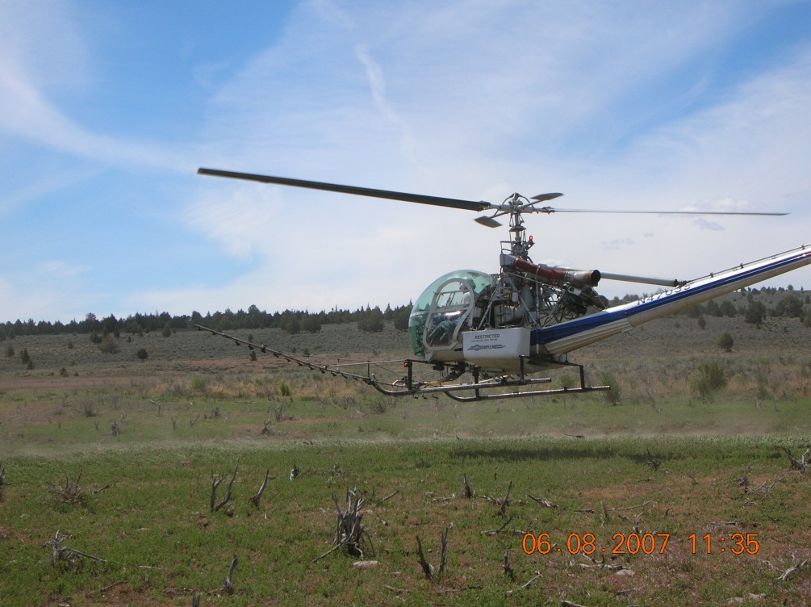
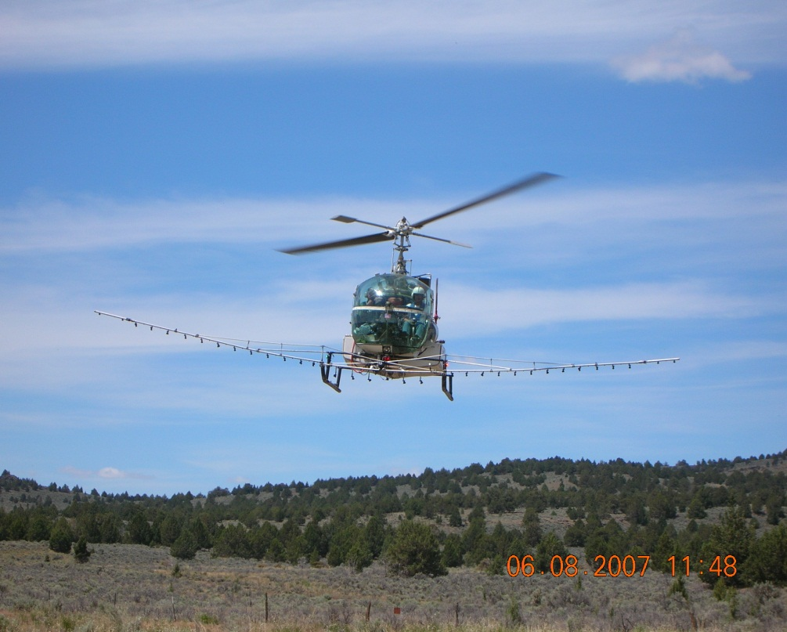
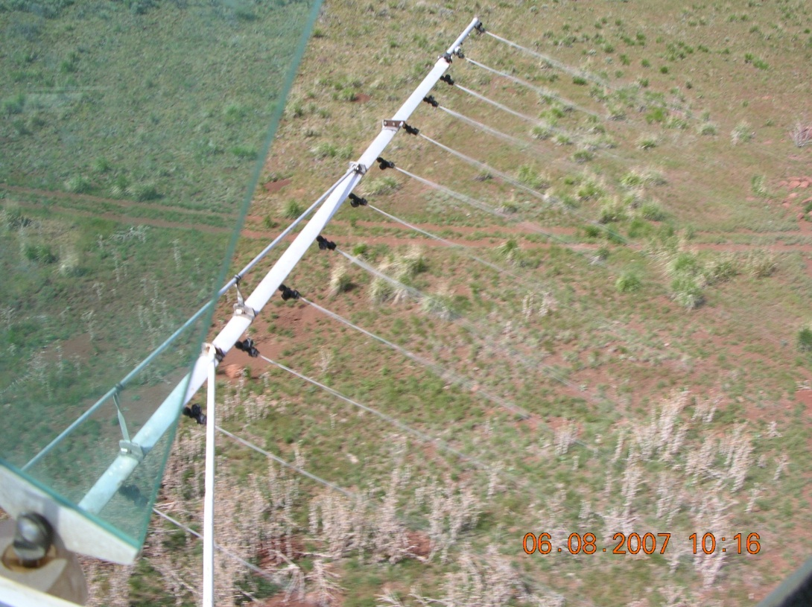

Slide 18
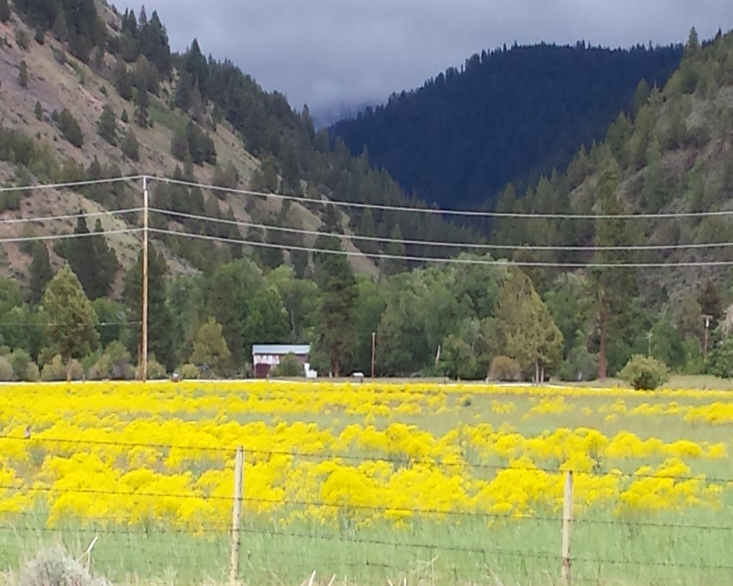
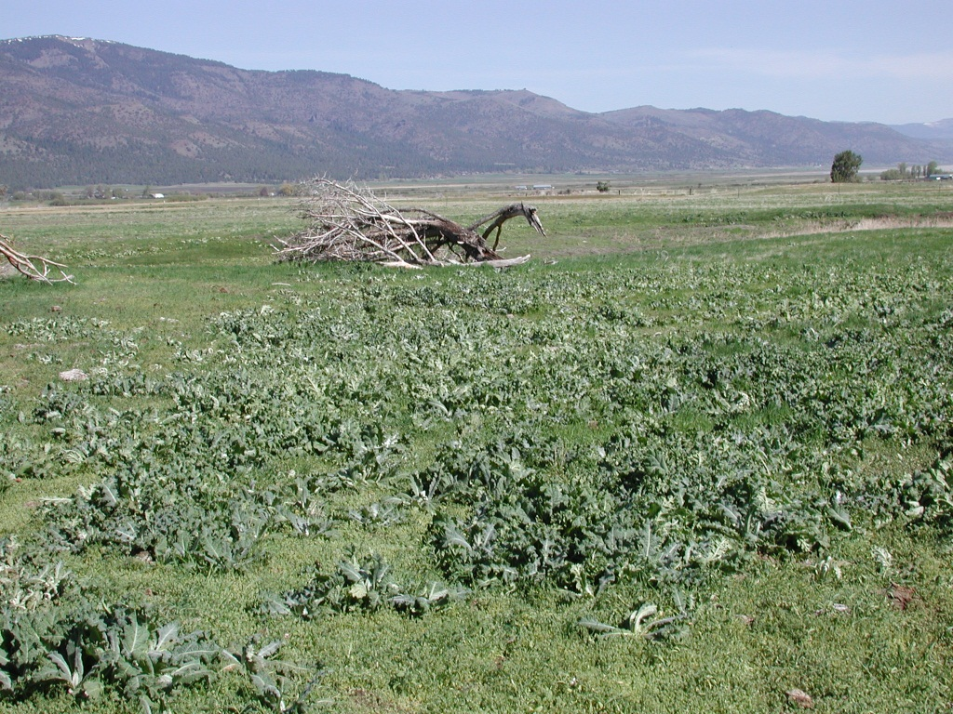
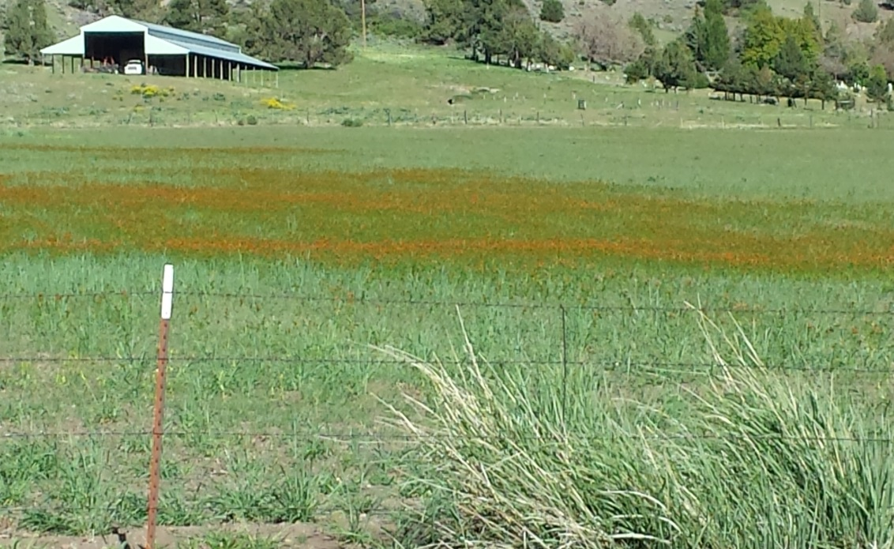

Slide 19
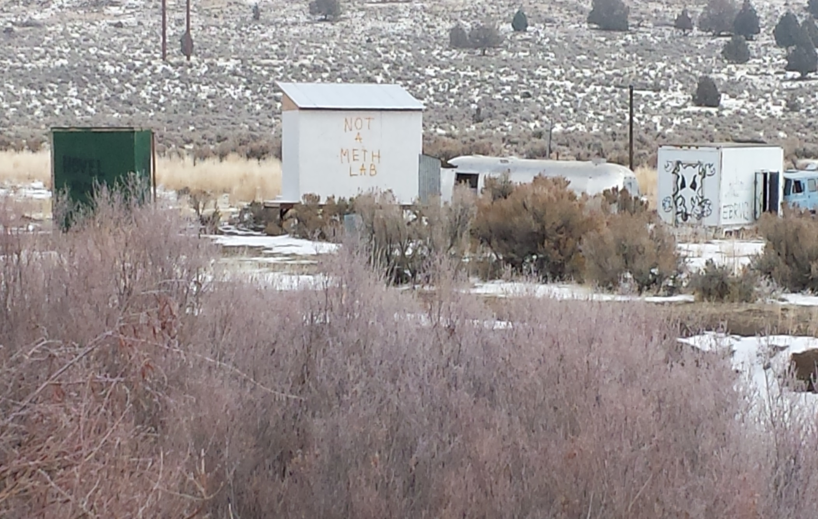

Slide 20
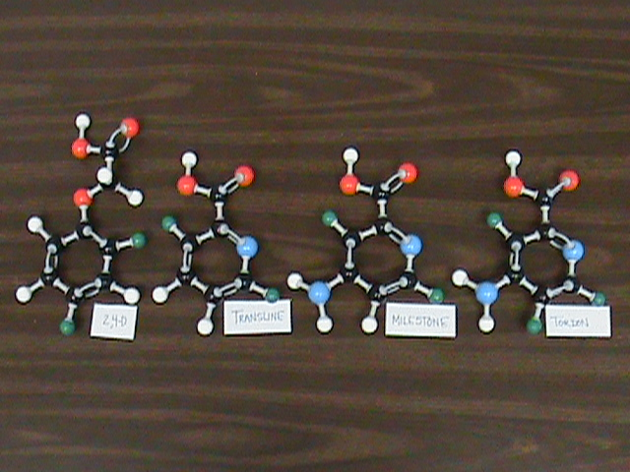
A pest of known economic or environmental detriment and, if present in California, it is usually widespread. C-rated organisms are eligible to enter the state as long as the commodities with which they are associated conform to pest cleanliness standards when found in nursery stock shipments. If found in the state, they are subject to regulations designed to retard spread or to suppress at the discretion of the individual county agricultural commissioner. There is no state enforced action other than providing for pest cleanliness.

Slide 21
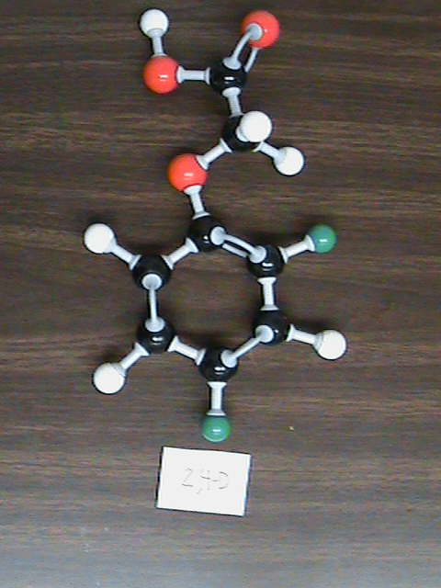
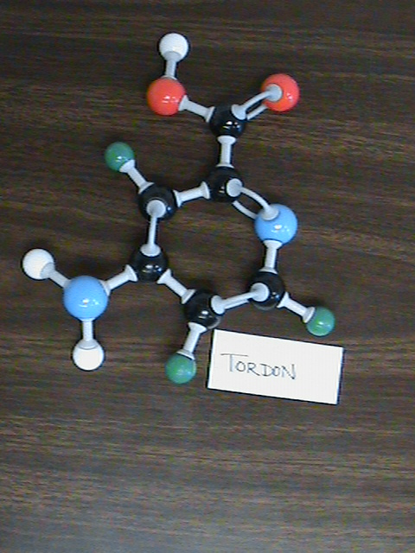
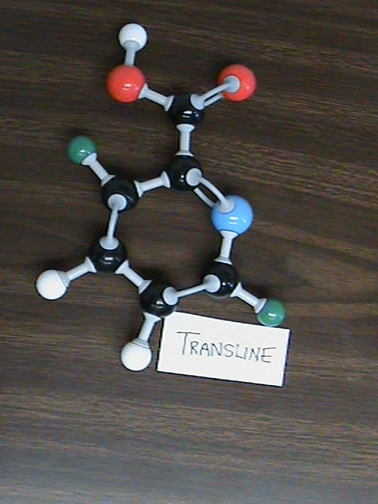
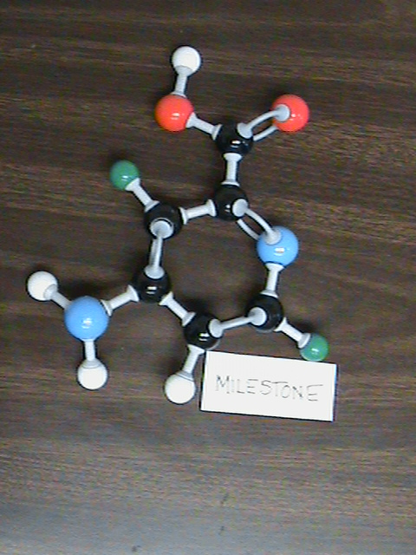

Slide 22
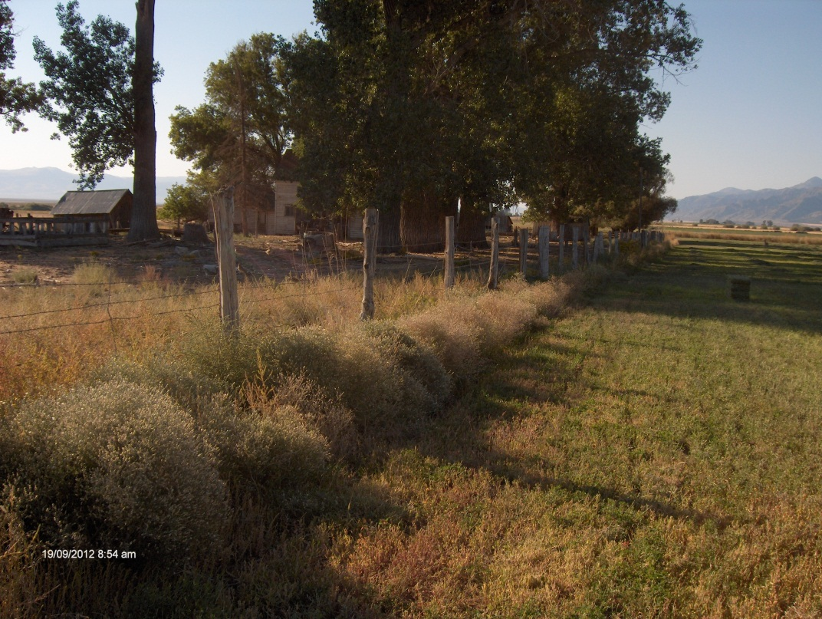
"D“ rated
An organism known to be of little or no economic or environmental detriment, to have an extremely low likelihood of weediness, or is known to be a parasite or predator. There is no state enforced action.

