Slide 1
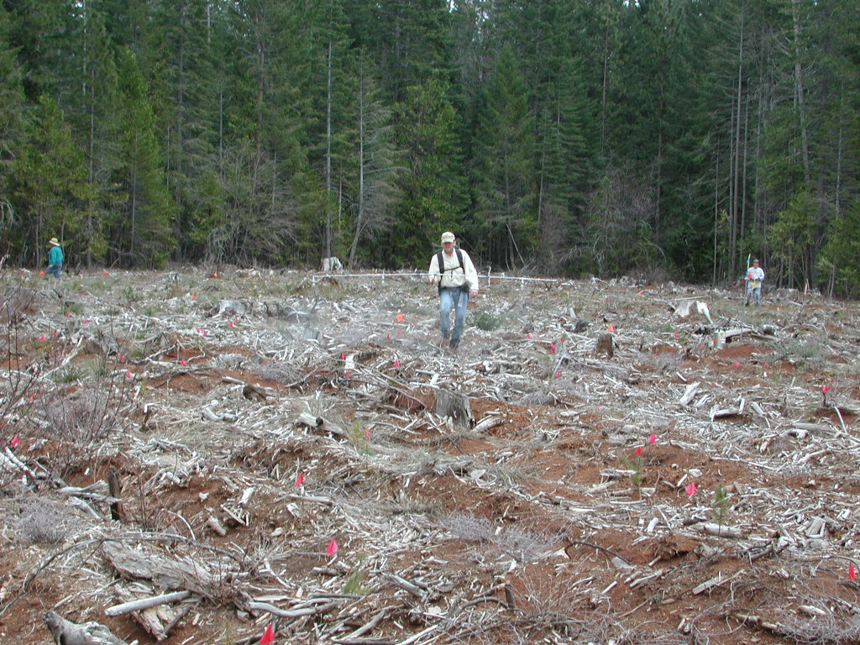
FOURTEEN YEARS OF FORESTRY RESEARCH
The Sierra Cascade Intensive Forest Management
Research Cooperative

Slide 2
Talking points
SCIFMRC background
Update on current work
A tour of past studies
How to get involved

Slide 3
SCIFMRC MISSION
To conduct applied reforestation and stand management research
from seed collection to the first commercial thinning
using sound land stewardship
To understand how conifer species interact with their environment in the interior region of Northern California and Southwestern Oregon.

Slide 4
OBJECTIVES
To help answer local issues associated with young stand management in the Sierra Nevada and Cascade Mtns.
To provide research findings on plantation establishment and growth for use in decision processes.

Slide 5
How does the CO-OP work?
Organized in 1999 by forest industry, manufacturers, FS, UC
Open membership with dues collected annually beginning in 2000
Research proposals:
Solicited annually
Membership vote and announcement of funded proposals in March
Results available in annual reports and journal publications

Slide 6
MEMBERSHIP
2000 2013
Roseburg Resources Roseburg Resources
Sierra Pacific Industries Sierra Pacific Industries
Fruit Growers Supply Co. Fruit Growers Supply Co.
W.M. Beaty & Associates W.M. Beaty & Associates Soper-Wheeler Soper-Wheeler
Collins Pine Co. Timber Products Co.
Boise Cascade Cal Fire
Cal Forest Nurseries Cal Forest Nurseries & Monsanto Mountain Gate Gardens
Wilbur-Ellis
PRT
Dupont
Pro-Source One
American Cyanamid (BASF)
Silver Butte Timber Silver Butte Timber Dow Agro Sciences Dow Agro Sciences
Pelton Reforestation Thunder Road Resources
UAP Northwest

Slide 7
HOW’S IT GOING?
$853,000 program
Approaching steady level of $60k per year

Slide 8
Co-op funded research
19 completed studies
5 on-going studies

Slide 9
Dollars spent on research
70% of total budget
Herbicide studies are relatively inexpensive
$45k

Slide 10
Dollars spent on research
Average study cost: $19,772

Slide 11
Talking points
SCIFMRC background
Update on current work
A tour of past studies
How to get involved

Slide 12
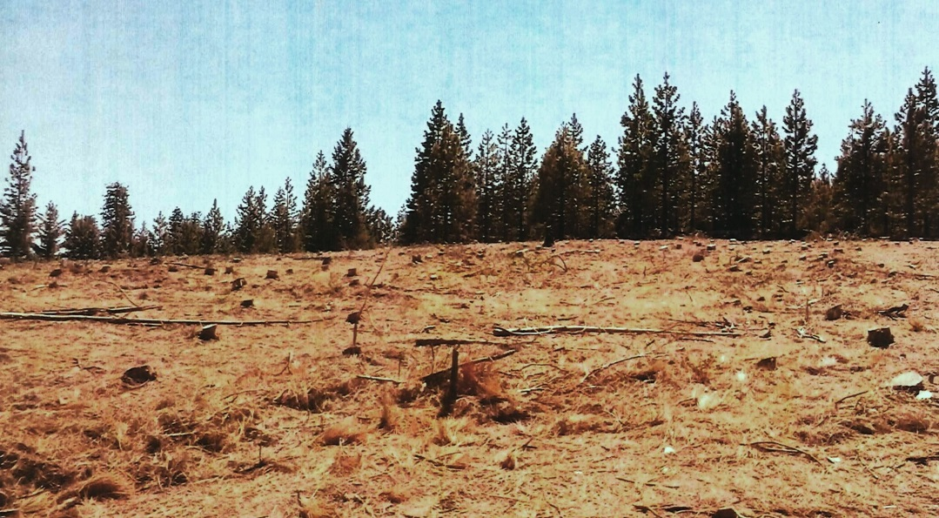
CO-OP update
On-going work
Herbicide trials – Matrix site prep, Pindar (Fredrickson)
Garden of Eden – second time around (Zhang and Powers)
Pondosa subsoiling study - tree remeasurement (Webster and Powers)
Geospatial mapping of all CO-OP study sites

Slide 13
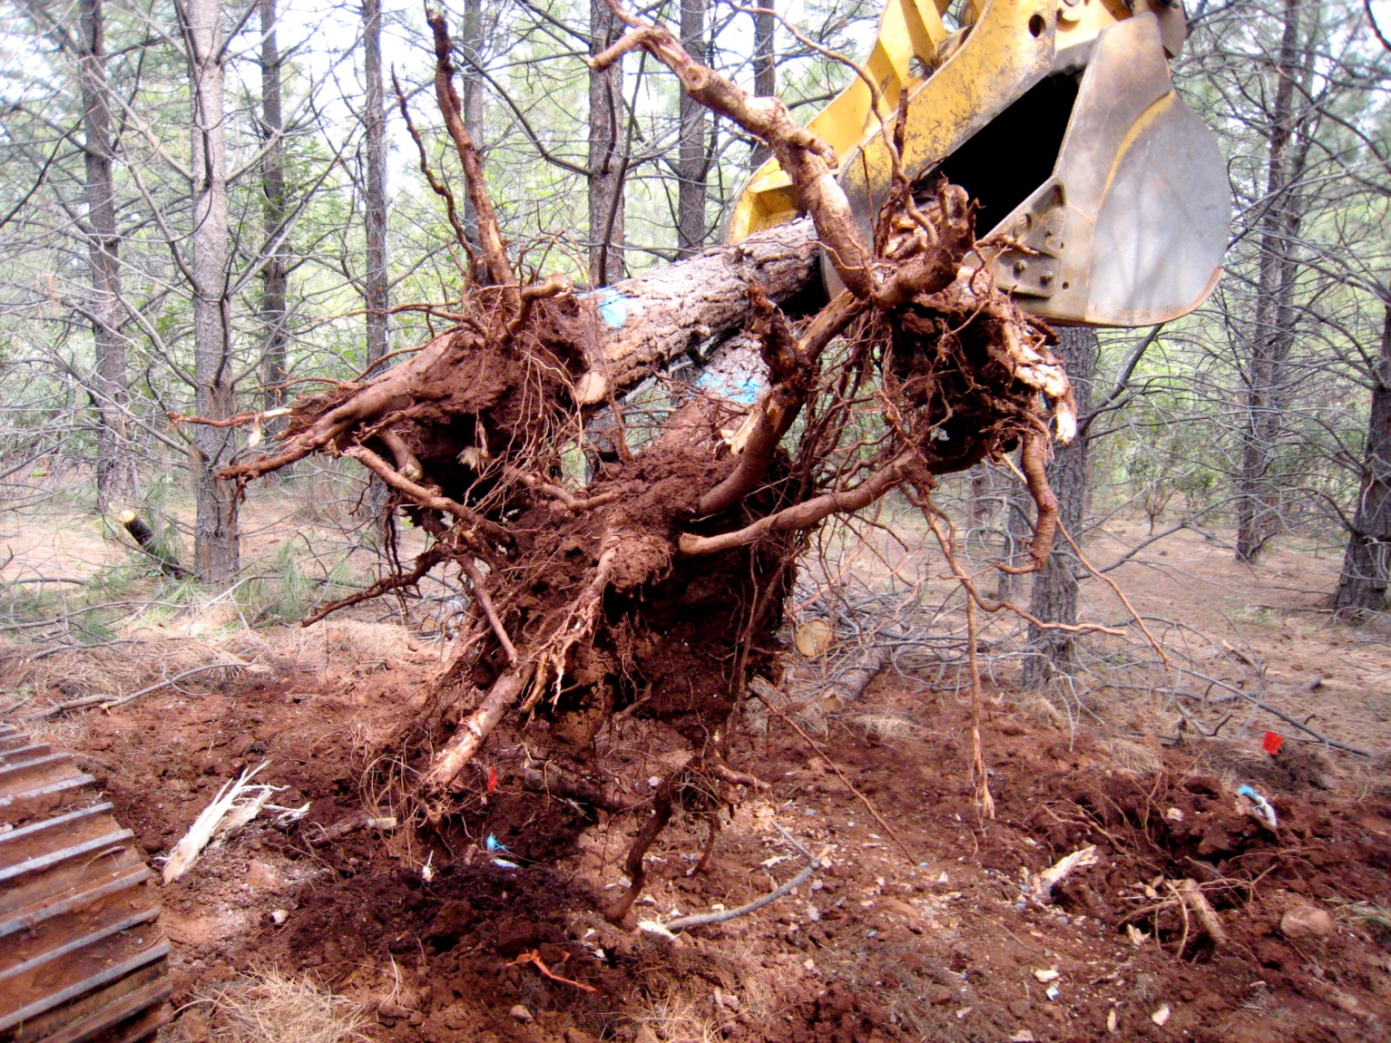
Tour of past studies

Slide 14
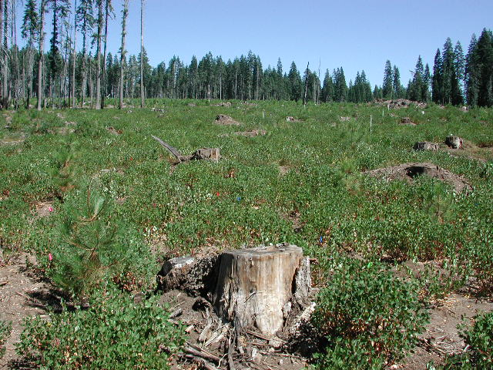
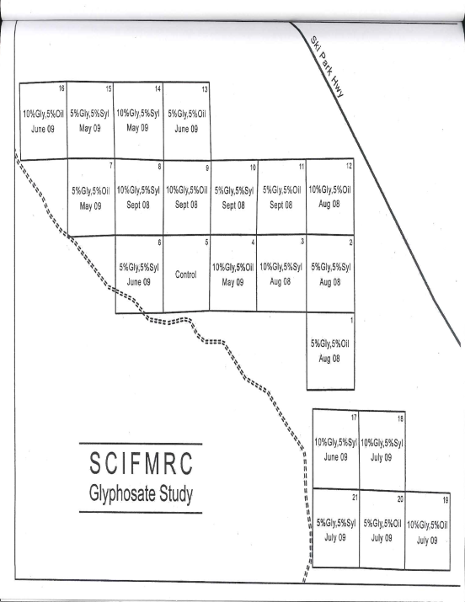
Glyphosate formulation and timing of application

Slide 15
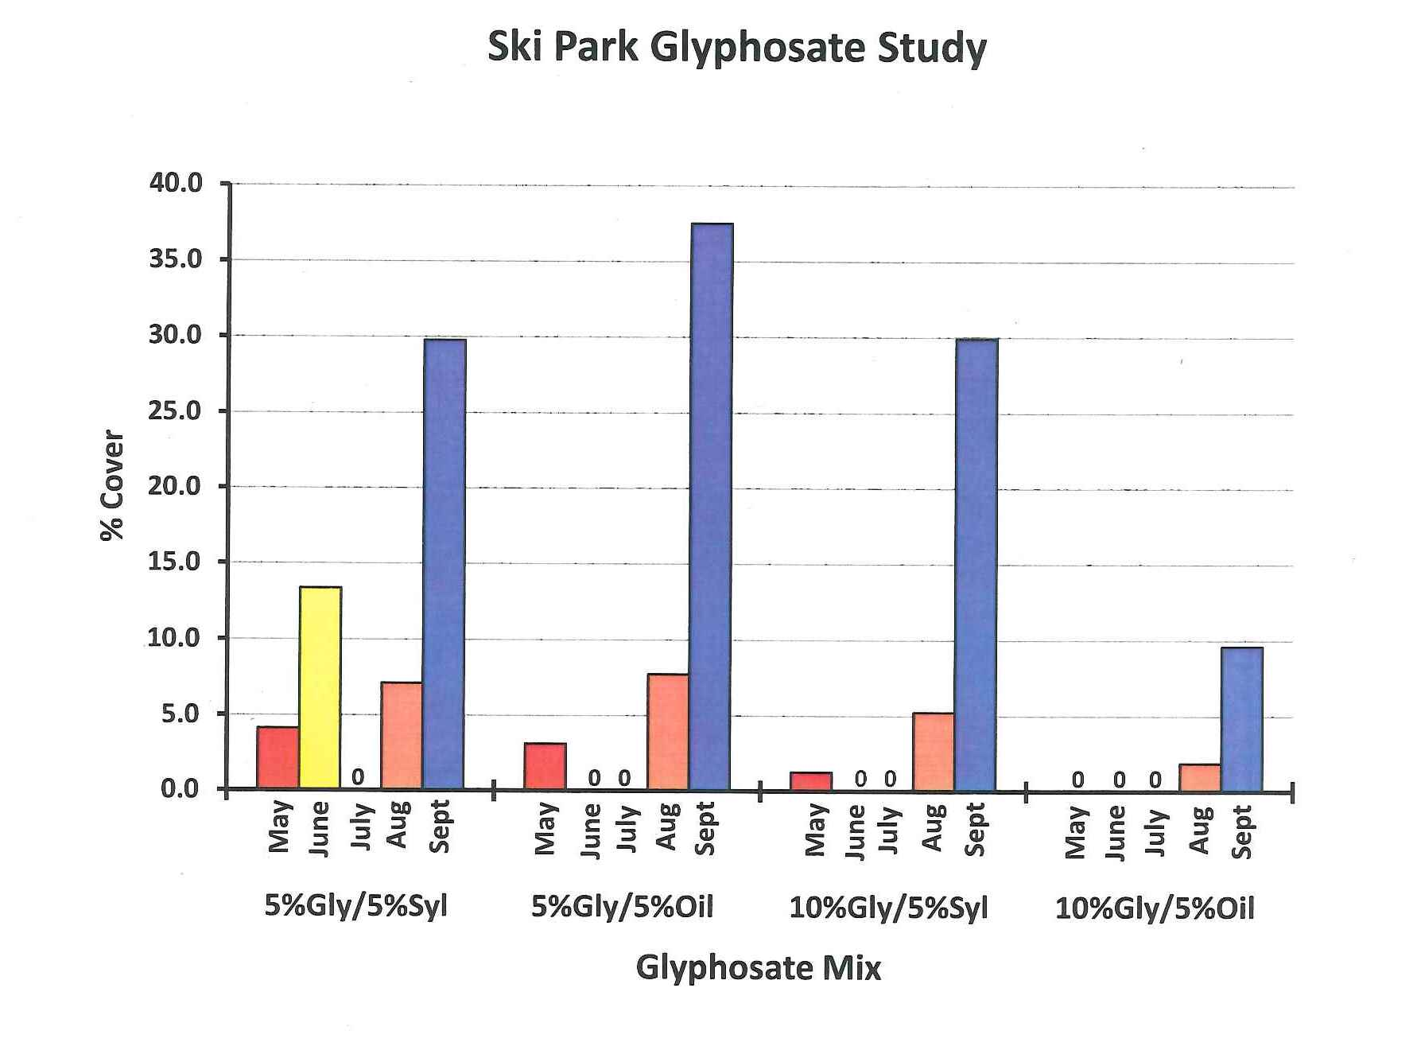
Glyphosate formulation and timing of application
Findings
Late-summer application was only slightly better than no treatment
Best success with June or July application
10% a.i. plus oil is optimal for shrub control

Slide 17
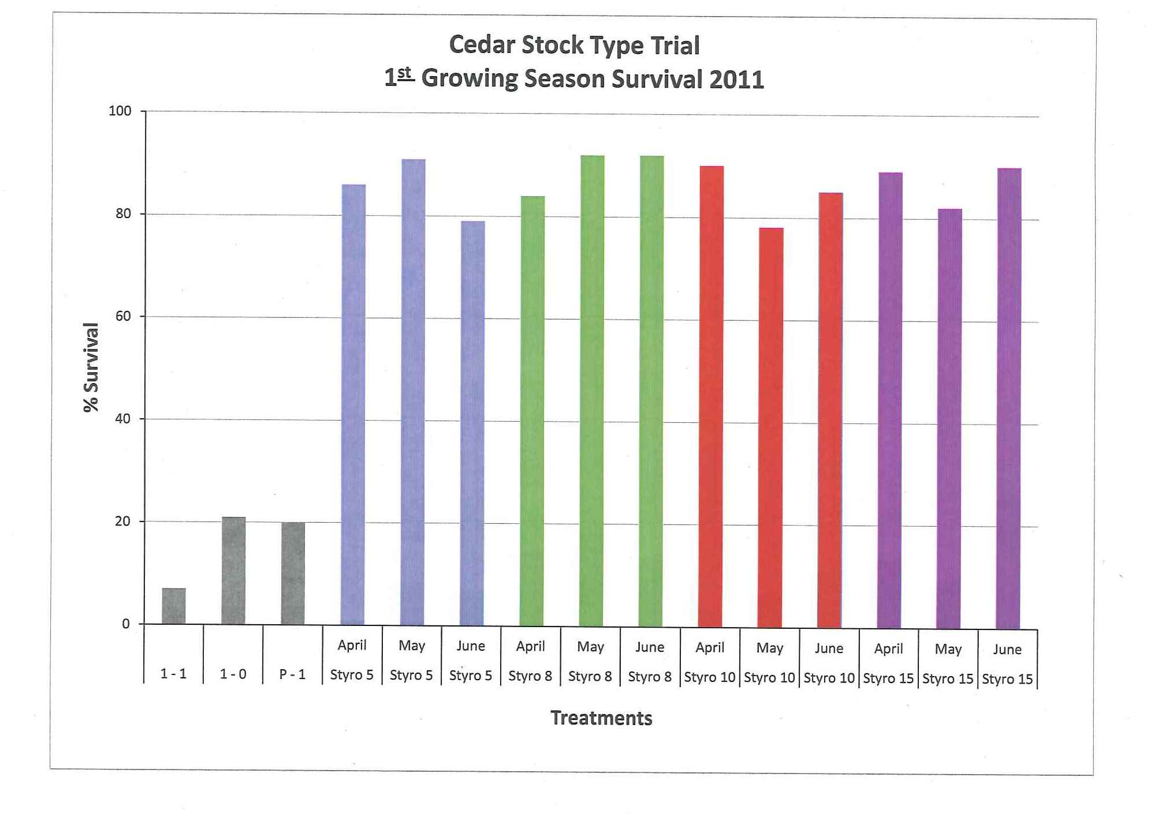
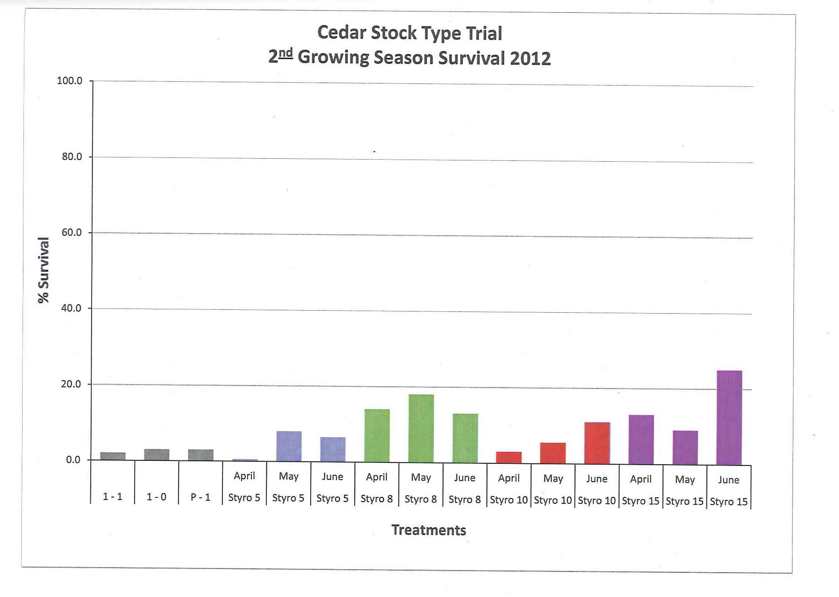
Incense Cedar Stock Type Trial
Findings
Excellent survival in 1st year
All styro stock types and planting dates successful
Poor survival in year 2 due to extremely cold weather

Slide 18
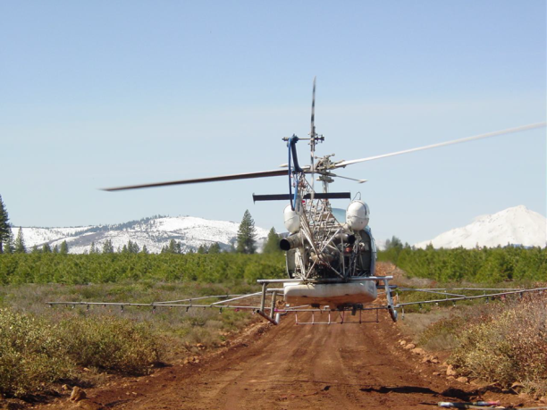
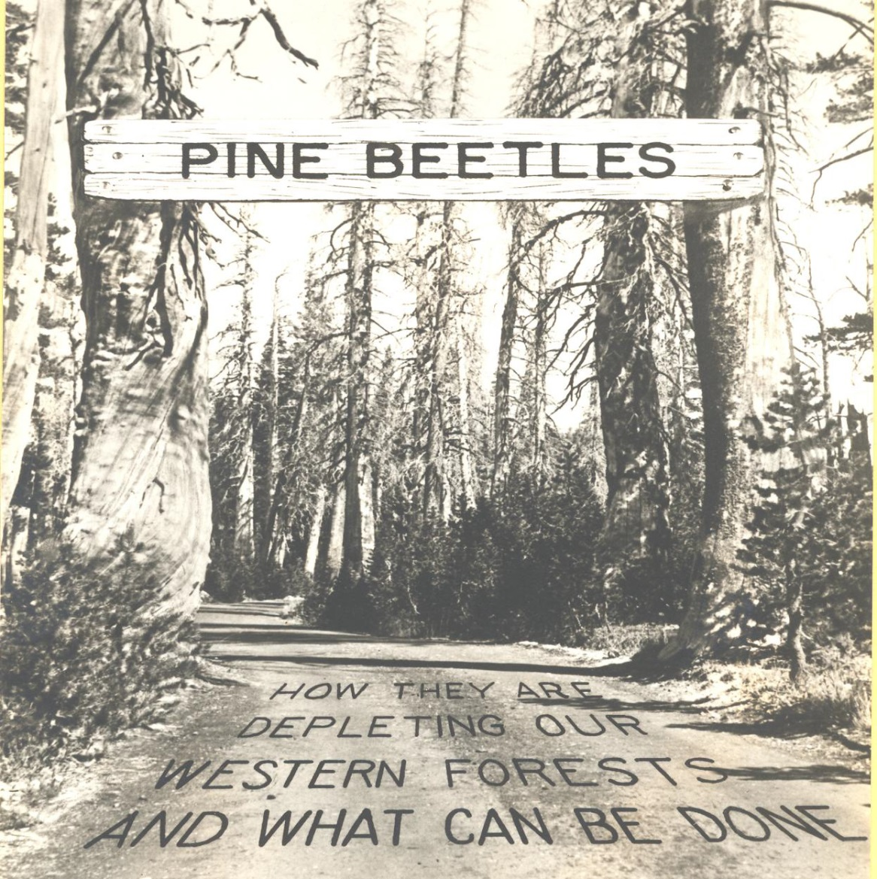
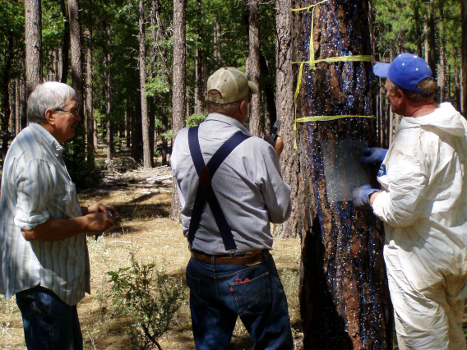
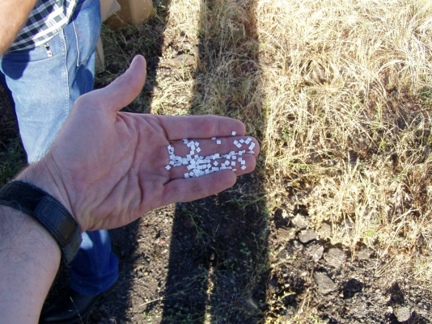
Bark beetle control: pheromones and application methods

Slide 19
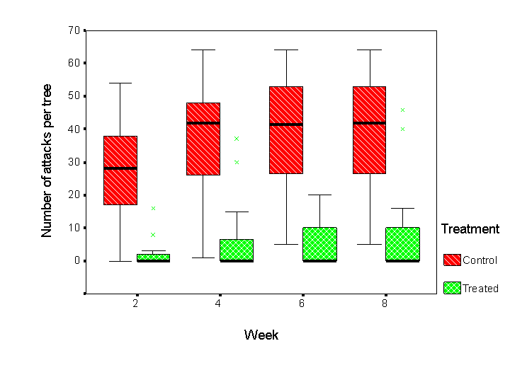
Bark beetle control: anti-aggregation pheromones and application methods
Findings
Effective ground or aerial application
Reduced tree mortality
Successful for MPB and RTB
Inconsistent response for WPB control
Verbenone microflake application

Slide 20
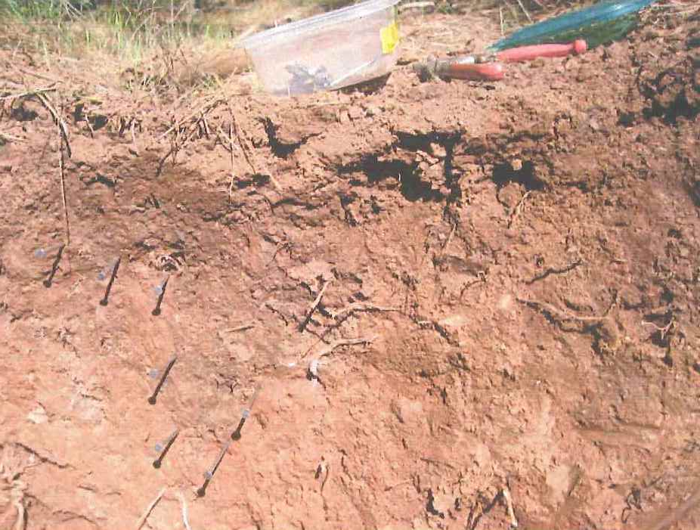
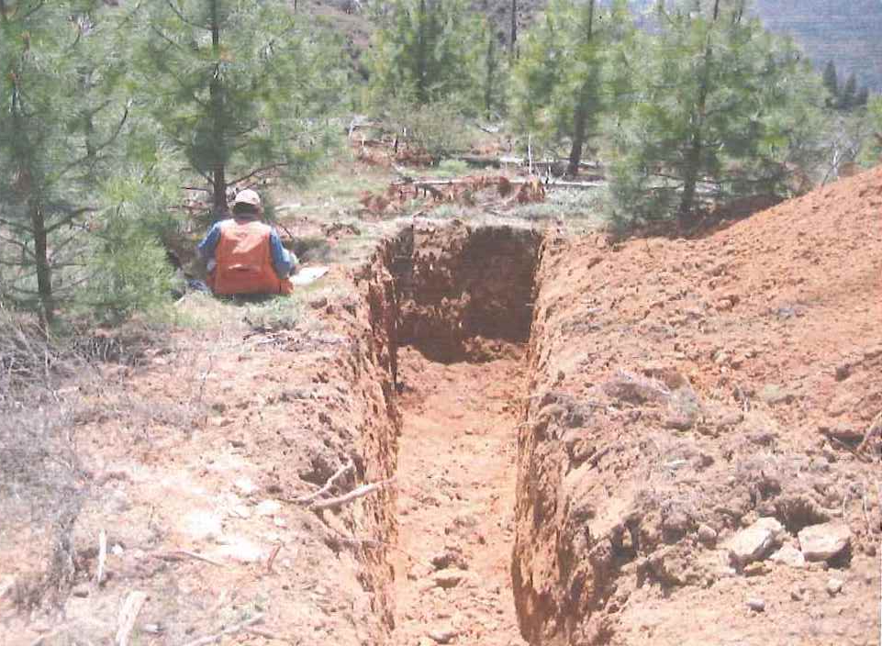
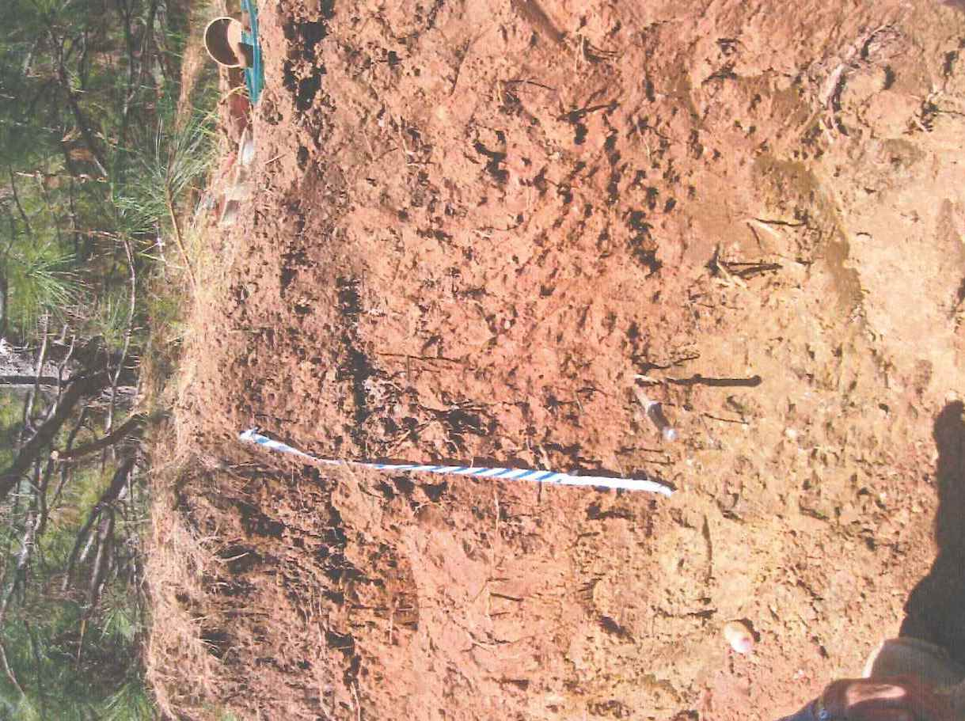
Does subsoiling affect seedling survival or growth?
Findings
No apparent benefit to soil properties or veg at CO-OP site
Know the soil water holding capacity, soil depth, and extent of compaction before deciding to subsoil

Slide 21
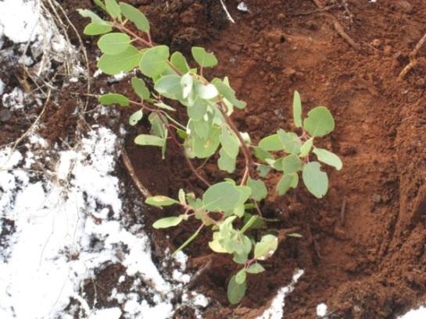
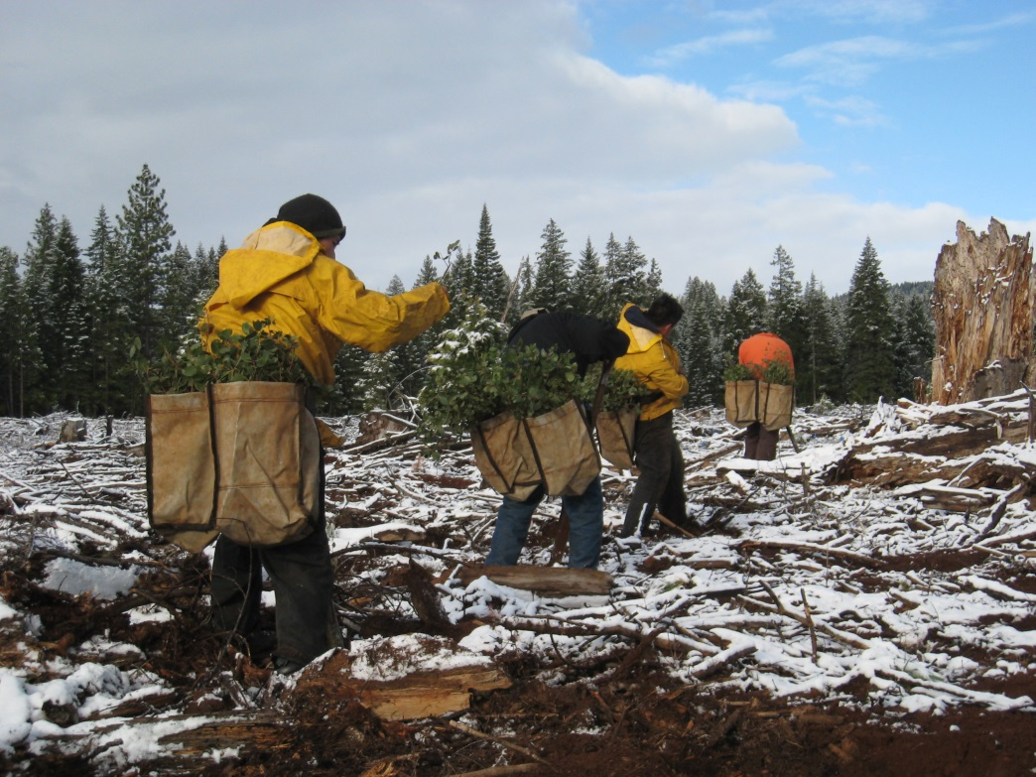
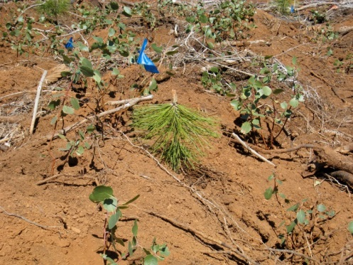
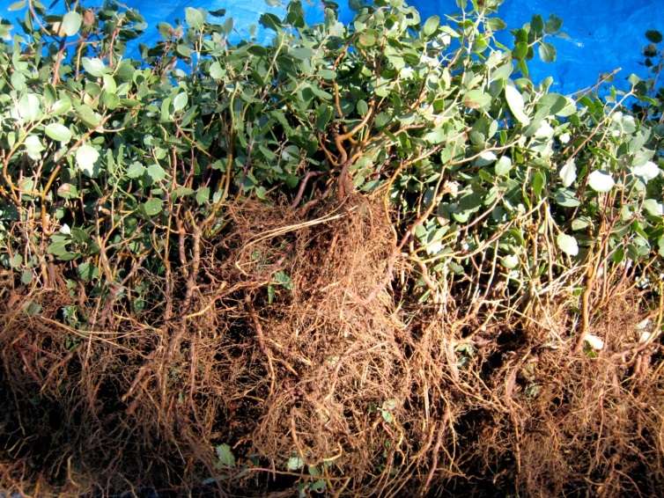
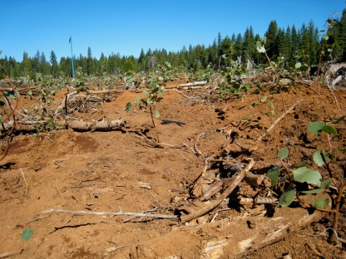
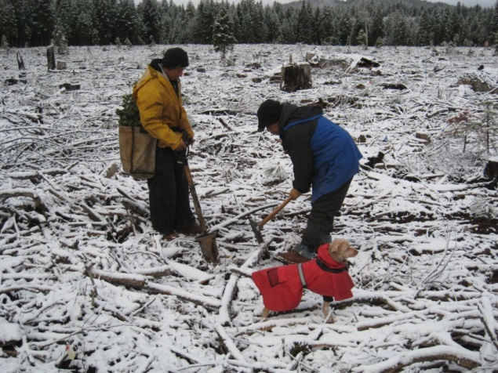
Agenda 2020
Defining the limits of shrub competition

Slide 22
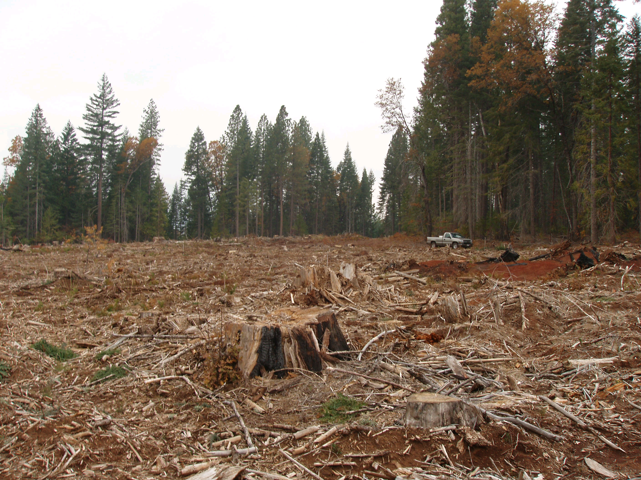
Treatments
1. No brush – 0% cover
Ceanothus – 5% cover
Ceanothus – 15% cover
Ceanothus – 30% cover
Ceanothus – 50% cover
Manzanita – 5% cover
Manzanita – 10% cover
Manzanita – 30% cover
Manzanita – 50% cover

Slide 23
Talking points
SCIFMRC background
Update on current work
A tour of past studies
How to get involved

Slide 24
Get involved
Submit a research proposal by early March
Attend the March 2014 CO-OP meeting
Help develop a CO-OP website
Contact Gary Fiddler, CO-OP manager gfiddler@fs.fed.us 530-226-2542

