Slide 1
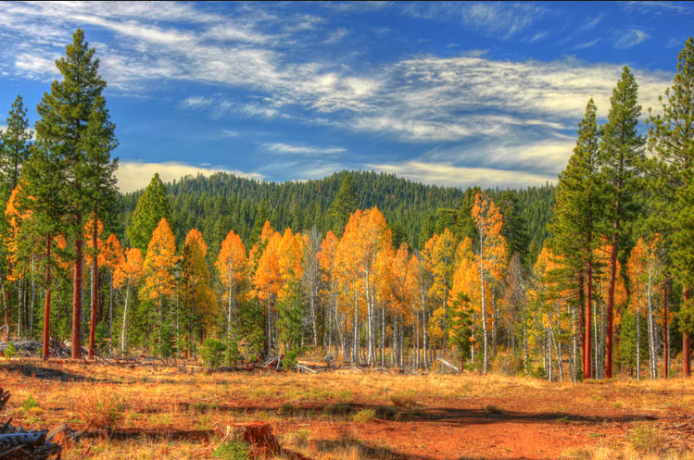
U.S. Department of Labor - Wage and Hour Division Migrant and Seasonal Agricultural Worker Protection Act (MSPA)
Housing and Transportation
FLC Registration Process and Requirements

Slide 2
DOL Contact Information
Ramon Huaracha Jr.
Regional Immigration Coordinator
San Francisco Regional Office
Office Number: (415) 241-3518
Email: huarachajr.ramon@dol.gov

Slide 3
MSPA Online
The MSPA regulations, MSPA Fact Sheets, MSPA Posters, MSPA videos, etc. can all be found online at:
http://www.dol.gov/whd/mspa/index.htm

Slide 4
What is MSPA?
MSPA regulations are found under Title 29 C.F.R. Part 500 Subparts A – F ; www.ecfr.gov
MSPA safeguards most migrant and seasonal agricultural workers by establishing employment standards related to disclosure, wages, recordkeeping, transportation, and housing.
MSPA applies to any migrant or seasonal worker engaged in any service or activity included within the provisions of section 3(f) of the Fair Labor Standards Act and the handling, planting, drying, packing, packaging, processing, freezing, or grading prior to delivery for storage of any agricultural or horticultural commodity in its unmanufactured state.
MSPA can apply to any agricultural employer, farm labor contractor, or agricultural association who recruits, solicits, hires, employs, furnishes, transports, or houses agricultural workers; however, there are some exemptions under certain limited circumstances (e.g., small business exemption if employer operates solely within a 25 mile intrastate radius of permanent home residence and not for more than 13 week per year).

Slide 5
MSPA Disclosure
AGERs, FLCs, and AGAs must inform migrant and seasonal agricultural workers about prospective employment, including the work to be performed, wages to be paid, the period of employment, whether state workers’ compensation or state unemployment insurance will be provided.
AGERs, FLCs and AGAs must provide required information to seasonal workers when they are offered work, in writing if requested; and to migrant workers in writing when they are being recruited.
Workers’ compensation must be provided in writing to any type of worker.
Information must be in English, Spanish or other language common to the workers as appropriate.
MSPA poster which sets forth the rights and protections of the migrant and seasonal workers must be displayed where it can be seen at the jobsite.

Slide 6
MSPA Wages
AGERs, FLCs, and AGAs must pay agricultural workers their wages when due (no less frequently than semi-monthly) and give workers itemized written statements of earnings for each pay period, including any amount deducted and the reasons for the deductions.
AGERs, FLCs and AGAs are prohibited from requiring workers to purchase goods or services solely from such AGER, FLC, or AGA, or any person acting as an agent for such a person.
AGERs, FLCs, or AGAs may not violate the terms of the working arraignment without adequate justification.

Slide 7
MSPA Recordkeeping
AGERs, FLCs, and AGAs must keep complete and accurate time and payroll records for 3 years.
AGERs, FLCs and AGAs must make and keep the following records: basis on which wages are paid, number of piecework units earned, if paid on a piecework basis, number of hours worked, total pay period earnings, specific sums withheld and the purpose of each sum withheld, and the net pay
FLCs must provide other FLCs, AGERs, or AGAs to whom they supply workers, copies of payroll records for each worker supplied to that particular FLC, AGER, or AGA.

Slide 8
MSPA Housing
AGERs, FLCs, and AGAs that provide housing to its migrant agricultural workers must ensure that the facility complies with the federal and state safety and health standards covering that housing.
Migrant housing may not be occupied until it has been inspected and certified to meet these safety and health standards.
AGERs, FLCs, AGAs that provides housing must post at each housing site a written statement of the terms and conditions of occupancy as well as an occupancy permit.

Slide 9
MSPA Transportation
AGERs, FLCs, and AGAs who uses, or causes to be used, a vehicle to transport migrant or seasonal agricultural workers must comply with the applicable vehicle safety standards.
AGERs, FLCs, and AGAs shall ensure that each driver of any such vehicle has a valid motor vehicle license.
Under MSPA the vehicle safety standards are either DOL standards or DOT standards incorporated into the DOL regulations depending on the type of vehicle and how the vehicle is to be used.

Slide 10
MSPA Transportation DOL Standards
AGERs, FLCs, and AGAs using, or causing to be used, a vehicle to transport migrant or seasonal agricultural workers for 75 miles or less must comply with DOL standards 29 C.F.R. § 500.104.
29 C.F.R. § 500.104 requires compliance with the following:
- External lights. Head lights, tail lights, stop lights, back-up lights, turn signals and hazard warning lights shall be operable.
- Brakes. Every vehicle shall be equipped with operable brakes for stopping and holding on an incline. Brake systems shall be free of leaks.

Slide 11
MSPA Transportation DOL Standards
- Tires. Tires shall have at least2/32 inch tread depth, and have no cracks/defects in the sidewall.
- Steering. The steering wheel and associated mechanism shall be maintained so as to safely and accurately turn the vehicles.
- Horn. Vehicles shall have an operable air or electric horn.
- Mirrors. Mirrors shall provide the driver full vision of the sides and to the rear of the vehicle.

Slide 12
MSPA Transportation DOL Standards
- Windshields/windshield wipers. Windshields and windows may not have cracks or opaque obstructions which obscure vision. Vehicles shall be equipped with windshield wipers that are operational to allow the operator full frontal vision in all weather conditions.
- Fuel system. Fuel lines and the fuel tank shall be free of leaks. The tank shall be fitted with a cap to securely cover the filling opening.
- Exhaust system. The exhaust system shall discharge carbon monoxide away from the passenger compartment and be free of leaks beneath the passenger compartment.

Slide 13
MSPA Transportation DOL Standards
- Ventilation. Windows will be operational to allow fresh air to the occupants of the vehicle.
Safe loading. Vehicles will not be driven
when loaded beyond the manufacturer's gross vehicle weight rating.
Seats. A seat securely fastened to the vehicle
will be provided for each occupant or rider in, or on, any vehicle, except that transportation which is primarily on private farm roads will be excused from this requirement provided the total distance traveled does not exceed ten (10) miles, and so long as the trip begins and ends on a farm owned or operated by the same employer

Slide 14
MSPA Transportation DOL Standards
Handles and latches. Door handles and latches
shall be provided and maintained to allow exiting capability for vehicle occupants.
Passenger compartment. Floor and sides of any
part of the vehicle to be occupied by passengers must be free of openings, rusted areas or other defects which are likely to result in injury to passengers.

Slide 15
MSPA Transportation DOT Standards
AGERs, FLCs, and AGAs using, or causing to be used, a vehicle to transport migrant or seasonal agricultural workers for greater than 75 miles and in either a 10+ passenger van, windowless cargo van, truck, truck tractor, semi-trailer, pick-up truck with workers riding in truck bed, multipurpose passenger vehicle, low speed vehicle must comply with DOT standards 29 C.F.R. § 500.105.
29 C.F.R. § 500.105 sets forth an exhaustive list addressing the following items that AGERs, FLCs, and AGAs must be in compliance with:

Slide 16
MSPA Transportation DOT Standards
Minimum physical and health requirements of the driver, certificate of medical examination of driver, minimum age and experience requirements, driving skill, knowledge of regulations, knowledge of English, driver's license, driving rules to be obeyed, prohibited use of alcoholic beverages, compliance with speed limits, service brakes, including trailer brake connections, parking (hand) brakes, steering mechanism, lighting devices and reflectors, tires, horn, windshield wipers, Rear-vision mirrors, coupling devices, fire extinguisher, road warning devices, safe loading, doors, tarpaulins, tailgates, maximum passengers, rest and meal stops, limitation on distance of travel in trucks, lighting devices and reflectors, prevention of fuel ignition…………

Slide 17
QUESTIONS

