Slide 1
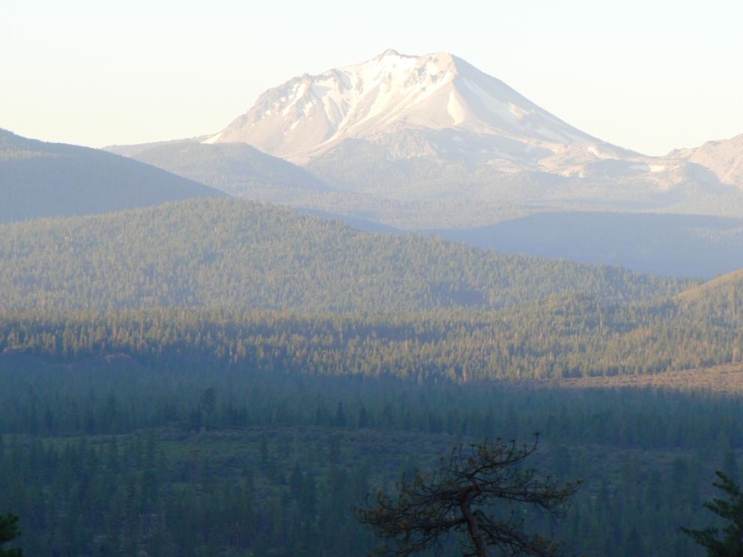
Pindar ® GT Potential Use in Forestry
Vanelle Peterson and Ed Fredrickson
Dow AgroSciences and Thunder Road Resources
CA Forest Vegetation Management Conference
January 2014
®™Trademark of The Dow Chemical Company (“Dow”) or an affiliated company of Dow
Always read and follow label directions

Slide 2
Agenda
Introduction to Pindar ® GT
Review trial data
  Site preparation: fall and spring
  Over the top of newly planted seedlings: spring
Conclusions to date
®™Trademark of The Dow Chemical Company (“Dow”) or an affiliated company of Dow
Always read and follow label directions

Slide 3
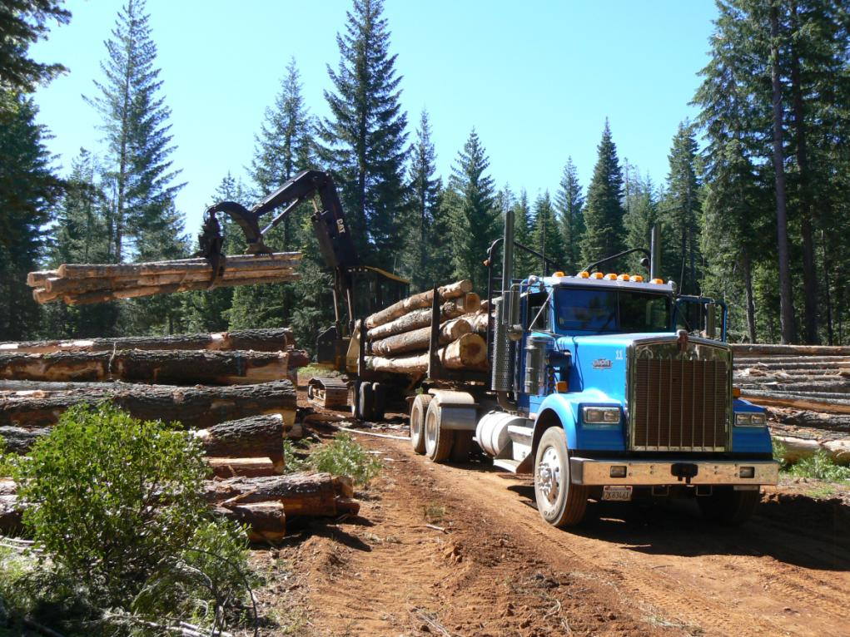

Slide 4
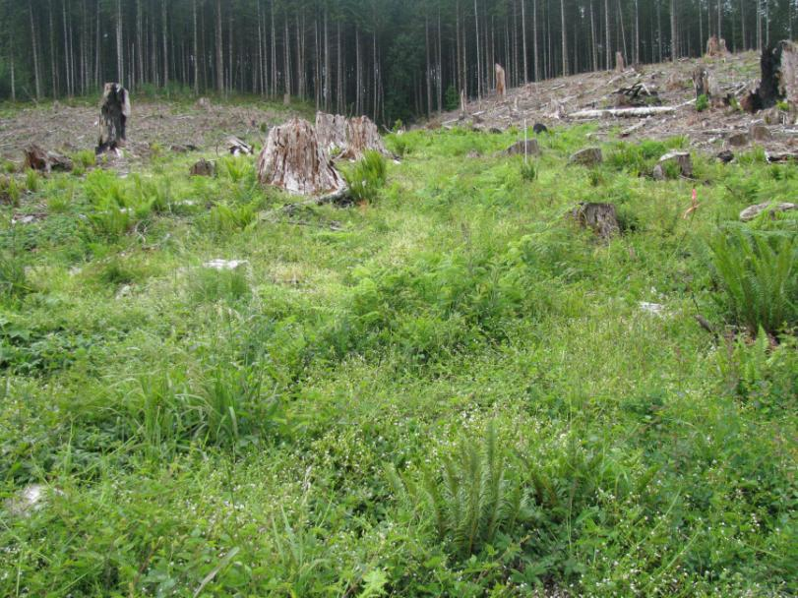
Forestry Site-prep Trials
Non-treated area

Slide 5
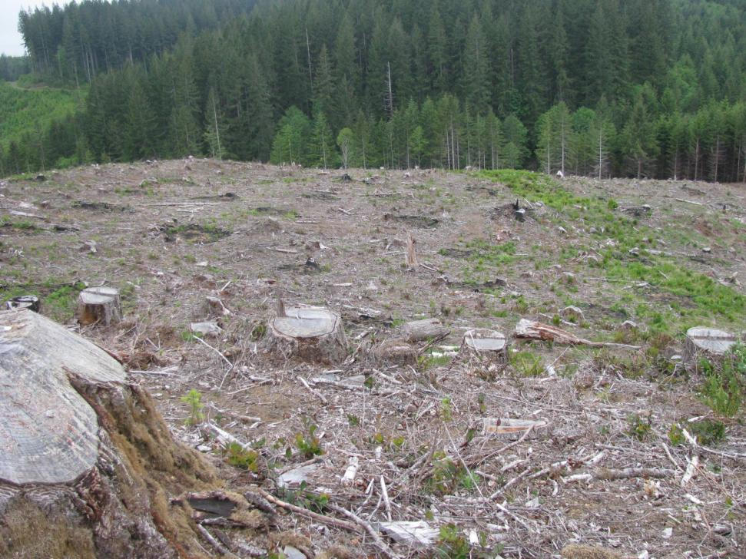
Forestry Site-prep Trials
GoalTender + Accord XRT II + Oust Extra

Slide 6
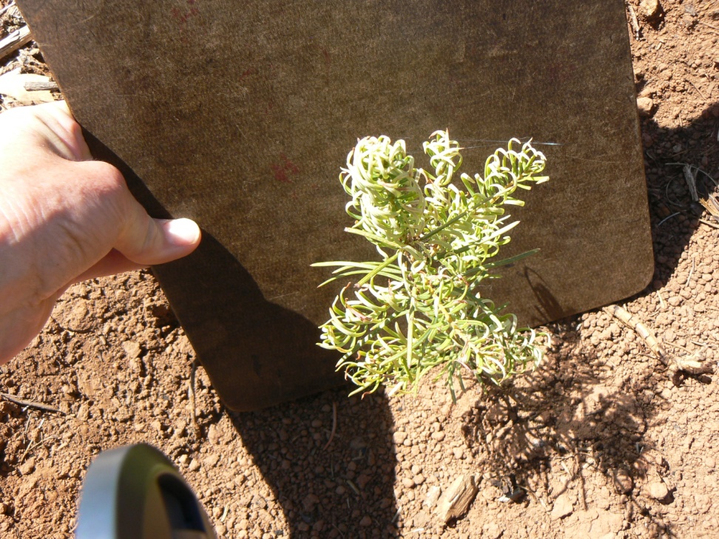
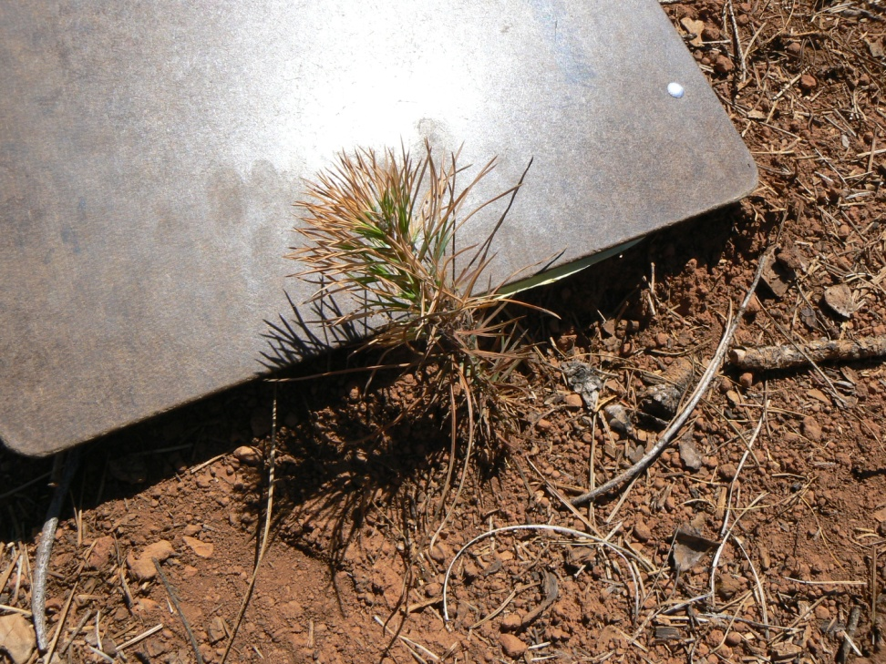
Injury from Herbicides
Velpar DF (4 lb/A) on white fir Site prep: 15 days before planting
Milestone ® (7 oz/A) on Douglas-fir
Site prep: 11 days before planting (this is too close and it is NOT the label recommendation!)
®™Trademark of The Dow Chemical Company (“Dow”) or an affiliated company of Dow

Slide 7


Products in New Research Trials
Pindar ® GT
  Oxyfluorfen + penoxsulam, 3.93 + 0.083 lb ai/gallon, SC
  Preemergent and early post emergent weed control
  Registered for use on noncropland and on nuts
GoalTender ®
  Oxyfluorfen, 4 lb ai/gallon SC
  Preemergent and early post emergent weed control
  Registered for use on conifer seedbeds, transplants, container stock and Christmas trees
  Also on cottonwood, eucalyptus, tree fruits, nuts and vines and other crops
®™Trademark of The Dow Chemical Company (“Dow”) or an affiliated company of Dow
Always read and follow label directions

Slide 8

What is Pindar® GT?
A premix of:
  Penoxsulam: A new ALS herbicide with broad spectrum weed control for use in tree nut crops
  Oxyfluorfen: a PPO inhibitor that has been a long time agricultural standard for broad spectrum residual and contact weed control
SC Formulation containing:
  Penoxsulam: 0.083 lb/gallon
  Oxyfluorfen: 3.96 lb/gallon
®™Trademark of The Dow Chemical Company (“Dow”) or an affiliated company of Dow
Always read and follow label directions
Notes:
Reduced risk of pesticides to human health
Reduced risk of pesticides to non-target organisms
Reduced potential for contamination of surface water and groundwater resources
Broadens adoption of Integrated Pest Management (IPM) practices while reducing environmental loading in tree nuts and grapes due to herbicides use.

Slide 9
Pindar ® GT – Control across all broadleaf weeds from fall applications in CA after 6 months
Summary of over 100 trials from 2004-2009
100
96
92
87
88
80
% control
60
n=489 n=231 n=188 n=223
40
20
0
Pindar GT @3pt
Rimsulfuron@4oz
Flumioxazin@8oz
Flumioxazin @12oz
n=number of obvs.
®™Trademark of The Dow Chemical Company (“Dow”) or an affiliated company of Dow
Always read and follow label directions
All treatments included Glyphosate @ 3pts

Slide 10
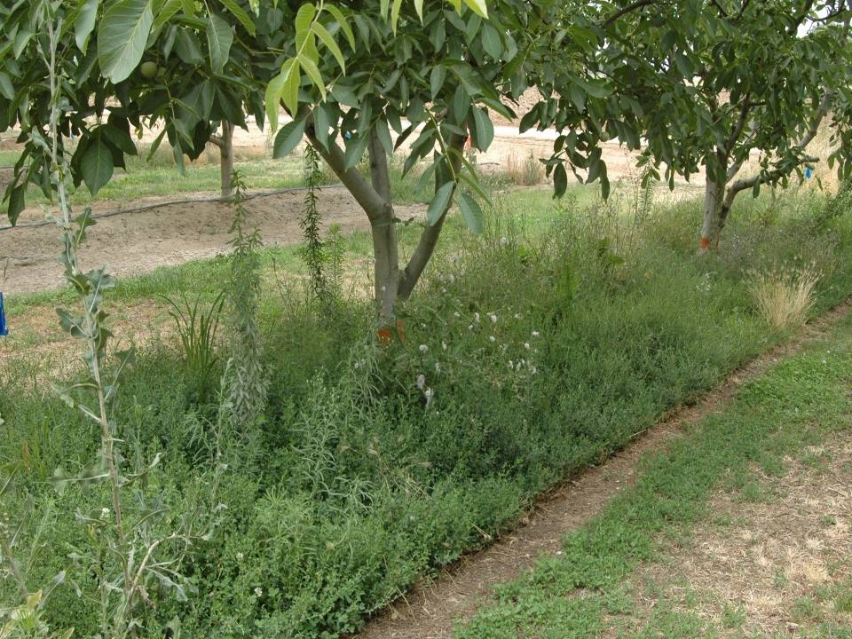
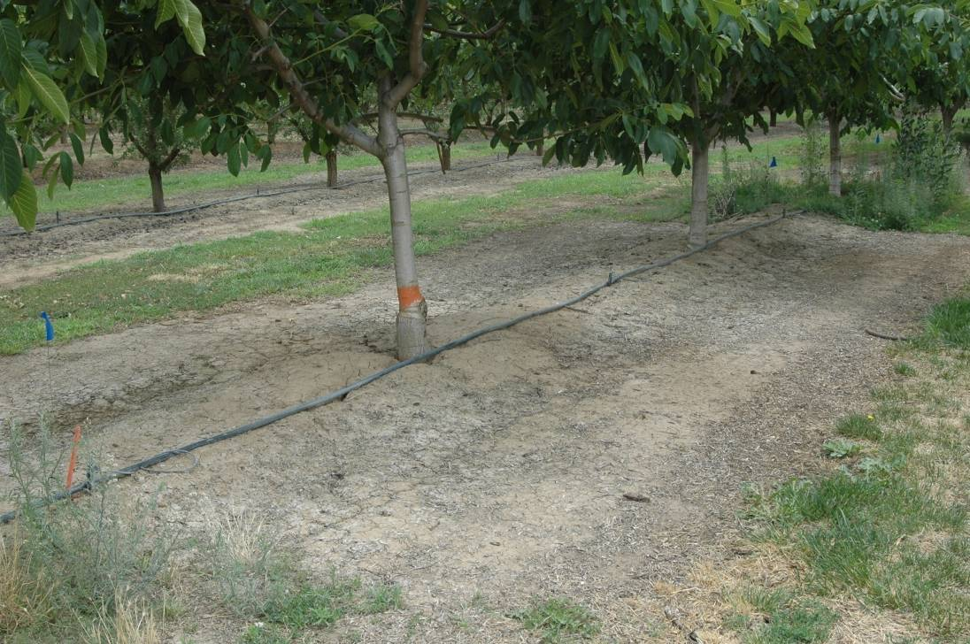
Weed Control with Pindar ® GT at 6 months after fall application
Nontreated
Pindar GT at 3 pt/A
®™Trademark of The Dow Chemical Company (“Dow”) or an affiliated company of Dow
Always read and follow label directions

Slide 11
Pindar ® GT - Benefits
Broad Spectrum Weed Control, over 65+ species in pre and post emergent, including glyphosate resistant species
Burndown and Residual Control, up to 6 months after the application
Tank mix compatibility, can be tankmixed with other tree nut herbicides with no compatibility issues
Crop Safety, excellent safety to bearing and non-bearing tree nuts
Outstanding environmental and toxicological profile, low toxicity to bees, parasitic wasps, lacewings, predatory mites, etc.
®™Trademark of The Dow Chemical Company (“Dow”) or an affiliated company of Dow
Always read and follow label directions
Notes:
Reduced risk of pesticides to human health
Reduced risk of pesticides to non-target organisms
Reduced potential for contamination of surface water and groundwater resources
Broadens adoption of Integrated Pest Management (IPM) practices while reducing environmental loading in tree nuts and grapes due to herbicides use.

Slide 12
Some Weeds Controlled by Pindar ® GT over 65 weeds labeled
Marestail
Willowherb
Wild radish
Wild oats and other annual grasses
Prickly lettuce
Redstem filaree
Sowthistle, annual and perennial
Lambsquarters
Pigweeds
®™Trademark of The Dow Chemical Company (“Dow”) or an affiliated company of Dow
Always read and follow label directions

Slide 13
Research Questions on Pindar GT
What is the tolerance of Ponderosa pine and Douglas-fir to either fall or spring site preparation applications?
What is the tolerance of Velpar DF intolerant species with site prep applications?
  Sugar pine, white fir and Douglas-fir
Is there a potential use of Pindar GT in the spring over the top of newly planted conifers?
What is the efficacy of Pindar GT on weeds of concern in CA forestry?
®™Trademark of The Dow Chemical Company (“Dow”) or an affiliated company of Dow
Always read and follow label directions

Slide 14
Pindar GT Assumptions
Conifer tolerance on Ponderosa pine and Douglas-fir are good with site preparation use either in the fall or spring
Conifer tolerance on Velpar DF intolerant species is good with Pindar GT
  Sugar pine, white fir and Douglas-fir with site prep applications
There is some potential for use of Pindar GT over the top of newly planted conifers in the spring
Pindar GT gives season long control of problem herbaceous species and
Pindar GT picks up preemergent control of some key brush species
  squaw carpet (Ceanothus prostratu)s
  other weedy Ceanothus species such as deerbrush (C. integerrimus) or snowbrush ceanothus (C. velutinus)
®™Trademark of The Dow Chemical Company (“Dow”) or an affiliated company of Dow
Always read and follow label directions

Slide 15
Site Preparation Trials
Fall or Spring Applications
Objective:
  Determine the effect of Pindar GT and GoalTender used for fall or spring site preparation on conifer tolerance and weed efficacy
Applications:
  October 12, 2012
  February 6, 2013
  10 GPA
Planting: February 21, 2013
  Douglas-fir, Sugar Pine, and White fir
Round Mountain
®™Trademark of The Dow Chemical Company (“Dow”) or an affiliated company of Dow
Always read and follow label directions

Slide 16
2013 Evaluations:
% Bareground at 10 Months After Fall and 7 Months After Spring Treatment
% Bareground
  October 12, 2012
  February 6, 2013
All Treatments Contain 1.5 qts Accord XRT II

Slide 17
2013 Evaluations for White Fir:
% Conifer Injury at 10 Months After Fall and 7 Months After Spring Treatment
% Injury (0-10 scale)
**
**
**
  Oct 12, 2012
  Feb 6, 2013 and planted Feb 21, 2013
All Treatments Contain 1.5 qts Accord XRT II

Slide 18
2013 Evaluations for Sugar Pine:
% Conifer Injury at 10 Months After Fall and 7 Months After Spring Treatment
% Injury (0-10 scale)
**
**
**
**
  Oct 12, 2012
  Feb 6, 2013 and planted Feb 21, 2013
All Treatments Contain 1.5 qts Accord XRT II

Slide 19
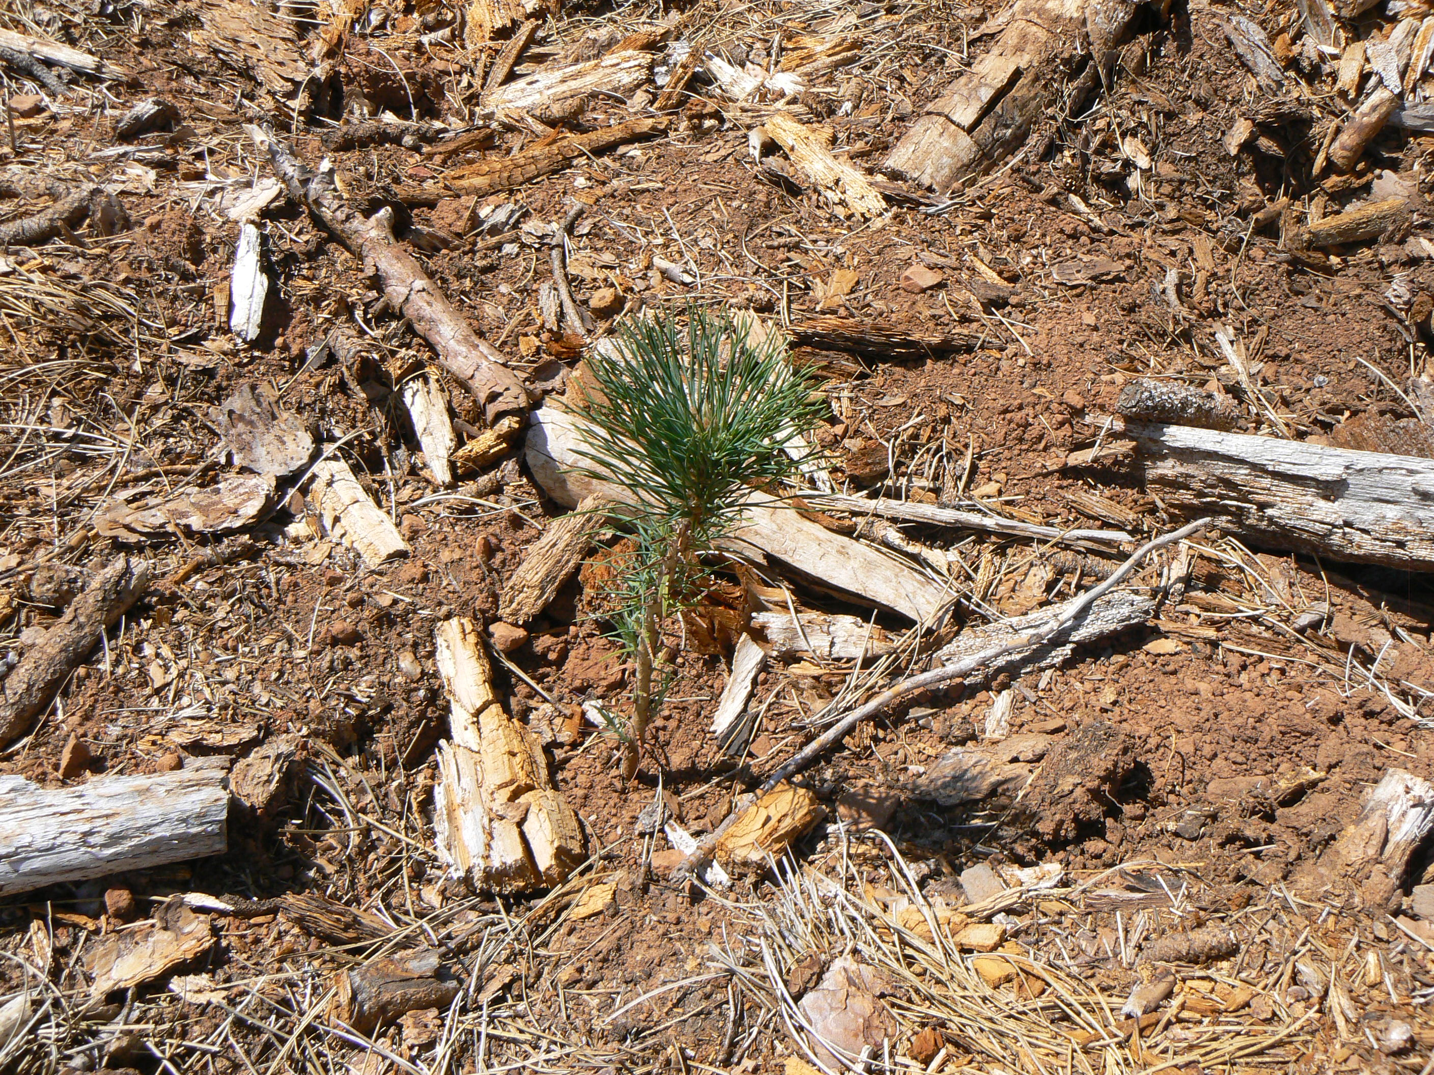
Sugar Pine Tolerance with Fall Application of Milestone + Pindar GT (7 oz + 3 pt/A)
®™Trademark of The Dow Chemical Company (“Dow”) or an affiliated company of Dow
Always read and follow label directions

Slide 20
2013 Evaluations for Douglas-fir:
% Conifer Injury at 10 Months After Fall and 7 Months After Spring Treatment
% Injury (0-10 scale)
  Oct 12, 2012
  Feb 6, 2013 and planted Feb 21, 2013
All Treatments Contain 1.5 qts Accord XRT II

Slide 21
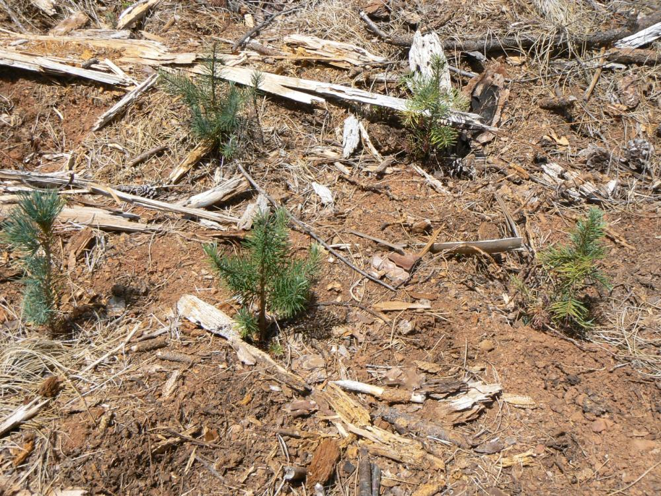
Milestone + Pindar GT @ 7 oz + 3 pt
Application: October 2012 site prep
Photo: August 2013

Slide 22
Site Preparation Conclusions
What is the effect of Pindar GT and GoalTender used for fall or spring site preparation on efficacy and conifer tolerance?
CONIFERS (Douglas-fir, sugar pine, white fir)
  Good survival and tolerance with Milestone and Pindar GT
  Sugar pine (sensitive to hexazinone) is tolerant to Pindar GT
WEED CONTROL
  Excellent weed control with fall applications of Milestone + Pindar GT
  All spring treatments gave excellent weed control
®™Trademark of The Dow Chemical Company (“Dow”) or an affiliated company of Dow
Always read and follow label directions

Slide 23
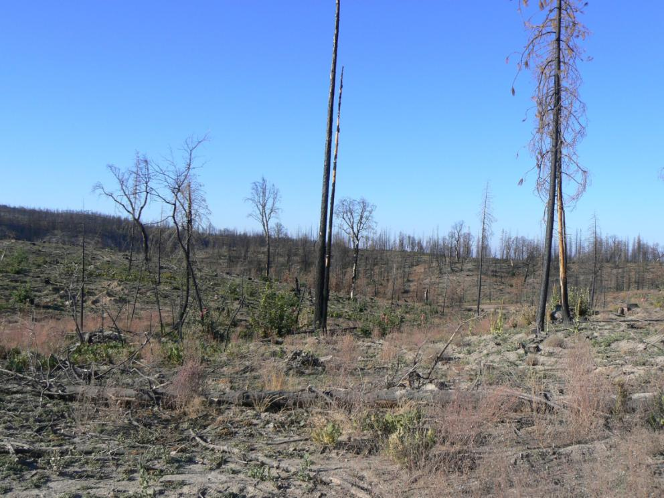
Pindar GT Conifer Tolerance Broadcast over the Top of Newly Planted Trees
Manton, CA

Slide 24
Effect of Pindar GT spring or fall broadcast over the top of newly planted (spring) conifers
Planting date: 25Mar13
Conifers: Douglas-fir, Ponderosa pine, white fir
15 seedlings planted per species so that 5 could be dug for root evaluations
Spring application: 26Mar13
Fall application: 03Oct13, no data yet
10 GPA

Slide 25
Survival
All conifers had excellent survival (95-100%)
  White fir
  Douglas-fir
  Ponderosa pine

Slide 26
% Bareground - March Application (140 days after application)
% Bareground
58
Spring application: 26Mar13
10 GPA

Slide 27
Control of Squaw carpet - March Application (140 days after application)
% Cover
36
Spring application: 26Mar13
10 GPA

Slide 28
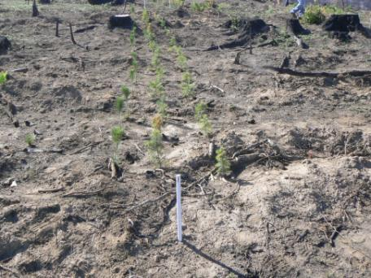
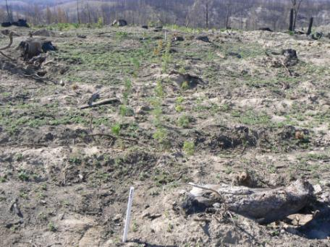
Squaw carpet control with Pindar GT photos taken June 11, 2013 (2.5 MAT)
Pindar GT at 3 pt/A
nontreated
White PVC post marks the center of the plot (12 X 36 ft), 3 rows of conifers planted in each plot

Slide 29
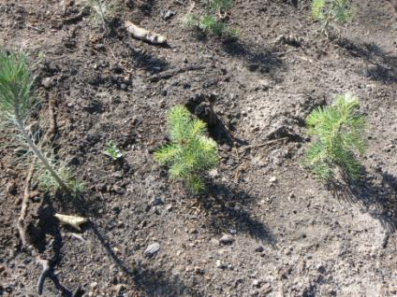
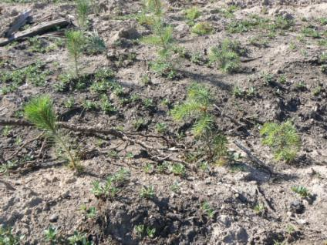
Ponderosa pine, white fir and Douglas-fir tolerance to Pindar GT
Pindar GT at 6 pt/A (2X rate): trees and no squaw carpet
Nontreated:
trees and squaw carpet
GoalTender also showed no conifer damage to date

Slide 30
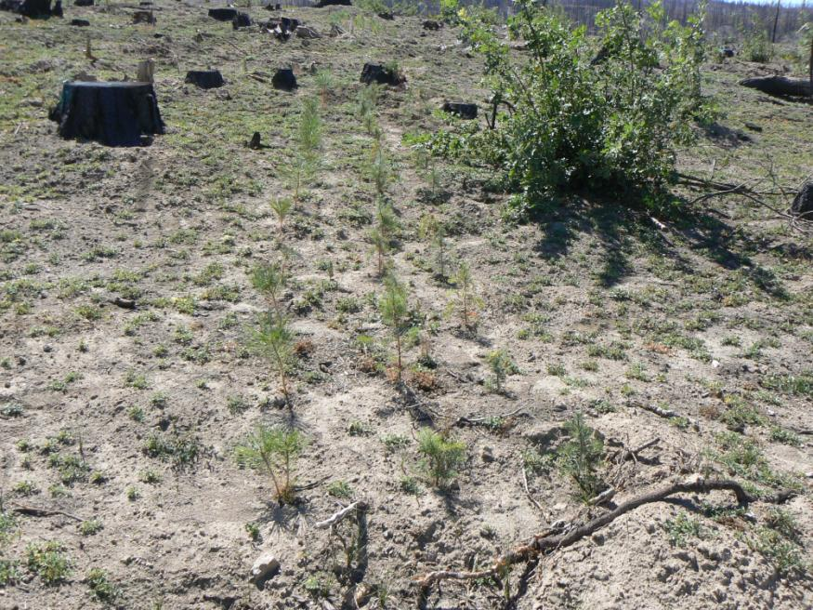
Nontreated Control
Squaw carpet seedlings

Slide 31
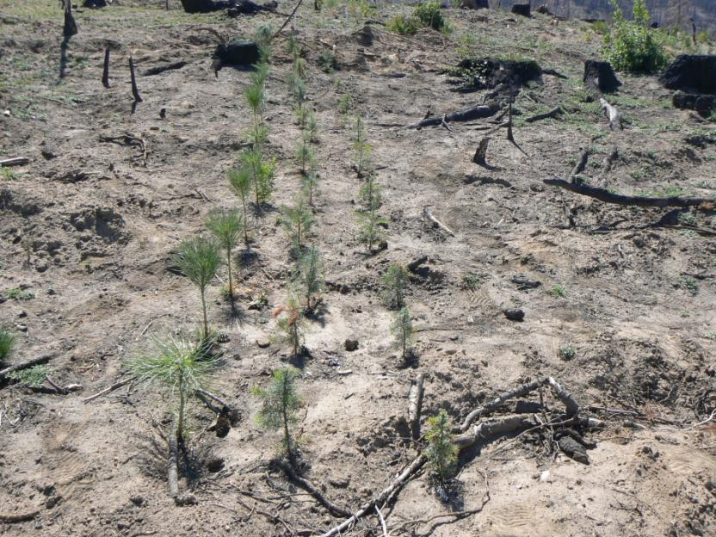
Pindar GT @ 3 pt applied in March photo at 5 months after treatment
Squaw carpet seedlings

Slide 32
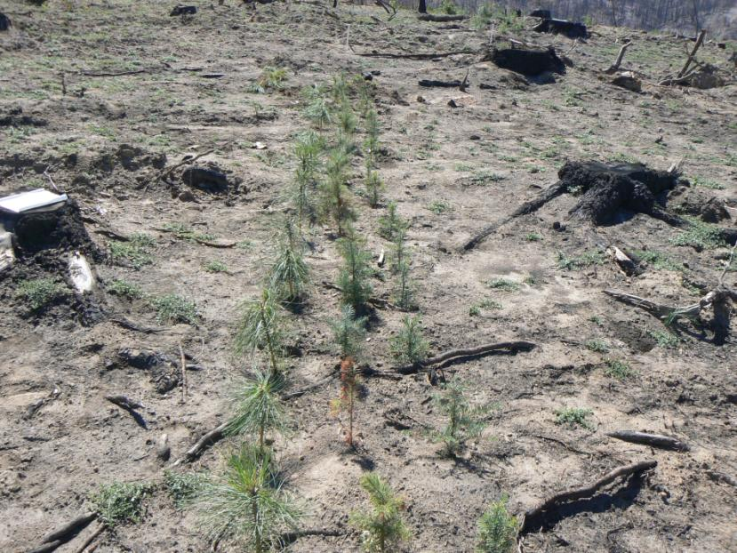
GoalTender @ 3 pt applied in March photo at 5 months after treatment
Squaw carpet seedlings

Slide 33
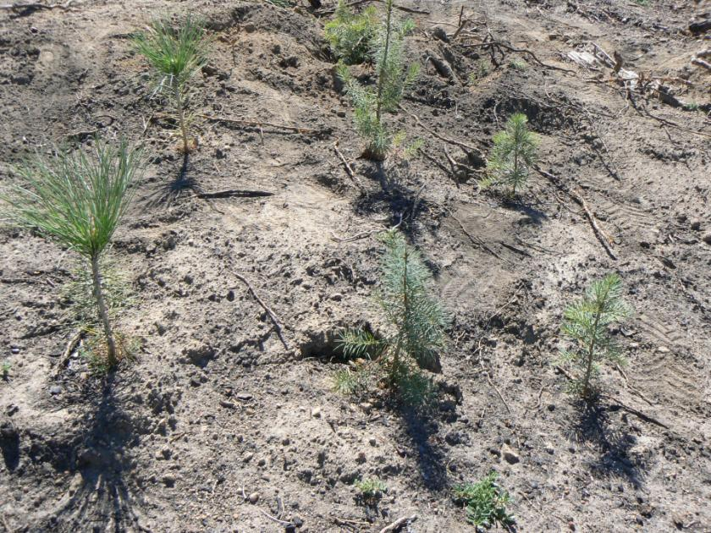
Pindar GT @ 6 pt (2X) over the top of newly planted Ponderosa pine, Douglas-fir and white pine at 5 Months after Planting

Slide 34
Evaluations for Conifer Roots
Root Length
0 = no new roots
1 = 0.1 to 1cm
2 = 1.1 to 2 cm
3 = 2.1 to 3 cm
4 = 3.1 to 4cm
5 = 4.1 to 5 cm
6 = 5.1 to 6 cm
7 = 6.1 to 7cm
8 = 7.1 to 8 cm
9 = 8.1 to 9 cm
10 = 10+ cm
Number of new roots
0 = no new roots
1 = 1 to 5 new roots
2 = 6 to 10new roots
3 = 11 to 15 new roots
4 = 16 to 20 new roots
5 = 21 to 25 new roots
6 = 25+ new roots

Slide 35
Root Length - March Application (140 days after application)
Root Length (0-10 scale)
NS
P = 0.05
Spring application: 26Mar13
10 GPA

Slide 36
New Roots - March Application (140 days after application)
# of New Roots (0-6 scale)
NS
P = 0.05
Spring application: 26Mar13
10 GPA

Slide 37
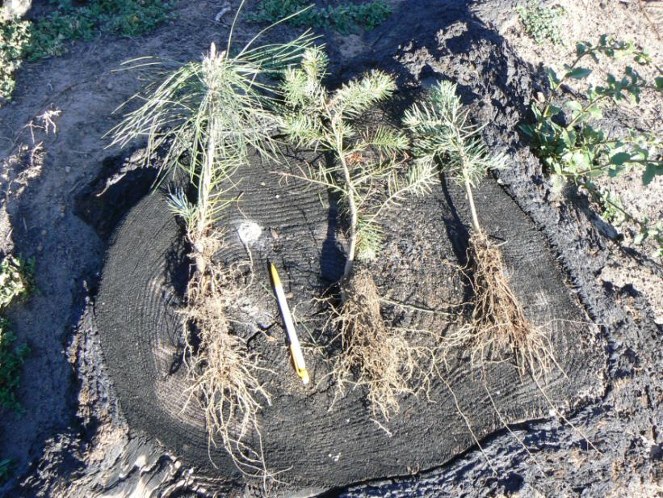
Pindar GT @ 3pt: Root growth on Ponderosa pine, Douglas-fir and white pine at 5 Months after Planting

Slide 38
Conclusions to Date about Pindar GT Use in Forestry
Conifer tolerance – site prep
  Fall or spring applications = excellent for Douglas-fir, Ponderosa pine, sugar pine, white fir
Conifer tolerance - over the top of newly planted seedlings
  Spring applications = excellent survival and growth for Dougals-fir, Ponderosa pine and white fir
  Conifer root data: There was no difference between treatments (including the 2X rates of Pindar GT and GoalTender) and the nontreated control
Weed control
  Very good weed control, Pindar GT gave better control of squawcarpet versus GoalTender

Slide 39
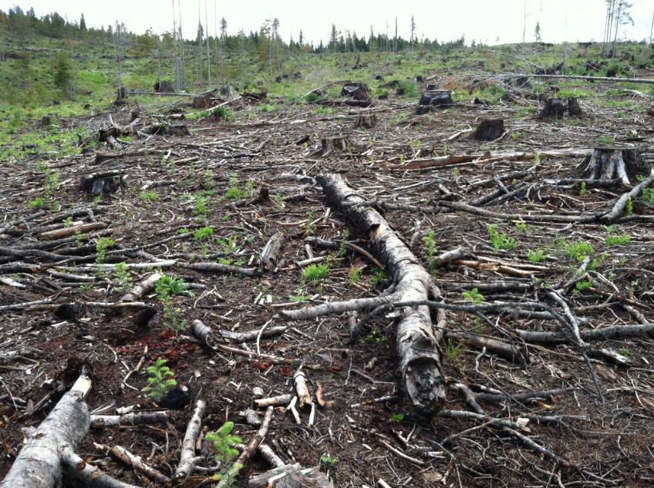
N Idaho
Oct 2012 application of Pindar GT + Milestone @ 3 pt + 7 fl oz
Photo taken June 2013 about a 45 to 50 inch rainfall zone, clay loam

Slide 40
Future Research Needs
Conifer tolerance:
  Continue established studies
  New trials with Oregon Vegetation Management Research Cooperative
Effect of high organic matter (up to 15-18%)
  Fall application on high elevation site before snow
  Spring application on low elevation site with high precipitation
Woody brush seed germination efficacy
  Manzanita, Deerbrush, Snowbrush ceanothus
CA SLN label for Pindar GT use in forestry

Slide 41
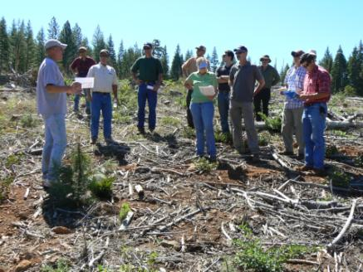
Partnerships
Dow AgroSciences is pleased and proud to partner with private timber companies, Thunder Road Resources, Sierra Cascade Forestry Cooperative, FSC Cooperative and others in forestry research
Thank you for your continued dedication to growing trees for our future

Slide 43

Trials with Potential New Products for Site Prep
Pindar ® GT and GoalTender ®
  Fall and spring applications for site prep
  Conifer tolerance and weed control
Fall:
  Sprayed October 20, 2011
    Planted March 24, 2012 (about 150 DAT/5 MAT) Redding
  New site sprayed fall 2012, planted spring 2013
    Conifer tolerance with destruction sampling for root analysis
Spring:
  Sprayed April 4, 2012
    Planted April 20, 2012 (16 DAT) Burney
  New site planned for spring 2013
    Conifer tolerance with destruction sampling for root analysis
®™Trademark of The Dow Chemical Company (“Dow”) or an affiliated company of Dow
Always read and follow label directions

