Slide 1


Fire resistance and fire resilience: forest management in a time of increasing fire activity
Eric Knapp
US Forest Service
Pacific Southwest Research Station
Redding, CA

Slide 2
Trends in fire activity
National
California

Slide 3
Reasons for increasing acres burned
Climate change:
  Higher temperatures, earlier snowmelt, longer fire season, lower fuel moisture
Increasing fuel loading, fuel continuity
More aggressive fire behavior
  direct attack generally only possible w/ flames <4ft

Slide 4
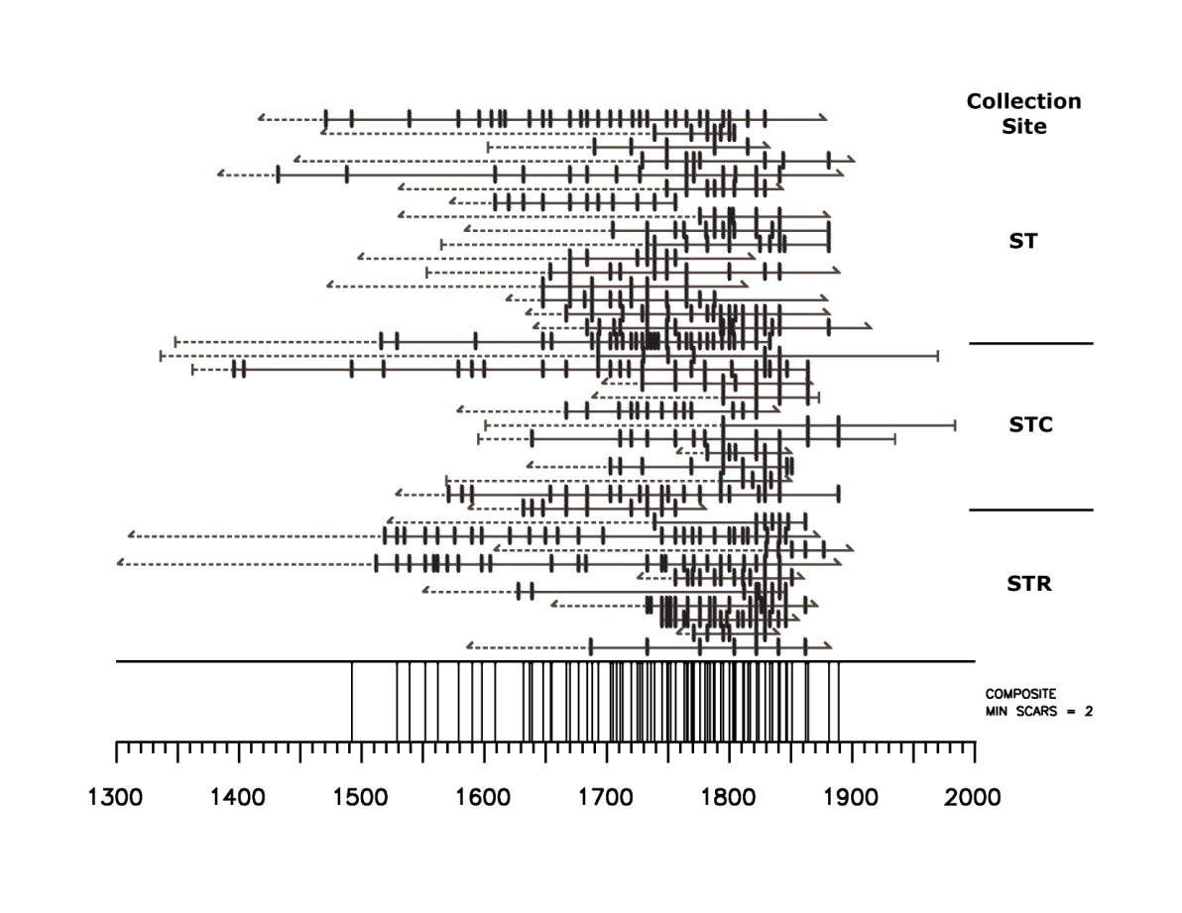
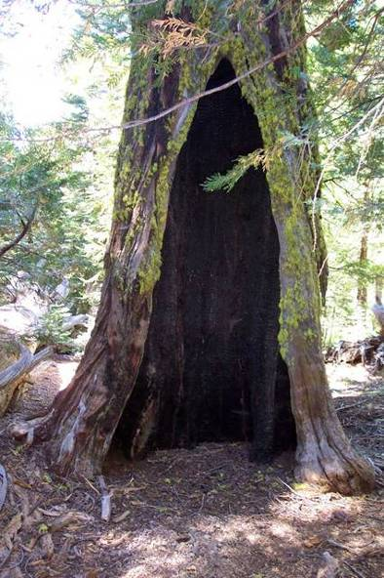
Fire exclusion, forest change, and fuels
Example: Stanislaus-Tuolumne Experimental Forest
Historical median fire return interval: 6 years
Last fire: 1889

Slide 5
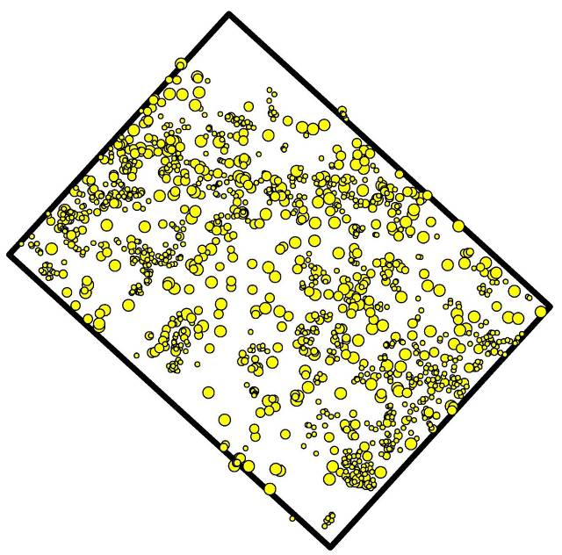
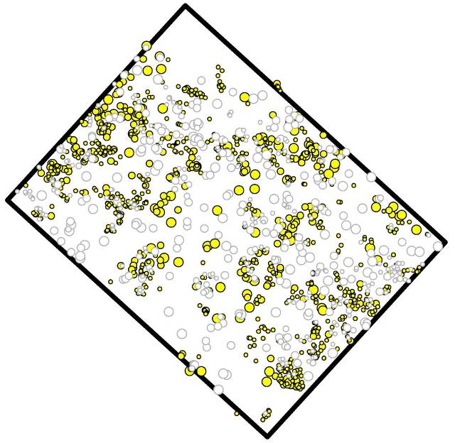
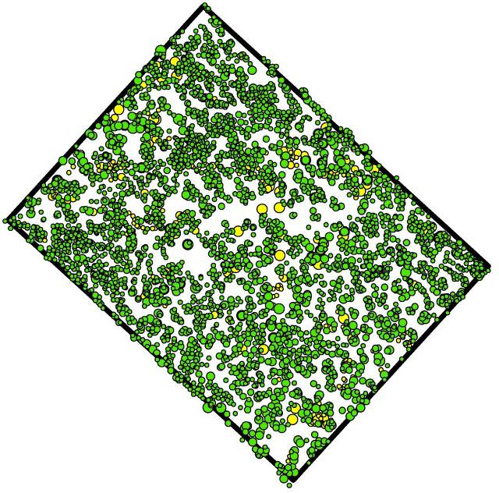
Live trees in 1929 post-logging
Live trees in 1929 prior to logging
Live trees in 2008
Stanislaus NF MC Plot 9
USFS cut
DBH 1929 (in)
DBH 2008 (in)

Slide 6
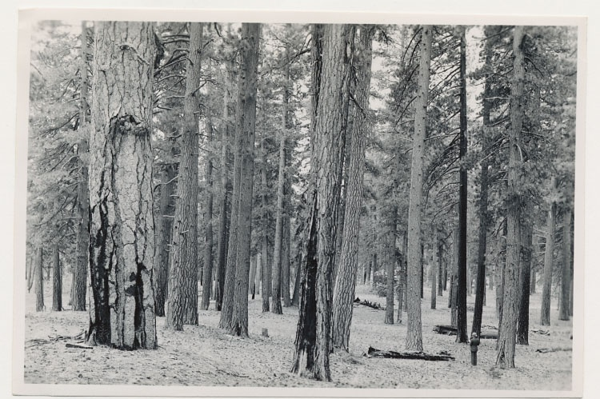
Historical surface fuel loading
Stanislaus National Forest - 1931 (E.A. Wieslander)

Slide 7
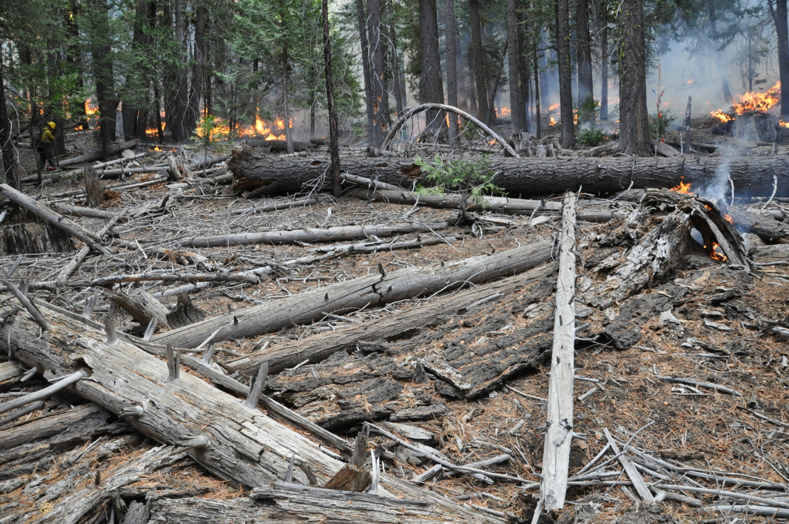
Surface fuel loading after 125 years of fire exclusion

Slide 8
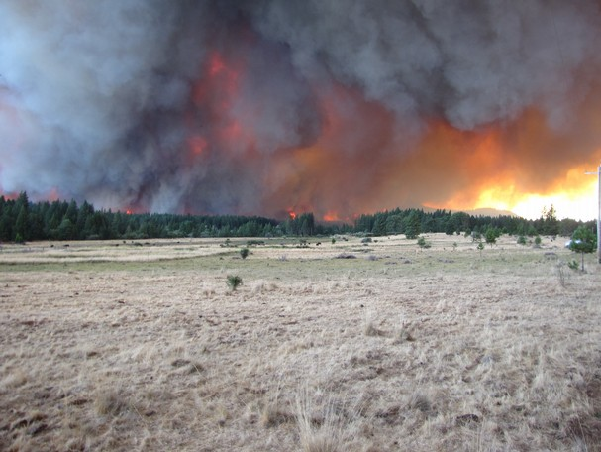
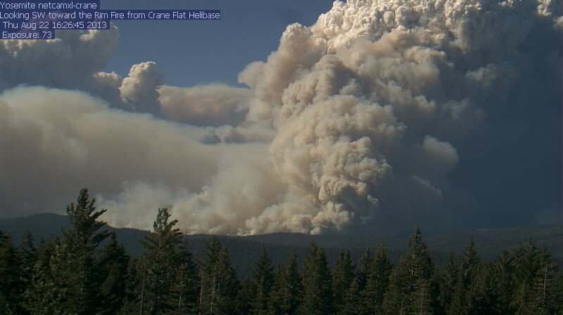
Fuel driven fire behavior
April and Tony Forward
Record Searchlight
Ponderosa Fire – Aug. 18, 2012
Rim Fire – Aug. 22, 2013

Slide 9
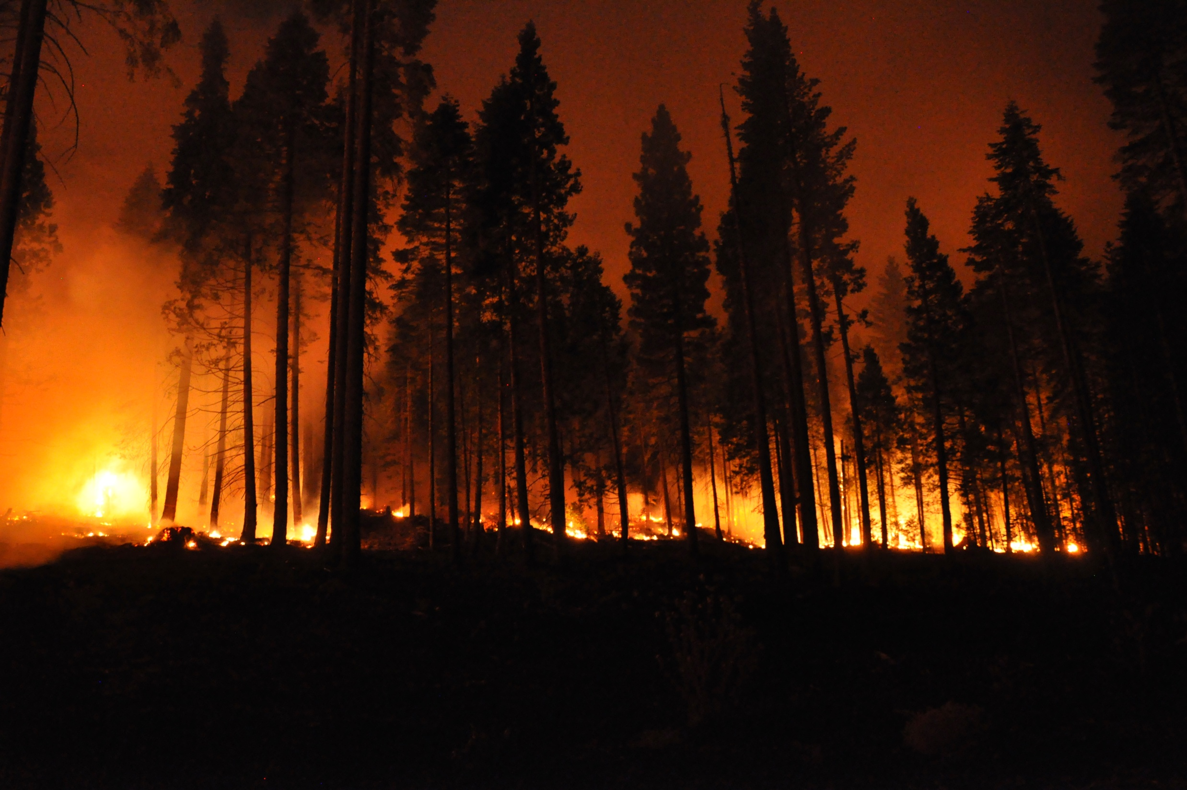
Management approaches to prevent wildfire loss
Landscape scale
  Fuel breaks to stop fires externally
Stand scale
  Resistance: will not burn – barrier to fire spread
  Resilience: If wildfire burns through, stand does not suffer excessive mortality

Slide 10
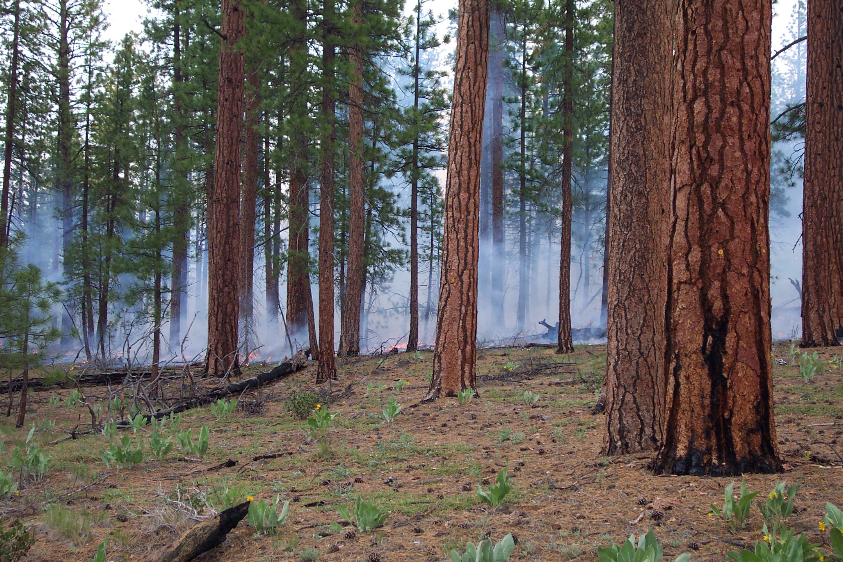
Fire resistance (definition): Not able to burn or able to burn only with difficulty

Slide 11
Fire resistance
Surface fuels too light to burn
Fuel discontinuity – fire can’t spread
  Stand initiation phase
    Clean site preparation, broadcast burning prior to planting
  Early growth and maintenance phase
    Manage competing vegetation
    Trees also produce fuels
    Prescribed burning
      Resistance lasts up to 5-10 years

Slide 12
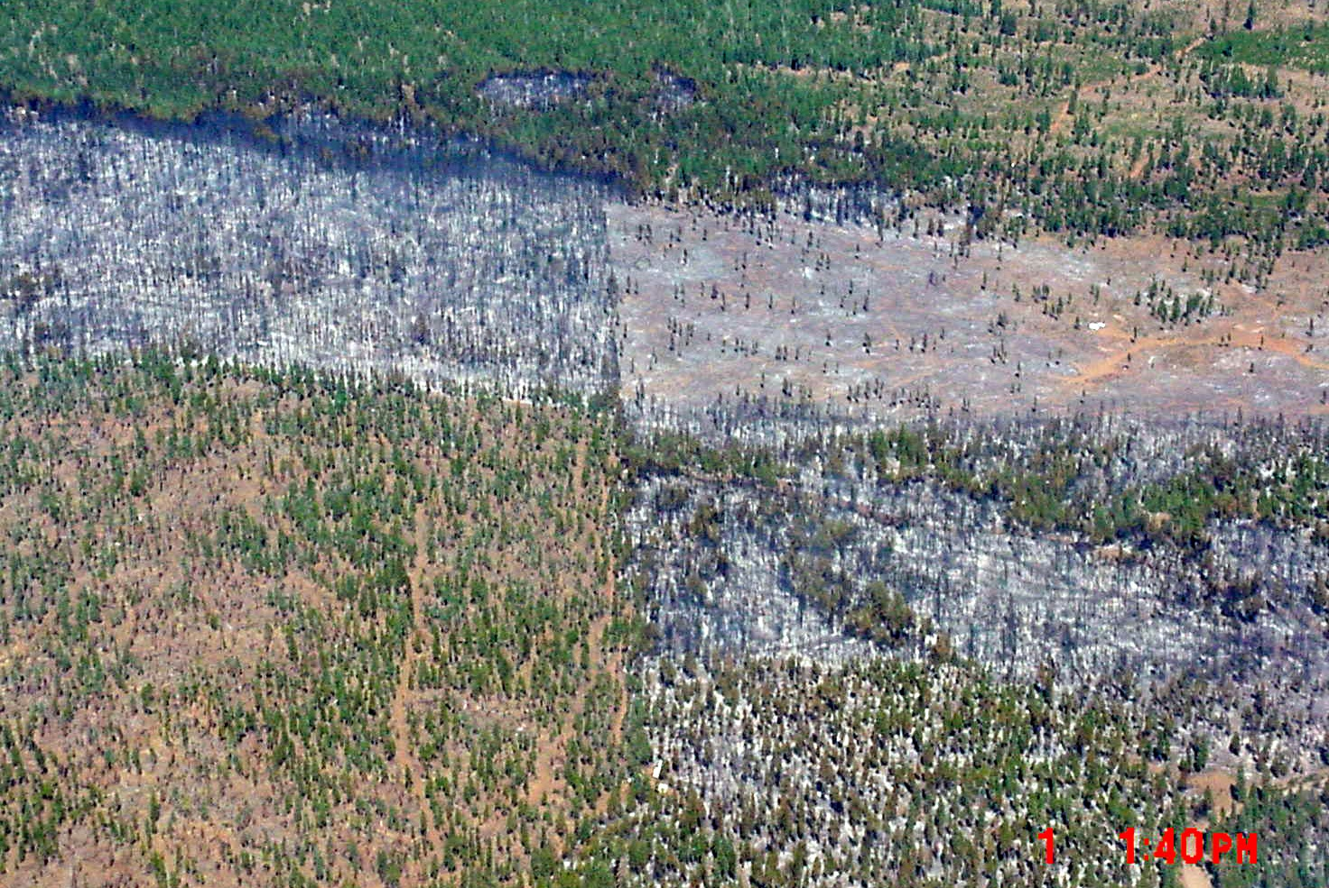
Unthinned plantation
Thinned (1998) +
RxBurn (2000)
Unthinned
Cone Fire – September 2002
Patchwork of pre-fire treatments and fire effects
Blacks Mountain Experimental Forest
Thinned
No RxBurn

Slide 13





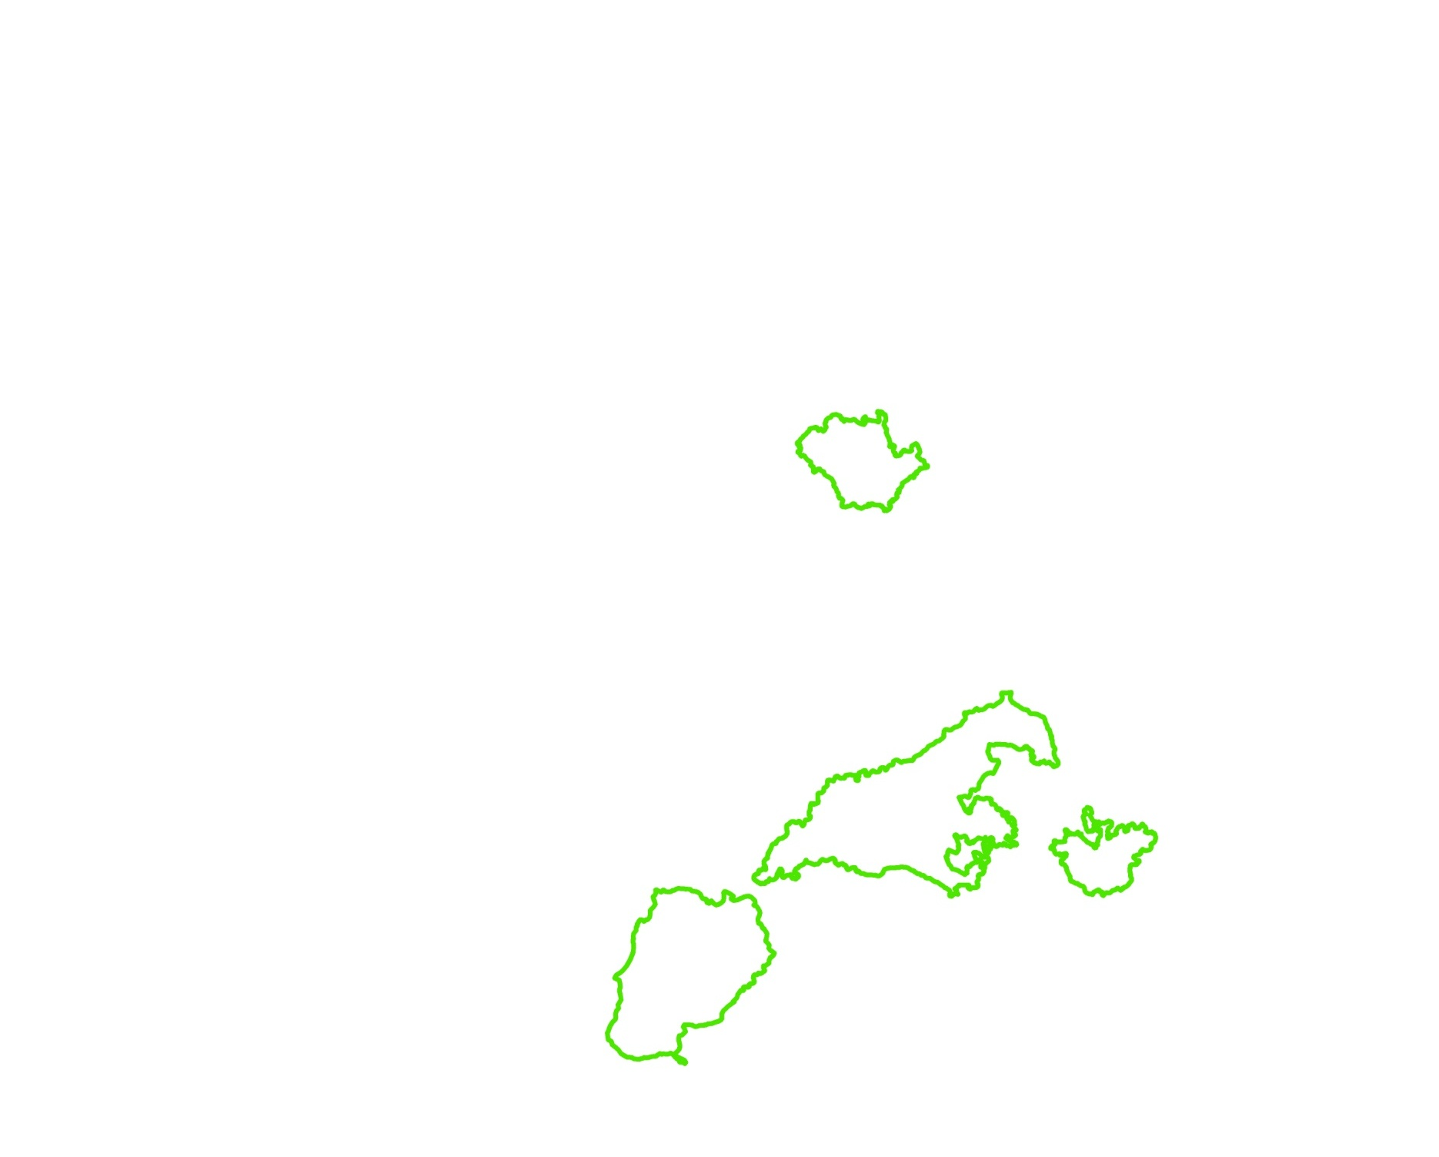
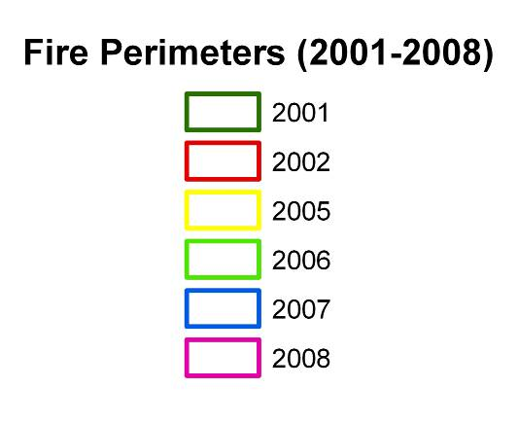
Mosaic of past fires limiting the extent of future fires
Klamath National Forest
Elk
Stanza
Swillup
Titus
Panther
Siskyou/Blue2
Wooley
Hancock
Uncles
Somes
Ukonom
Forks

Slide 14
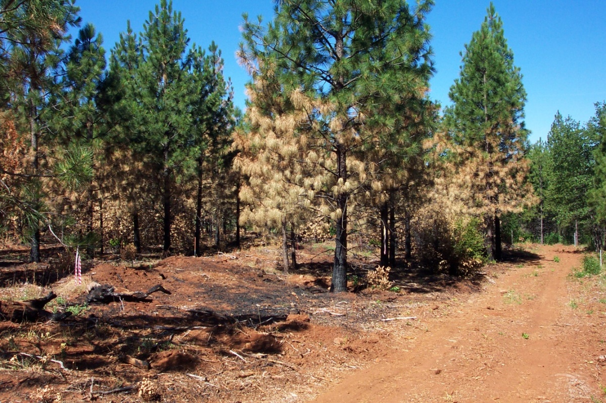
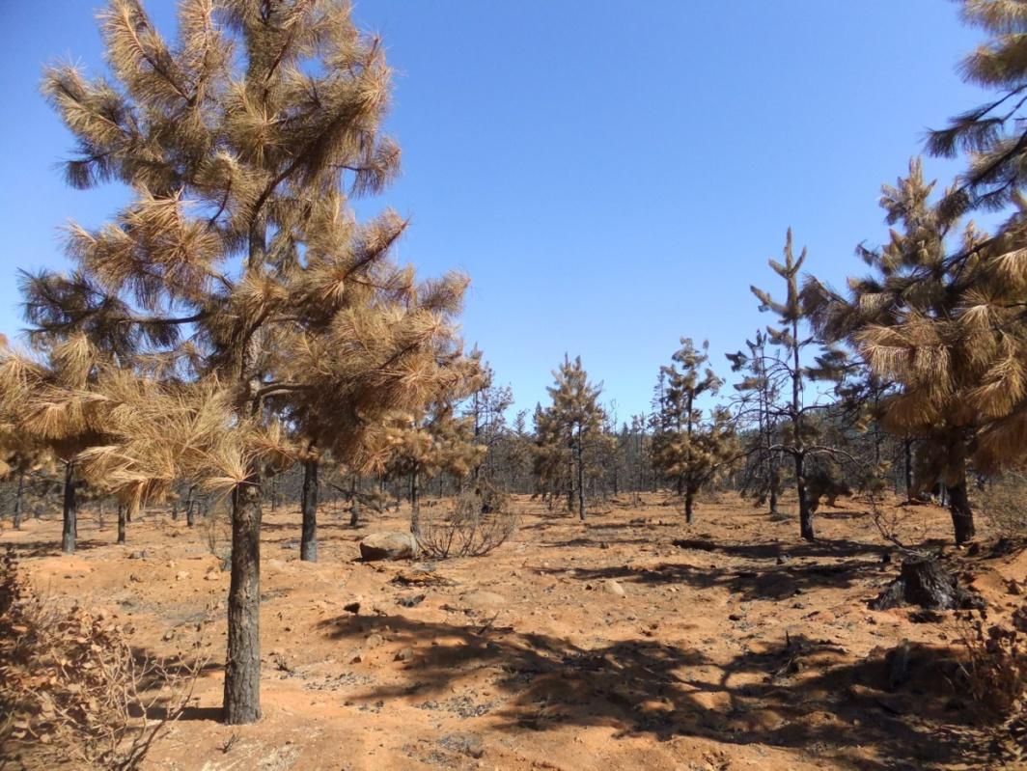
Fire resilience (definition): The ability of a vegetation type, ecosystem, or community to respond positively to or recover quickly from the effects of fire
Resilient
Not resilient

Slide 15
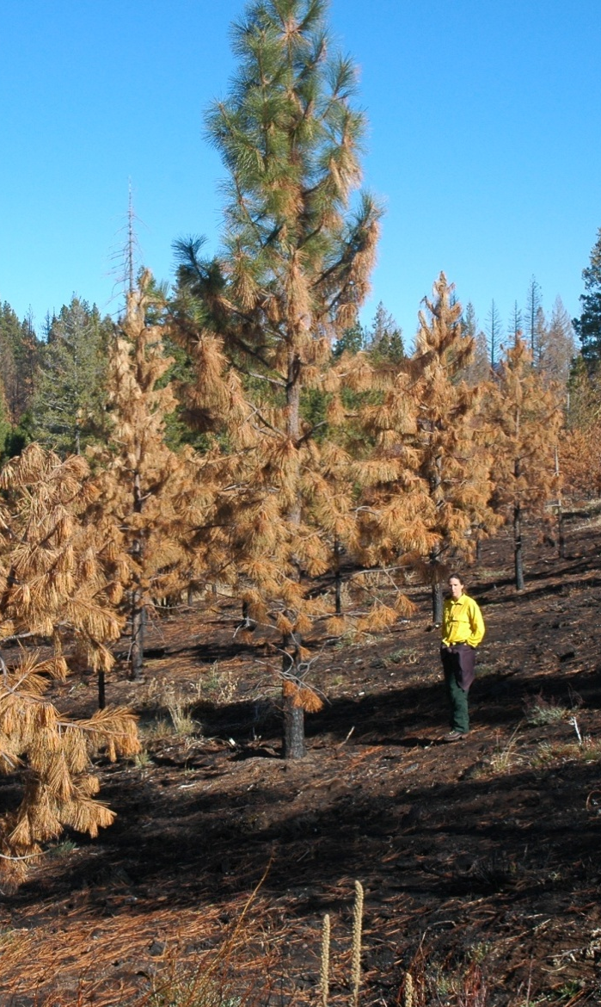
Mechanisms of tree mortality in young stands: crown scorch
Scorch height: isotherm of >140ºF for over 1 minute
(depends on ambient air temperature, fire intensity, wind speed)
Flame height
3 ft flames ~ 20 ft scorch height

Slide 16
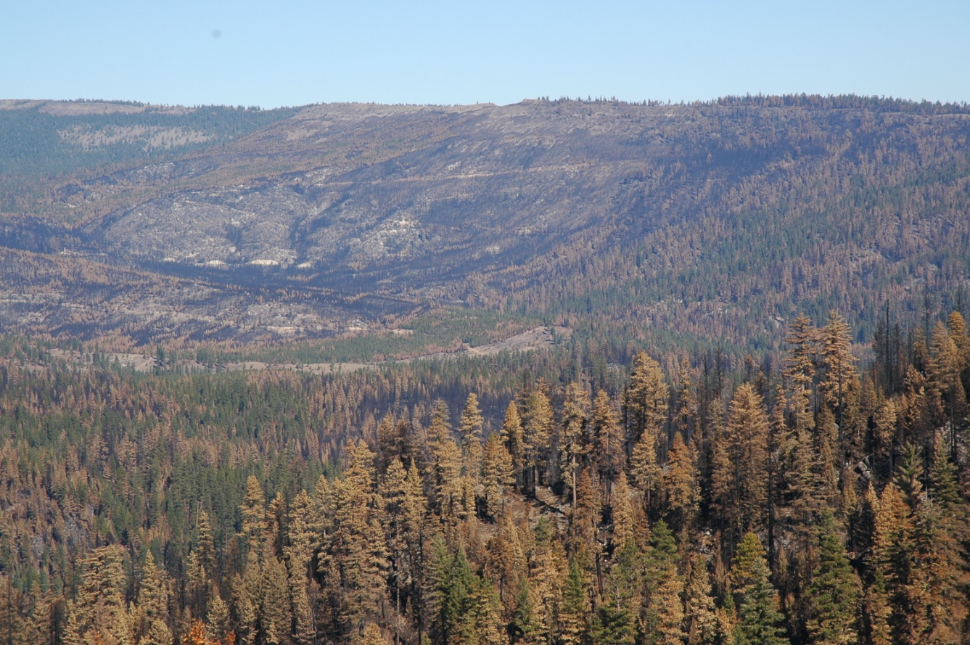
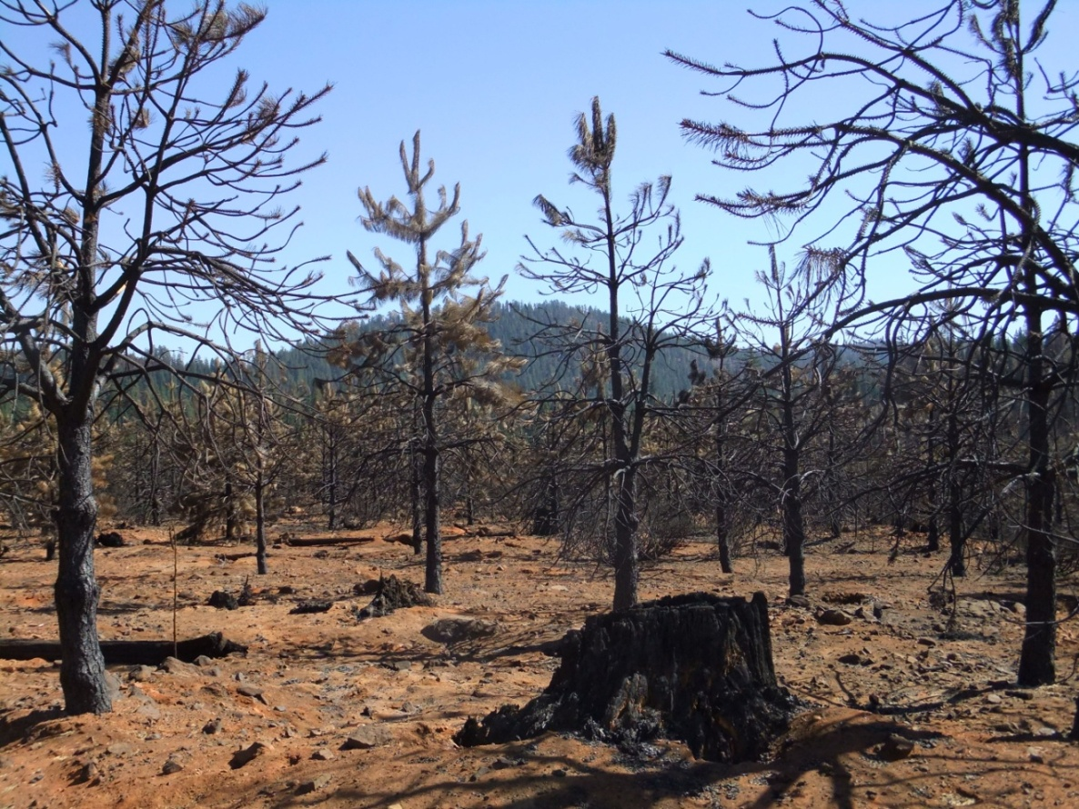
Torching and crown fire behavior
In CA forests, crown fire is typically fueled by heat from intense surface fire
Majority of mortality is caused by crown scorch, not crown fire

Slide 17
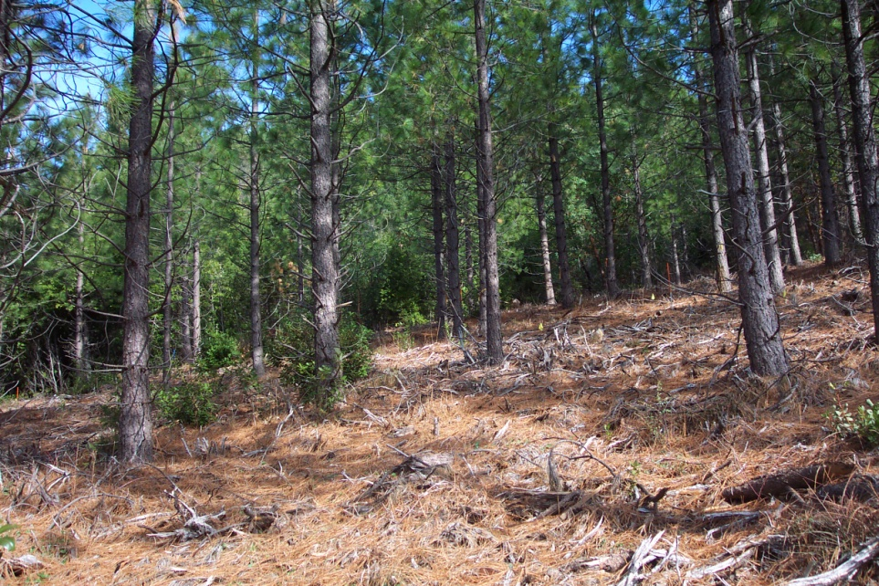
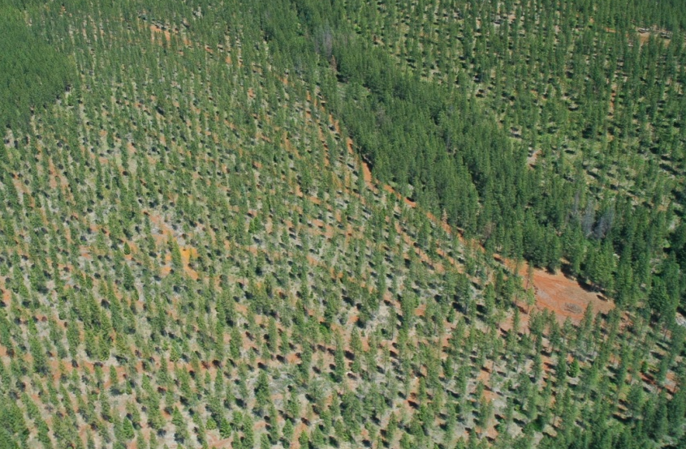
Structure of plantations can pose some challenges for wildfire resilience
Small tree size
Vertical and horizontal fuel continuity
  Even aged
  Even tree spacing

Slide 18
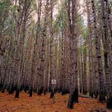
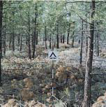
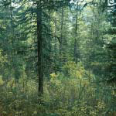
BehavePlus model to estimate flame length and crown scorch height in plantations with varying slope & wind
Timber litter
  Tl8 long needled pine litter
  Tl9 needle drape
Logging slash
  Sb2 moderate logging slash
  Sb3 heavy logging slash
Shrub understory
  Tu5 heavy load needles plus understory shrubs
  Sh5 shrubs 4-6 ft tall, covering >50% of area
Fine fuel moisture: 5 to 7% (dry but not extreme)
Air temperature: 85 ºF
Scott and Burgan 2005

Slide 19
Estimated scorch height (ft)
 | Wind spd: 0 mph |  |  |  | Wind spd: 5 mph |  |  |  | Wind spd: 10 mph
 | % slope |  |  |  | % slope |  |  |  | % slope
Fuel Type | 0 | 30 | 60 |  | 0 | 30 | 60 |  | 0 | 30 | 60
Needle litter | 6-10 | 11-18 | 21-35 |  | 17-35 | 20-39 | 27-52 |  | 21-48 | 23-51 | 27-59
Logging slash | 12-21 | 23-41 | 47-83 |  | 52-102 | 58-113 | 75-142 |  | 81-178 | 86-185 | 98-208
Litter + shrubs | 15-19 | 28-47 | 56-104 |  | 63-160 | 70-172 | 90-208 |  | 83-252 | 89-261 | 105-290
Probability of resilience
40 feet
High
Moderate
Very low

Slide 20
Estimated scorch height (ft)
 | Wind spd: 0 mph |  |  |  | Wind spd: 5 mph |  |  |  | Wind spd: 10 mph
 | % slope |  |  |  | % slope |  |  |  | % slope
Fuel Type | 0 | 30 | 60 |  | 0 | 30 | 60 |  | 0 | 30 | 60
Needle litter | 6-10 | 11-18 | 21-35 |  | 17-35 | 20-39 | 27-52 |  | 21-48 | 23-51 | 27-59
Logging slash | 12-21 | 23-41 | 47-83 |  | 52-102 | 58-113 | 75-142 |  | 81-178 | 86-185 | 98-208
Litter + shrubs | 15-19 | 28-47 | 56-104 |  | 63-160 | 70-172 | 90-208 |  | 83-252 | 89-261 | 105-290
Probability of resilience
High
20 feet
Moderate
Very low

Slide 21
Managing surface fuels to improve resilience
  Reduce activity fuels
    Avoid planting into slash
    When possible, remove debris from pre-commercial thinning or pruning
      Biomass
      Pile burning
    Prescribed fire
  Manage competing vegetation
    Hand removal to herbicides
      Important tool, but not “the” solution
      Stand does not need to be free of shrubs to be resilient
        Discontinuity is important

Slide 22
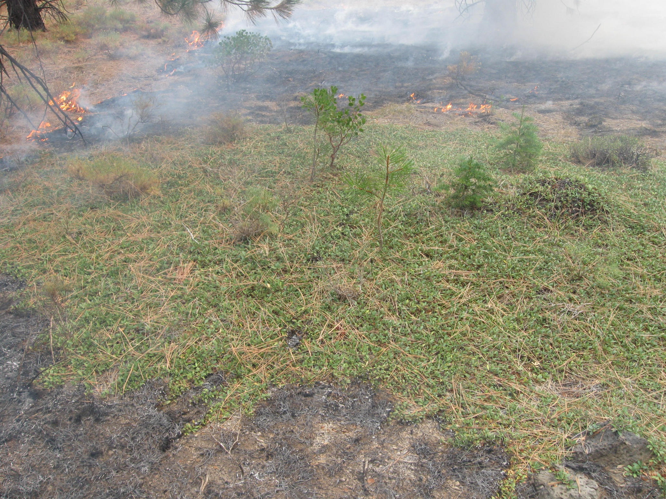
Not all shrubs are a fire hazard problem

Slide 23
Managing surface fuels to improve resilience (continued)
  Reduce rate of surface fuel accumulation
    Planting at lower density
    Thinning (less live biomass= less future litter and fine woody fuel)
++
+
Fuel loading
Fire intensity
Tree canopy cover
++
-
Shrub cover

Slide 24
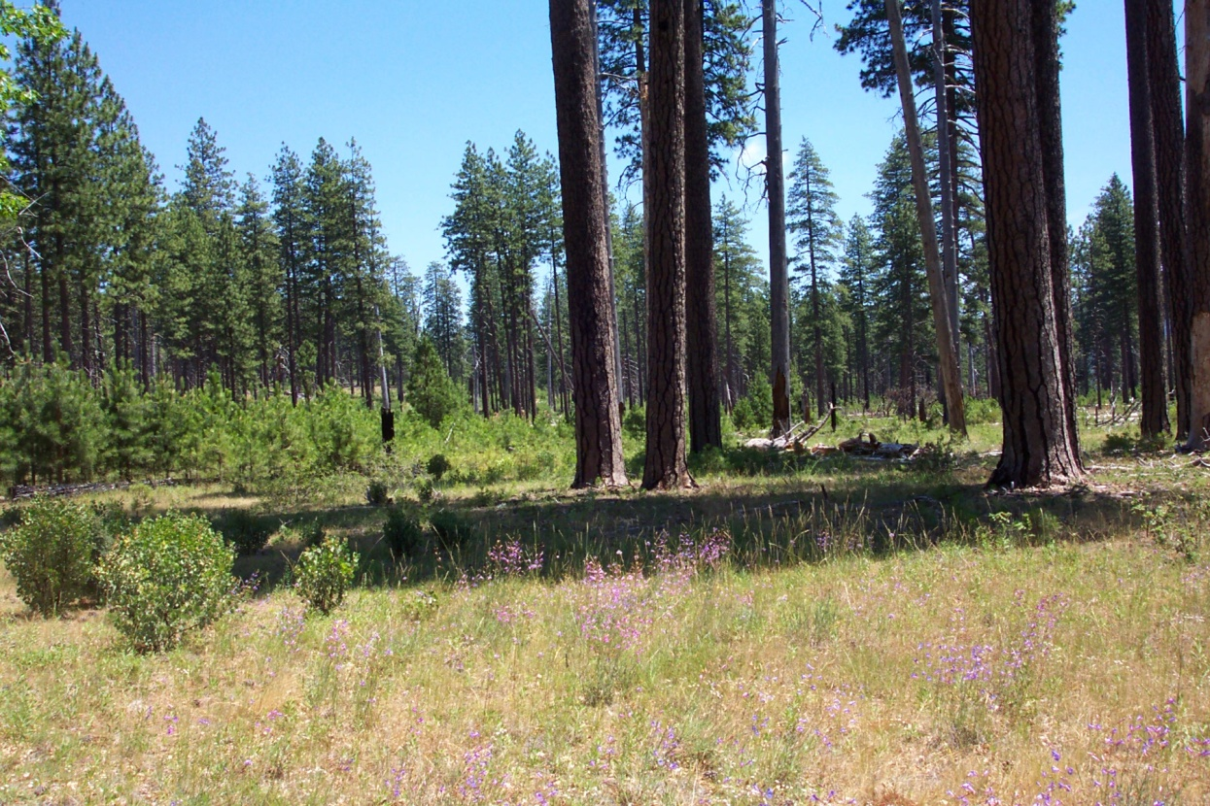
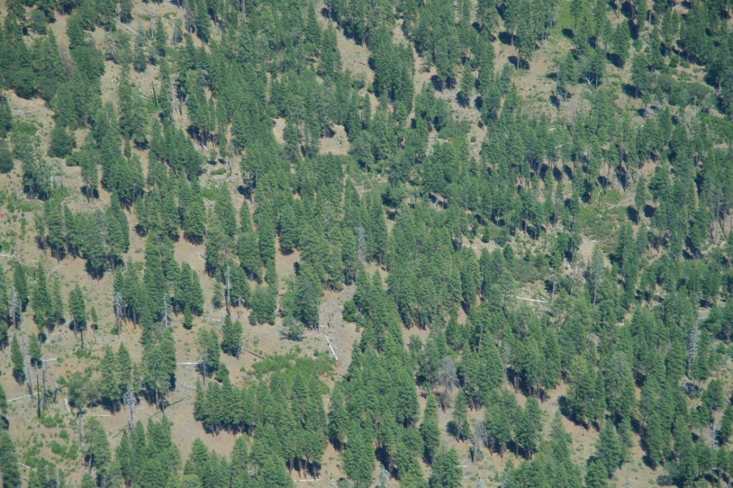
Fuel continuity
Learning from fire-resilient structures:
Beaver Creek Pinery, Lassen NF

Slide 25
The good news:
Just about any forest structure can made resilient to wildfire by managing the surface fuels
  Must be done in a way appropriate for that structure and position on the landscape

Slide 26
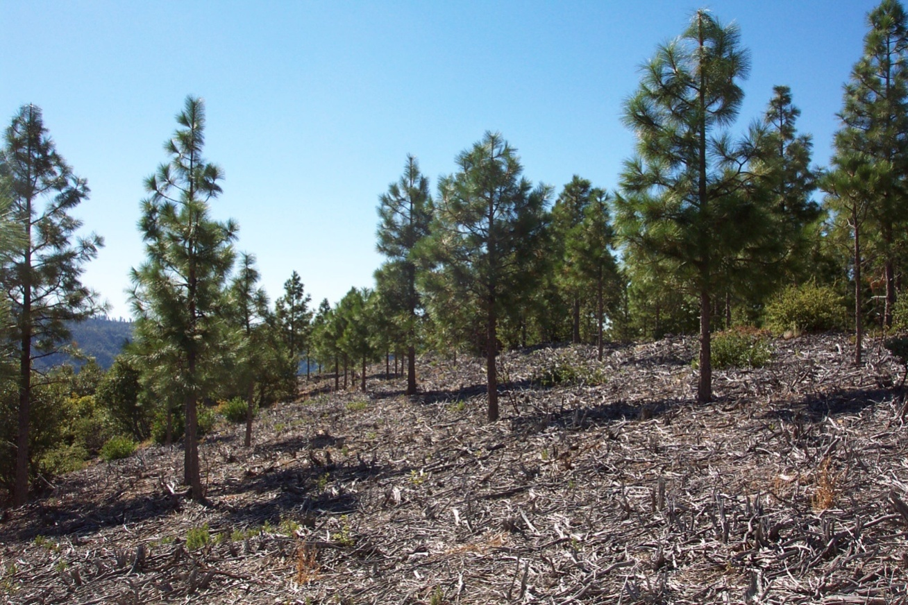
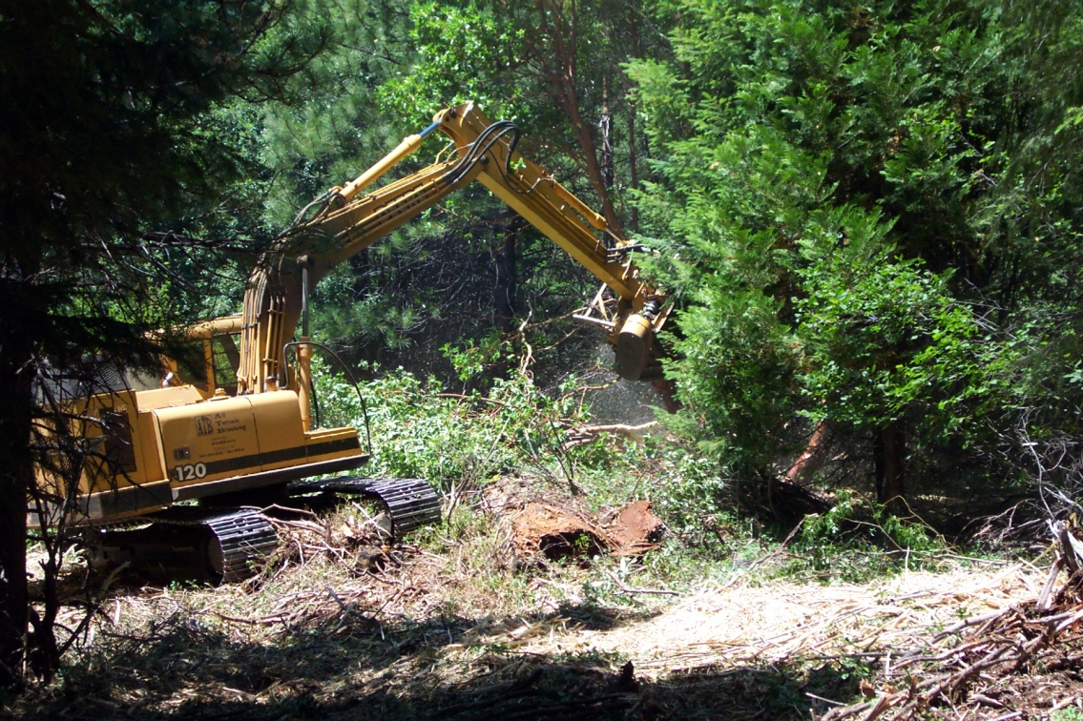
Fuel mastication
  Fuel rearrangement, not fuel reduction
    Fuelbed compression changes rate of spread, flame length

Slide 27
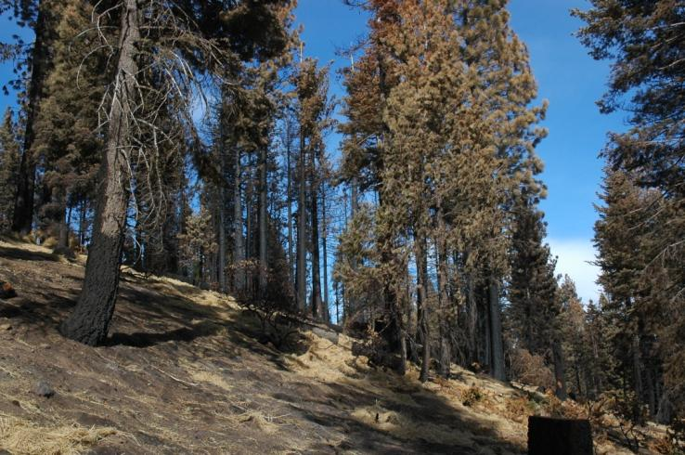
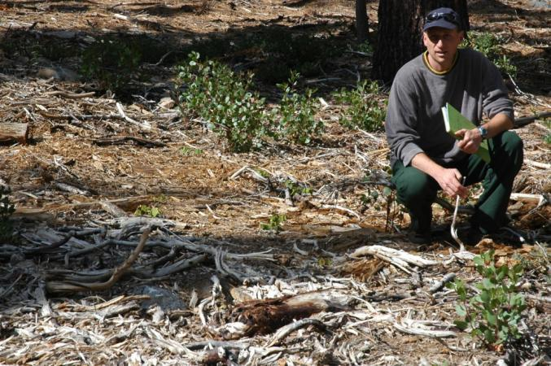
Little Washoe Fire, Lake Tahoe Basin
August 18, 2007
(Masticated July/Aug. 2006)
Slow spread in masticated unit helped firefighters to contain the fire
Heat killed most overstory trees
Photos taken 9/2007

Slide 28
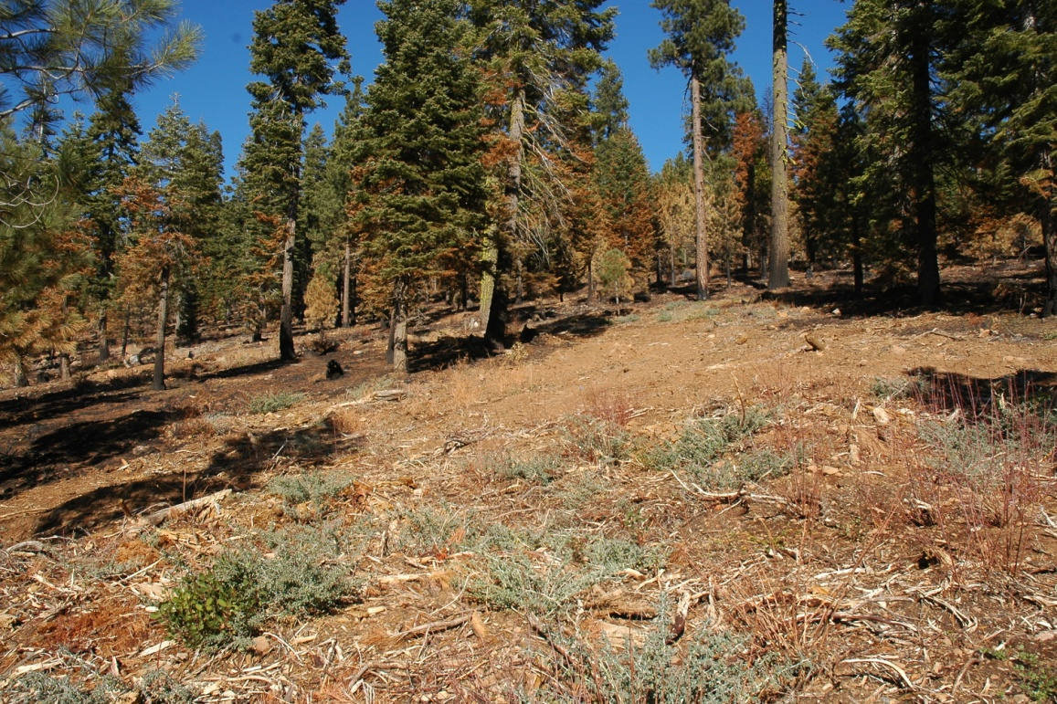
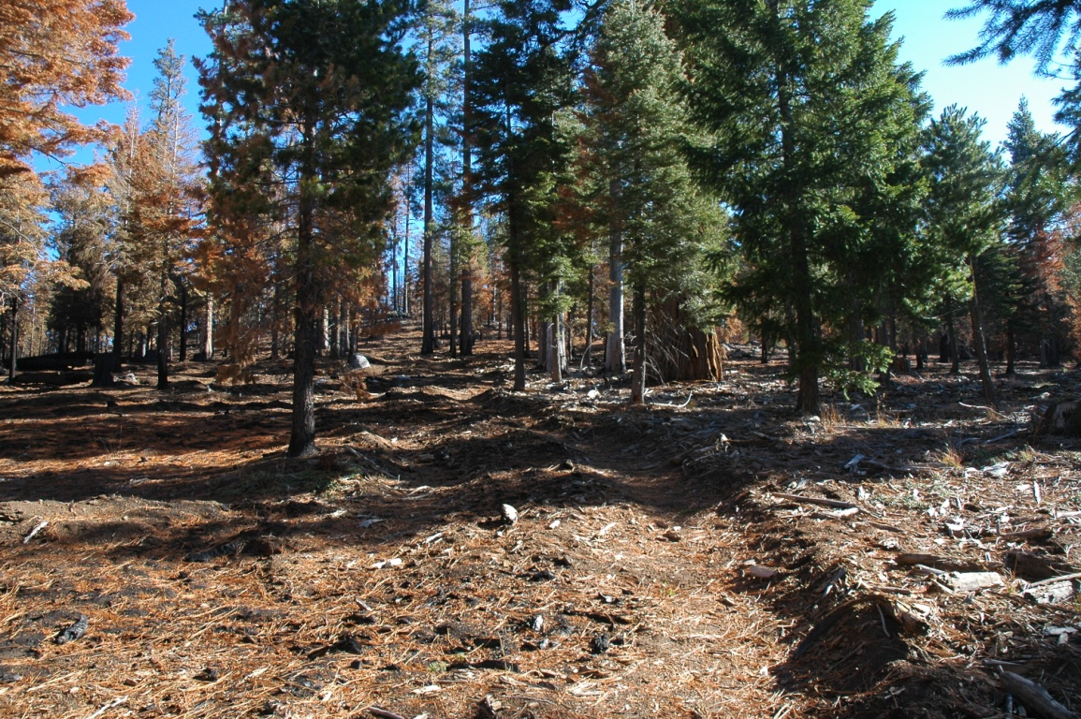
Mastication and future fire behavior/effects: Moonlight Fire (2007)
Mixed effects
Some units had low tree mortality
Some units had high tree mortality
Masticated units aided in fire line construction

Slide 29
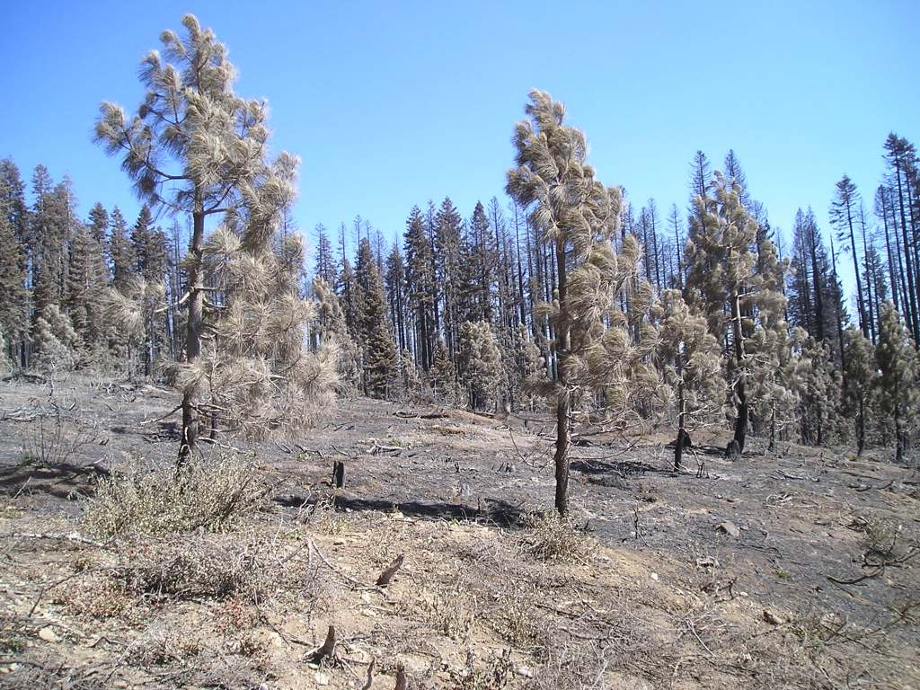
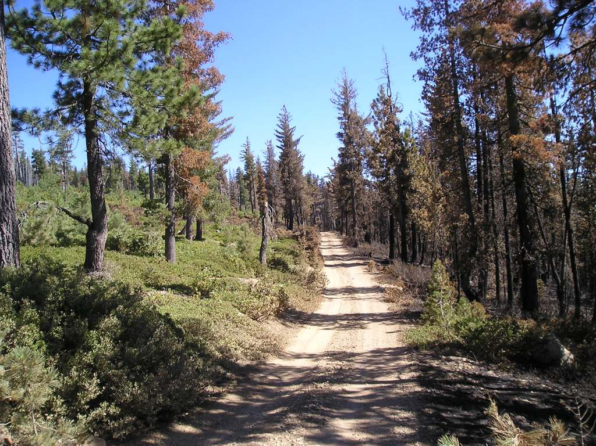
Mastication and future fire behavior/effects: American Complex
Photos: Hugh Safford
Masticated in 2007
Plantation on left unmasticated
Burned July 9, 2008

Slide 30
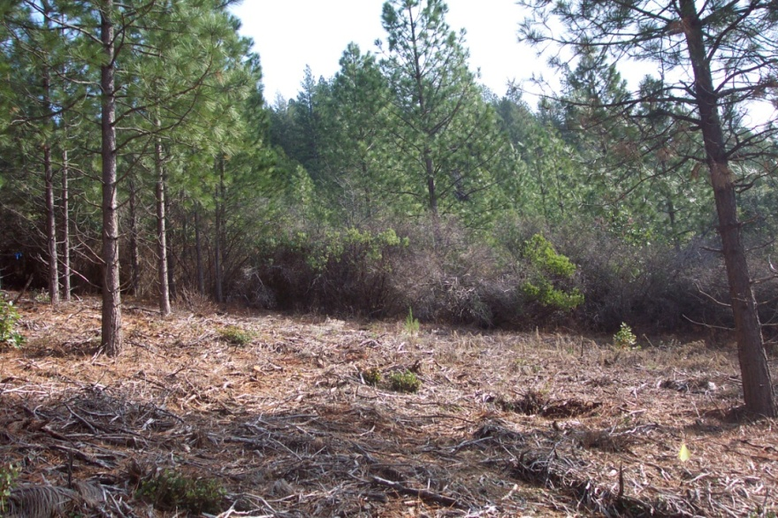
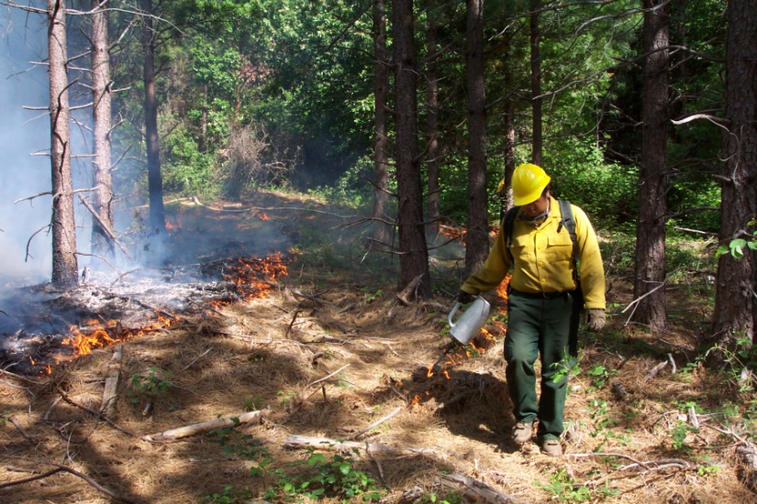
Mastication and fire effects - summary
Fire behavior
  Lower flame lengths, rate of spread, but higher residence time
  Live fuel converted to dead; more total fuel may be consumed
Can aide firefighting, but generally does little to improve resilience to wildfire
Prescribed fire may be easier to apply

Slide 31
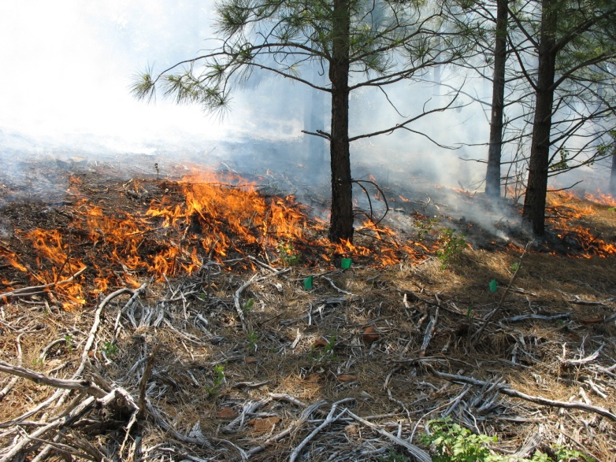
Prescribed burns with masticated fuels in young stands
 | Slope º | Survival (%)
Challenge 1 | 8 | 91
Challenge 2 | 5 | 76
Challenge 3 | 12 | 9
Challenge 4 | 11 | 85
Whitmore 1 | 2 | 90
Whitmore 2 | 1 | 100
Whitmore 3 | 5 | 95
Whitmore 4 | 7 | 91

Slide 32
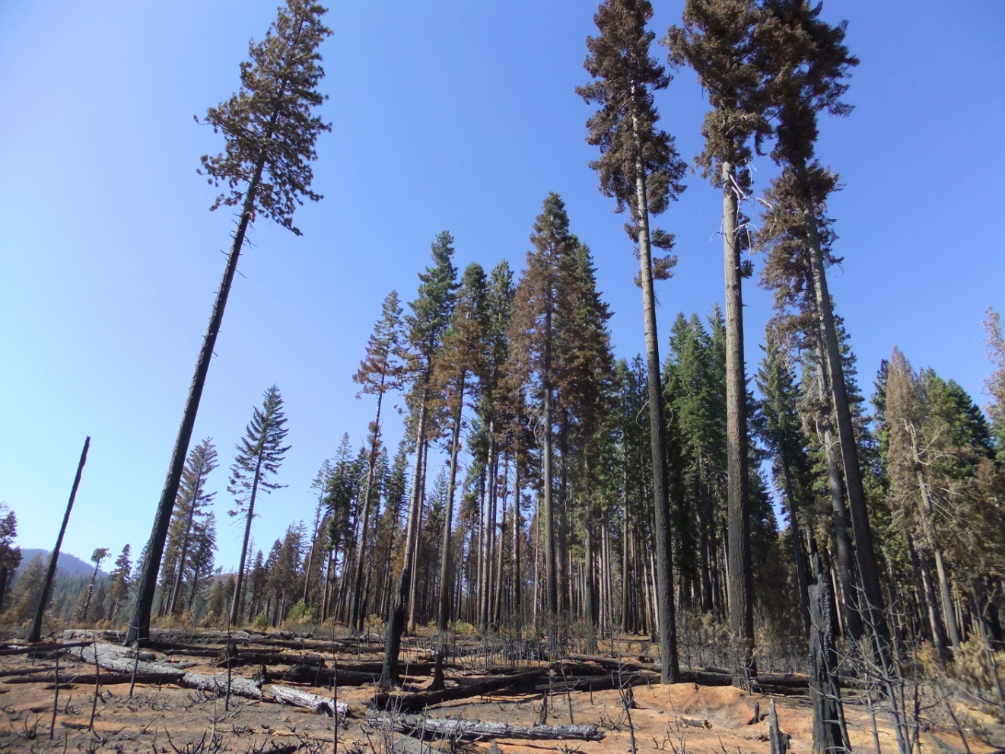
Edge effects: what if fuels in neighboring stands are not managed?

Slide 33
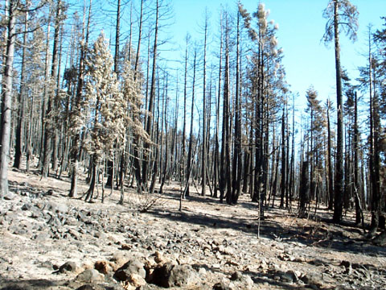
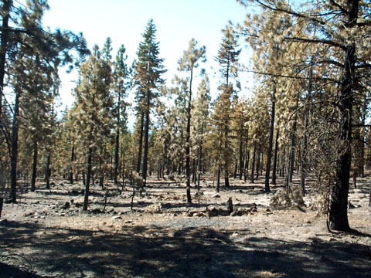
Cone Fire
Thinned with no prescribed burn
Unthinned
No fuels treatment
Back-to-back photos
Across treatment boundary

Slide 34
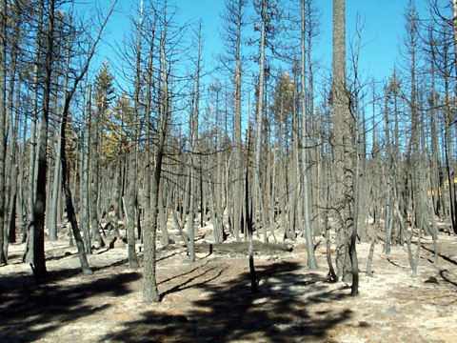
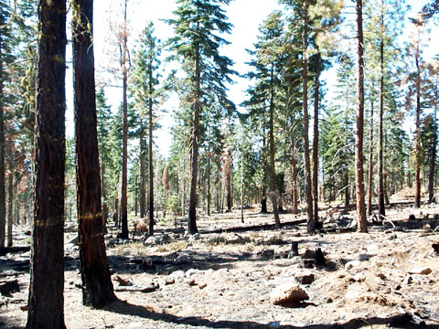
Cone Fire
Thinned
with prescribed burn
Unthinned
No fuels treatment
Back-to-back photos
Across treatment boundary

Slide 35
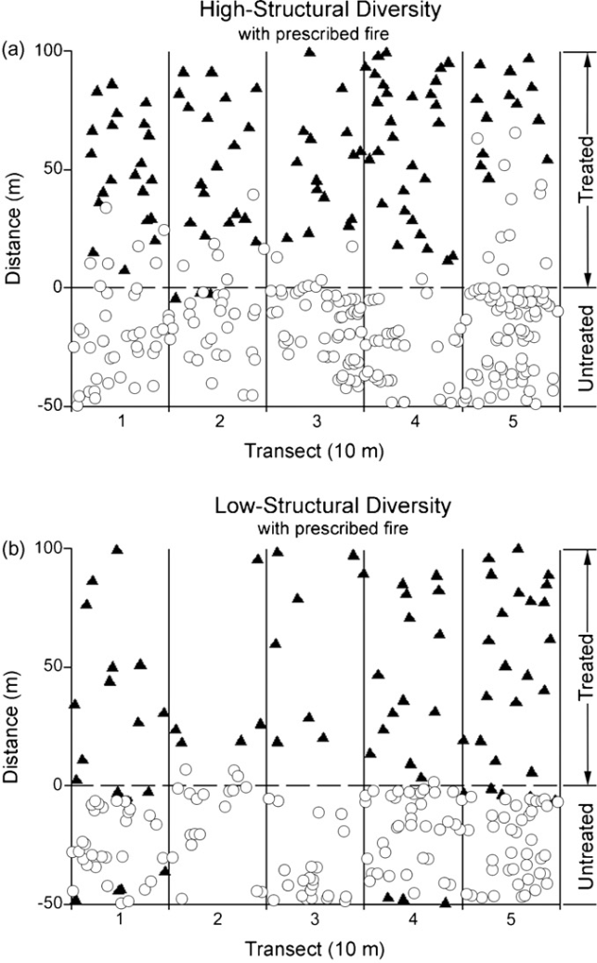
Poor survival first 30 ft; nearly 100% survival 80 ft from treatment boundary
Nearly 100% survival 30 ft from treatment boundary
Ritchie et al. 2007. Forest Ecology and Management 247: 200-208

Slide 36
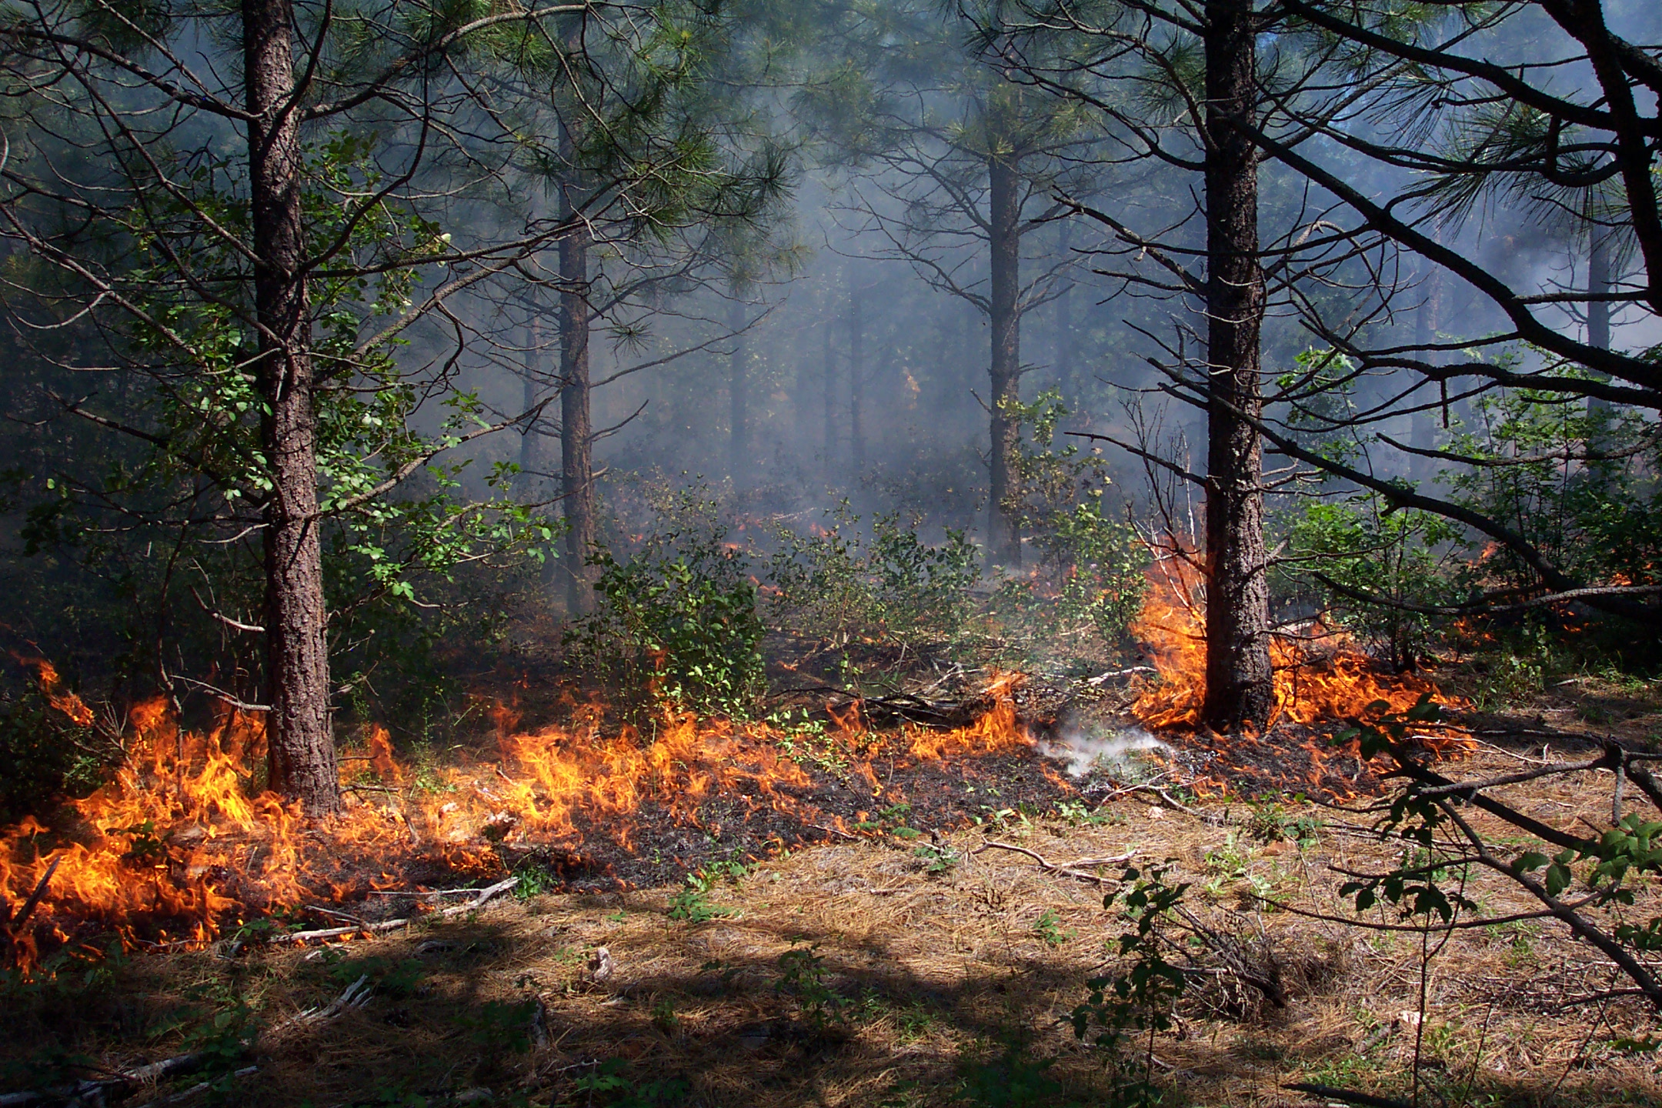
Conclusions
Keeping surface fuels low is key to wildfire resilience, especially in young stands
All treatments that reduce surface fuels or slow the build-up of fuels will help
No fuel treatment improves resilience to wildfire better than prescribed fire
Given fire activity trends, long-term benefits of treating fuels may increasingly outweigh costs

