Slide 1
Fuels Management: Historical Perspective
Carl N. Skinner
Geographer
USDA Forest Service
Pacific Southwest Research Station
Redding, CA
PSW
Notes:
Fuels Management: Historical Perspective

Slide 2
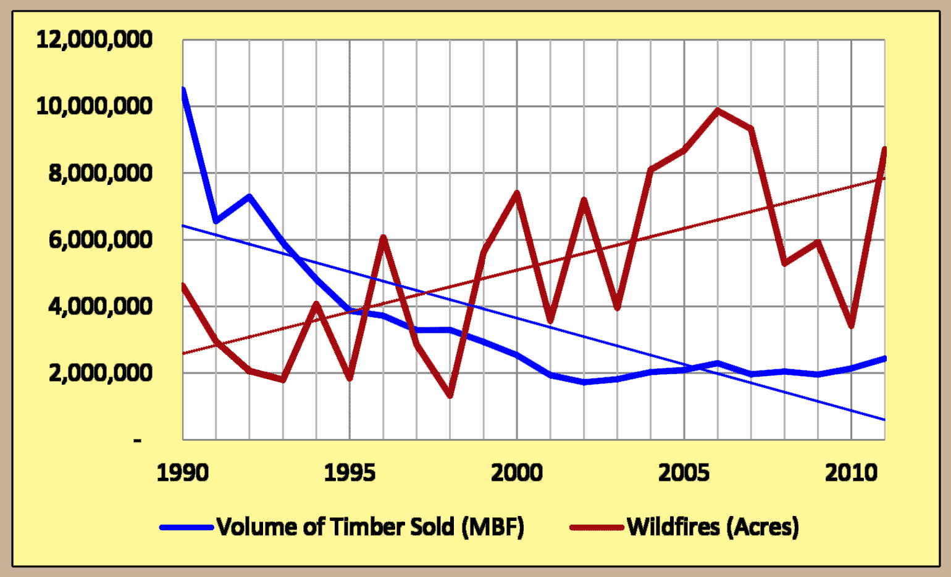
Forest Service Timber Sales vs. Total Acres of Wildfire Since 1990
WFLC
2012
Notes:
Wildfire Area vs Volume of Timber Sold

Slide 3
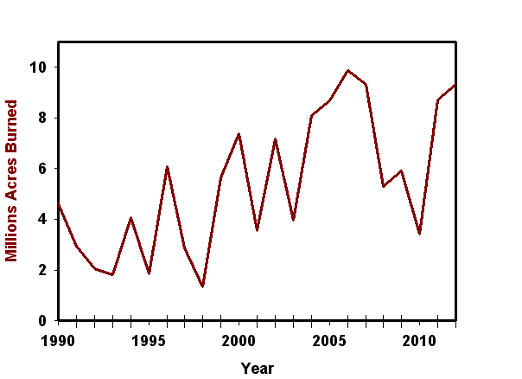
Notes:
Wildfire Area Burned

Slide 4
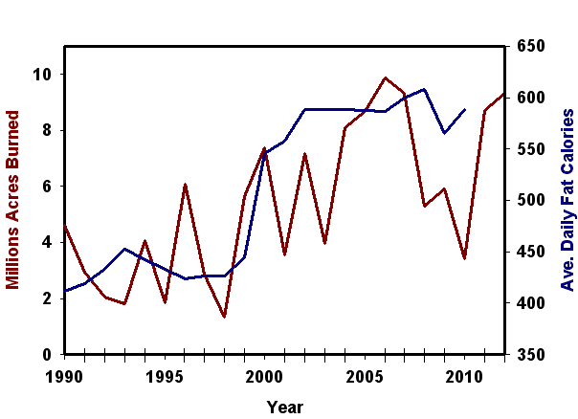
Notes:
Wildfire Area vs Average Daily Fat Calories Consumed by Americans

Slide 5
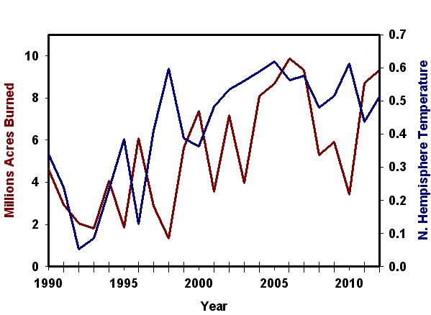
Notes:
Wildfire Area vs Average Daily Fat Calories Consumed by Americans

Slide 6
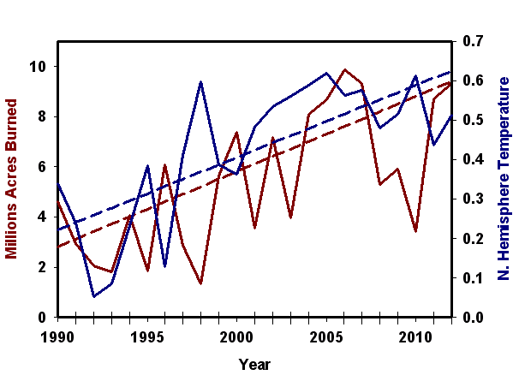
Notes:
Wildfire Area vs Average Daily Fat Calories Consumed by Americans

Slide 7
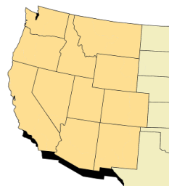
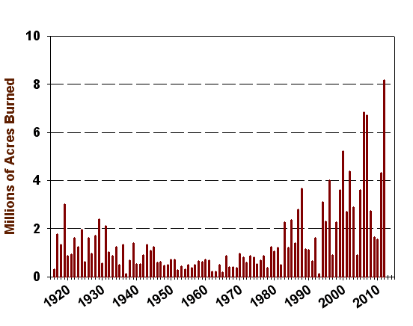
Annual Area Burned Western States
From: Arno & Allison-Bunnell 2002 (1915 to 2000) &
National Interagency Fire Center http://www.nifc.gov/fire_info/fire_stats.htm
Notes:
Trend in annual area burned in 11 western states.

Slide 8
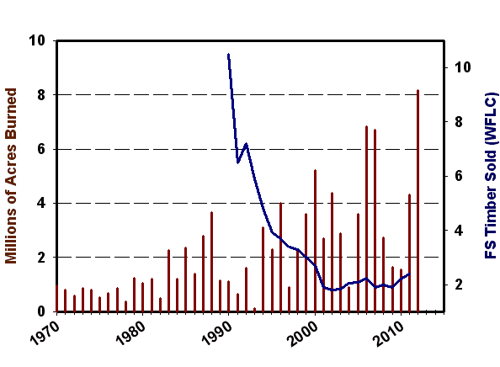
Annual Area Burned Western States
From: Arno & Allison-Bunnell 2002 (1915 to 2000) &
National Interagency Fire Center http://www.nifc.gov/fire_info/fire_stats.htm
Notes:
Trend in annual area burned in 11 western states vs. FS timber sold according to WFLC

Slide 9
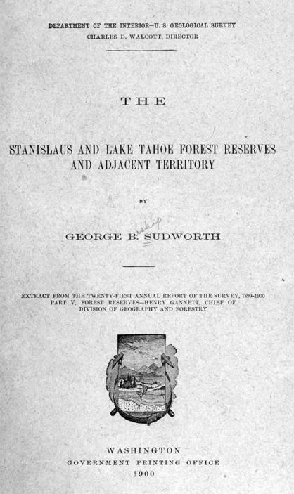
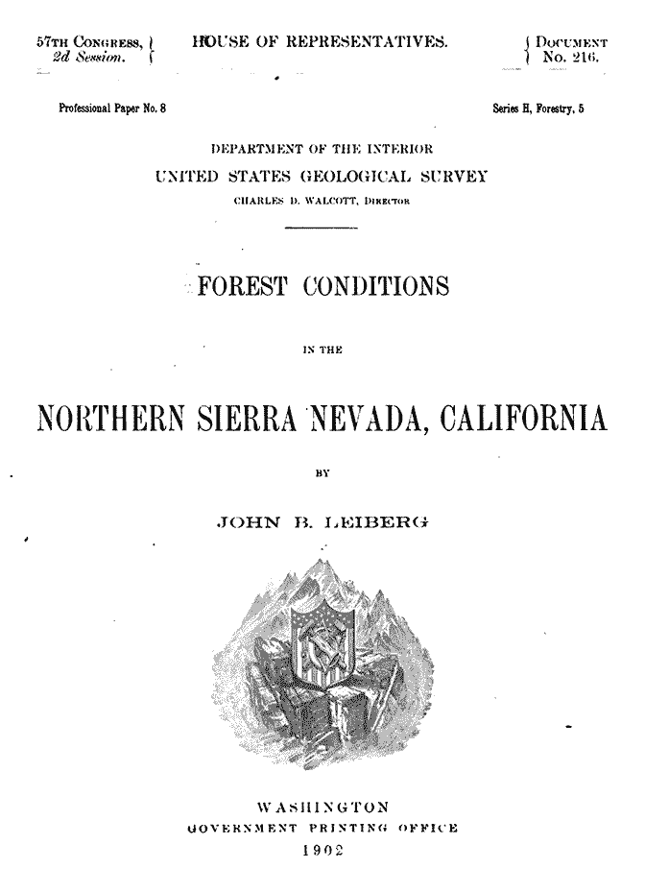
Notes:
Covers: Sudworth & Leiberg

Slide 10
“The fires of the present time are peculiarly of a surface nature, and with rare exception there is no reason to believe that any other type of fire has occurred here.”
George B. Sudworth
1900
Stanislaus and Lake Tahoe Forest Reserves, California, and adjacent territories.
21st Annual Rept. of the U.S.G.S., Part 5, pp. 505-561, US Govt. Printing Office, Washington, D.C.
Notes:
Sudworth on fire intensity

Slide 11
“Barring the debris left from timber-cutting, the only food for these fires is the scanty fall of pine and fir needles, irregular patches of low conifer seedlings, and chaparral.”
George B. Sudworth
1900
Stanislaus and Lake Tahoe Forest Reserves, California, and adjacent territories.
21st Annual Rept. of the U.S.G.S., Part 5, pp. 505-561, US Govt. Printing Office, Washington, D.C.
Notes:
Sudworth on fuels in the forests

Slide 12
“The instances … where large timber has been killed outright … are comparatively rare. Two cases only were found… One of these burns involved less than an acre, and the other included several hundred acres.”
George B. Sudworth
1900
Stanislaus and Lake Tahoe Forest Reserves, California, and adjacent territories.
21st Annual Rept. of the U.S.G.S., Part 5, pp. 505-561, US Govt. Printing Office, Washington, D.C.
Notes:
Sudworth on fuels in the forests

Slide 13
“The most potent factor in shaping the forest of the region has been, and still is, fire. The general character of the forest, ... in fact almost every phase of its condition has been determined by ... fire.”
J. B. Leiberg
1902
Forest conditions in the northern Sierra Nevada, California.
Professional Paper 8, Series H, Forestry, 5.
US Geological Survey, GPO, Washington, D.C.
Notes:
Leiberg on importance of fire in shaping forests

Slide 14
“Fires … have been ground fires, and easily controlled. A trail will sometimes stop them.”
R.B. Wilson
1904
Township descriptions of the lands examined for the proposed Trinity Forest Reserve, California.
US Department of Agriculture, Bureau of Forestry, Washington, D.C.
Notes:
Said about the township in the Hayfork watershed where Taylor & Skinner (2003) reconstructed fire and stand history.

Slide 15
“Of the hundreds of persons who visit the Pacific slope in California every summer to see the mountains, few see more than the immediate foreground and a haze of smoke which even the strongest glass is unable to penetrate.”
C. Hart Merriam
1898
Chief, Division of Biological Survey
From: Morford 1984
Notes:
Historical perspective on “pristine” air quality and smoke conditions.

Slide 16
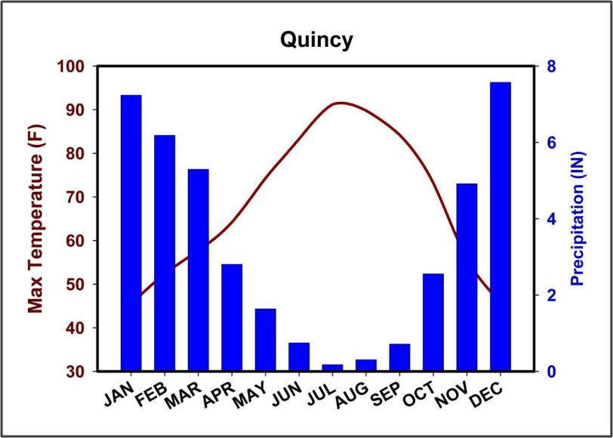
Mediterranean Climate
Notes:
Typical chart of precip and temp in montane Mediterranean California.

Slide 17
33 Fire Scars
Notes:
Jeffrey pine in Sierra Nevada with 33 fire scars.

Slide 18
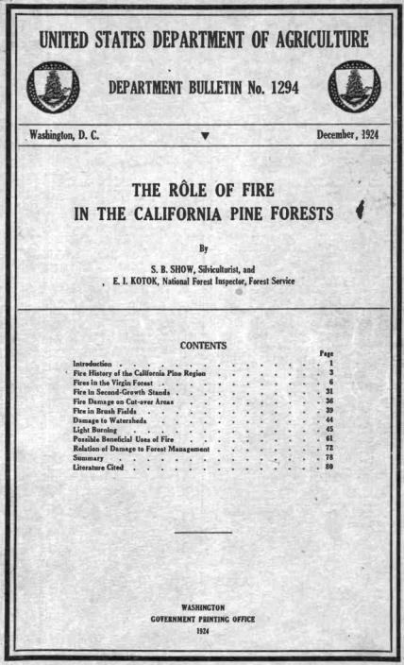
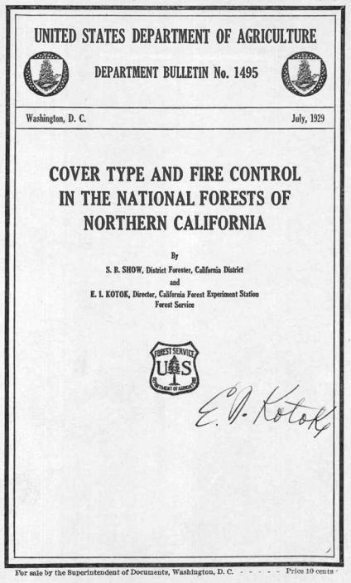
Notes:
Show & Kotok: Important historical papers

Slide 19
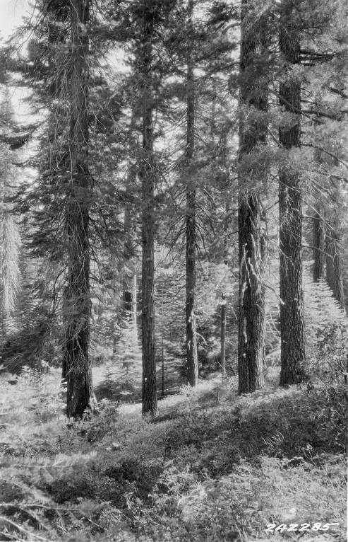
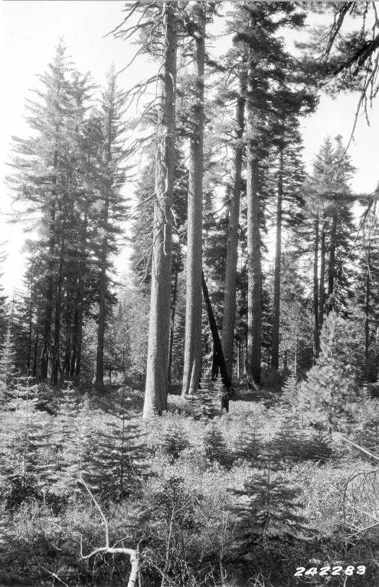
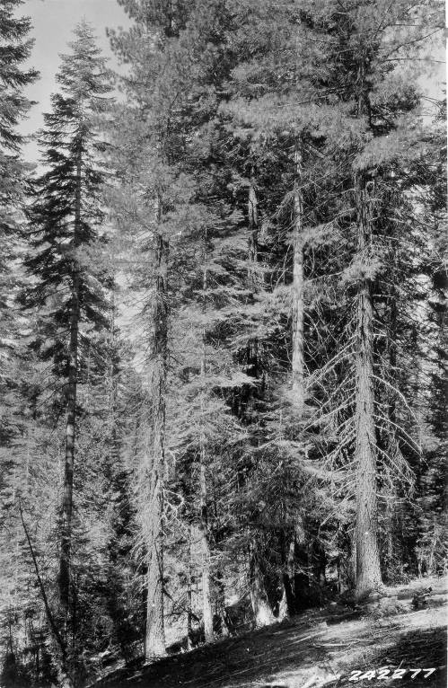
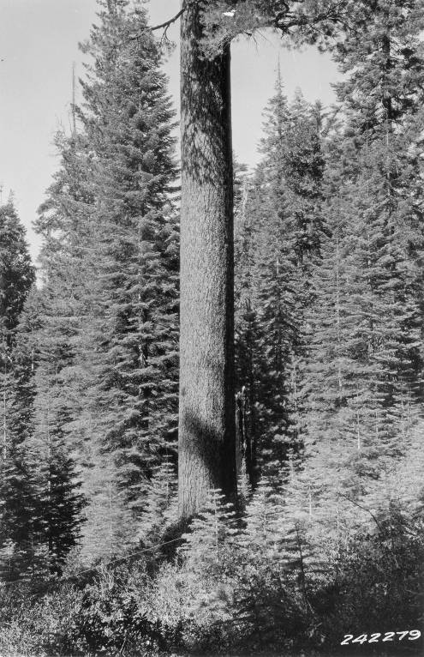
Stanislaus NF - 1929
“The virgin forest is uneven-aged, or at best even-aged by small groups, and is patchy and broken; hence it is fairly immune from extensive devastating crown fires.”
“fire creates a patchy scattered distribution of reproduction”
(Show and Kotok 1924)
Knapp et al. 2013
Notes:
E. Knapp study at STEF

Slide 20
Notes:
Diversity of conditions in pre-fire suppression forests.

Slide 21
Notes:
Beaver Creek Pinery aerial view. Overlain by aerial view of the STEF.

Slide 22
1st Fire Scar
History
Too Much Fire!
Notes:
Show & Kotok fire history – conclusion: Too much fire! Need to exclude fire!

Slide 23
Characteristic Fire Type
Crown Fires
Chaparral
Brush
Surface Fires
Grass
Woodland
Western Yellow Pine
Mixed Conifer
Douglas-fir
Ground Fires
Sugar Pine – Fir
Fir
Notes:
Show & Kotok: characteristics of fire in the absence of logging

Slide 24
If fire exclusion is going to work,
there needs to be a concerted effort to deal with logging slash.
Notes:
Show & Kotok: characteristics of fire in the absence of logging

Slide 25
Priorities for Fuels Assessments Stand Scale
Surface Fuels
Ladder Fuels
Crown Fuels
Maintain Large Fire Resistant Trees
Agee & Skinner 2005
Basic principles of forest fuel reduction treatments.
Forest Ecology & Management 211: 83-96
Notes:
Fuel layers and priorities for treatment

Slide 26
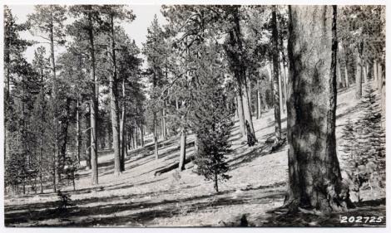
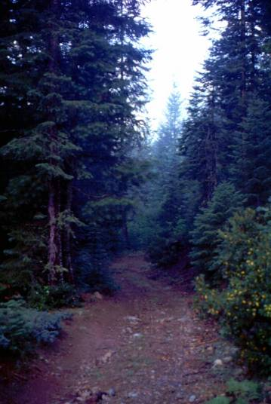
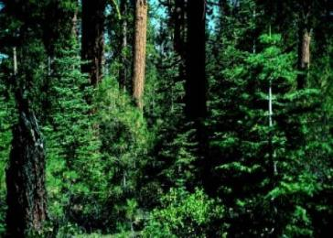
Stand Structure & Species Composition Changes over 20th Century
Notes:
Change in forest conditions: BMEF

Slide 27
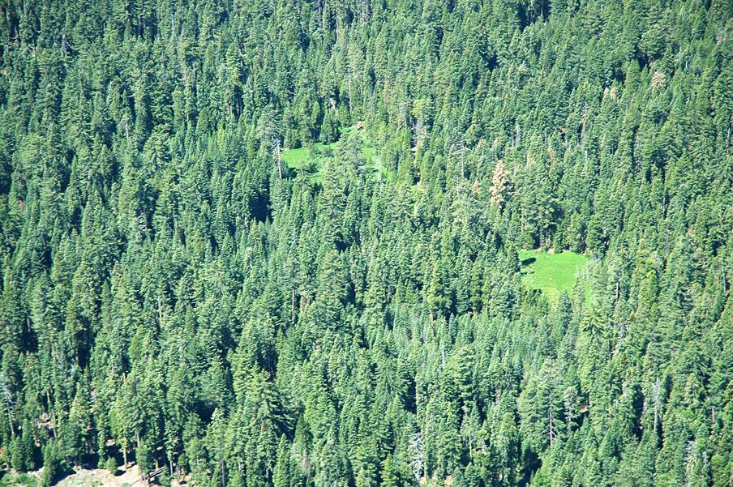
Notes:
Beaver Creek Pinery aerial view. Overlain by aerial view of the STEF.

Slide 28
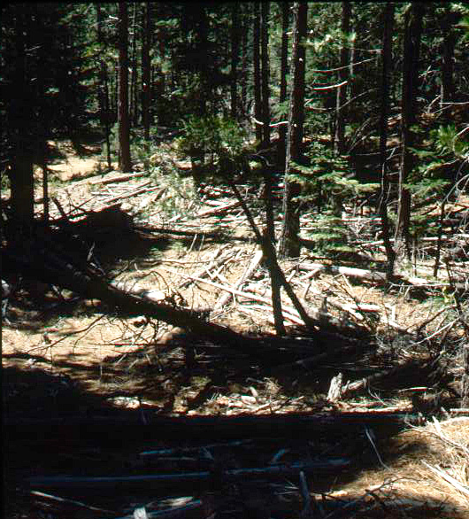
Traditional
Historical
Logging
Remove the large trees
Leave the small trees
Treat as little slash as you can get away with
Notes:
Fuel conditions following logging – Sacramento River watershed above Lake Siskiyou

Slide 29
Extra Crews
Notes:
Fuel conditions following logging – Hat Creek area

Slide 30
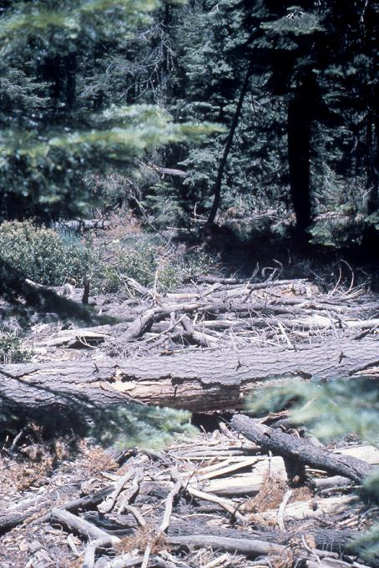
Policy:
No Increase
In
Fire Hazard
Arguing Over
Sticks
Notes:
Fuel conditions following logging – Mosquito Ridge north of Shasta Lake

Slide 31
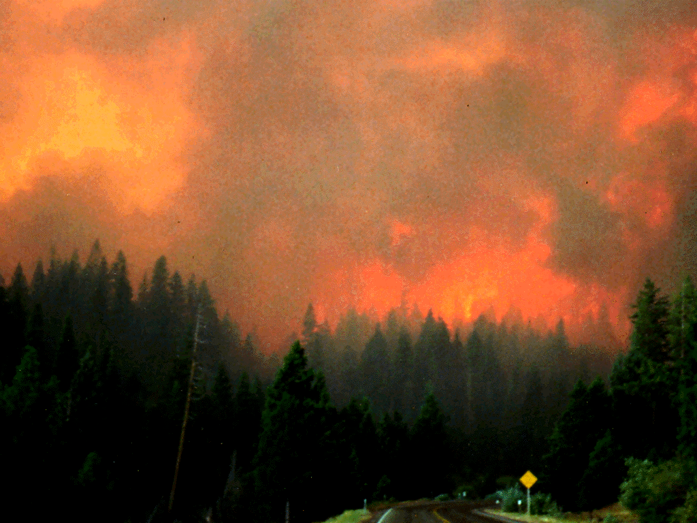
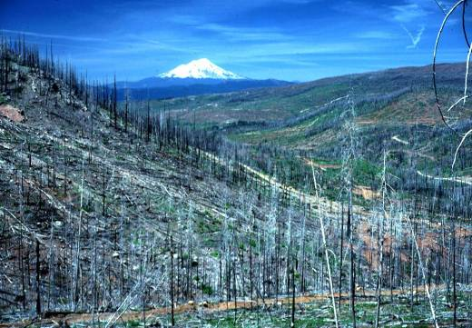
1992
1982
1994
Notes:
Hatchet Mt and Fountain Fire area

Slide 32
SNEP 1996
Critical Findings
Effects of Logging
Timber harvest, through its effects on forest structure, local microclimate, and fuel accumulation, has increased fire severity more than any other recent human activity.
However, logging can serve as a tool to help reduce fire hazard when slash is adequately treated and treatments are maintained.
Notes:
SNEP Critical Finding on Effects of Logging – Page 4 of SNEP Summary

Slide 33
Thank You!
For more information:
California Fire Science Consortium
http://www.cafiresci.org/
TreeSearch
http://www.treesearch.fs.fed.us/
PSW Research Station
http://www.fs.fed.us/psw/
PSW
Notes:
Prescribed fire in the Blacks Mountain Research Natural Area

