Slide 1
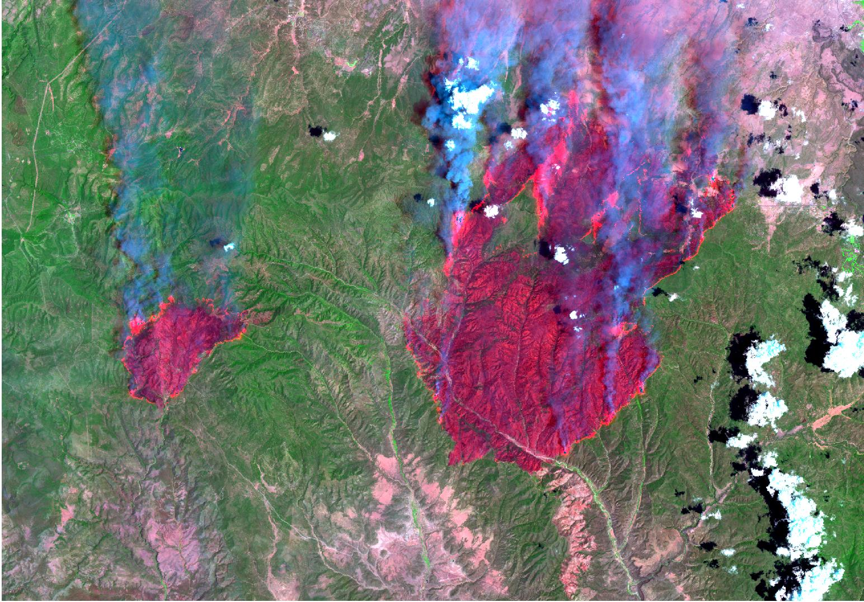
Landscape Fuel Management and Risk Reduction
Mark A. Finney
Charles W. McHugh
Karen C. Short
Rocky Mountain Research Station
Fire Sciences Laboratory
Missoula, Montana

Slide 2
Main Points
Historical Perspective: less burning now than in history (settlement) and pre-history
Changes in fuel/vegetation conditions (continuity) have resulted
Modern fires & behavior: even with suppression, fire is inevitable
What can we do about it?

Slide 3
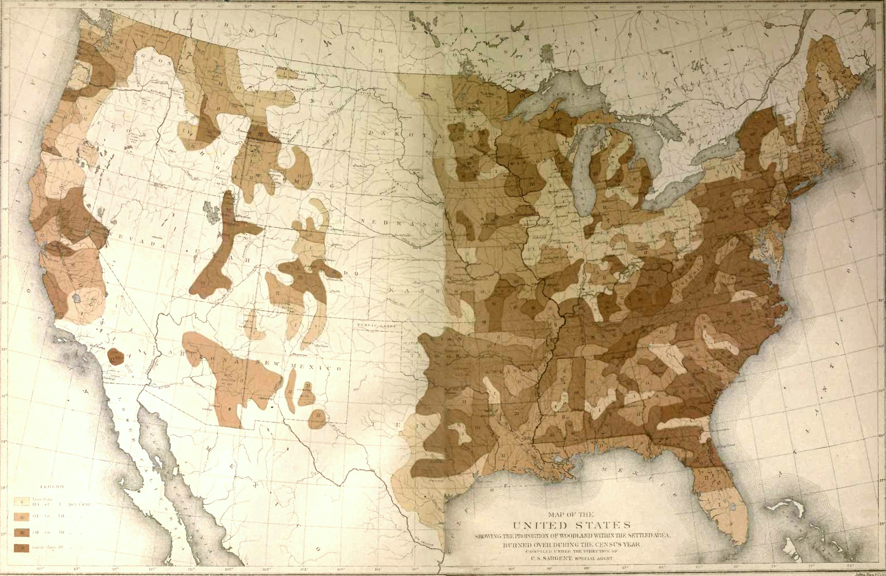
Proportion of Woodland Within Settled Area Burned Over During the Census Year 1880
Sargent, C.S. 1884. Report of the Forests of North America (Exclusive of Mexico).
0-0.1 %
0.1-1.0%
1.0-10.0
%>10%

Slide 4
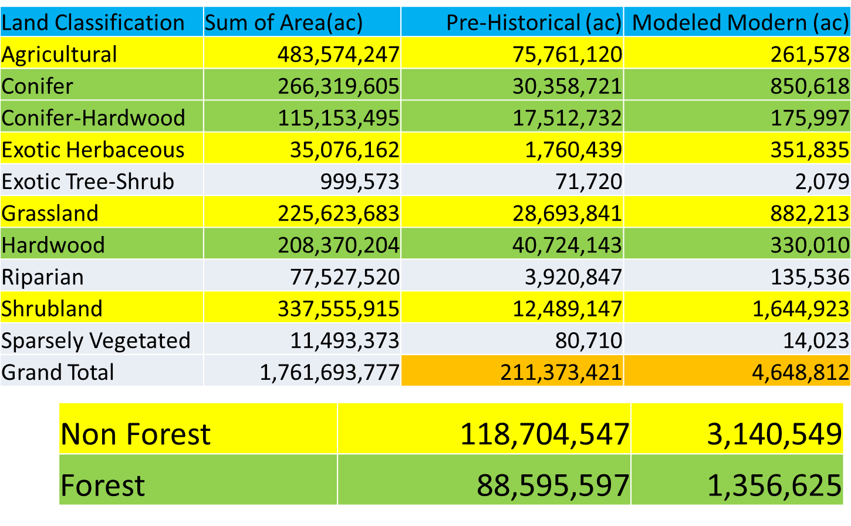
Comparison of Modeled Annual Burn Rates

Slide 5
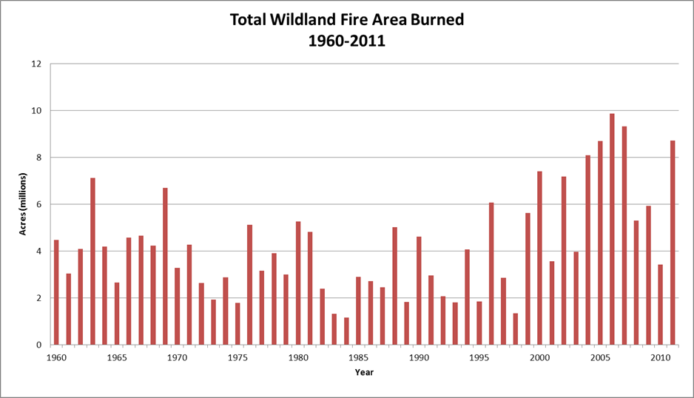
Modern Average ~ 4.8 million acres/year

Slide 6
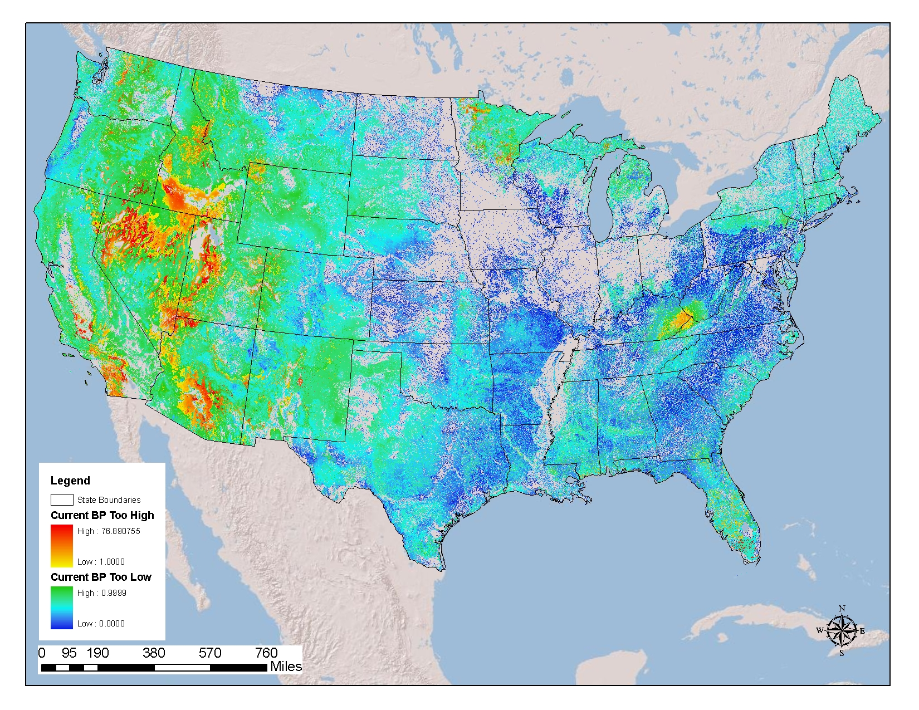
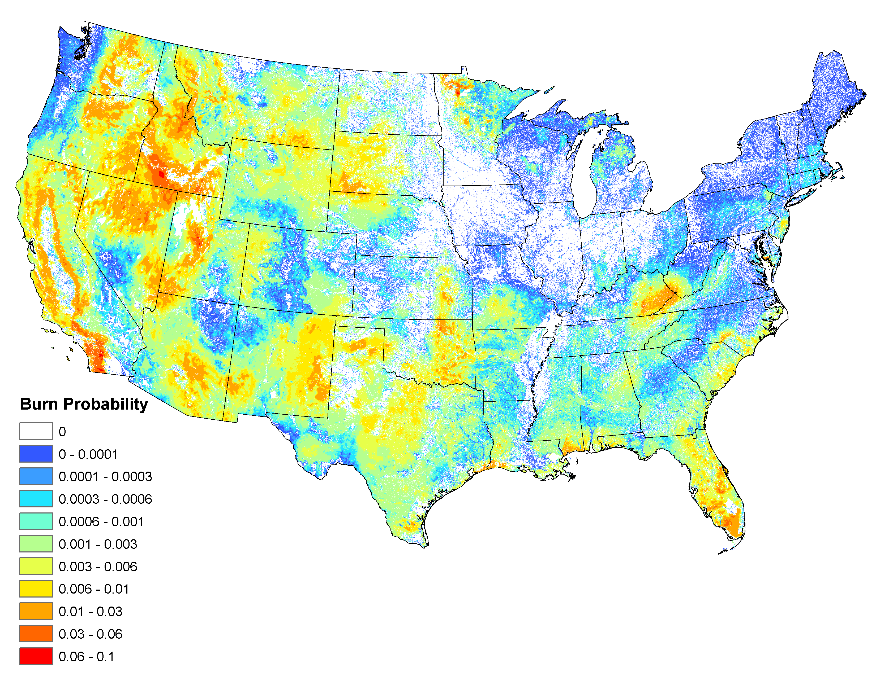
Ratio of Modeled/Historical Burn Probability

Slide 7
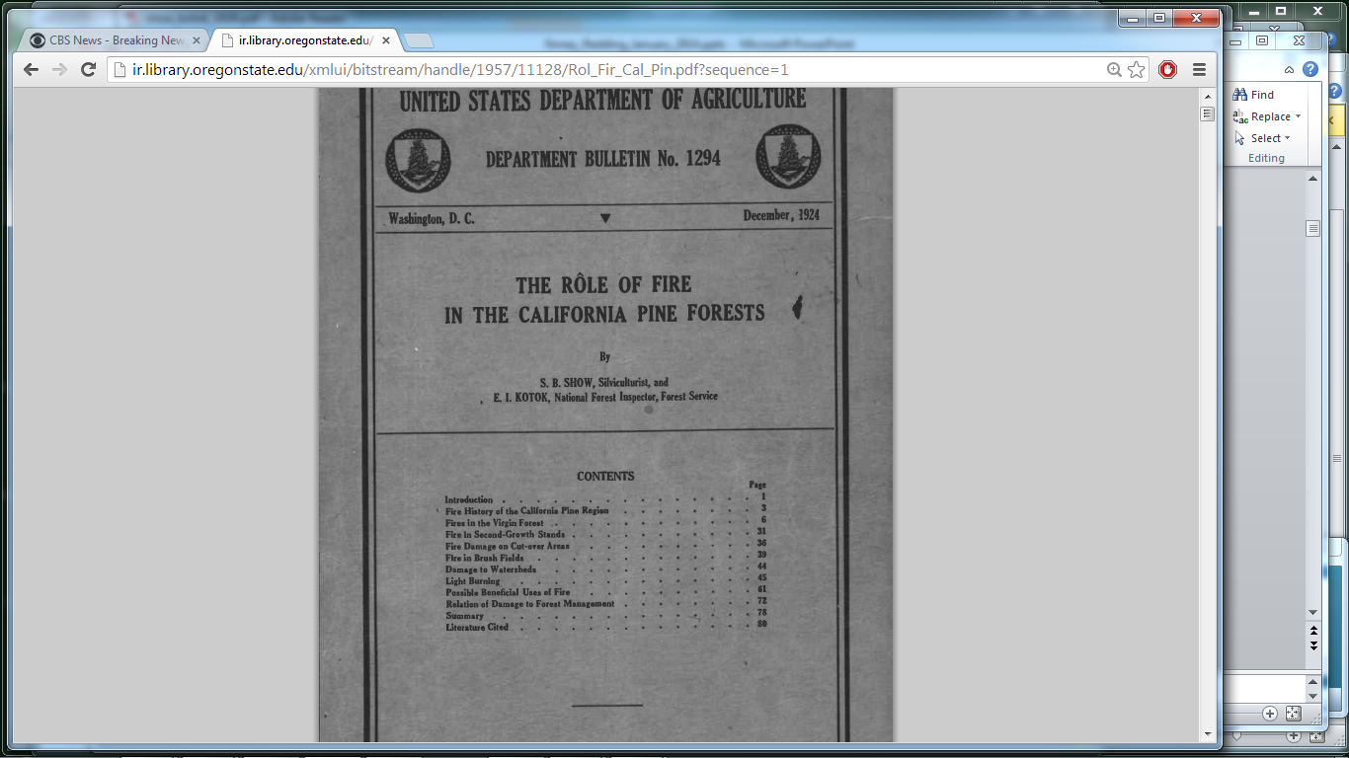

Slide 8
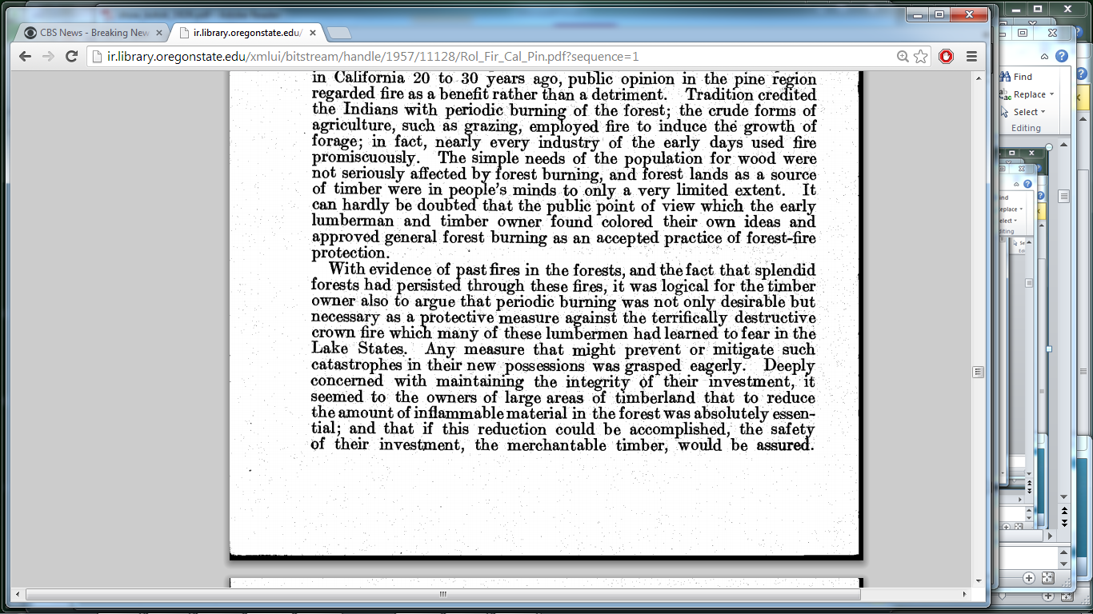

Slide 9
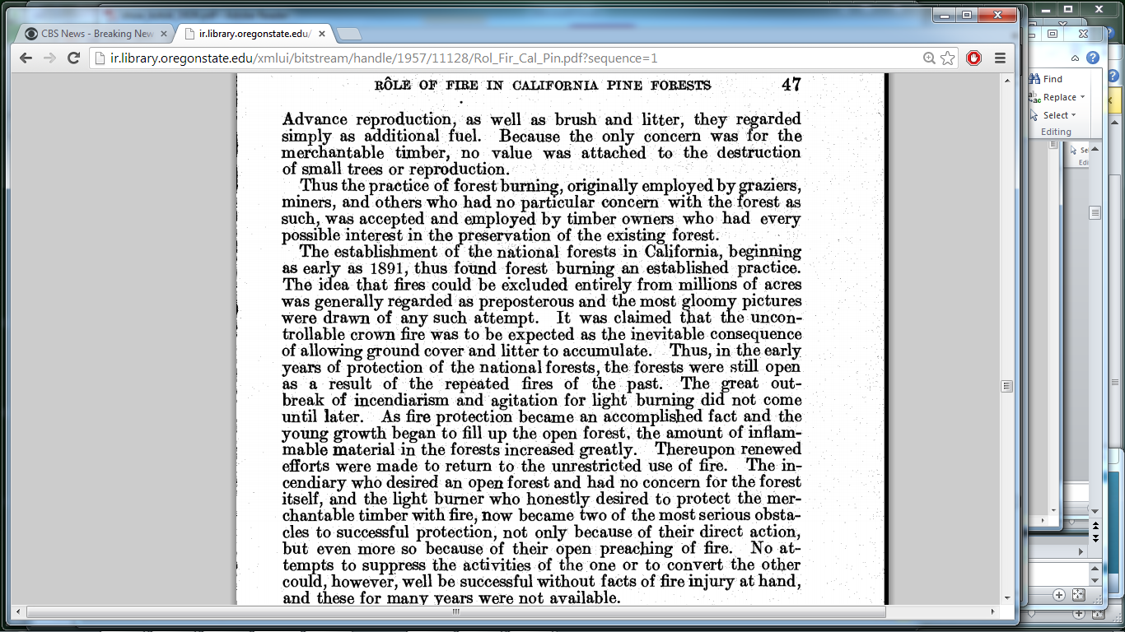

Slide 10
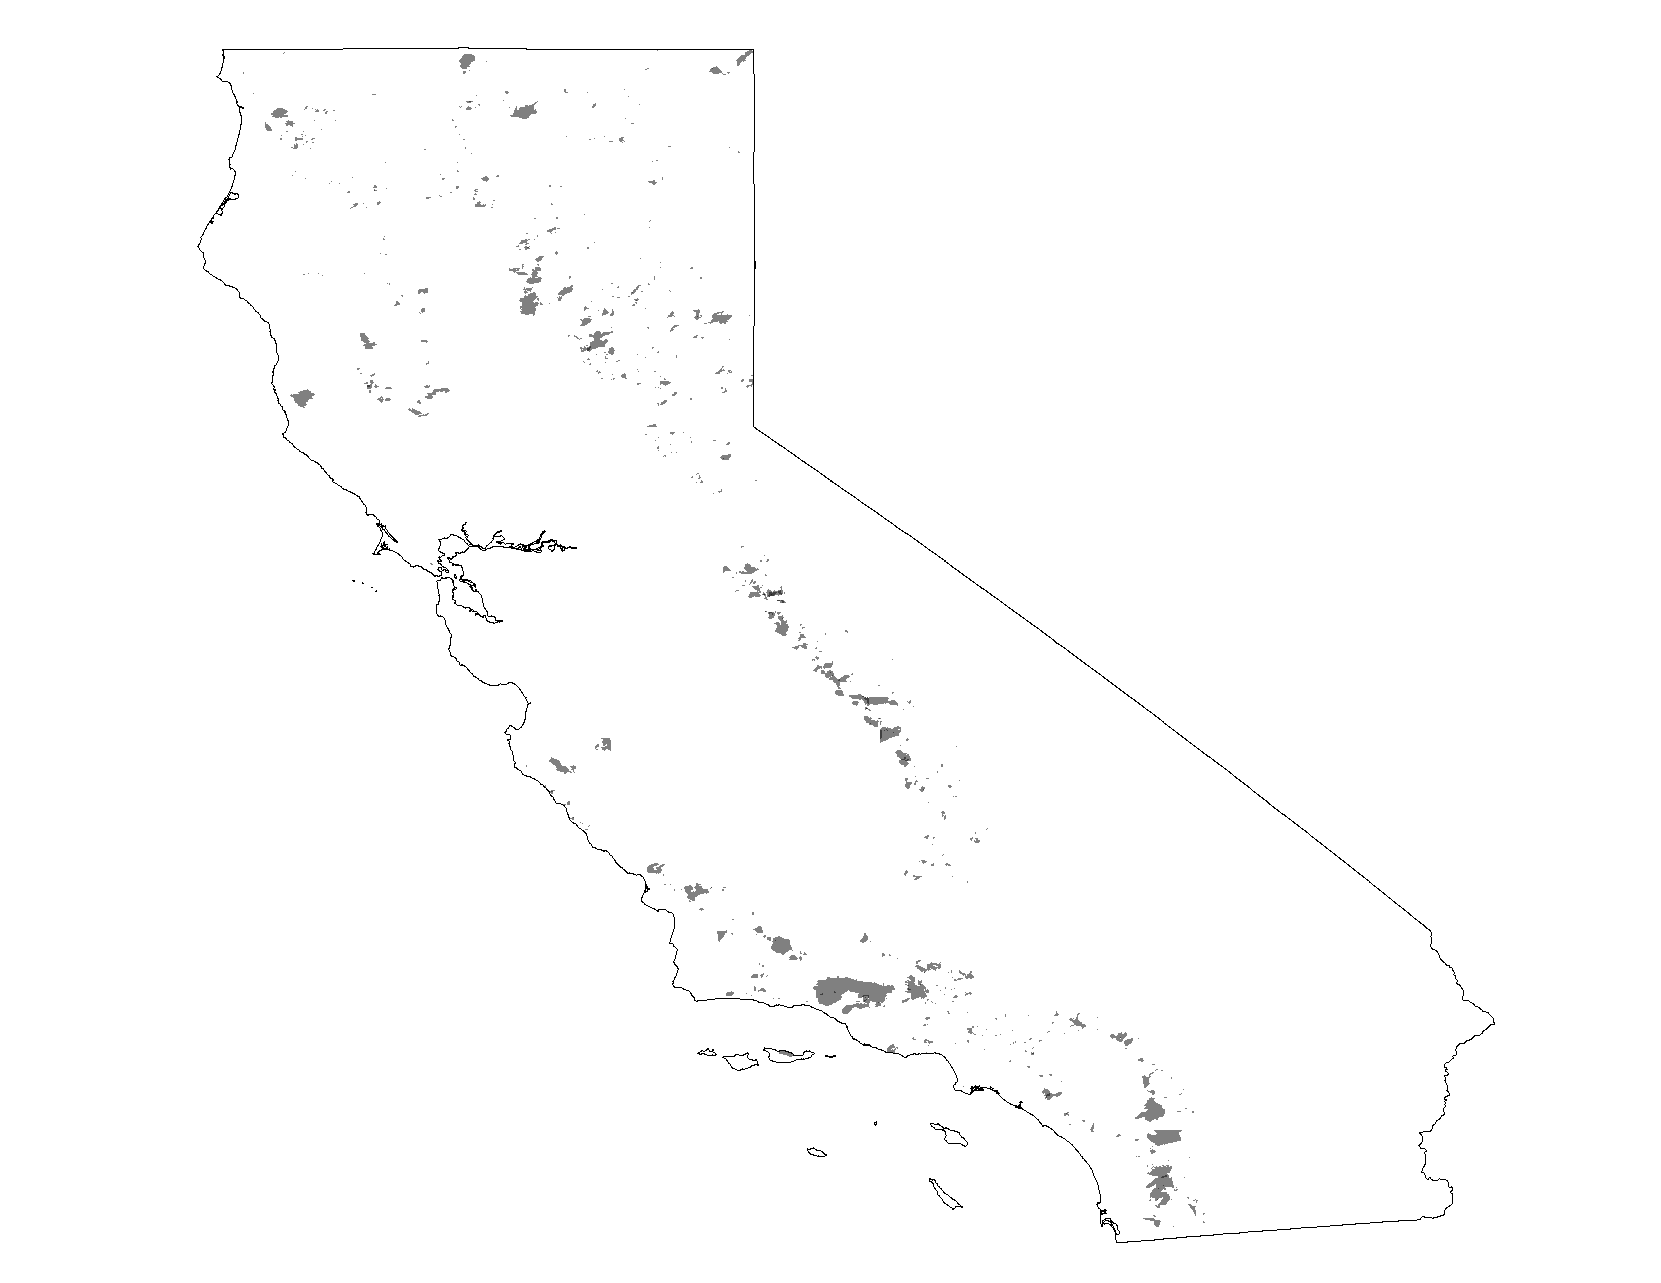
CAL FIRE/FRAP Mapped Wildfires
1926-1932
~5.6M acres reported burned
1926
1932
1942
1952
1962
1972
1982
1992
2002
2012

Slide 11
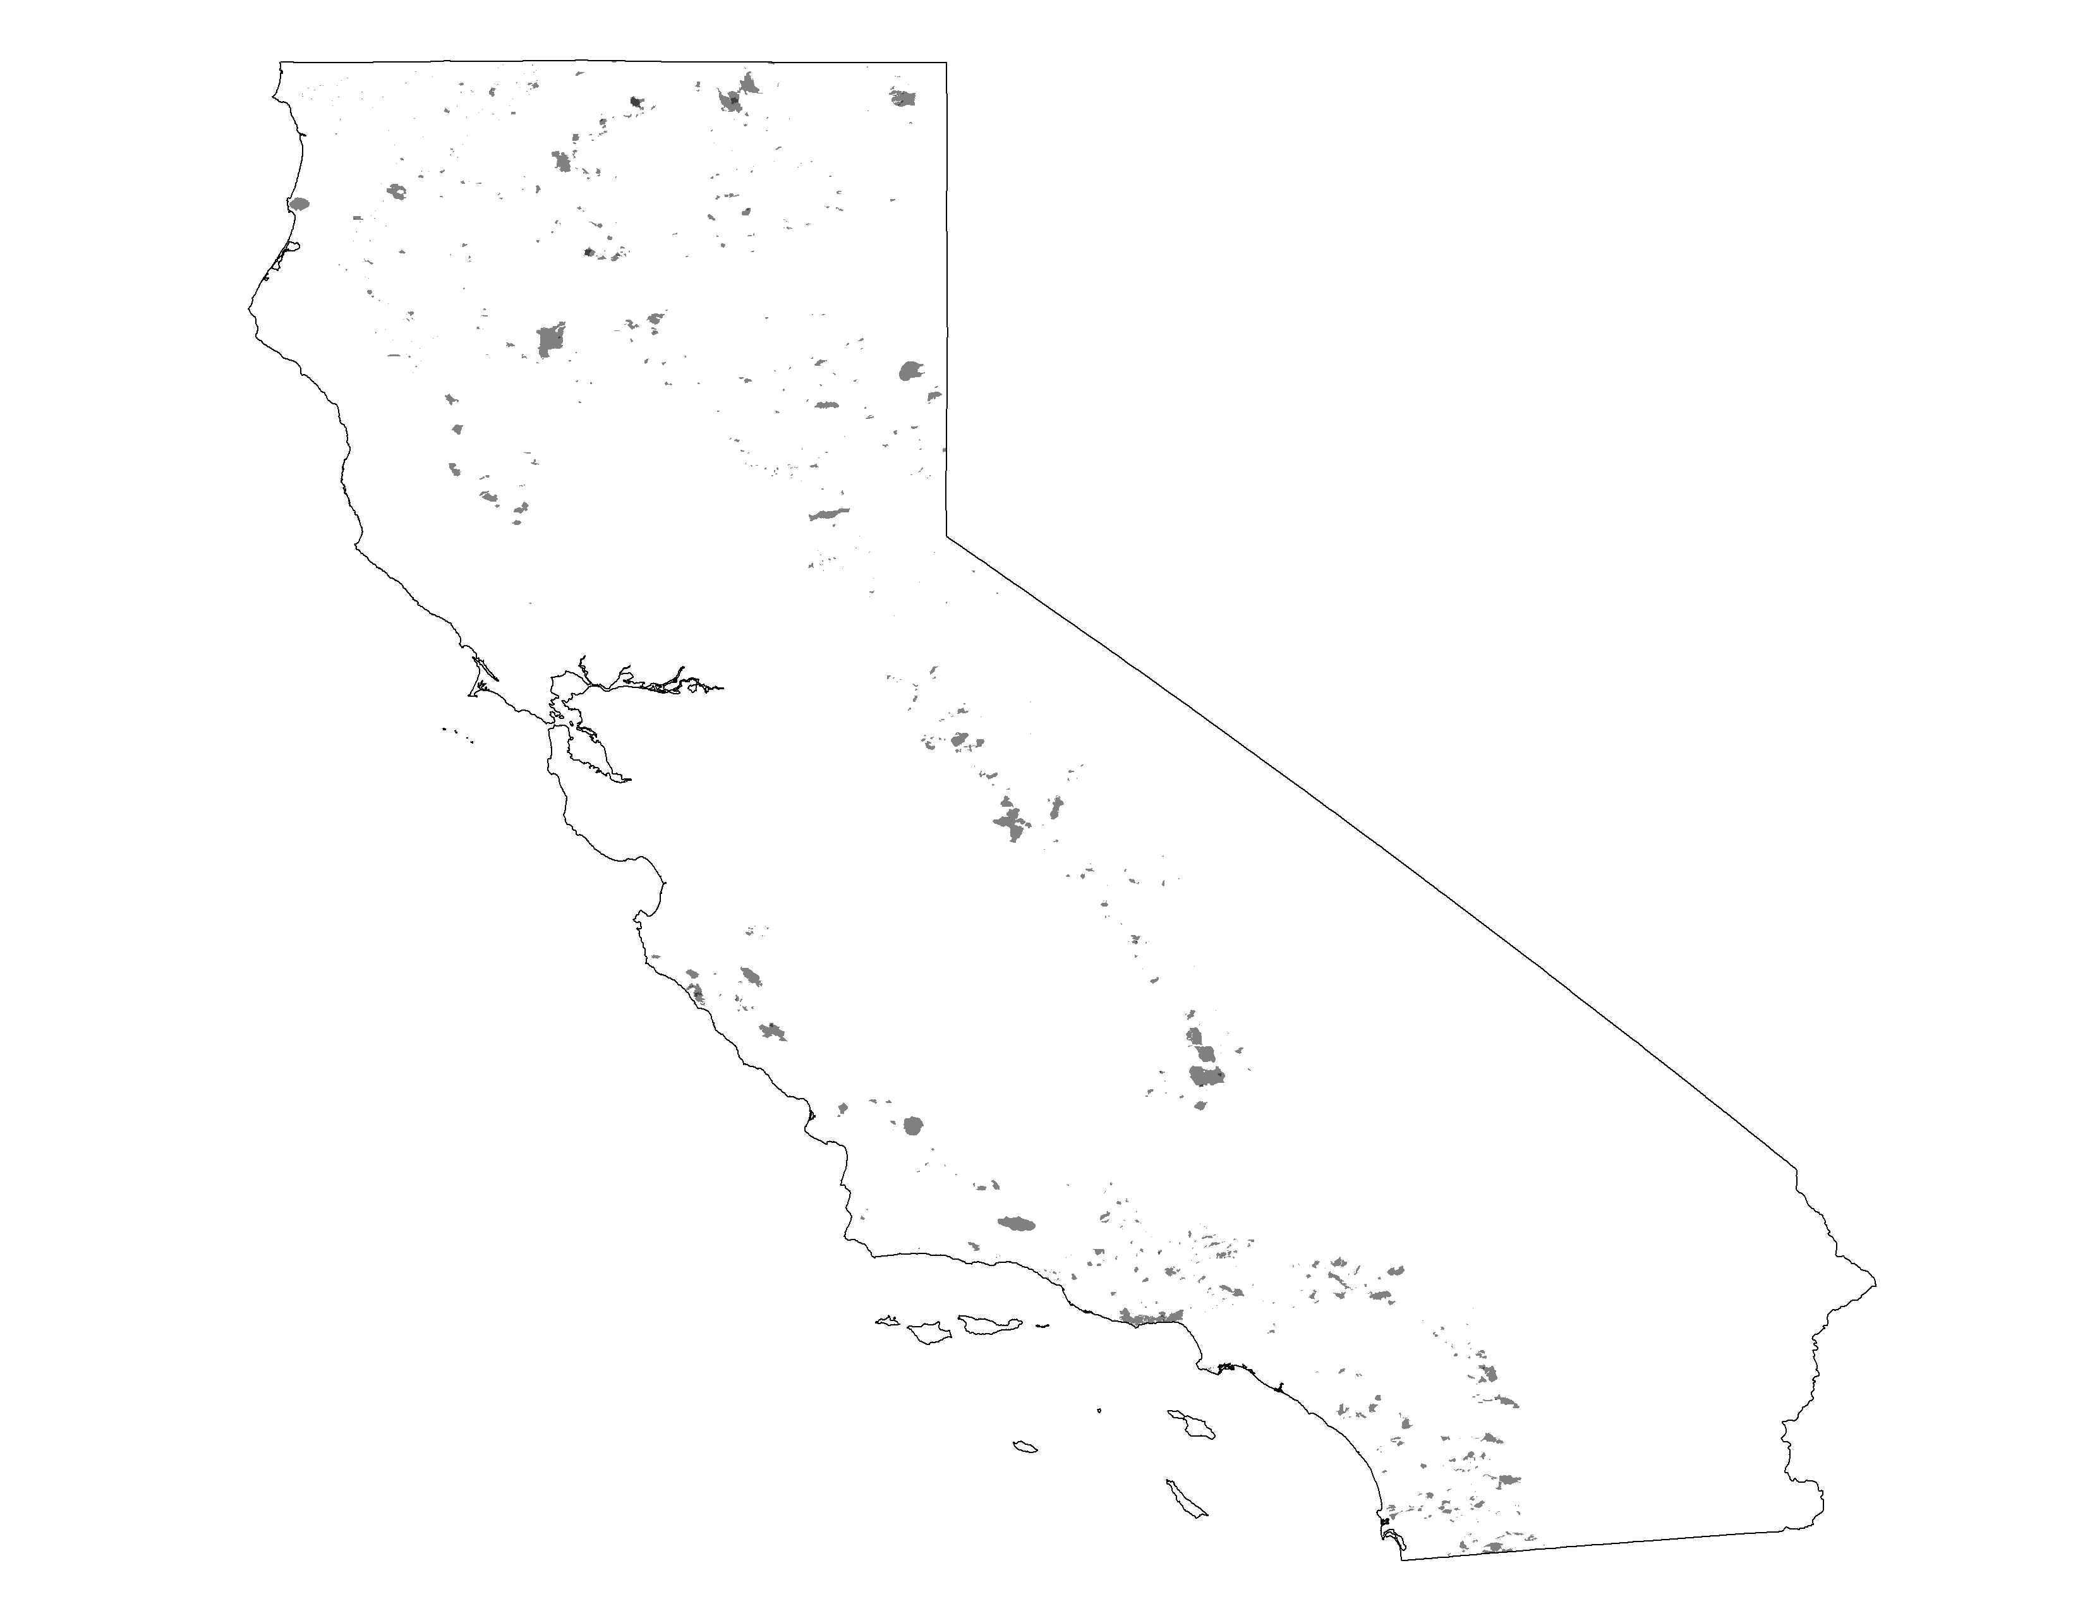
CAL FIRE/FRAP Mapped Wildfires
1933-1942
~3.5M acres reported burned
1926
1932
1942
1952
1962
1972
1982
1992
2002
2012

Slide 12
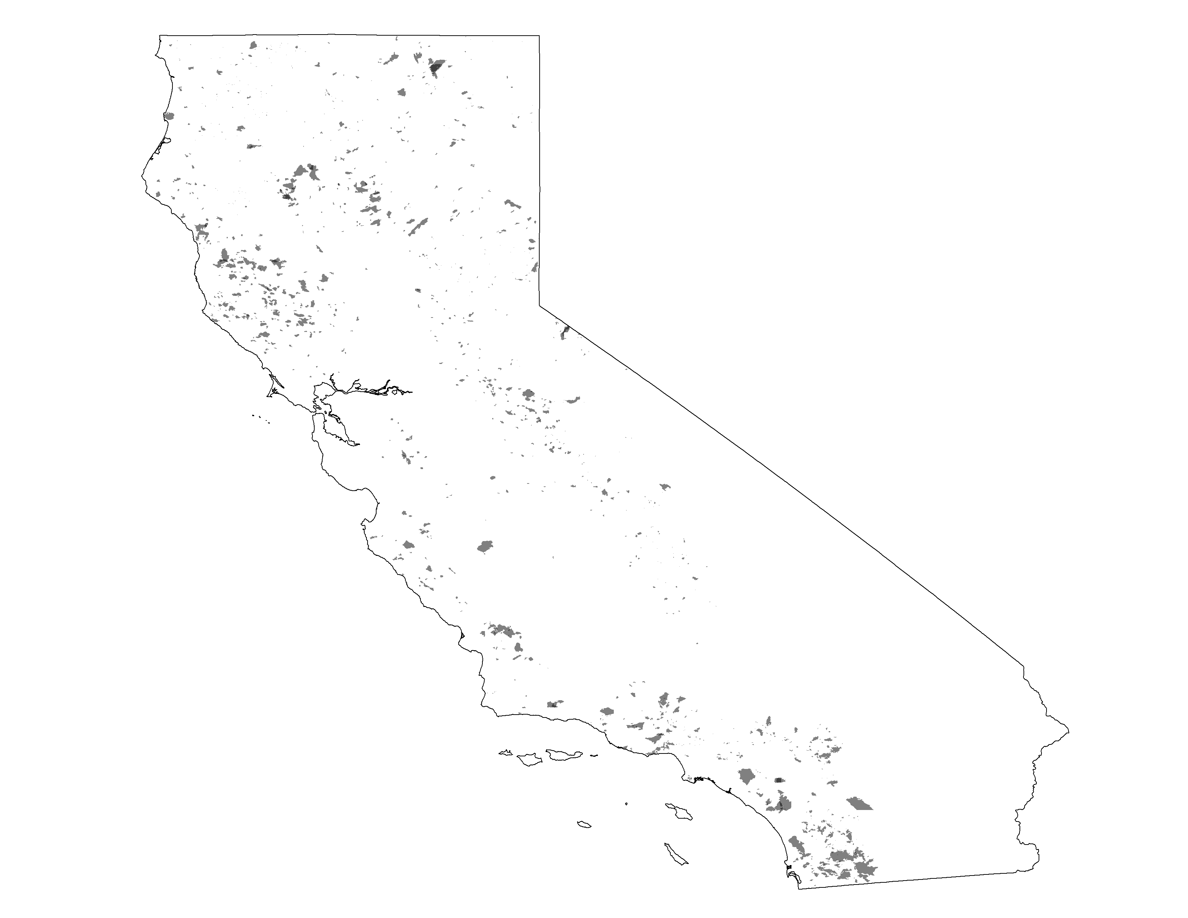
CAL FIRE/FRAP Mapped Wildfires
1943-1952
~3.6M acres reported burned
1926
1932
1942
1952
1962
1972
1982
1992
2002
2012

Slide 13
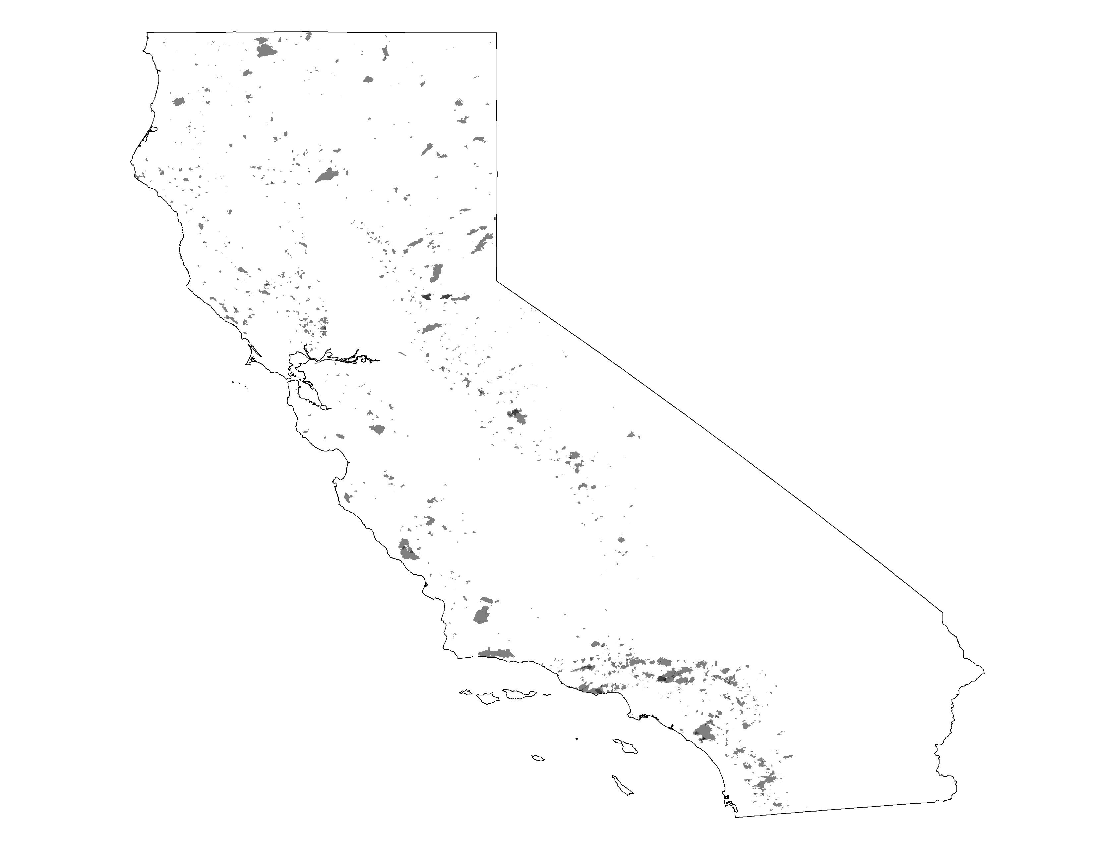
CAL FIRE/FRAP Mapped Wildfires
1953-1962
~2.5M acres reported burned
1926
1932
1942
1952
1962
1972
1982
1992
2002
2012

Slide 14
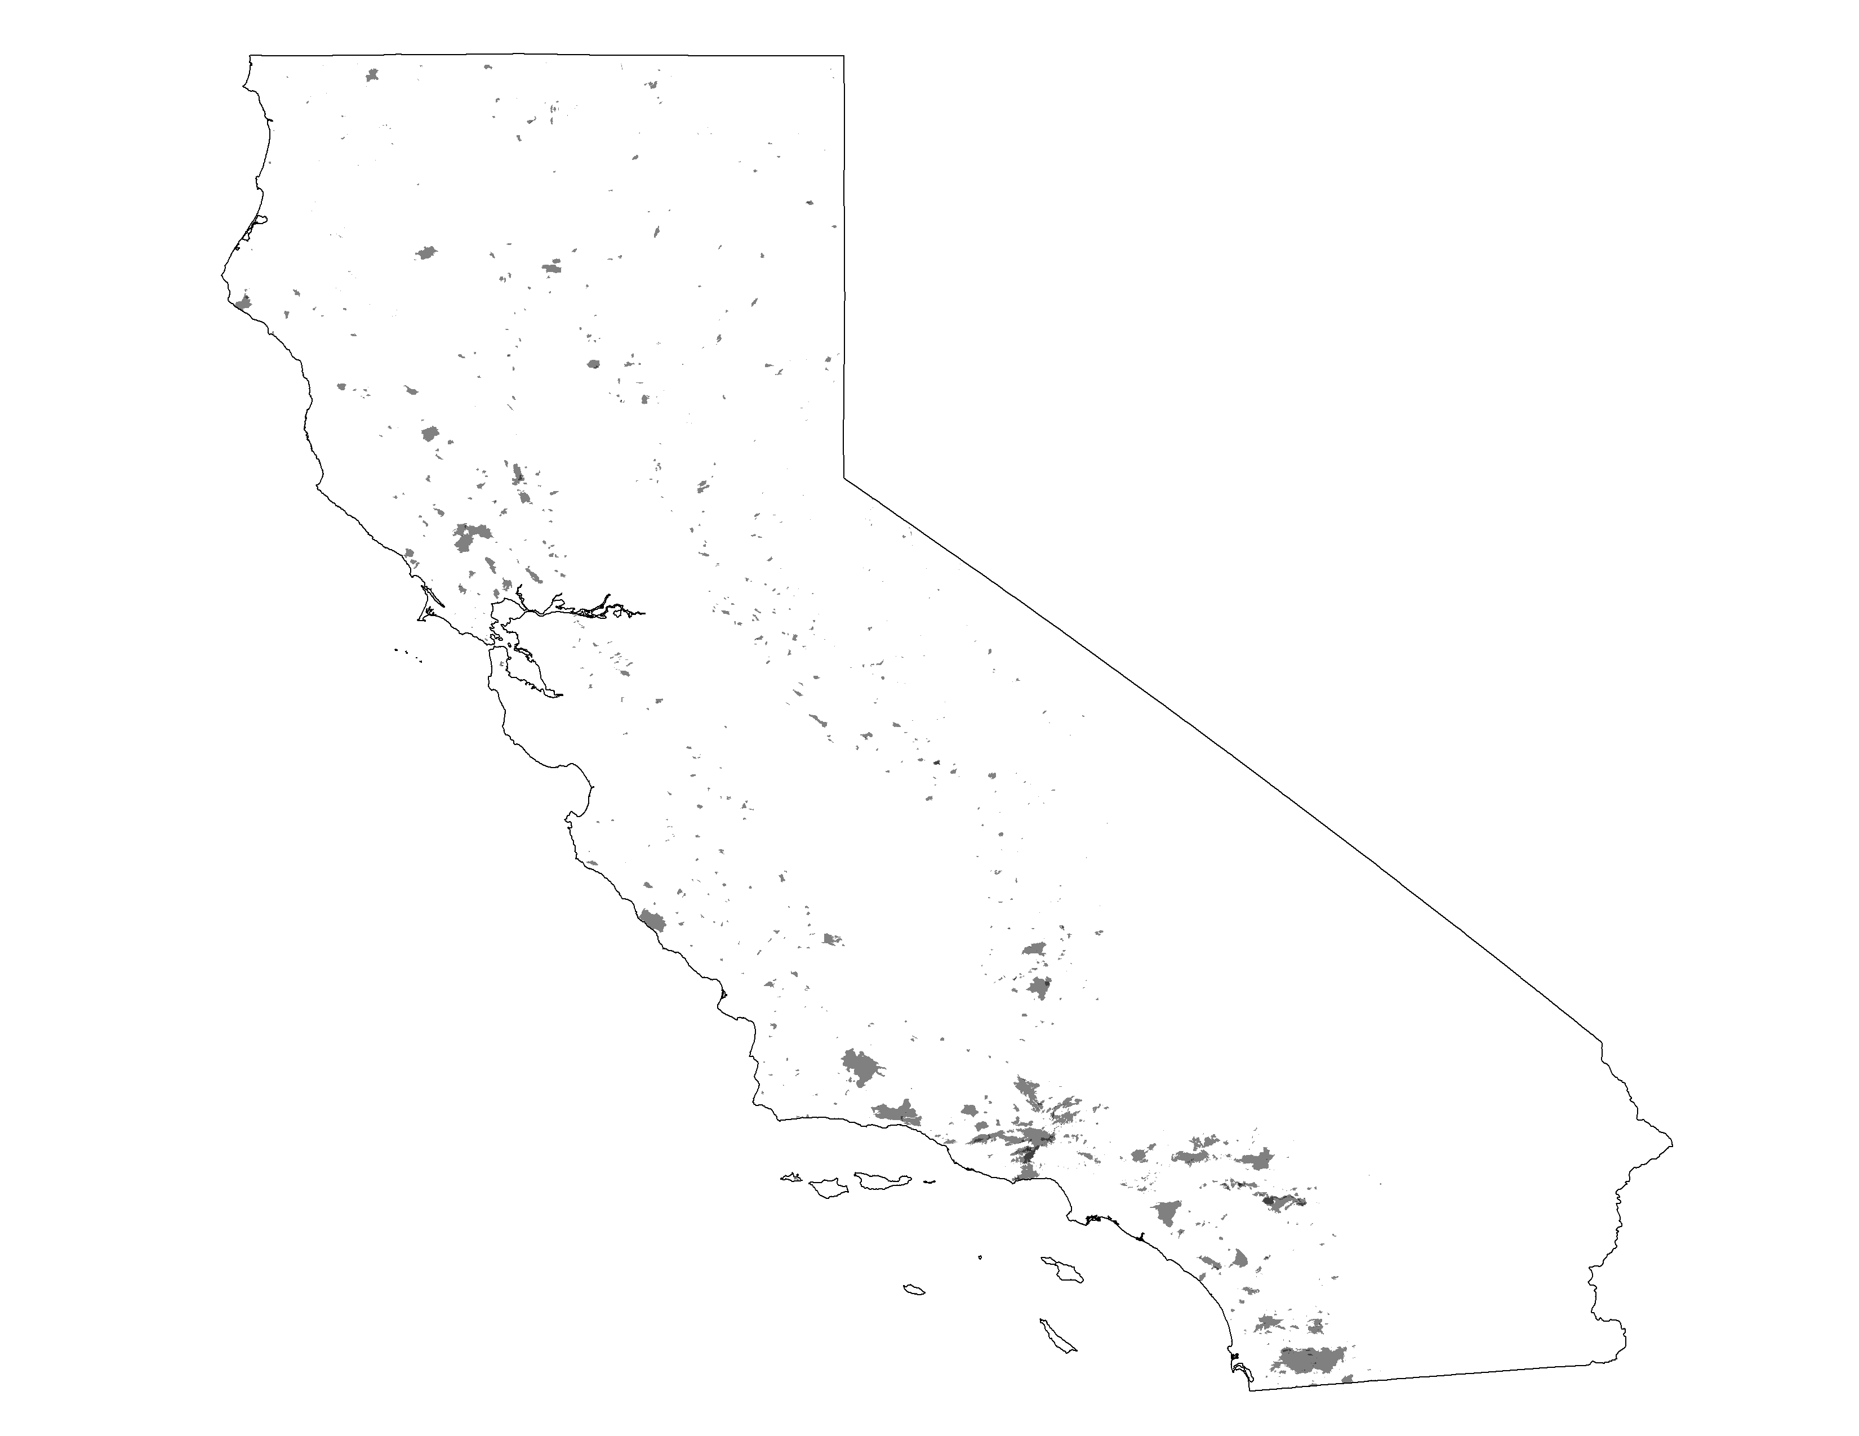
CAL FIRE/FRAP Mapped Wildfires
1963-1972
~2M acres reported burned
1926
1932
1942
1952
1962
1972
1982
1992
2002
2012

Slide 15
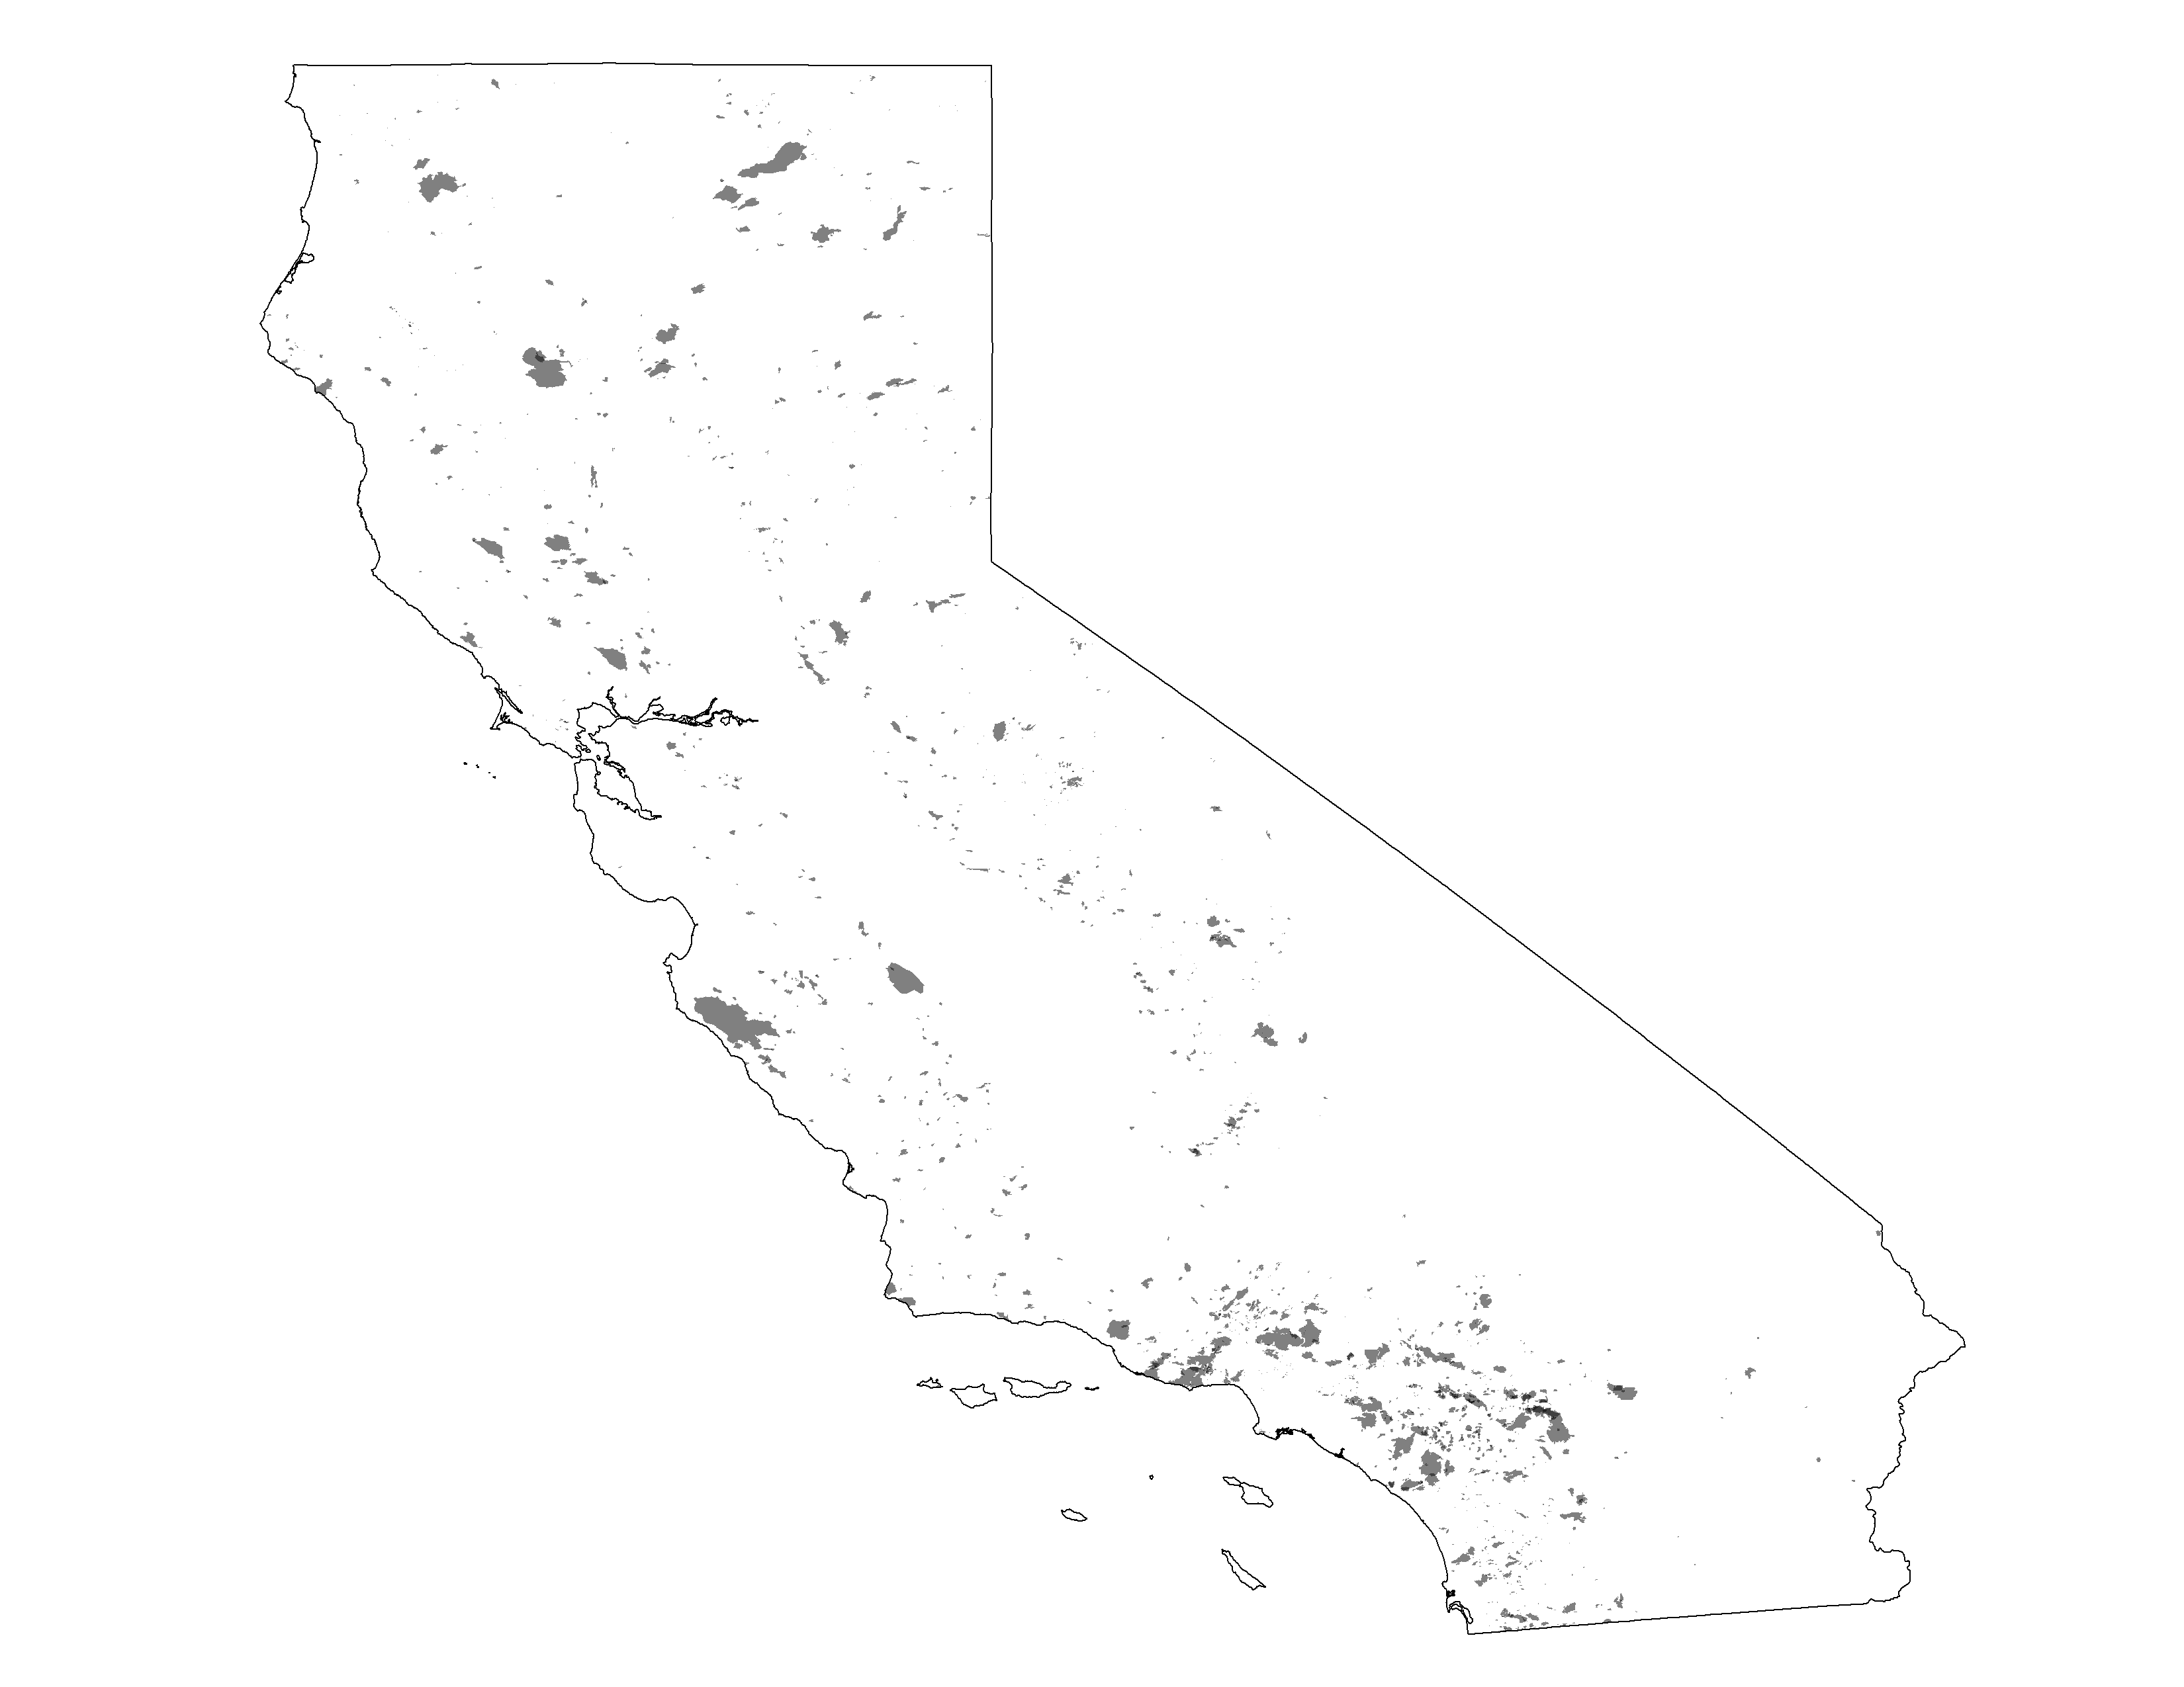
CAL FIRE/FRAP Mapped Wildfires
1973-1982
~3M acres reported burned
1926
1932
1942
1952
1962
1972
1982
1992
2002
2012

Slide 16
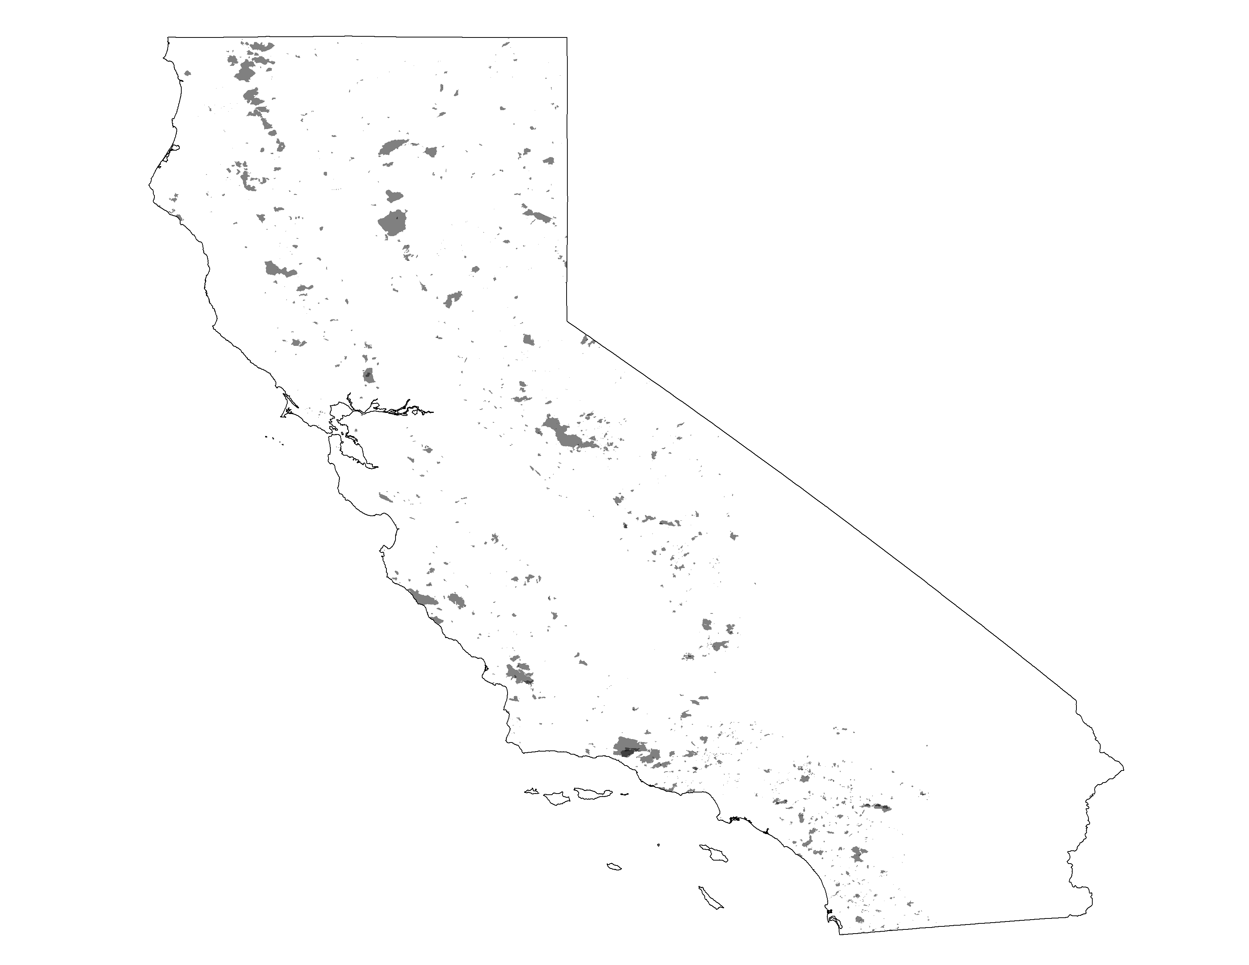
CAL FIRE/FRAP Mapped Wildfires
1983-1992
~3.2M acres reported burned
1926
1932
1942
1952
1962
1972
1982
1992
2002
2012

Slide 17
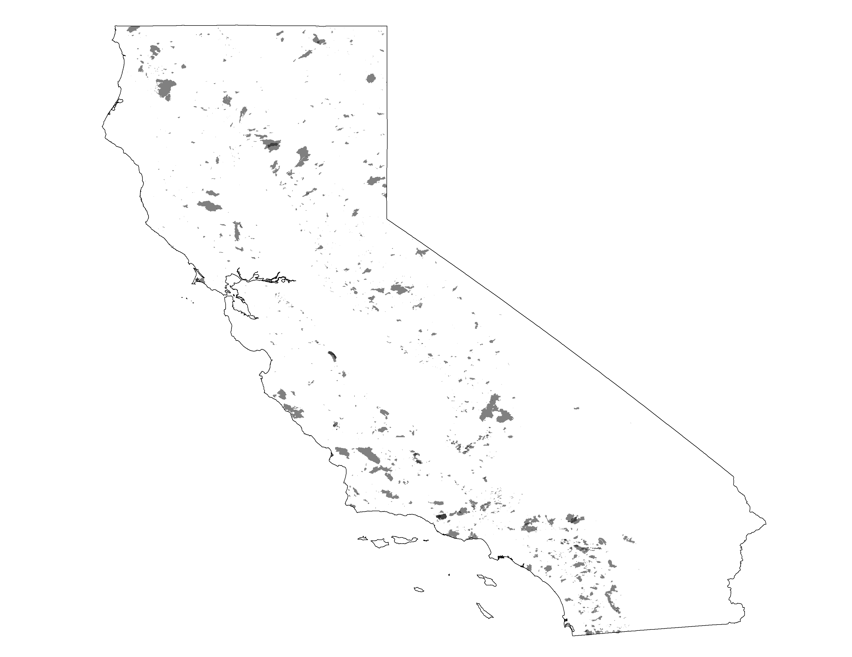
CAL FIRE/FRAP Mapped Wildfires
1993-2002
~4.3M acres reported burned
1926
1932
1942
1952
1962
1972
1982
1992
2002
2012

Slide 18
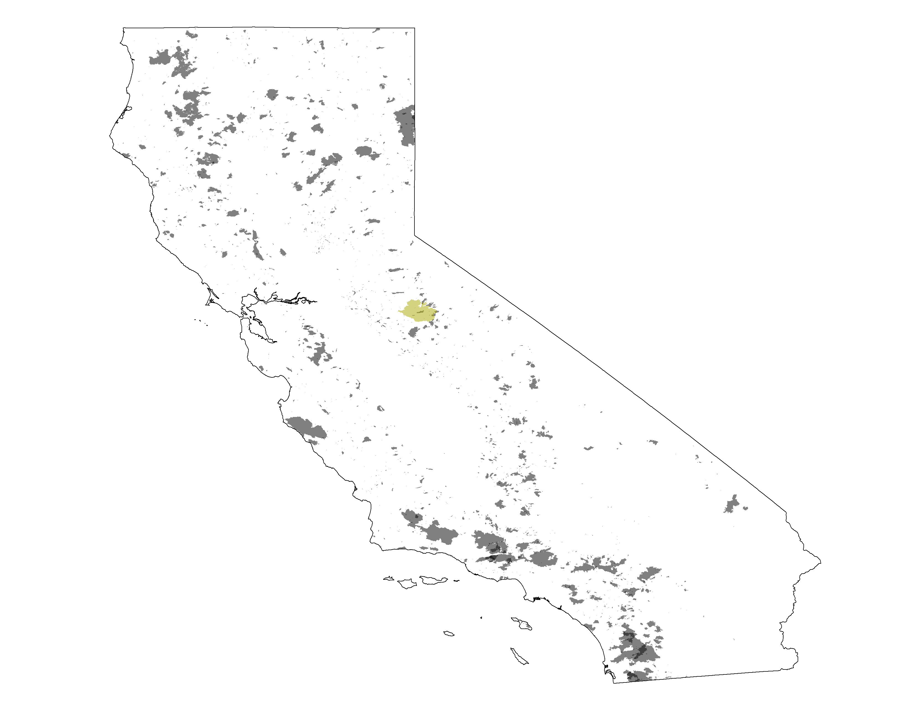
CAL FIRE/FRAP Mapped Wildfires
2003-2012
~6.8M acres reported burned
+ 2013 Rim Fire
1926
1932
1942
1952
1962
1972
1982
1992
2002
2012

Slide 19
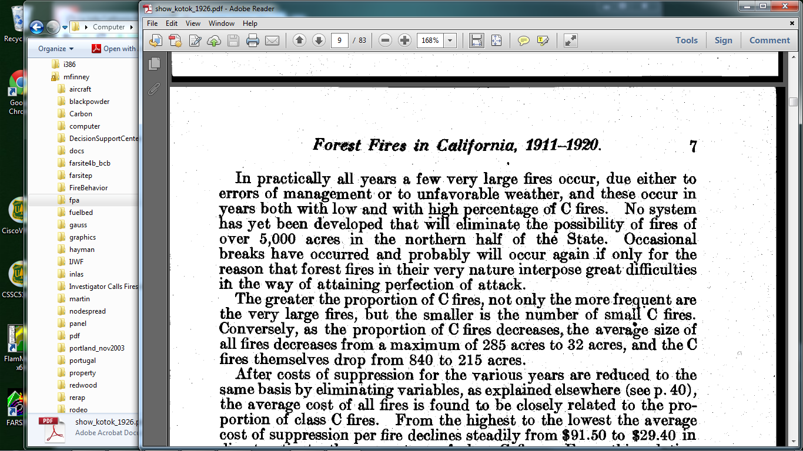
Show, S.B., and E.I. Kotok. 1926.

Slide 20
Modern Fire Regime
Mild and moderate fires are extinguished……in all vegetation zones
Most area burned under Extreme Conditions (3% fires burn 95% area)
Dry, Windy, Spotting
Suppression forces overwhelmed / ineffective

Slide 21
Modern Situation
More people
More infrastructure
More regulations (air, planning etc.)
Much more expense (suppression)
Fires are still inevitable
The only choices we have are: what kind of fires and when to have them

Slide 22
Options for Changing Wildfire Risk?
More logging?

Slide 23
Rodeo-Chediski Fires 2002, Arizona
Notes:
Landsat 7 ETM+ Bands 6,4,2 for the Rodeo-Chediski Fire. Image Date is July 07, 2002 at 11:00 in the morning….

Slide 24
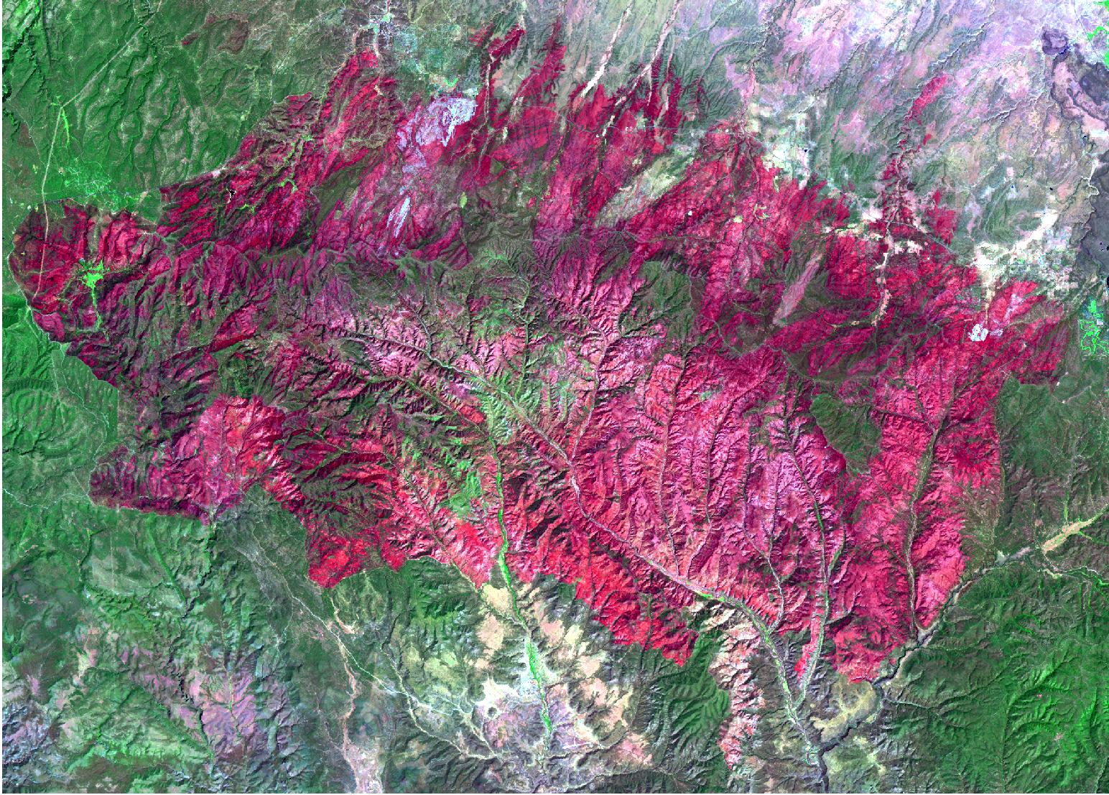
460,000 ac
Notes:
Landsat ETM plus for August 24, 2002. Bands 6, 4, 2. Raw Images were provided by Tom Mellin Remote Sensing Specialist R-3, Albq. NM

Slide 25
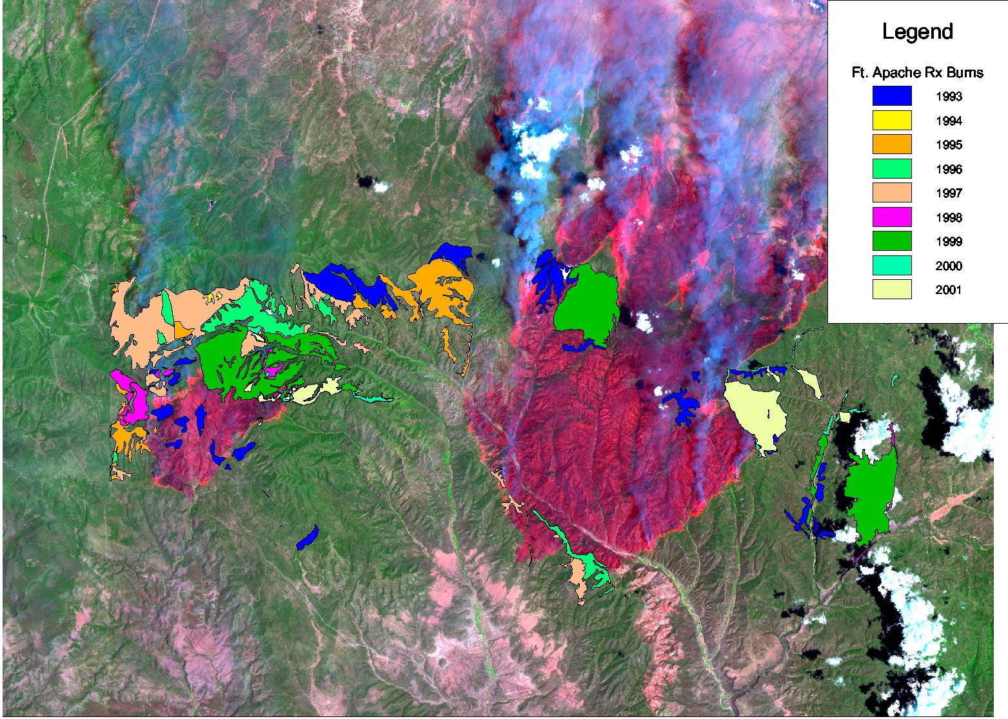

Slide 26
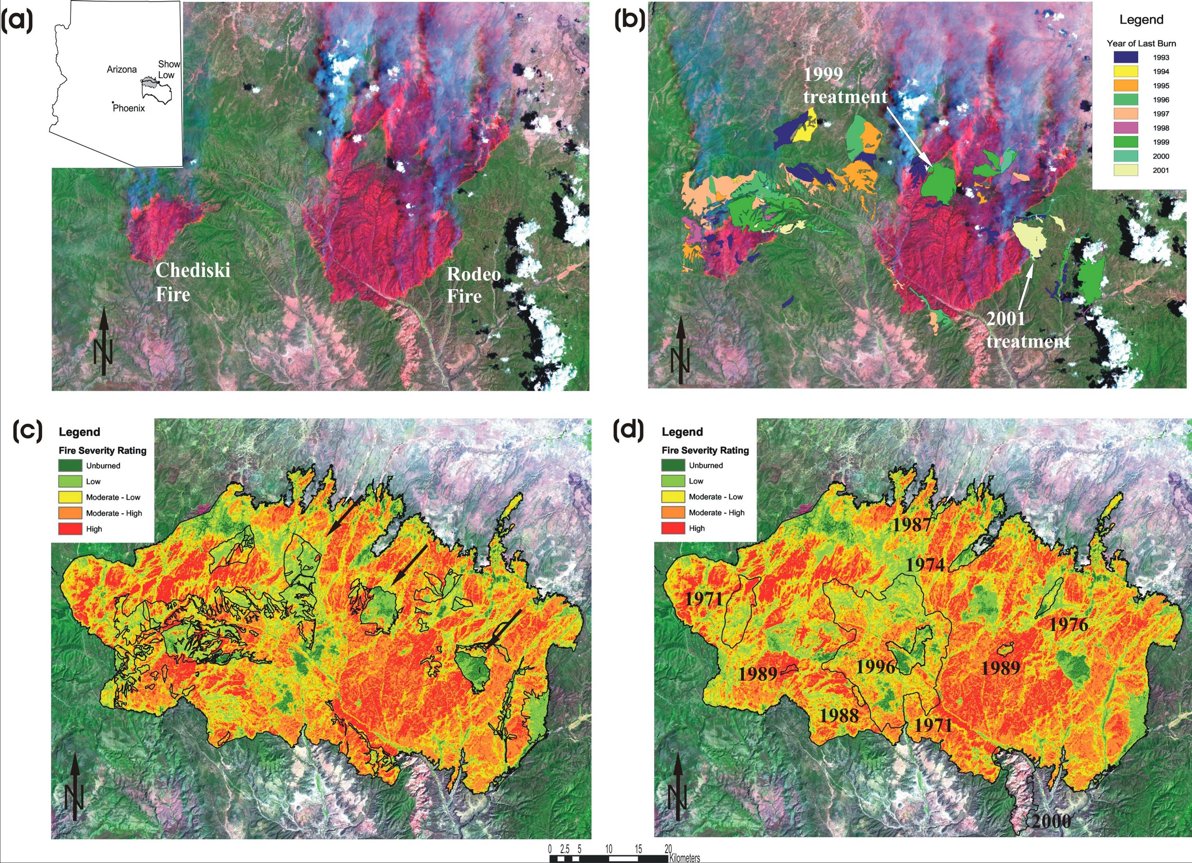

Slide 27
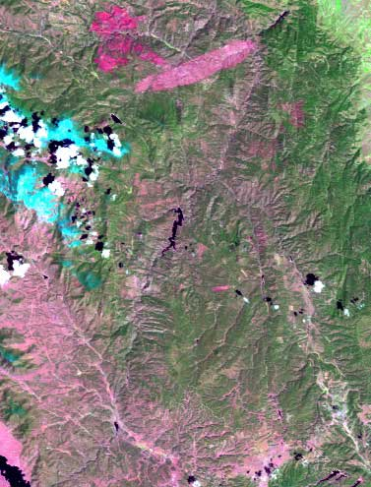
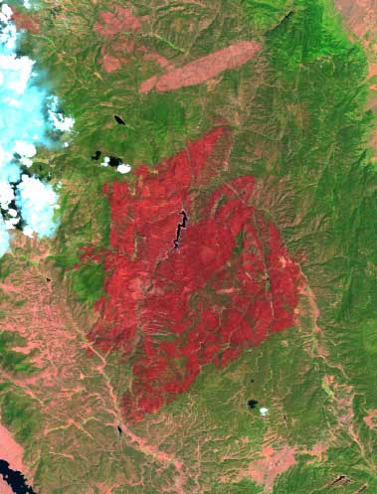
Hayman Fire (June 2002)
136,000ac

Slide 28
Prescribed Burns and Wildfires
Hayman Fire 2002, Arizona
Notes:
Hayman fire again, note the 8000 acre Rx burn labeled 2001 Polhemus Rx in upper right. This is a LARGE fuel treatment that stopped the crown fire along that segment of the fire perimeter. However, the scale effects are clear – local effect STRONG but little effect on fire as a whole (see next slide for close up)

Slide 29
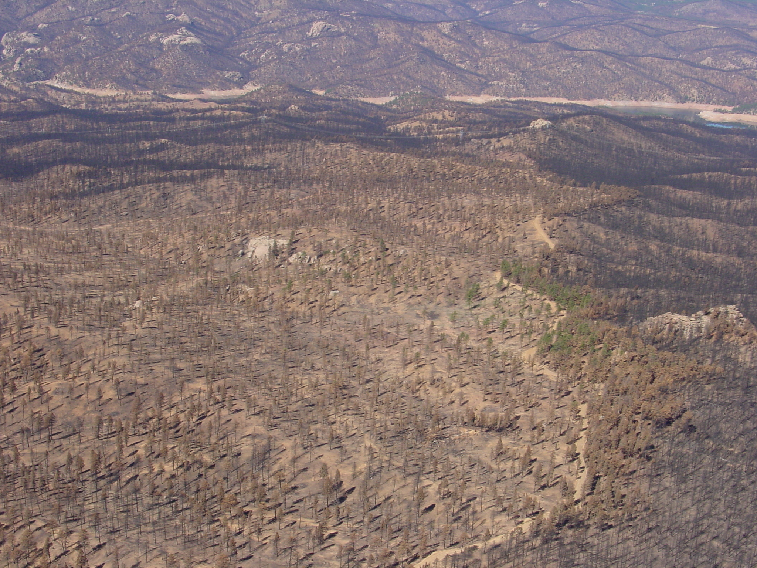
Sheepnose Shelterwood (2001)
Shelterwood Harvest, fuels crushed
N
Photo: Erik Martinson

Slide 30
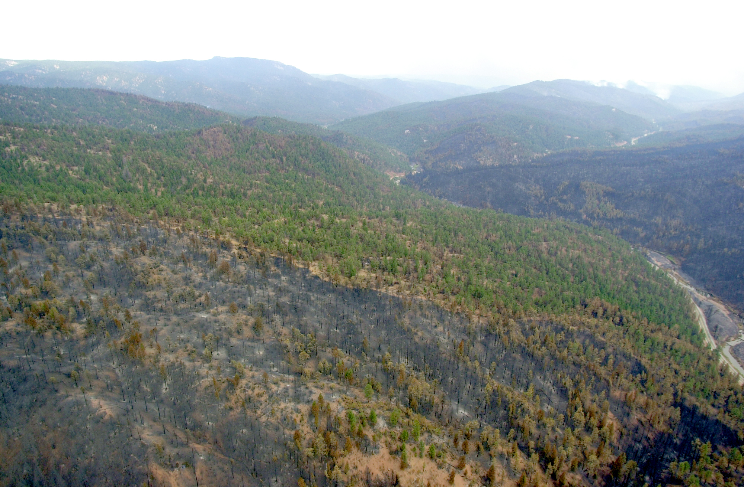
Polhemus Prescribed Burn
N
Polhemus Prescribed Fire
October 2001
Hayman Fire
Hayman Fire
Photo: Karen Wattenmaker

Slide 31
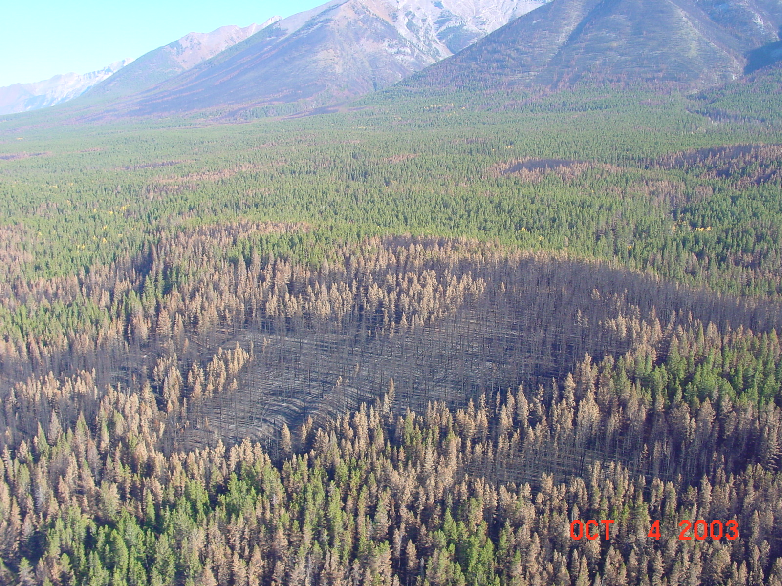
Thinning and Fire Behavior, Banff NP
Control
Thin, no slash
Thin, slash
Photo: Stew Walkinshaw

Slide 32
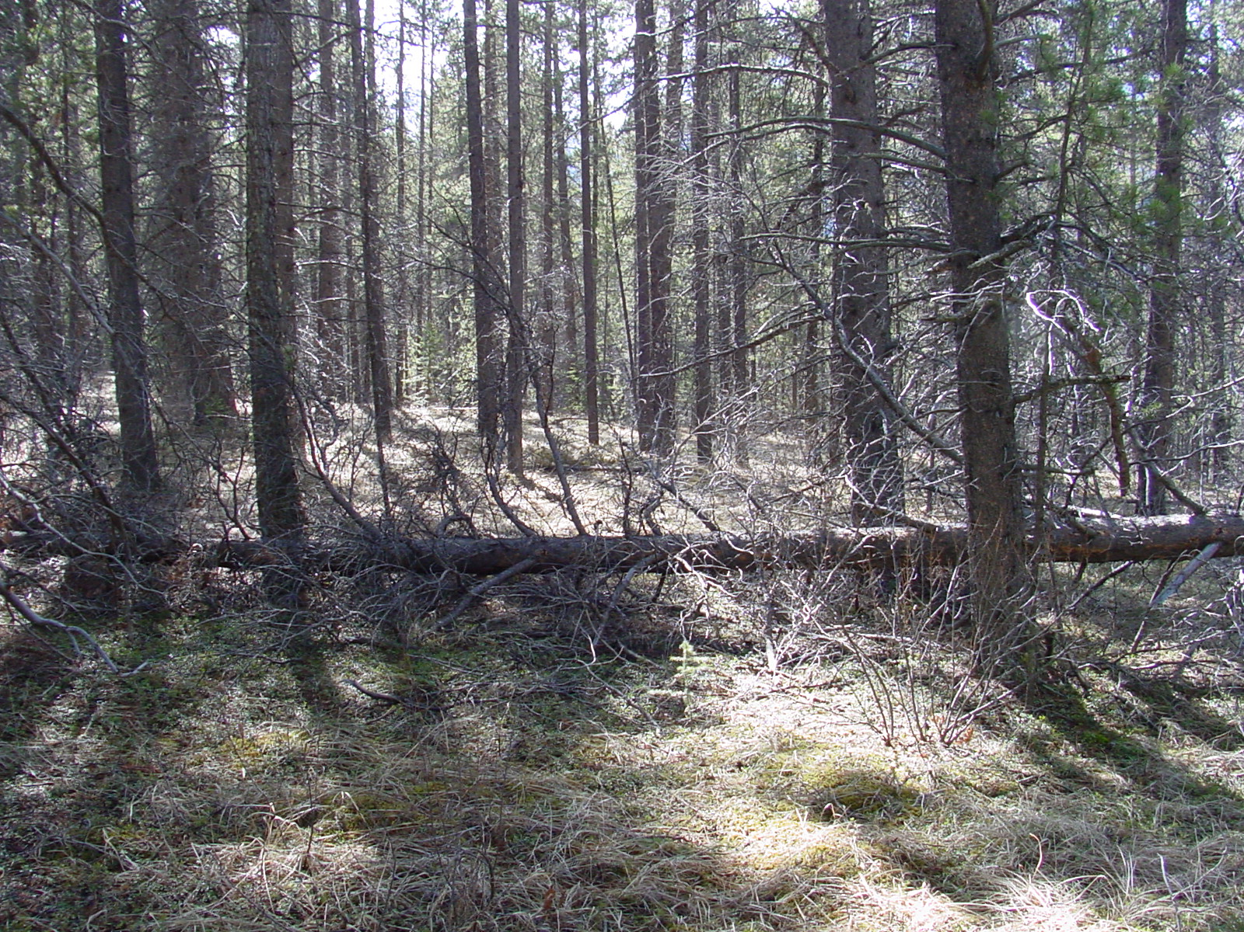
Control
Thin, slash
removed
Thin, slash
on-site

Slide 33
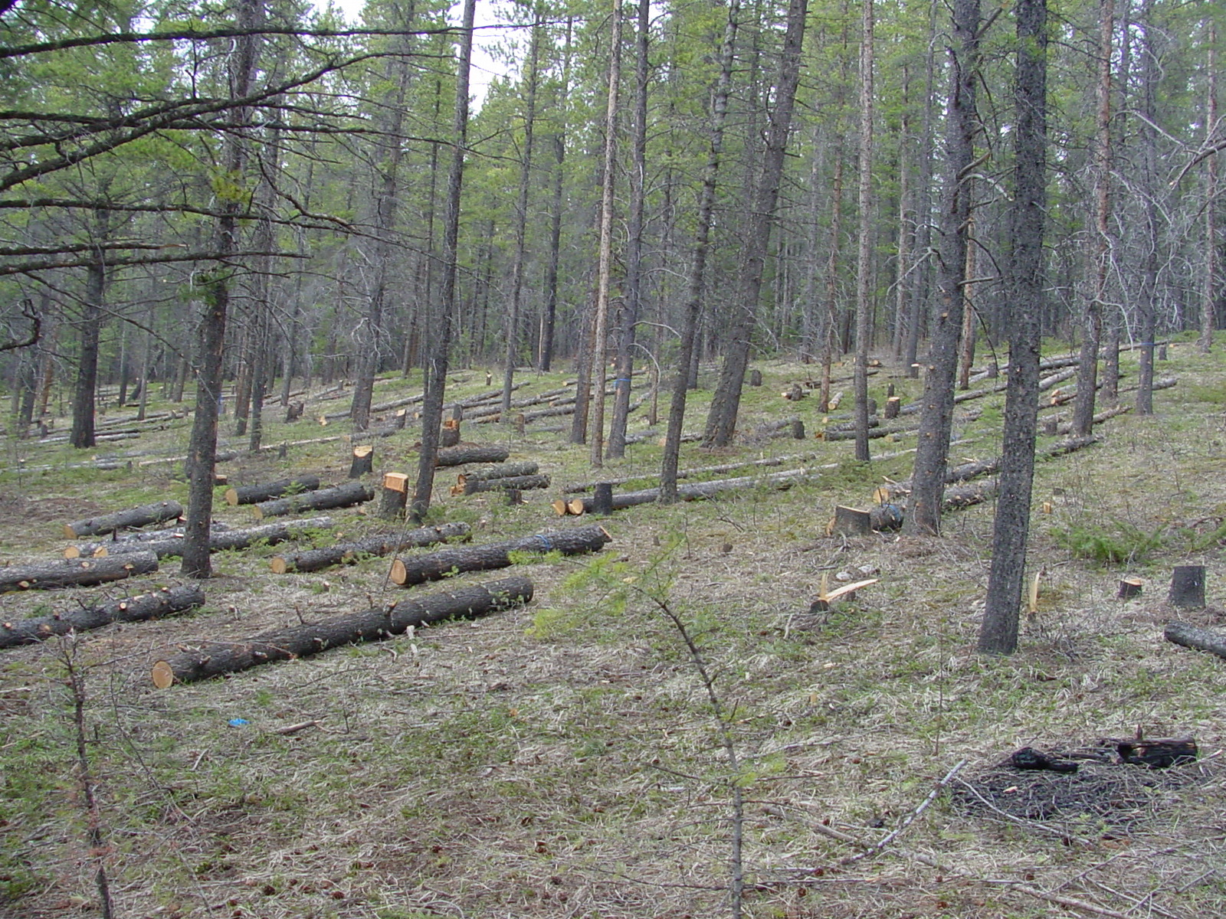
Control
Thin, slash
removed
Thin, slash
on-site
Slides Courtesy of FERIC

Slide 34
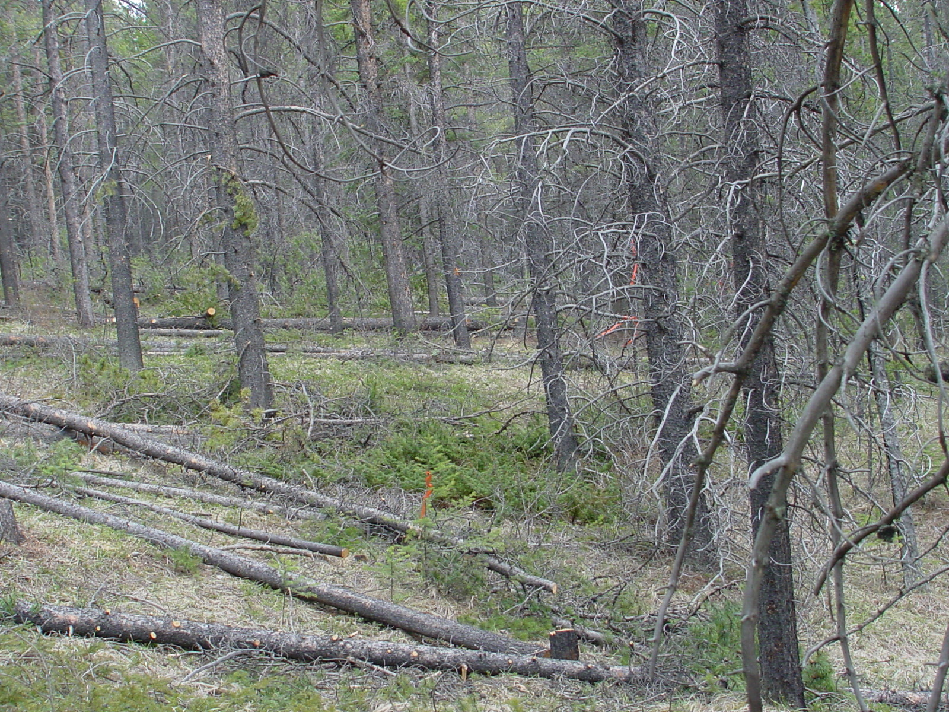
Control
Thin, slash
removed
Thin, slash
on-site
Slides Courtesy of FERIC

Slide 35
Thinning and Fire Behavior, Banff NP
Control
Thin, no slash
Thin, slash
Photo: Stew Walkinshaw

Slide 36
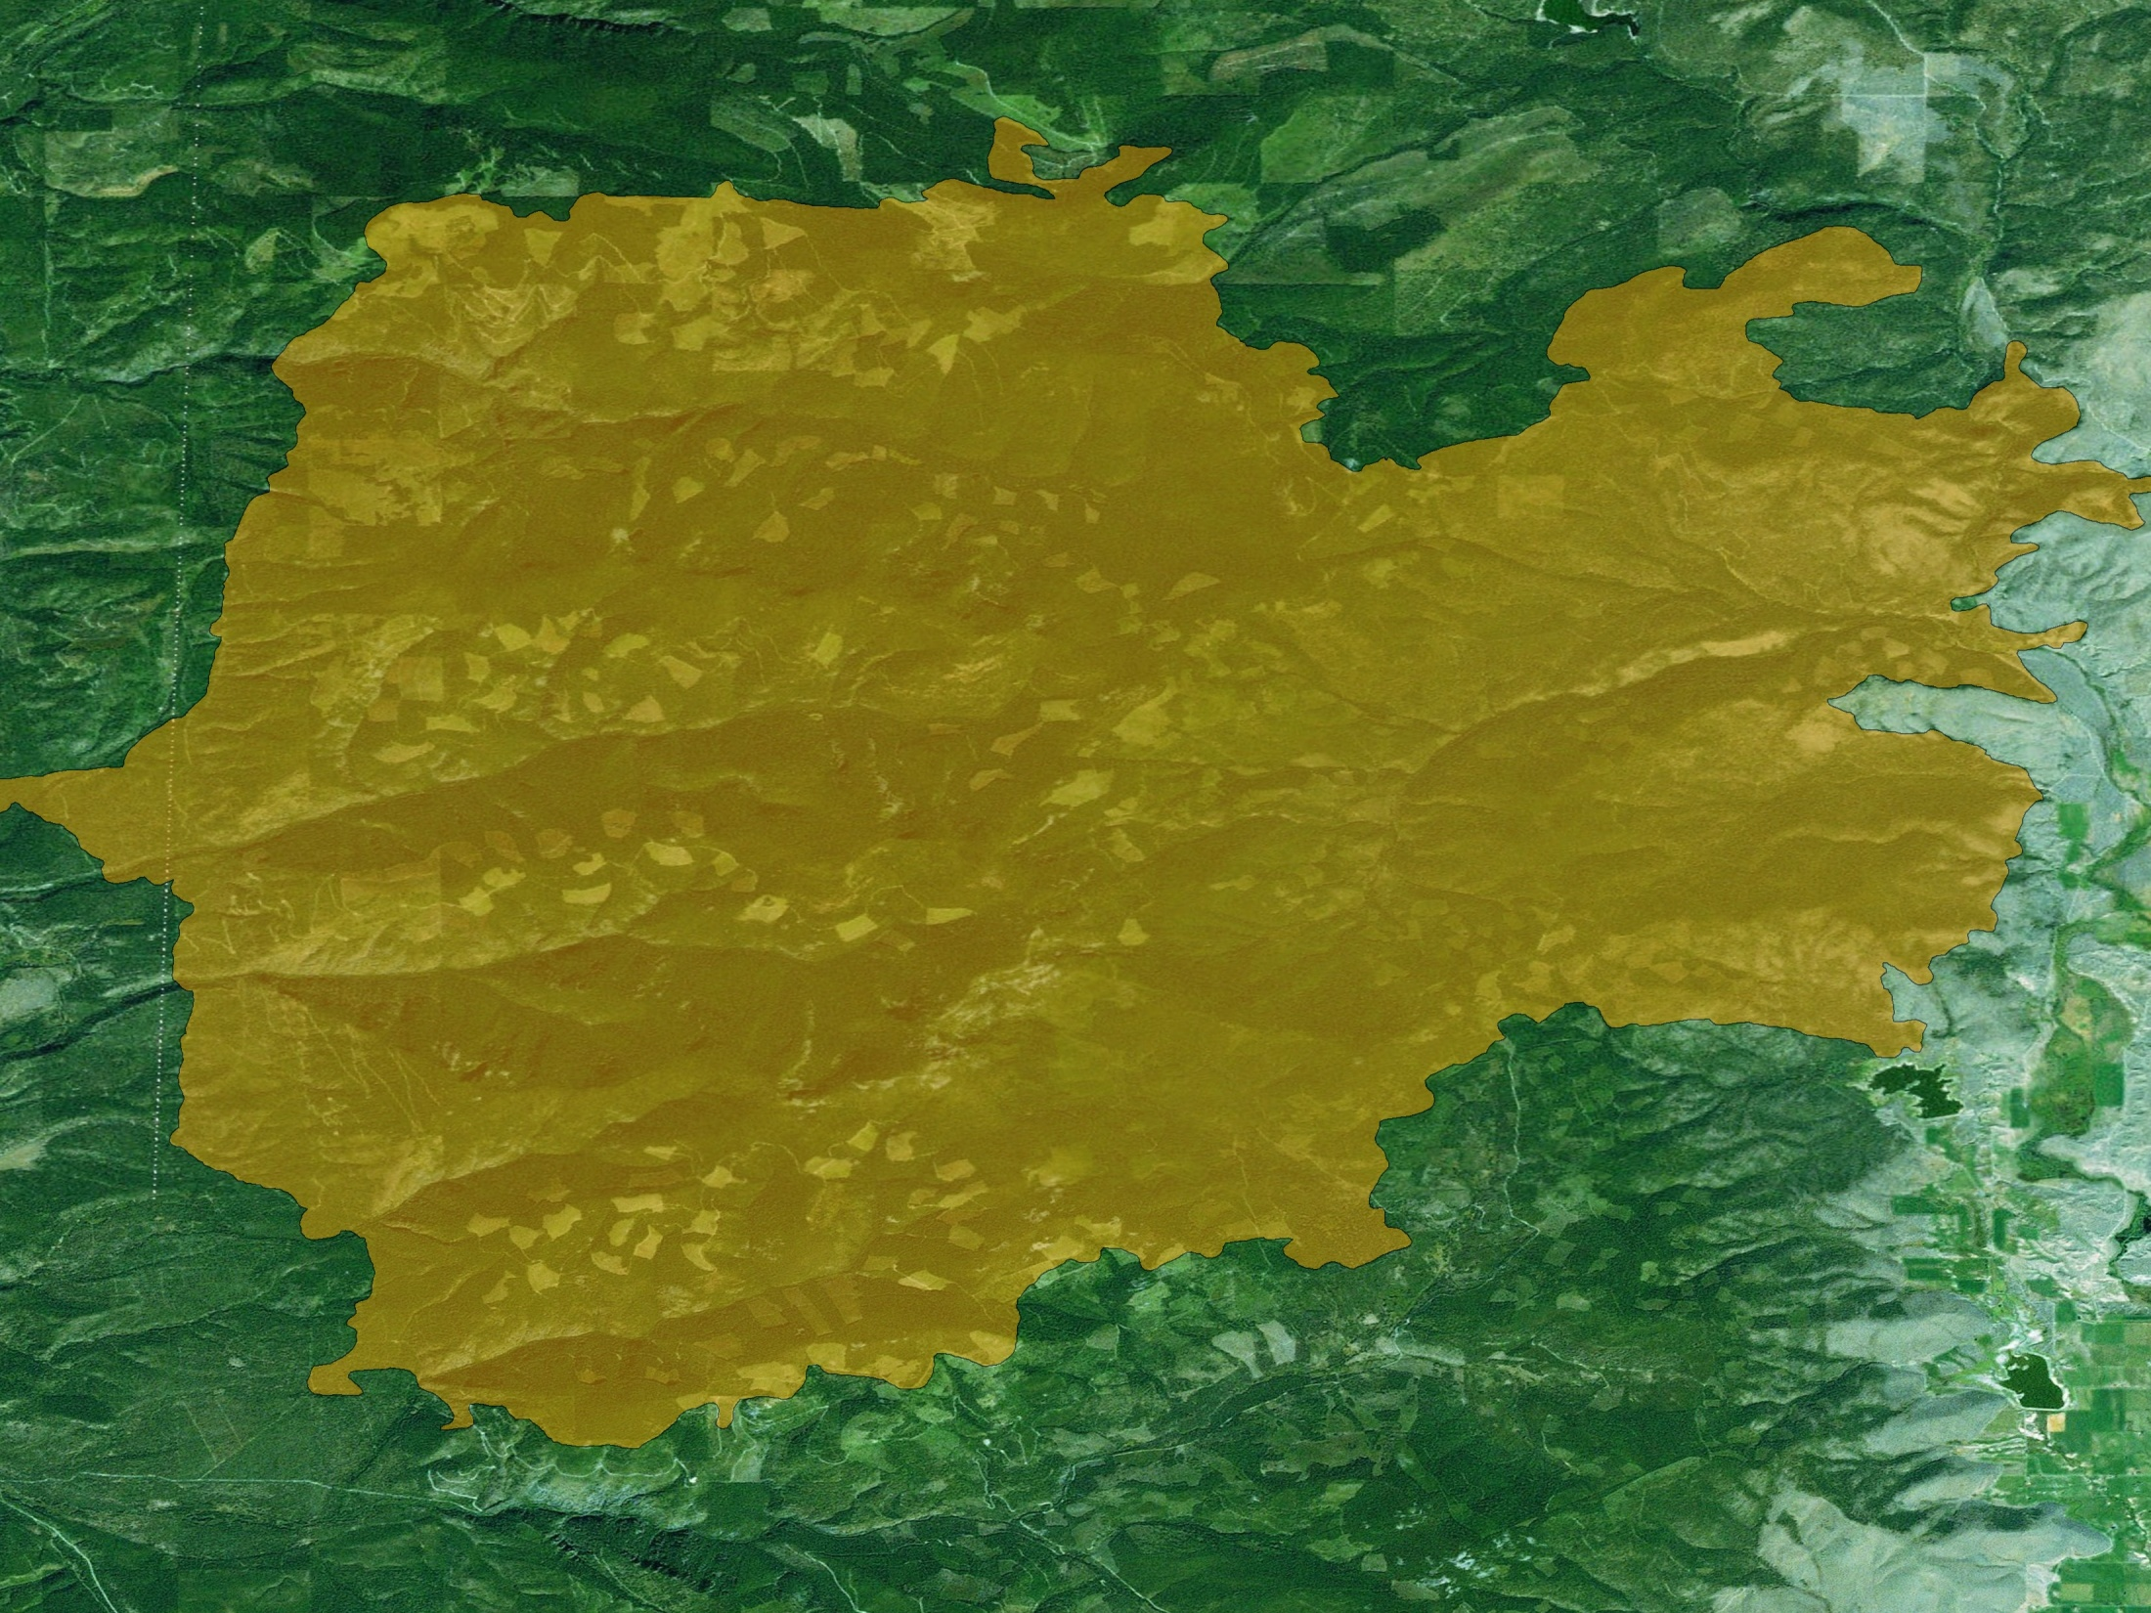
2007 Chippy Creek ~ 99K
2004 landscape

Slide 37
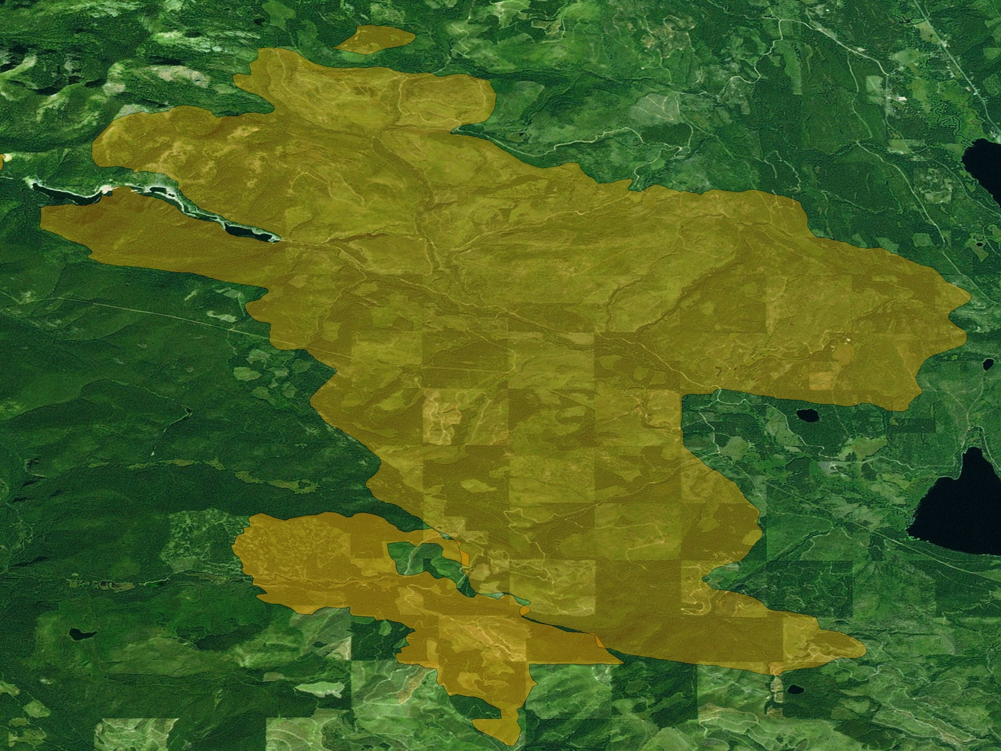
2004 landscape
Jocko Lakes (2007) ~ 36K
Boles Meadow (2003) ~ 4K

Slide 38
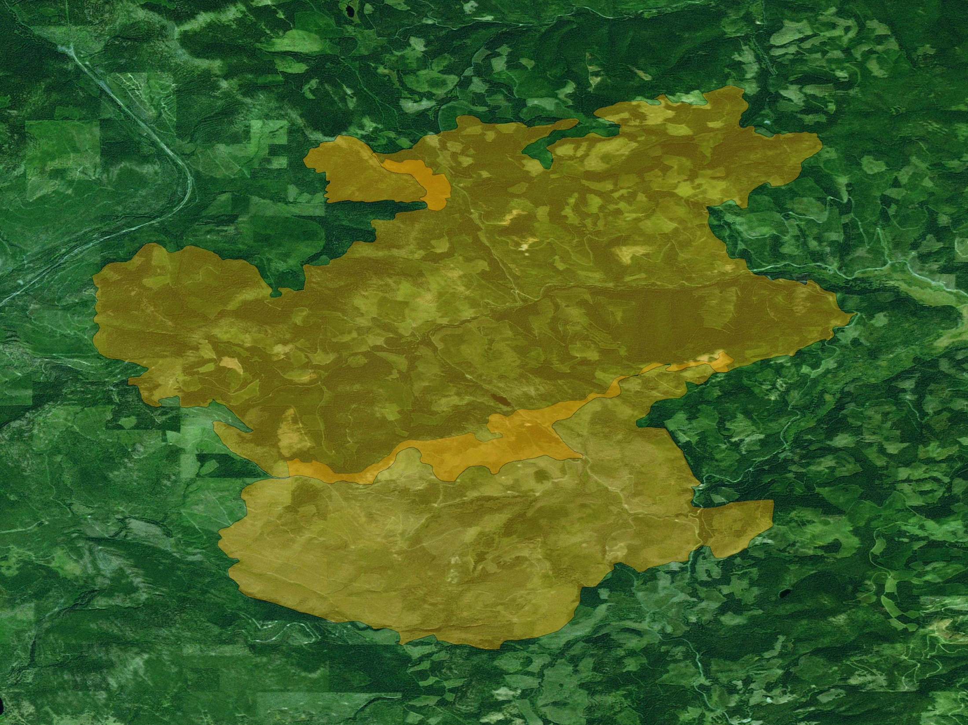
2004 landscape
Elk Mountain
(2000) ~ 1K
Brush Creek
(2007) ~ 30K
Little Wolf (1994) ~ 10K

Slide 39
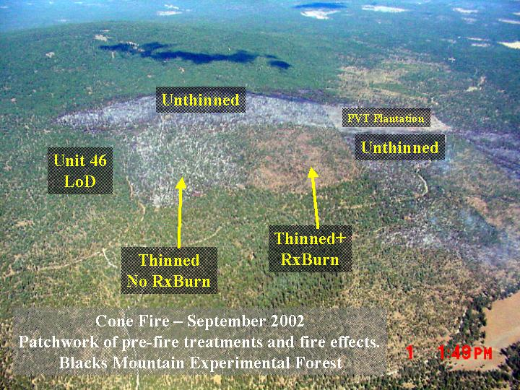
Wind Direction
Origin
Source: Carl Skinner, PSW

Slide 40
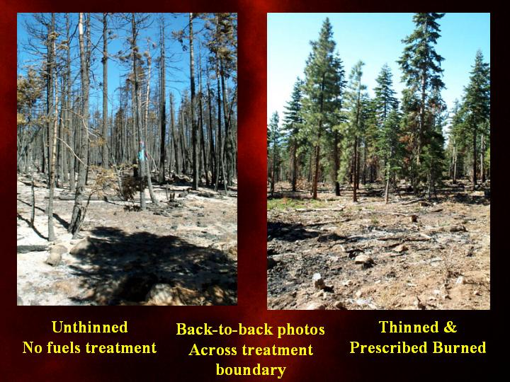
Treatment Effects- Stand Level
Carl Skinner, USFS

Slide 41
Treatment Effects- Stand Level
Carl Skinner, USFS

Slide 42
Options for Changing Wildfire Risk?
More logging?
Not without fire
Fuel Breaks?
OK for point protection
Don’t stop fires (spotting, etc.)
Little effect to landscape/watershed severity
Must include broadcast burning

Slide 43
2 Strategies for Landscape Fuel Treatments
Fire Containment
Fuelbreaks
Fire Modification
Area/dispersed treatments
Notes:
Compare and contrast two fundamental strategies

Slide 44
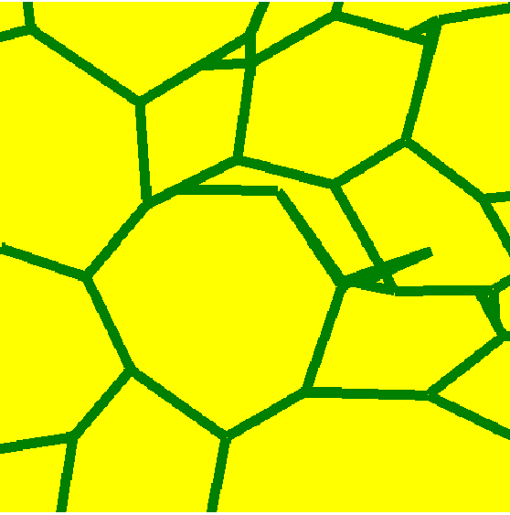
Fuel Breaks: fire containment
Reinforce existing defensible positions
Active suppression needed
Tactics: indirect attack
Reduced fire effects only if fires are smaller, intensities unchanged
Burnout: larger wildfires, higher severity
Typical for buffering high-value areas (WUI)
Maintenance?
Notes:
Fire containment strategy – very common for people to think of this, but there is a problem in that there is no evidence that we can stop fires at fuel breaks, very poor performance history (slides will follow to demonstrate).

Slide 45
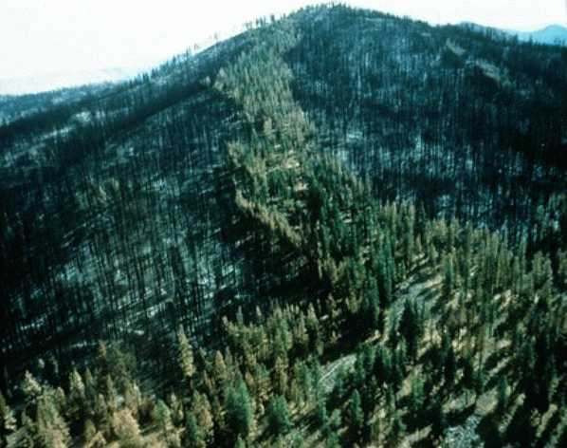
Tyee Fire, Washington State, 1994
Notes:
Fuel break “performance” of Tyee fire in 1994 (black on both sides indicates failure of “containment” objective)

Slide 46
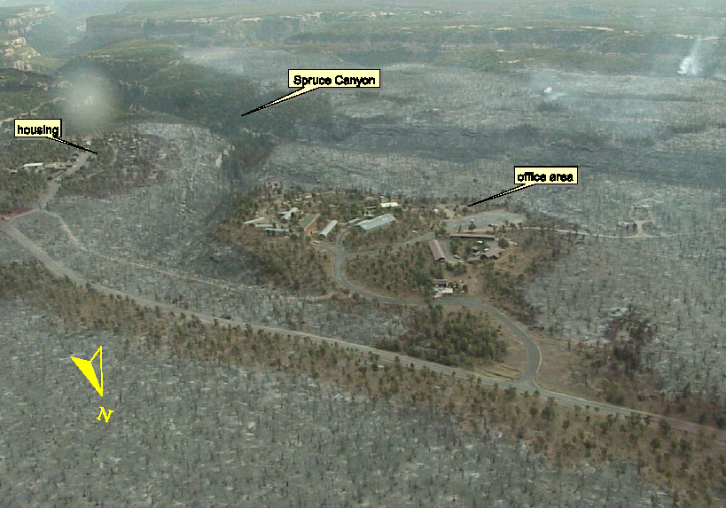
Long Mesa Fire 7/2002, Mesa Verde NP
FUEL TREATMENT
Notes:
Long-mesa fire in Mesa Vere NP – fuel break black on both sides indicating failure in containment. Fuel changes made meaningful changes to fire behavior and severity, but the configuration of these units and the INTENT TO CONTAIN FIRES (not just change behavior) has failed.

Slide 47
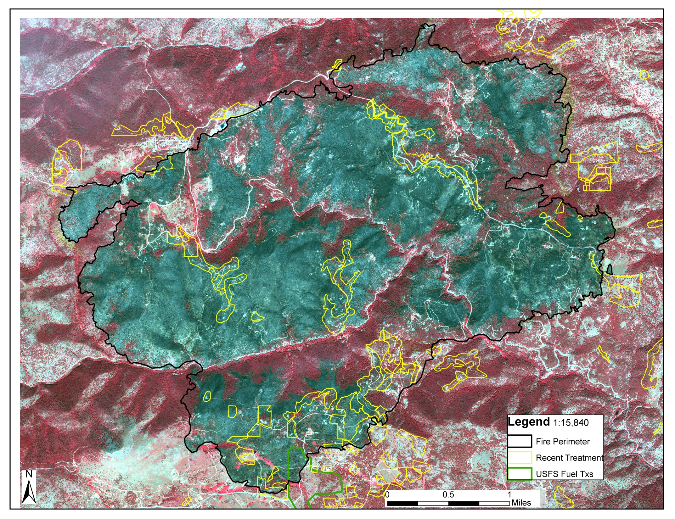
Fourmile Canyon fire,
Boulder Colorado September 2010

Slide 48
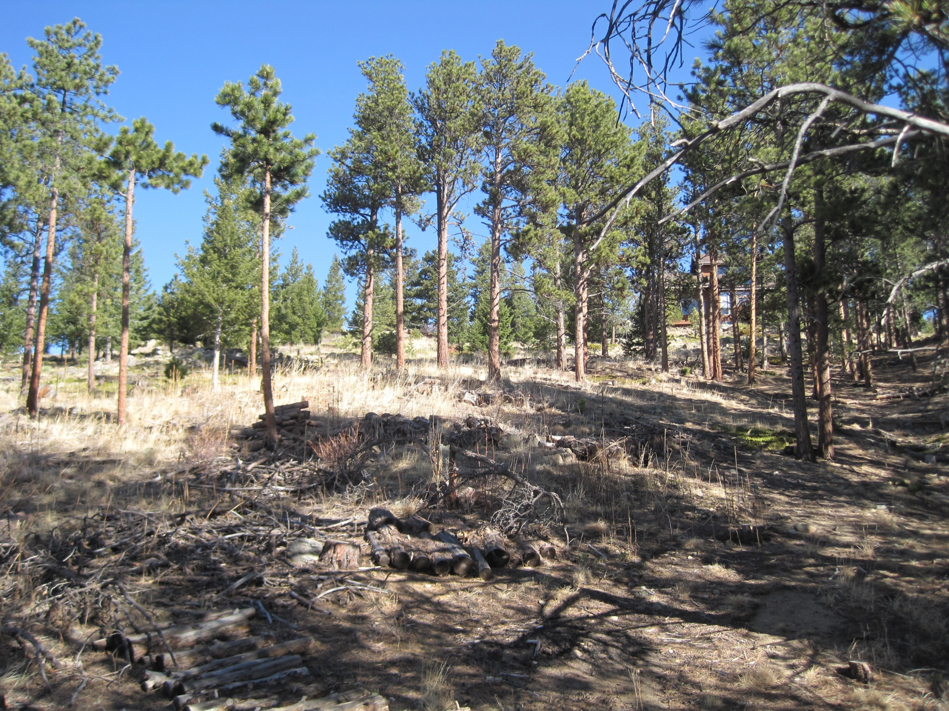

Slide 49
2 Strategies for Landscape Fuel Treatments
Fire Containment
Fuelbreaks
Fire Modification
Area/dispersed treatments
Notes:
Compare and contrast two fundamental strategies

Slide 50
Area Treatments: Fire Modification
Treatments meant to burn
Suppression adapts to
modified fire behavior
All tactics (direct, indirect,
parallel)
Modified fire effects, indep. of fire size
More appropriate for wildland landscape
Maintenance or new units -- mosaic
Notes:
Alternative approach – recognize that we can’t stop fires under extreme conditions – but good evidence of changing behavior. Thus, if behavior is changed, then effects and suppression can follow suit

Slide 51
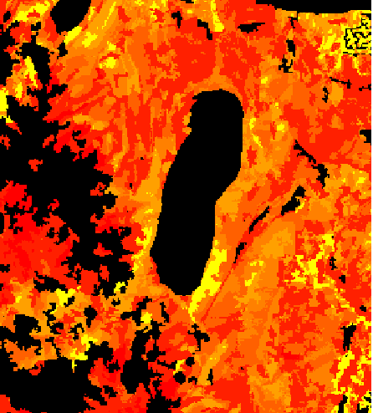
Possible Treatment Criteria
Highest Hazard
F
l
a
m
e
L
e
n
g
t
h
(
m
)
0
.
0
-
0
.
5
0
.
5
-
1
.
0
1
.
0
-
1
.
5
1
.
5
-
2
.
0
2
.
0
-
2
.
5
2
.
5
-
3
.
0
3
.
0
-
4
.
0
4
.
0
-
6
.
0
6
.
0
-
9
.
0
Notes:
Start list of possible criteria in picking units to treat on landscape

Slide 52
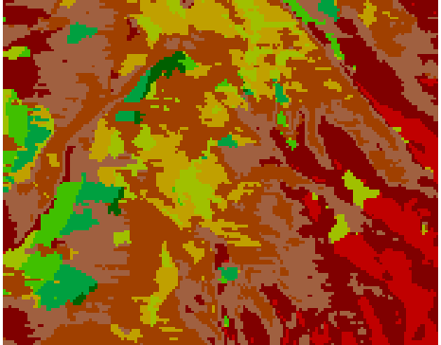
Possible Treatment Criteria
Highest Hazard
Ecological Need
Fire Cycles Missed
8
+
7
6
5
4
3
2
1
0
Notes:
Continue with list

Slide 53
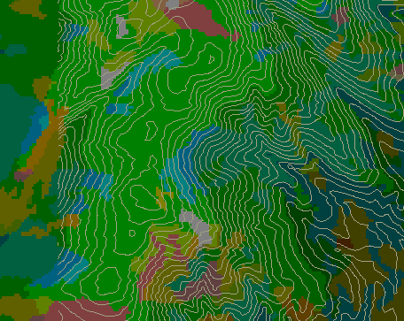
Possible Treatment Criteria
Highest Hazard
Ecological Need
Easy Areas (operationally)

Slide 54
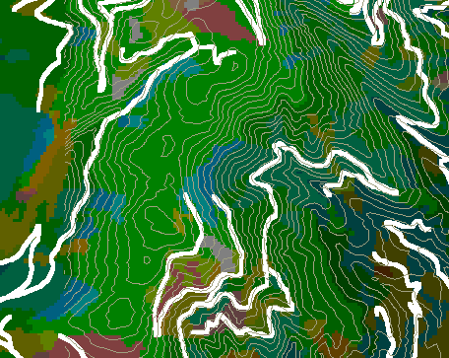
Possible Treatment Criteria
Highest Hazard
Ecological Need
Easy Areas (operationally)
Accessible Areas
Visible Areas

Slide 55
Problems & Questions
Criteria don’t consider how fires move across landscape
Not topological with respect to fire – don’t incorporate spatial fire behavior
What properties of spatial patterns are important to fire behavior and growth?
Notes:
Despite the routine use of the preceding criteria by fire management, there are problems with using these alone: Don’t consider movement of fires across the landscape! This is critical to changing large fires

Slide 56
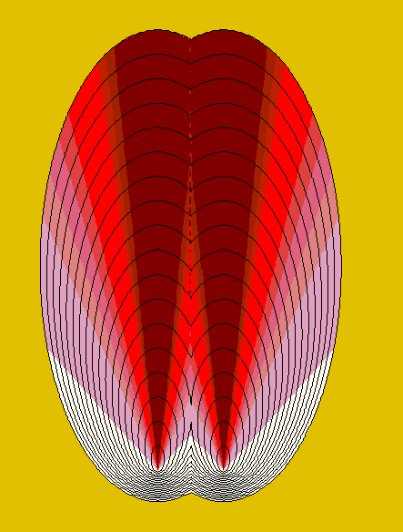
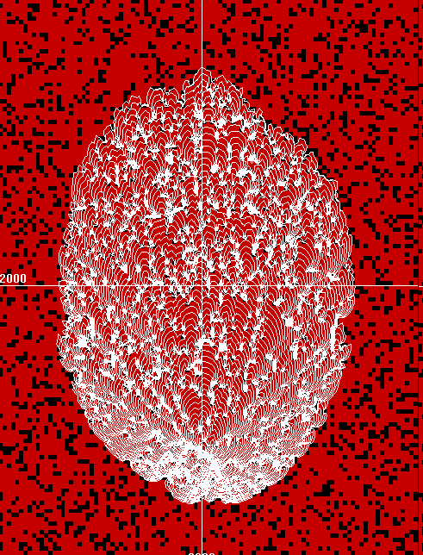
~20% treatment
Random
Notes:
One solution, just put in fuel treatments randomly. Simulation (FARSITE) used to compare them. Left – fire growth and intensity pattern with no treatment. Right, fire growth with 20% random – note that there isn’t much difference. By the way, can ask how much of a given landscape people think they can treat and maintain.

Slide 57
Random Fuel Patterns, 2 Fuel Types
1
0.9
0.8
Treatment
ROS
0.7
0.6
0.5
0.5
Average Spread Rate
0.4
0.3
0.2
0.2
0.1
0.1
0.01
0
0
0.2
0.4
0.6
0.8
1
Fraction of Landscape Treated
Notes:
Summary of random effects for changing proportion of landscape treated. Four lines depict 4 intensities of treatment prescription within the unit – changes in spread rate. Note that all lines are coincident at low fractions treated, meaning that fire is just going around the treatments no matter what treatment prescription is applied. Use highway example: 4 lane highway, you will pass any car that is going slower than you (irrespective if how much slower) if you can switch lanes and go around them. Only when highway gets crowded with cars (i.e. treatments) do you have to slow down and wait before you can pass.
Random patterns are very inefficient – must treat a lot before you get the effect.

Slide 58
Examples of Area- Treatment Effects
Nature -- Yosemite, Sequoia and Kings Canyon NPs, Gila Wilderness
Natural Fire Programs since 1970’s
Notes:
Start of series of slides for example of natural fire patterns – random patterns that do change fire progress on landscape but only after large fractions of landscape are “treated” or fuels are modified by previous fires.

Slide 59
Source: J.van Wagtendonk
Notes:
Fire suppression era– killed all fires in 42 years

Slide 60
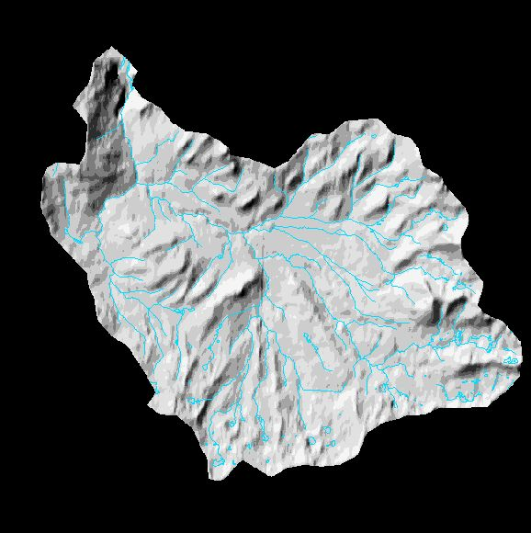
Illilouette Creek Fires
1973
-
1979
1973
-
1979
Source: J.van Wagtendonk
Notes:
A few fires, no interaction among first fire patterns

Slide 61
Illilouette Creek Fires
1973
-
1986
1980
-
1986
1973
-
1979
Source: J.van Wagtendonk
Notes:
More fires and more interaction

Slide 62
Illilouette Creek Fires
1973
-
1993
1987
-
1993
1980
-
1986
1973
-
1979
Source: J.van Wagtendonk
Notes:
Lots of interaction of fire perimeters – jigsaw puzzle pattern starting to form.

Slide 63
Illilouette Creek Fires
1973
-
2000
1987
-
1993
1980
-
1986
1973
-
1979
1994
-
2000
Source: J.van Wagtendonk

Slide 64
Illilouette Creek Fires
1973
-
2004
1987
-
1993
1980
-
1986
1973
-
1979
1994
-
2000
2001
-
2004
Source: J.van Wagtendonk

Slide 65
Random Treatments
Inefficient (large treatment % needed)
Treatment level irrelevant (at low fractions of area treated)
Notes:
Summary of random patterns. Probably the most stupid thing we can do if our objective is to have fuel treatments limit the largest fires.

Slide 66
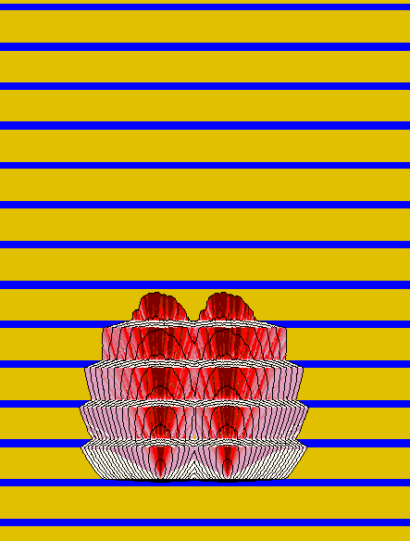
Complete Overlap
20% Treatment
Random
No Treatment
Notes:
Contrasting patterns with theoretical alternative – parallel strips are VERY EFFICIENT – they force fire to go through and not around, but highly IMPRACTICAL – (Why? Because can’t treat everywhere you want to, don’t own the land, might have owls there etc.), also don’t know exactly the direction that fires come from).

Slide 67
1
0.9
0.8
0.7
0.6
Expected Spread Rate
0.5
Treatment
ROS
0.4
0.3
0.2
0.2
0.1
0.1
0.05
0
0
0.2
0.4
0.6
0.8
1
Fraction of Landscape Treated
Practical amount of Treatment
Notes:
Look how efficient parallel strips are on same chart as before – treat a little bit and change gross fire spread rate a large amount. Also different treatment intensities make a big difference – that is, you can treat fewer acres if you treat them effectively.

Slide 68
Parallel Strips
Very efficient (small treatment % needed for big effect)
Impractical – treatment restrictions, fire spread direction
Notes:
Summary of parallel strips

Slide 69
1
0.9
Random
Practical but Ineffective
0.8
0.7
0.6
Expected Spread Rate
0.5
0.4
Parallel
Impractical but effective
0.3
SRR=
0.2
0.2
0.1
0
0
0.2
0.4
0.6
0.8
1
Fraction of Landscape Treated
Fraction of Landscape Treated
Notes:
Compare basic patterns – since both are either impractical or ineffective, RAISE the question – is there anything in between? Something that is both PRACTICAL and EFFICIENT?

Slide 70
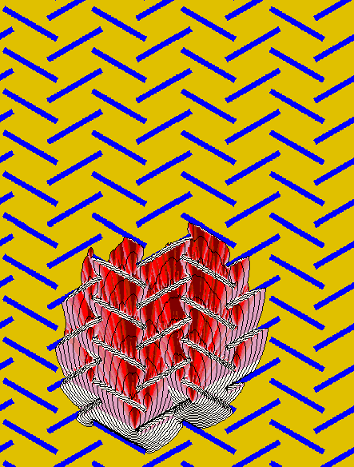
~20% treatment
Random
Strips
Strategic
Notes:
SPLATS – theoretical pattern of disconnected treatment units that overlap in the primary heading fire direction – note that this is theoretical and we wouldn’t want to try to implement such a strict pattern, but it gives us an image of what properties of spatial patterns are important to disrupting the growth of fires – Orientation of units against heading direction, overlapping, short spacing compared to scale of the fire….

Slide 71
1
0.9
0.8
Random
0.7
0.6
Expected Spread Rate
Partial Overlap
0.5
0.4
Parallel Strips
0.3
0.2
0.2
0.1
0
0
0.2
0.4
0.6
0.8
1
Fraction of Landscape Treated
Fraction of Landscape Treated
Practical amount of Treatment
Notes:
Here’s the comparison – the partially overlapping pattern – both efficient and hopefully practical – it is a REGION not a LINE because of many possible dimension of the pattern – lots of flexibility.

Slide 72
S
L
W
O
Notes:
Start of slide-series cartoon, showing fire movement among optimal units. Units are dimensioned in terms of Width, Length, Separation and Overlap

Slide 73
Notes:
Fire moves quickly through the gap between units – and hits next row of treatment

Slide 74
Notes:
Fire flanks around treatment

Slide 75
Notes:
Fire flanks until it can circumvent the unit and then heads up to next row where the fingers of the fire contact treatment units.

Slide 76
Notes:
And the fire growth pattern repeats

Slide 77
Flanking=
Lower ROS
& Intensity
Notes:
Note that there are areas where the fire had to flank – lower intensity. These areas are not treated but lie outside treatment units on lee-side. This is a bonus effect of treatment.

Slide 78
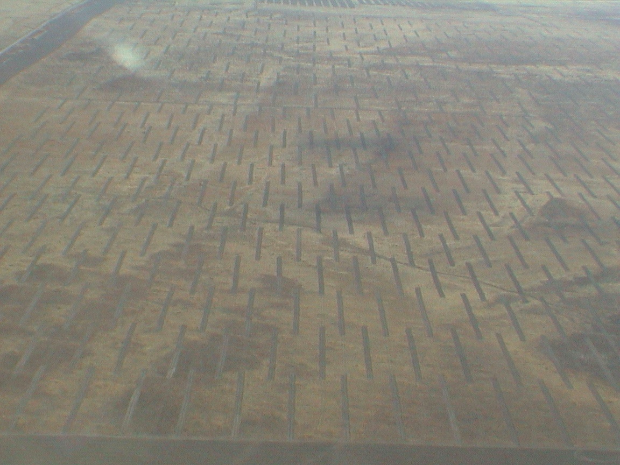
Gil Dustin, BLM
Notes:
Gil Dustin’s work – disk lines in cheat grass – planted with less flammable species – he tested different disk line spacings (treatment fractions) and then lit the units on fire.

Slide 79
Gil Dustin, BLM Salt Lake City UT
Notes:
Fire grew through the strips like predicted. Note triangular shapes on lee sides of strips caused by backing and flanking

Slide 80
Gil Dustin, BLM Salt Lake City UT
Notes:
Fire spread around treatments but slams into next row. This is good test of theory under very simple fuel situations.

Slide 81
Gil Dustin, BLM Salt Lake City UT
Notes:
Gil’s results. Notice that the curve shape is similar to the parallel strips from previous slides – but reversed.

Slide 82
Practical Implications
Specific weather conditions (i.e. 99th percentile) - ROS, fire shapes, sizes, general spread directions
Treatments must overlap in heading direction
Scale independent (~10¹-10³m)
Scale of patterns finer than fire sizes
Tradeoff between intensive and extensive treatment strategies
Notes:
What do we learn from this about how to design landscape level treatment patterns

Slide 83
Practical Implications
Specific weather conditions (i.e. 99th percentile) - ROS, fire shapes, sizes, spread directions
SPLATs overlap in heading direction
Scale of patterns finer than fire sizes
Scale independent (~10¹-10³m)
Tradeoff between intensive and extensive treatment strategies
Partial Overlap is flexible with spatial constraints

Slide 84
Practical Implications
Specific weather conditions (i.e. 99th percentile) - ROS, fire shapes, sizes, spread direction
SPLATs overlap in heading direction
Scale of patterns finer than fire sizes (e.g. S<fire length)
Scale independent (~10¹-10³m)
Tradeoff between intensive and extensive treatment strategies
Flexible with spatial constraints
Reduced intensities within fire area

Slide 85
Notes:
Example of strategic thinking. Green blobs are treatment units identified before any strategy. Look at fire history atlas and find that “large” fires are typically oriented a certain direction because of winds and are of a rough size (dotted ellipses) – these treatments leave large areas unaffected by any treatment.

Slide 86
Notes:
Now, the treatments are modified in orientation and size to repeatedly interrupt fires – note some places cannot be treated or have influence of treatments -- might be land ownership etc.

Slide 87
Applications of Theory
Apply topological principles to real conditions (heterogeneity)
Accommodate conflicts with other resource objectives
Scheduling (space, time)
Examine long-term impacts (~20-50 yrs, simulations)
Notes:
Practical examples of application of theory. – last two points have almost no research – need research on these!

Slide 88
BWCA, Minnesota

Slide 89
BWCA, Minnesota
~200,000 ha of blowdown July 4th 1999
Swath from west to east
25 miles
Surface Fuel
Model
5
6
8
9
1
0
1
3
9
8
9
9
Notes:
Blowdown ½ million ac (red)

Slide 91
Overlapping Treatment Pattern
Increase continuity of lakes (burn islands,
peninsulas, isthmuses)
Decrease continuity of fuels (treatment patches)
Primary spread direction (from west)
Notes:
Application of theory to these areas

Slide 92
Overlapping Treatment Pattern
Notes:
Identify possible units, keeping in mind the objective of overlap and orientation

Slide 93
Notes:
Final EIS from BWCA – showing units identified to form the pattern – talk about comparison to theory (lakes etc.)

Slide 98
Flagstaff Arizona
Fuel Treatment
Optimization
Analysis Area
Notes:
We used this algorithm on an area by Flagstaff AZ

Slide 99
Flagstaff
Notes:
Example from Flagstaff AZ on treatment orientation – most large fires are oriented SW to NE because of winds – this gives us a lot of information on the movement and weather conditions that our fuel treatments will need to perform under --

Slide 100
Notes:
Figure 2 – Treatment Optimization Model Simulation 1. Allowable treatment area 20%, maximum size and extent of treatment units 2,500 meters.

Slide 101
Notes:
Figure 3 - Treatment Optimization Model Simulation 2. Allowable treatment area 20%, maximum size and extent of treatment units 1,200 meters.

Slide 102
Three Frequent Questions
How much fuel treatment is necessary?
What will we get for it?
What are our priorities?
Answer:
Depends on spatial pattern

Slide 103
Summary: Main Points
Historical Perspective: less burning now than in history (settlement) and pre-history
Changes in fuel/vegetation conditions (continuity)
Modern fires & behavior: even with suppression, fire is inevitable
What can we do about it? (burn intentionally, strategically)

Slide 104
Challenge for Fuel Treatments
Wildfires are rare (on a given acre)
Most treatments won’t be affected by fire in their lifetime
Analyze treatment effects as changing Risk

Slide 106
Risk : Actuarial Definition
Risk = expected loss or expected net value change
Variation around E[nvc]
Risk Recipe Requires:
Burn Probabilities
Fire Behavior Distribution (hazard)
Values Changes wrt Fire Behaviors (sensitivities)
Can’t infer risk if you are missing any of the ingredients
Probabilities by themselves are meaningless
Hazard by itself is meaningless
Values by themselves are meaningless

Slide 107
Risk : Actuarial Recipe
Risk = expected loss or expected net value change
1. Summations over values, fire characteristics, time, area etc.
2. Probabilities of fire behavior
3. Response Function)

Slide 108
Fire Risk Management
Risk = expected loss or expected net value change
Risk=Probability of Fire Behavior * Effects
Landscape
level
Stand
level
Construction
(roofing,
decks,
Sprinklers…)
Yard &
Ornamental
vegetation
Wildland Fuel Management
Home Ignition Zone
Notes:
Summary of fire risk management – probability times the consequence. Wildland fuel management can change the probability at the landscape level and consequences at the stand level.

Slide 109
Fire Risk Management
Risk = expected loss or expected net value change
Risk=Probability of Fire Behavior * Effects
Landscape
level
Stand
level
Wildland Fuel Management
Notes:
Summary of fire risk management – probability times the consequence. Wildland fuel management can change the probability at the landscape level and consequences at the stand level.

Slide 110
Probabilities
Landscape level
Dominated by fire spread
Weather for high-spread events very important (more acres)

Slide 111
Deschutes National Forest, Oregon
Fire Occurrence
1987-2002 (15 years)
3155 fires/15 years/1,954,563 acres
= 210/year/1,954,563 ac
= 0.000108
fires/ac/year

Slide 112
Deschutes National Forest, Oregon
Large Fires
1910-2001 (91 years)
239 large fires,
246,761 total acres
Fire Rotation
=1,954,563/246,761/91
=721 years to burn area of this size
Annual Burn Probability
1.0/721 = 0.00138
Burning is ~10 times more likely than ignition

Slide 113
Probabilities
Landscape level
Dominated by fire spread
Weather for high-spread events very important (more acres)
Affects fire behavior – trajectory (heading, flanking, backing)

Slide 114
Fire Behavior Varies by Spread Direction
heading
flanking
backing
ROS/FLI

Slide 116
Rodeo-Chediski Fires 2002, Arizona
Notes:
Landsat 7 ETM+ Bands 6,4,2 for the Rodeo-Chediski Fire. Image Date is July 07, 2002 at 11:00 in the morning….

Slide 117
Hi Meadow Fire, Colorado
June 2000

Slide 118
Alder Wildfire, Missoula MT 2000

Slide 119
1
0.9
0.8
Random
0.7
0.6
Treatment
ROS
Average Spread Rate/
Fire Size/
Probability
0.5
0.4
0.3
0.2
0.2
0.1
0
0
0.2
0.4
0.6
0.8
1
Fraction of Landscape Treated

Slide 120
Random Fuel Patterns, 2 Fuel Types
1
0.9
0.8
Treatment
ROS
0.7
0.6
0.5
0.5
Average Spread Rate
0.4
0.3
0.2
0.2
0.1
0.1
0.01
0
0
0.2
0.4
0.6
0.8
1
Fraction of Landscape Treated
Notes:
Summary of random effects for changing proportion of landscape treated. Four lines depict 4 intensities of treatment prescription within the unit – changes in spread rate. Note that all lines are coincident at low fractions treated, meaning that fire is just going around the treatments no matter what treatment prescription is applied. Use highway example: 4 lane highway, you will pass any car that is going slower than you (irrespective if how much slower) if you can switch lanes and go around them. Only when highway gets crowded with cars (i.e. treatments) do you have to slow down and wait before you can pass.
Random patterns are very inefficient – must treat a lot before you get the effect.

Slide 121
~20% treatment
Random
Notes:
One solution, just put in fuel treatments randomly. Simulation (FARSITE) used to compare them. Left – fire growth and intensity pattern with no treatment. Right, fire growth with 20% random – note that there isn’t much difference. By the way, can ask how much of a given landscape people think they can treat and maintain.

Slide 122
Examples of Area- Treatment Effects
Nature -- Yosemite, Sequoia and Kings Canyon NPs, Gila Wilderness
Natural Fire Programs since 1970’s
Notes:
Start of series of slides for example of natural fire patterns – random patterns that do change fire progress on landscape but only after large fractions of landscape are “treated” or fuels are modified by previous fires.

Slide 123
Source: J.van Wagtendonk
Notes:
Fire suppression era– killed all fires in 42 years

Slide 124
Illilouette Creek Fires
1973
-
1979
1973
-
1979
Source: J.van Wagtendonk
Notes:
A few fires, no interaction among first fire patterns

Slide 125
Illilouette Creek Fires
1973
-
1986
1980
-
1986
1973
-
1979
Source: J.van Wagtendonk
Notes:
More fires and more interaction

Slide 126
Illilouette Creek Fires
1973
-
1993
1987
-
1993
1980
-
1986
1973
-
1979
Source: J.van Wagtendonk
Notes:
Lots of interaction of fire perimeters – jigsaw puzzle pattern starting to form.

Slide 127
Illilouette Creek Fires
1973
-
2000
1987
-
1993
1980
-
1986
1973
-
1979
1994
-
2000
Source: J.van Wagtendonk

Slide 128
Illilouette Creek Fires
1973
-
2004
1987
-
1993
1980
-
1986
1973
-
1979
1994
-
2000
2001
-
2004
Source: J.van Wagtendonk

Slide 129
Chrandal Creek
Saddle
Mustang

Slide 130
Random Treatments
Inefficient (large treatment % needed)
Treatment level irrelevant (at low fractions of area treated)
Bigger fires move faster than smaller fires (larger sample size for rare fuels)
Notes:
Summary of random patterns. Probably the most stupid thing we can do if our objective is to have fuel treatments limit the largest fires.

Slide 131
Complete Overlap
20% Treatment
Random
No Treatment
Notes:
Contrasting patterns with theoretical alternative – parallel strips are VERY EFFICIENT – they force fire to go through and not around, but highly IMPRACTICAL – (Why? Because can’t treat everywhere you want to, don’t own the land, might have owls there etc.), also don’t know exactly the direction that fires come from).

Slide 132
1
0.9
0.8
0.7
0.6
Expected Spread Rate
0.5
Treatment
ROS
0.4
0.3
0.2
0.2
0.1
0.1
0.05
0
0
0.2
0.4
0.6
0.8
1
Fraction of Landscape Treated
Practical amount of Treatment
Notes:
Look how efficient parallel strips are on same chart as before – treat a little bit and change gross fire spread rate a large amount. Also different treatment intensities make a big difference – that is, you can treat fewer acres if you treat them effectively.

Slide 133
1
0.9
Random
Practical but Ineffective
0.8
0.7
0.6
Expected Spread Rate
0.5
0.4
Parallel
Impractical but effective
0.3
SRR=
0.2
0.2
0.1
0
0
0.2
0.4
0.6
0.8
1
Fraction of Landscape Treated
Fraction of Landscape Treated
Notes:
Compare basic patterns – since both are either impractical or ineffective, RAISE the question – is there anything in between? Something that is both PRACTICAL and EFFICIENT?

Slide 134
~20% treatment
Random
Strips
Strategic
Notes:
SPLATS – theoretical pattern of disconnected treatment units that overlap in the primary heading fire direction – note that this is theoretical and we wouldn’t want to try to implement such a strict pattern, but it gives us an image of what properties of spatial patterns are important to disrupting the growth of fires – Orientation of units against heading direction, overlapping, short spacing compared to scale of the fire….

Slide 135
1
0.9
0.8
Random
0.7
0.6
Treatment
ROS
Average Spread Rate/
Fire Size/
Probability
Strategic
0.5
0.4
Parallel Strips
0.3
0.2
0.2
0.1
0
0
0.2
0.4
0.6
0.8
1
Fraction of Landscape Treated

Slide 136
Boundary Waters Canoe Area,
Superior National Forest, MN

Slide 139
Cheatgrass/Sage Utah

Slide 140
Gil Dustin, BLM

Slide 141
Gil Dustin, BLM Salt Lake City UT

Slide 142
Gil Dustin, BLM Salt Lake City UT

Slide 143
Gil Dustin, BLM Salt Lake City UT
Notes:
Gil’s results. Notice that the curve shape is similar to the parallel strips from previous slides – but reversed.

Slide 144
Summary: Main Points
Historical Perspective: less burning now than in history (settlement) and pre-history
Changes in fuel/vegetation conditions (continuity)
Modern fires & behavior: even with suppression, fire is inevitable
What can we do about it? (burn intentionally, strategically)

