Slide 1
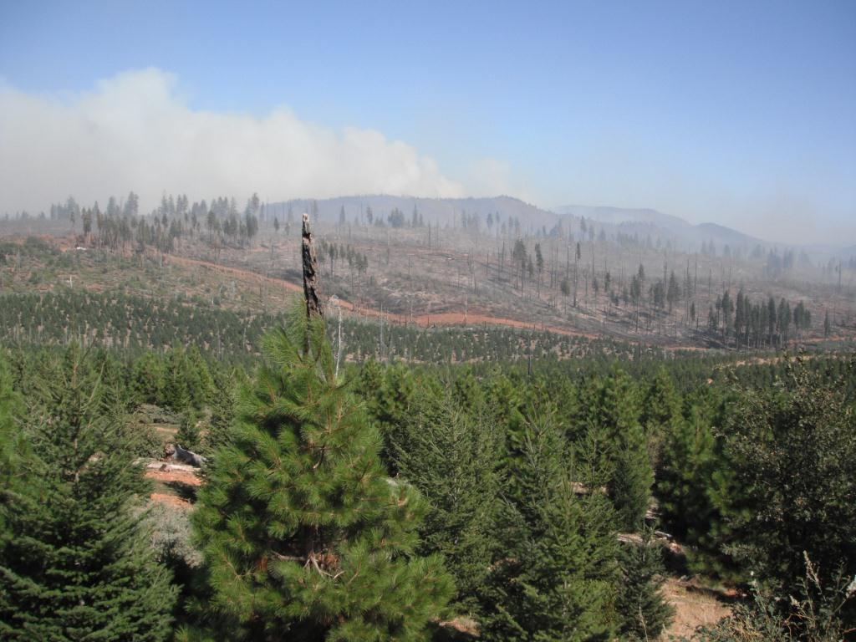
Role of Vegetation Management in Protecting Plantation Investments from Wildfire:
Some considerations, examples and lessons learned
Bob Rynearson
W. M. Beaty & Associates, Inc.
35th Annual
Forest Vegetation Management Conference
Fire Resilient Reforestation

Slide 2
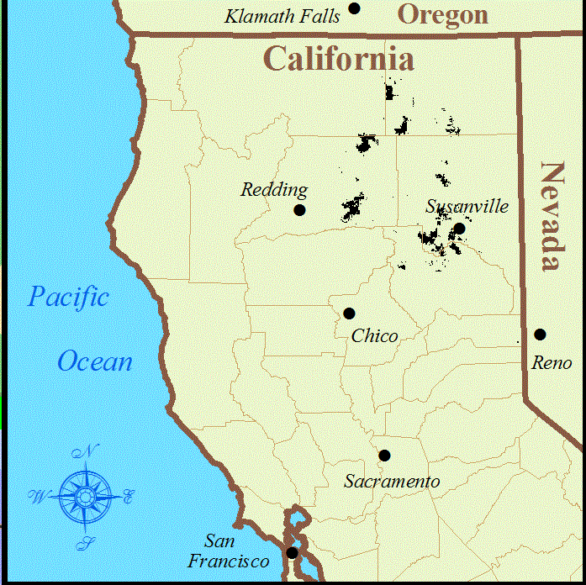
Beaty managed forest lands in NE California
Plantations from 1/2 ac to 14,000 ac
Notes:
NE Calif.:
- PPT range 15” to 70”
- mostly well-drained, volcanic, stable soils on moderate terrain
-mixed conifer to eastside pine w/ true fir @ high elev.
-heavy white fir mortality during periodic droughts
- long dry summers & frequent dry lightning
- markets for wood fuel chips

Slide 3
Key Factors to Reduce Plantation Losses from Wildfire
  Management of Adjacent Timberlands in the Watershed
Maximize individual tree growth to reduce damage and/or shorten time of exposure to risk of economic loss
  Reduce Plantation Fuel Loads & Configuration
  Vegetation Management Activities that Facilitate Fire Suppression Efforts

Slide 4
Key Factors to Reduce Plantation Losses from Wildfire
  Management of Adjacent Timberlands in the Watershed – Fuel management and/or biomass thinning the landscape surrounding a plantation greatly enhances the positive effects of fuel management in a plantation, especially “small” plantations
Maximize individual tree growth to reduce damage and/or shorten time of exposure to risk of economic loss
  Reduce Plantation Fuel Loads & Configuration
  Vegetation Management Activities that Facilitate Fire Suppression Efforts

Slide 5
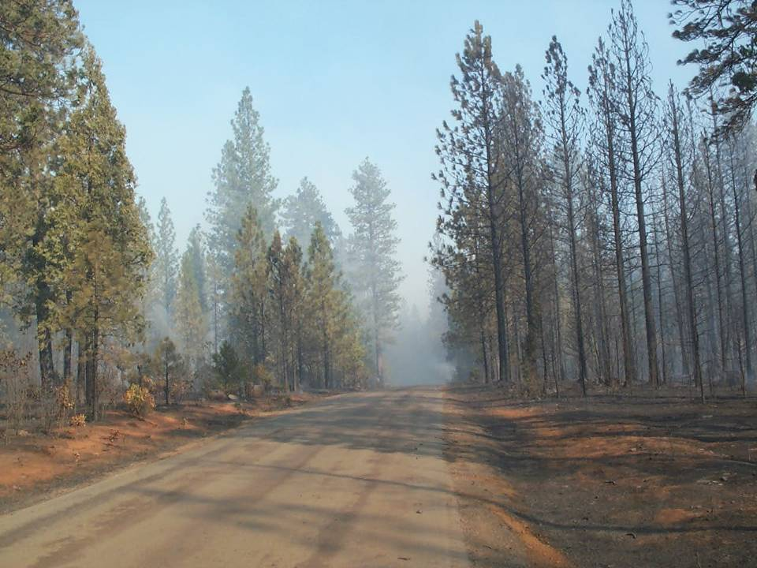
Oct. 2003 Whitmore Wildfire
Stand thinned in 2002 =
ground fire
Un-thinned stand =
Crown fire
Wind Direction

Slide 6
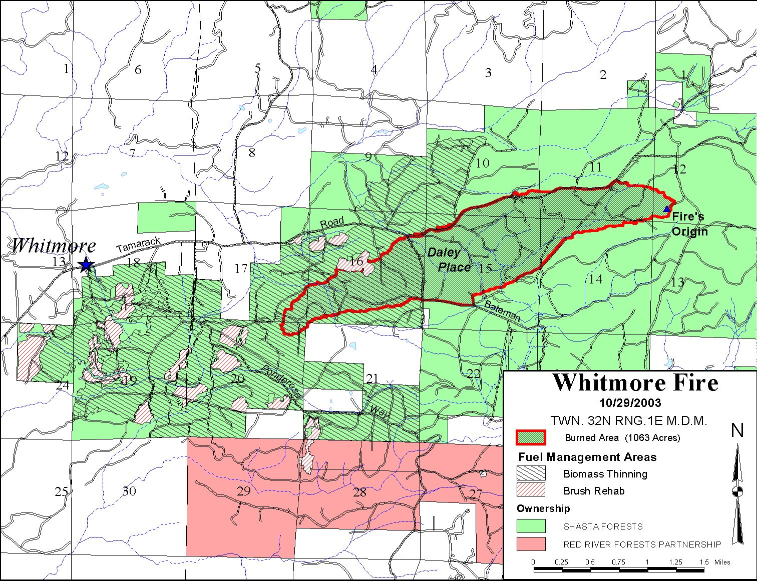
Wind Direction from east
Shaded Fuelbreak

Slide 7
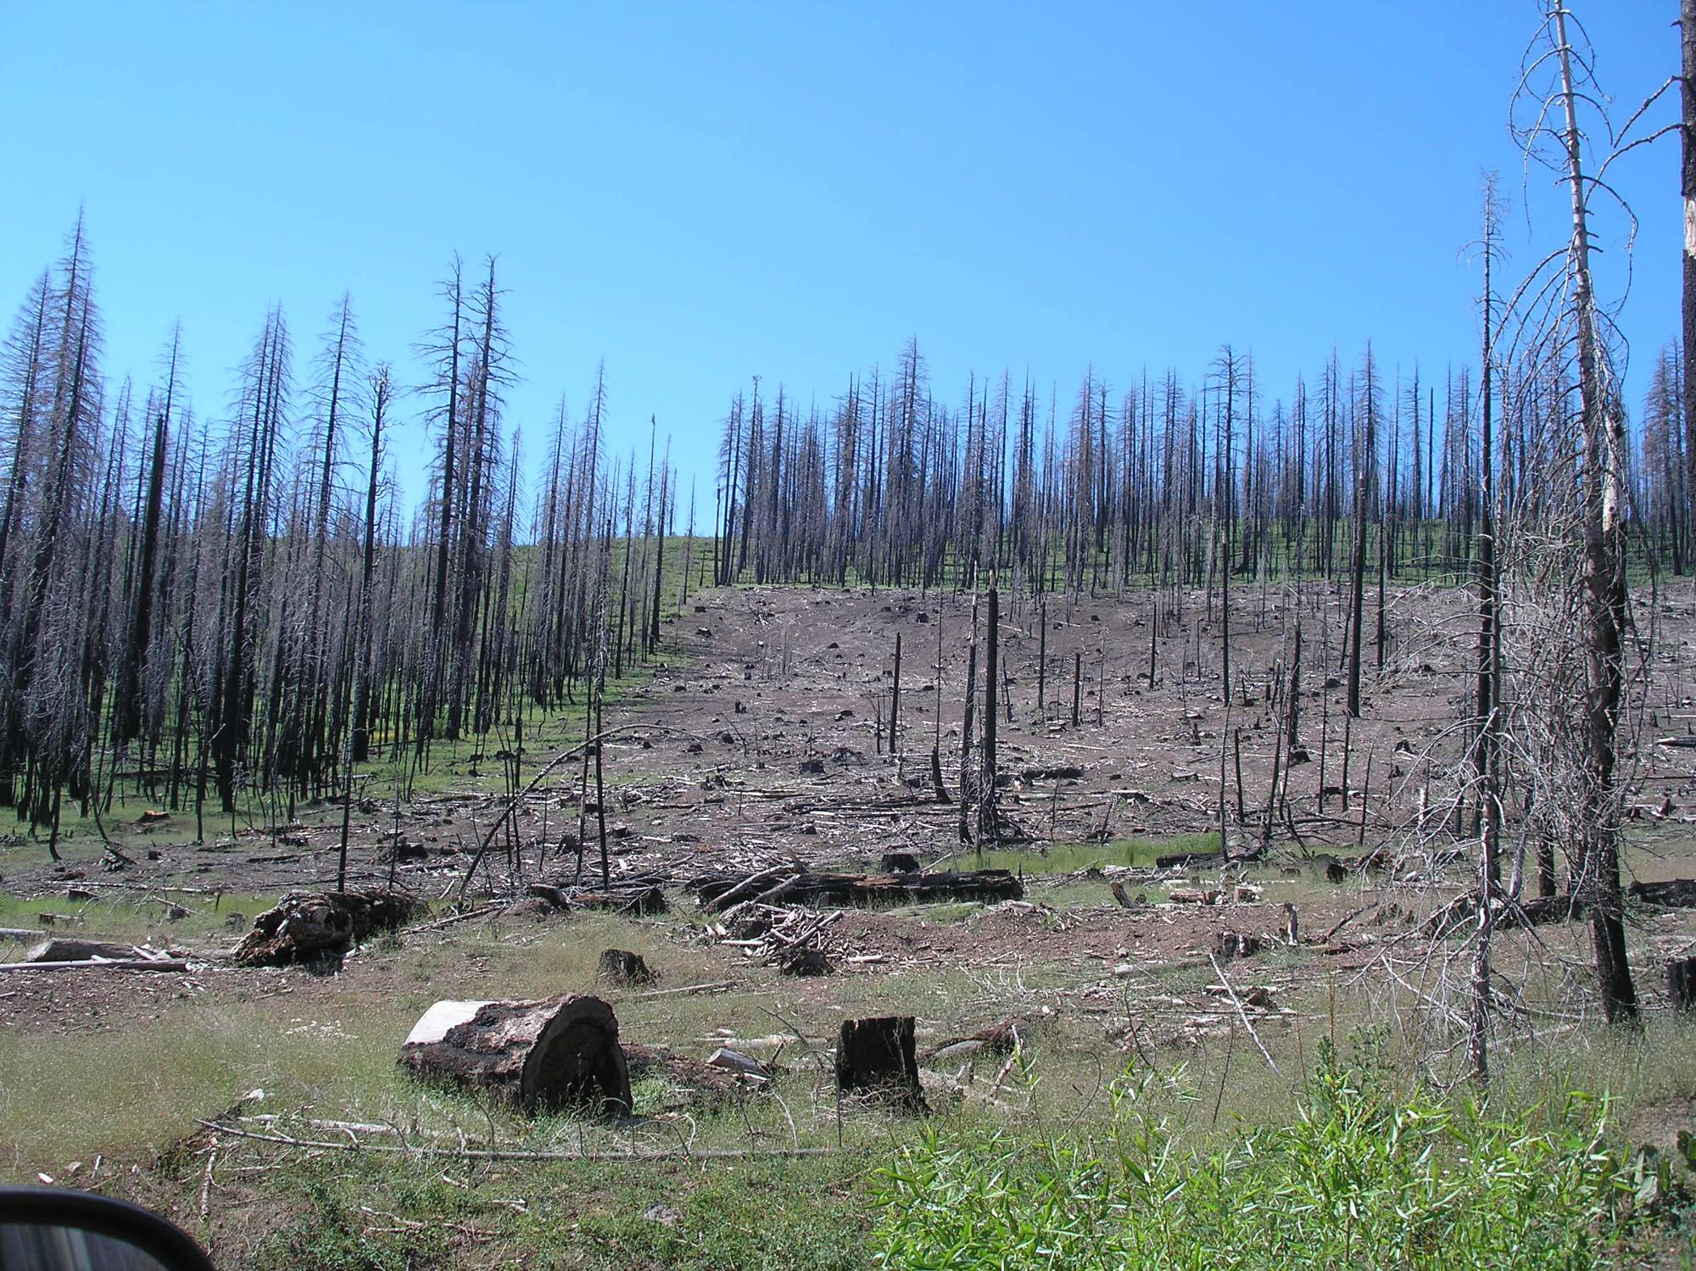
Management decisions after wildfire are influenced by neighboring land manager’s post-fire fuel management decisions ….

Slide 8
Key Factors to Reduce Plantation Losses from Wildfire
  Management of Adjacent Timberlands in the Watershed
Maximize individual tree growth to reduce damage and/or shorten time of exposure to risk of economic loss
  quality seed and seedling stock & planting operations
  early weed control
  stocking control - limit inter-tree competition
  Reduce Plantation Fuel Loads & Configuration
  Vegetation Management Activities that Facilitate Fire Suppression Efforts

Slide 9
Key Factors to Reduce Plantation Losses from Wildfire
  Management of Adjacent Timberlands in the Watershed
Maximize individual tree growth to reduce damage and/or shorten time of exposure to risk of economic loss
  Reduce Plantation Fuel Loads & Configuration
  Site preparation: re-sprouting brush, dead wood etc.
  Grass/forb vs. Brush control - suitable road access for spray crews
  Spacing: Initial plant, PCT and/or Biomass Thin
  Plantation Vigor & Health
  Vegetation Management Activities that Facilitate Fire Suppression Efforts

Slide 10
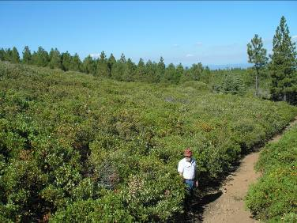
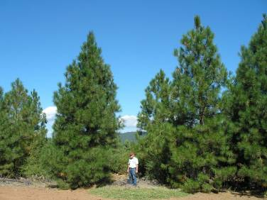
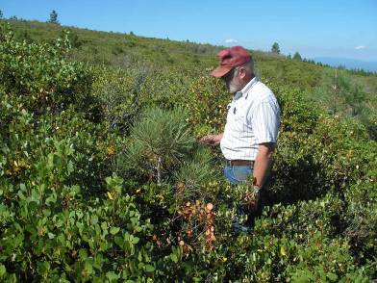
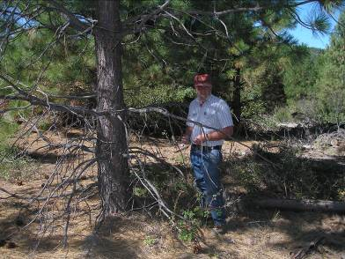
16 year old plantation Modoc Co.: both areas planted after wildfire
No weed control (L) vs. weed control (R)
Notes:
16 year old plantation on the 1990 Day Fire. Plantation on left (foreground of upper left picture) is BLM that was planted without site prep spraying or followup weed control.
Plantation on right is on Red River Forests that was planted after site prep spray and followed by release spray treatment.

Slide 11
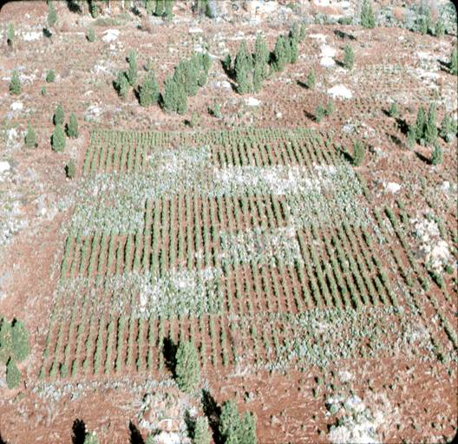
PSW “Garden of Eden” Study
Whitmore Study Site - W.M Beaty
HF
F
HF
HF
FI
C
F
F
H
HFI
HF
C
F
C
F
H
H
C
HI
H
I

Slide 12
PSW Whitmore Study Site W.M Beaty
What does vegetation treatment buy you?
FI
HFI
C
C
F
H
I

Slide 13
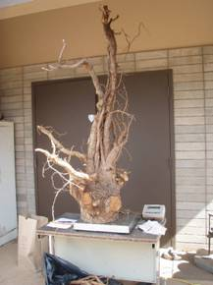
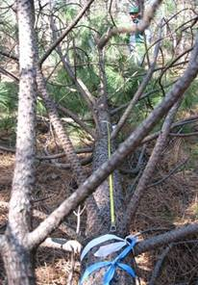
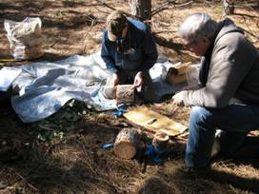
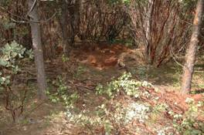
PSW “Garden of Eden” Study
Whitmore Site - W. M. Beaty & Assoc.
FI
F
I
Destructive sampling
at 21 years

Slide 14
WHITMORE STANDING BIOMASS AT 21 YEARS
All Vegetation
200
150
Trees
Pine Foliage
100
Pine Branches
Trees
Pine Boles
Mg per ha
Understory Tops
50
Forest Floor
Understory Coarse Roots
0
Pine Coarse Roots
C
H
Fine Roots
-50
-100

Slide 15
WHITMORE: GROWTH WILDFIRE EXCLUDED
300
250
TREES
SHRUBS
200
FOREST FLOOR
ROOTS
Mg CARBON ha⁻¹
150
100
50
0
C
H
C
H
C
H
C
H
C
H
10
20
30
40
50
PLANTATION AGE (yrs)

Slide 16
WHITMORE: NET GROWTH WITH WILDFIRE (20 yr cycle)
300
TREES
250
SHRUBS
200
FOREST FLOOR
ROOTS
Mg CARBON ha⁻¹
150
100
50
0
C
H
C
H
C
H
C
H
C
H
10
20
30
40
50
PLANTATION AGE (yrs)

Slide 17
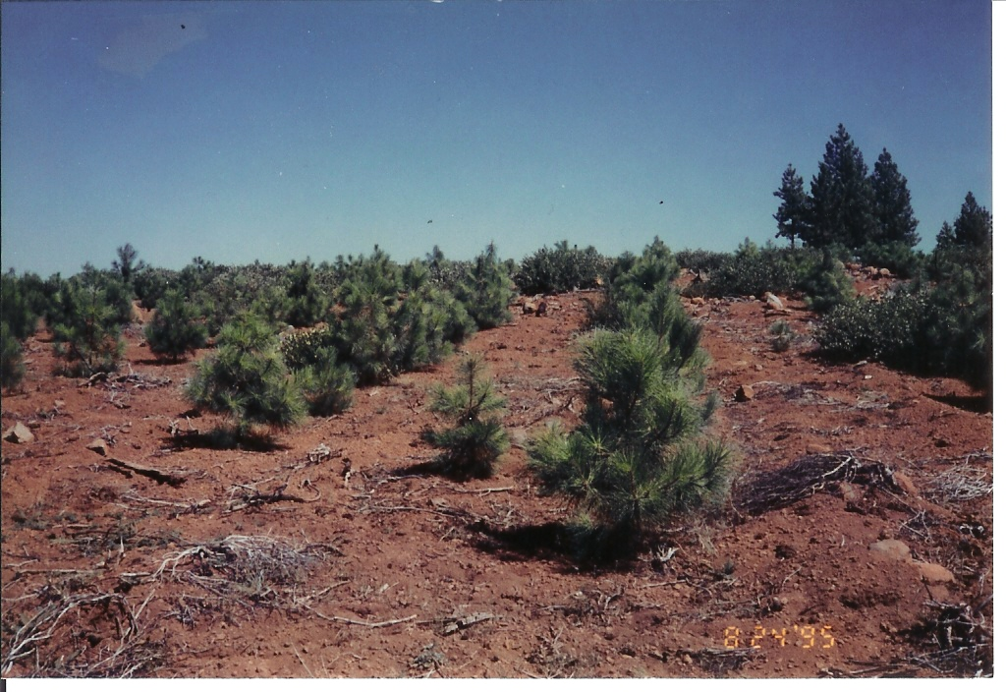
Grasses/forbs (fine flashy fuels) controlled by cattle grazing
in four year old ponderosa pine plantation in Modoc County
Notes:
Once trees reach this age when roots are well established and provided they are free to grow,
Annual leader and diameter growth increases rapidly.

Slide 18
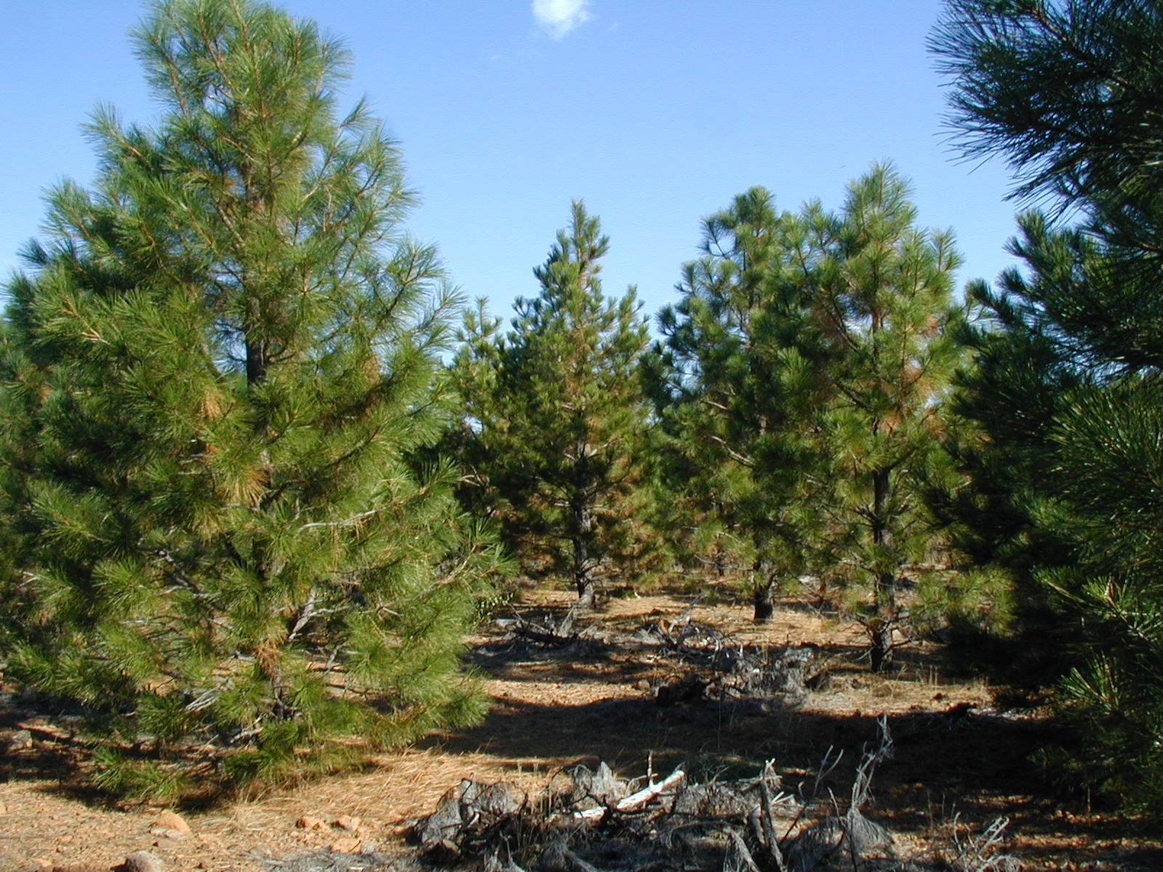
13 year old plantation Modoc Co.
a few years after PCT
Scarface Fire Planted in 1992 pictured in 2004
Notes:
Once trees reach this age when roots are well established and provided they are free to grow,
Annual leader and diameter growth increases rapidly.

Slide 19
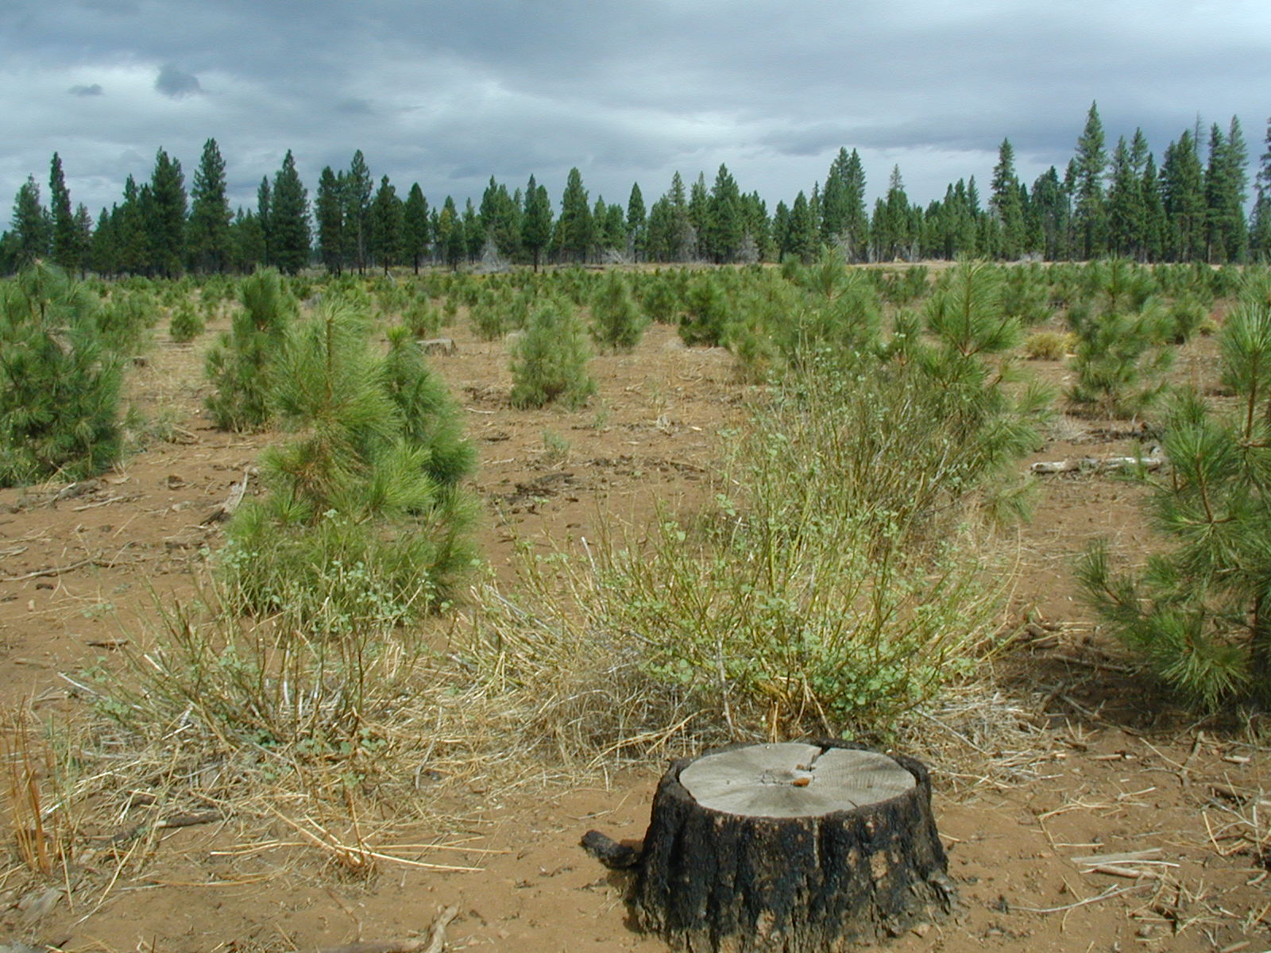
Grasses/forbs (fine flashy fuels) controlled by sheep grazing
in young ponderosa pine plantation in Modoc County
Notes:
Once trees reach this age when roots are well established and provided they are free to grow,
Annual leader and diameter growth increases rapidly.

Slide 20
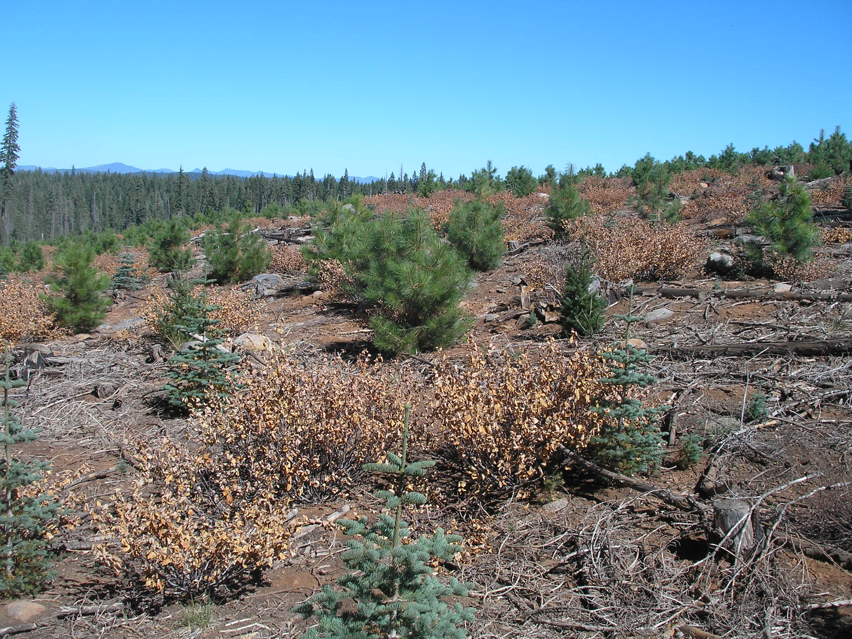
Brush spray delayed 1 year = higher cost & more dead fuel (temporary risk?)
Even if cost of spray vs. discounted future value of increased timber growth does not meet cost/benefit threshold, reducing long term investment risk of loss from wildfire can justify spray cost.
Notes:
Once trees reach this age when roots are well established and provided they are free to grow,
Annual leader and diameter growth increases rapidly.

Slide 21
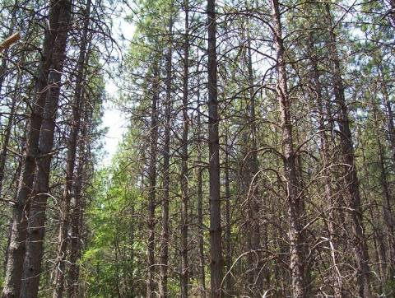
Initial Spacing Study - Challenge Experimental Forest
42 year old pond pine planted @ 12’ x 12’ spacing: QMD = 11.5”

Slide 22
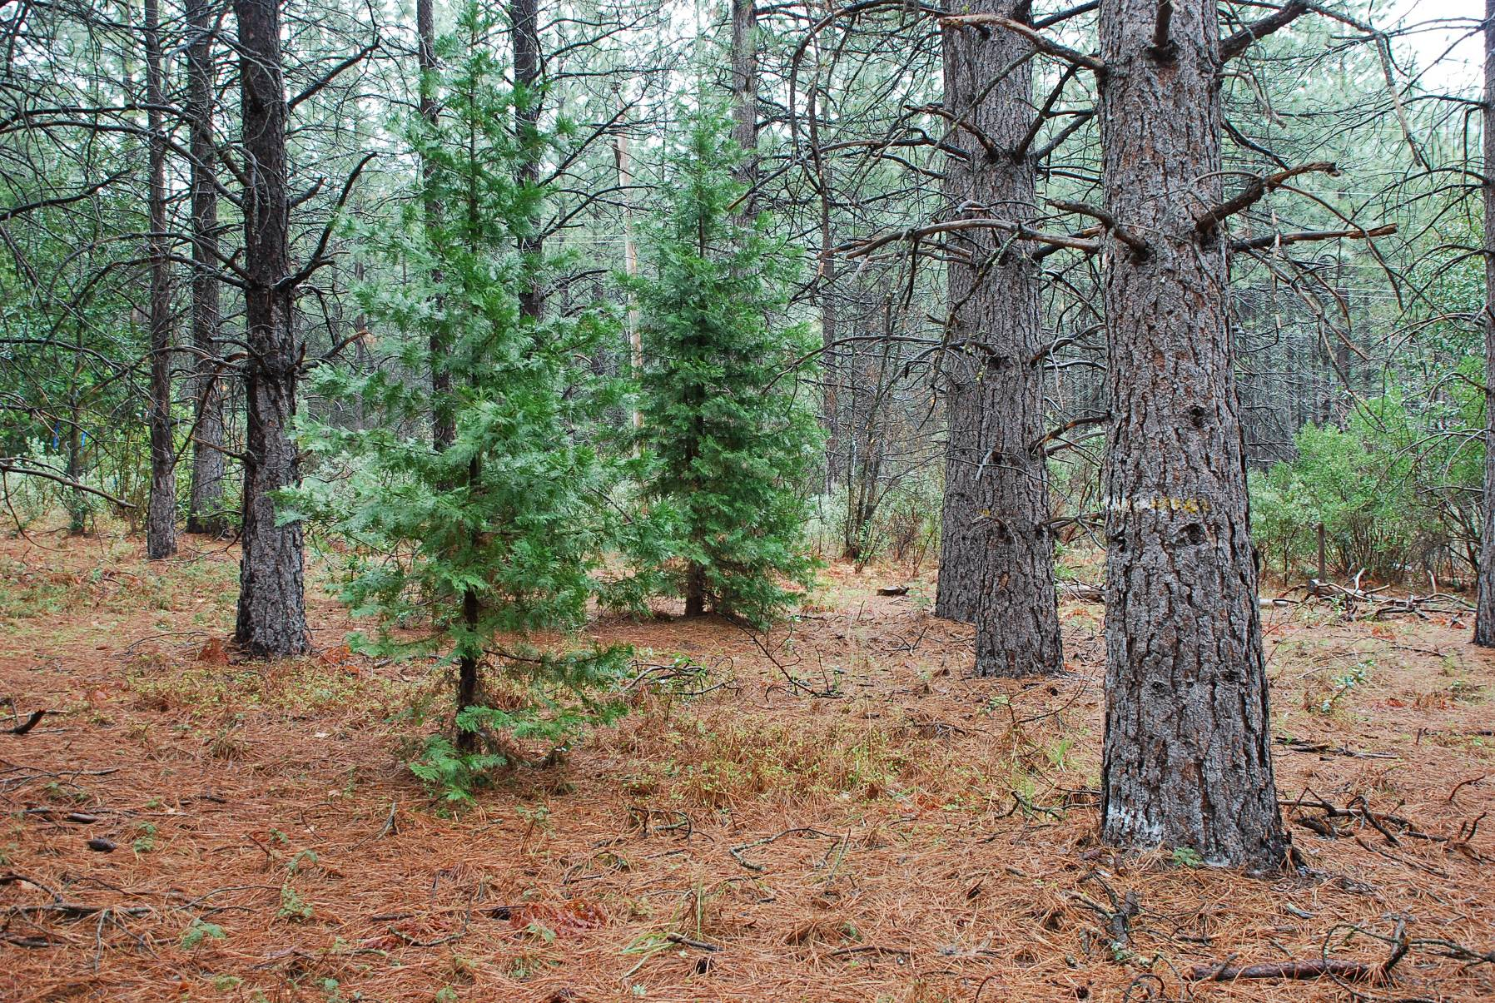
Veg control
Initial Spacing Study - Challenge Experimental Forest
42 year old pond pine planted @ 18’ x 18’ spacing: QMD = 16.0”

Slide 23
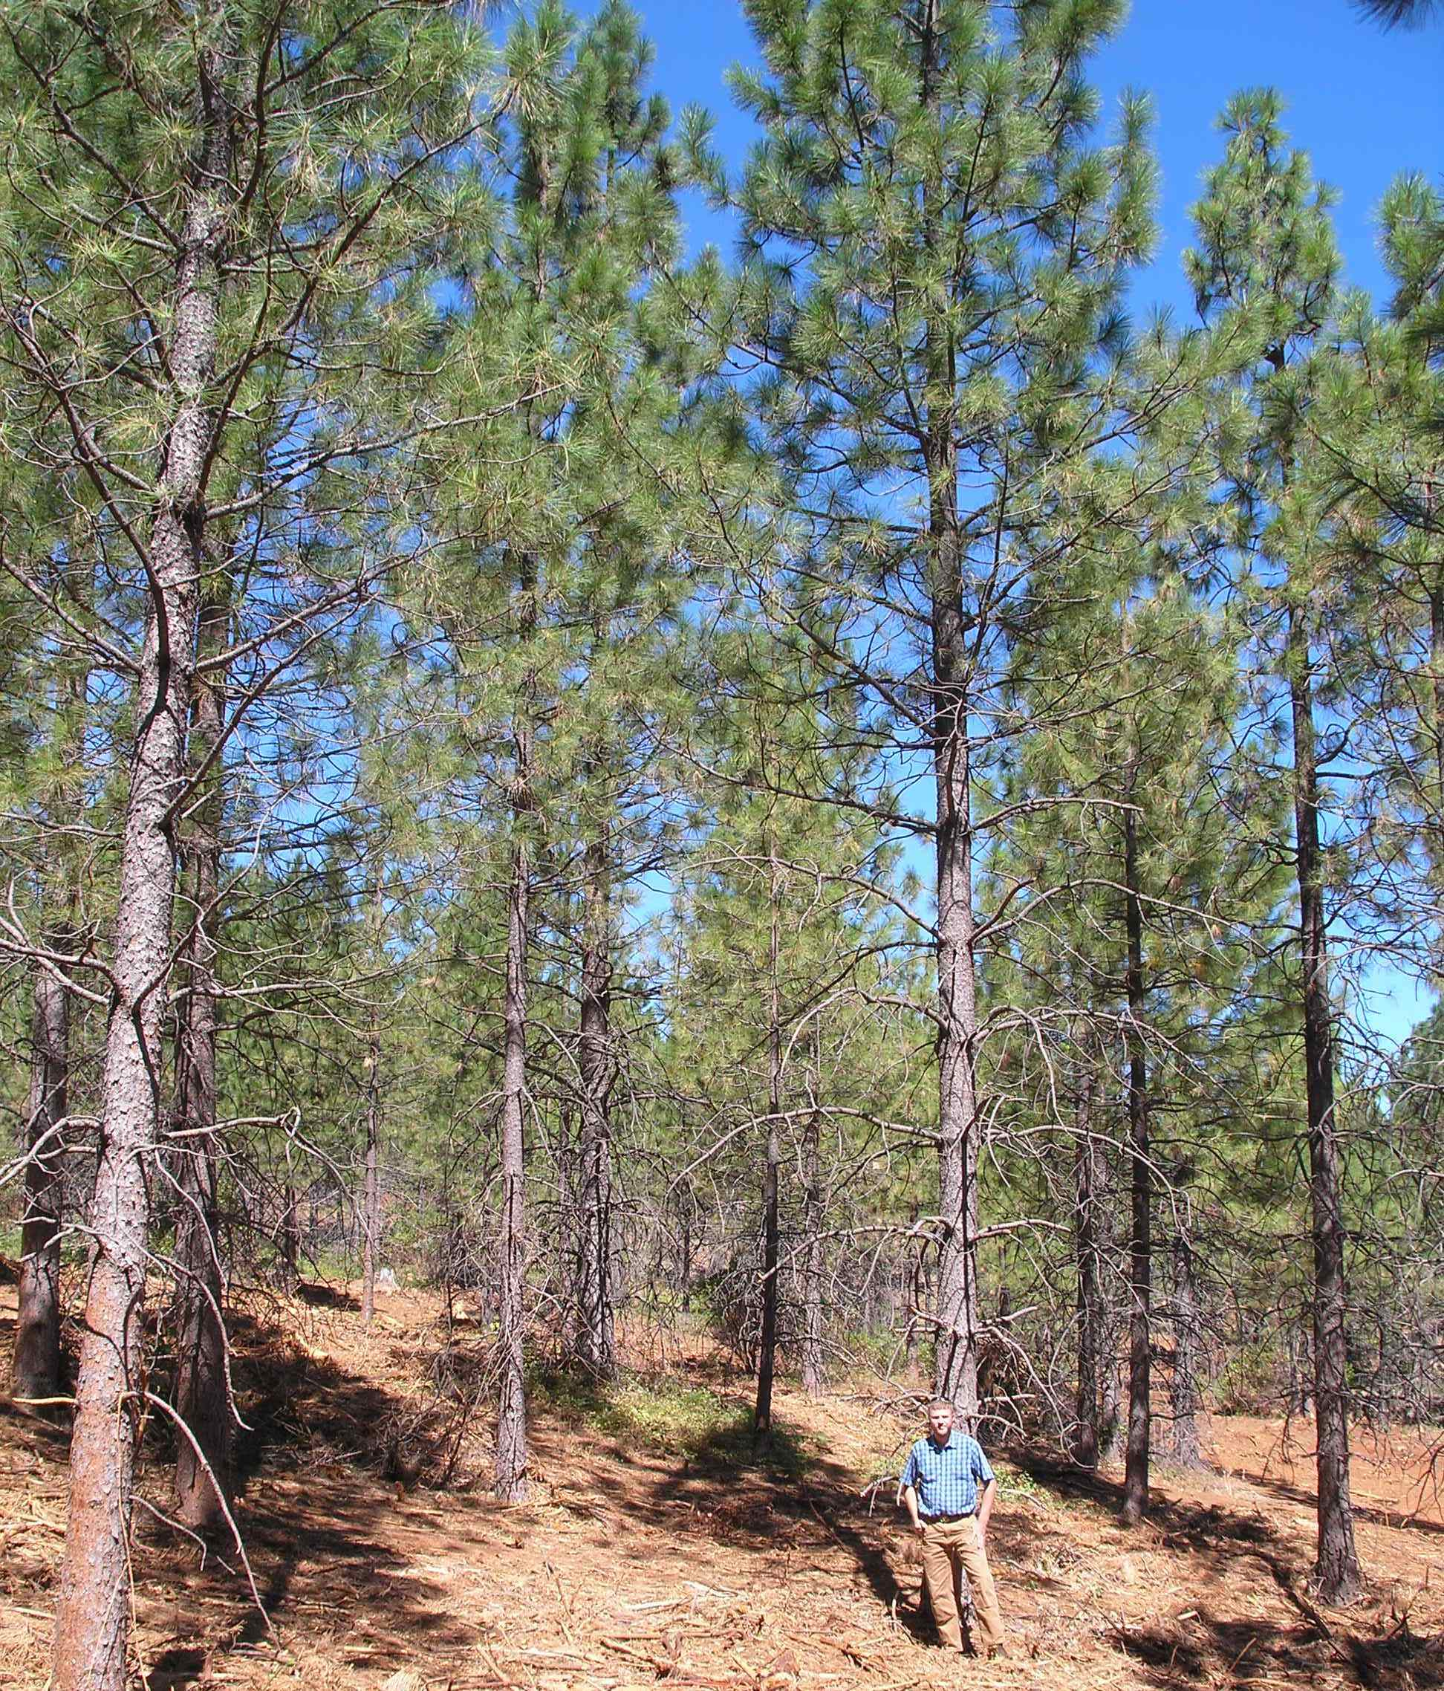
Whitmore Fire
28 year old Plantation
Planted 300 TPA
biomass thin
to 150 tpa
(~ 17’ x 17’)
Notes:
Local biomass market allows us to pre-commercially thin some plantations to improve growth and reduce fuel loading
So that for this plantation in only 10 to 15 years until commercial saw-log thin.

Slide 24
Key Factors to Reduce Plantation Losses from Wildfire
  Management of Adjacent Timberlands in the Watershed
Maximize individual tree growth to shorten time of exposure to risk of economic loss
  Reduce Plantation Fuel Loads & Configuration
  Facilitate Fire Suppression Efforts
  See 1st & 3rd points above
  Road construction, maintenance & improvements
  Strategic Fuel Breaks w/ pruning – main roads, property lines, ridges etc.
  Do not plant landings but control brush
  Strategically locate 3 to 5 acre Safety Zones w/ no live and/or dead woody or brushy vegetation

Slide 25
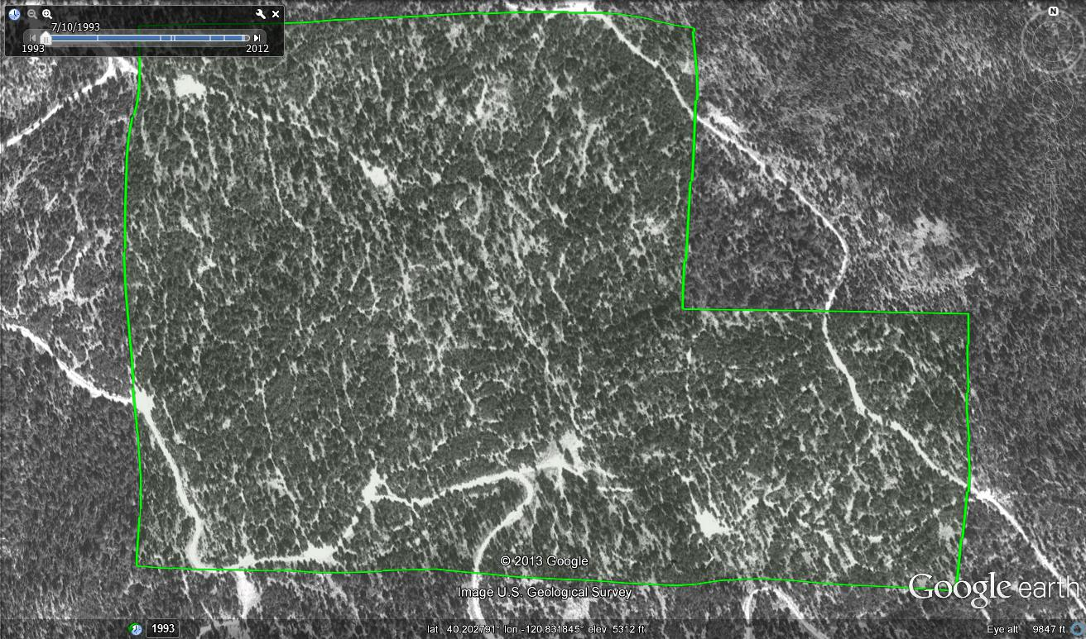
Recent examples of wildfires burning/threatening our plantations….
Shasta Forests’ Moonlight Tract 1993

Slide 26
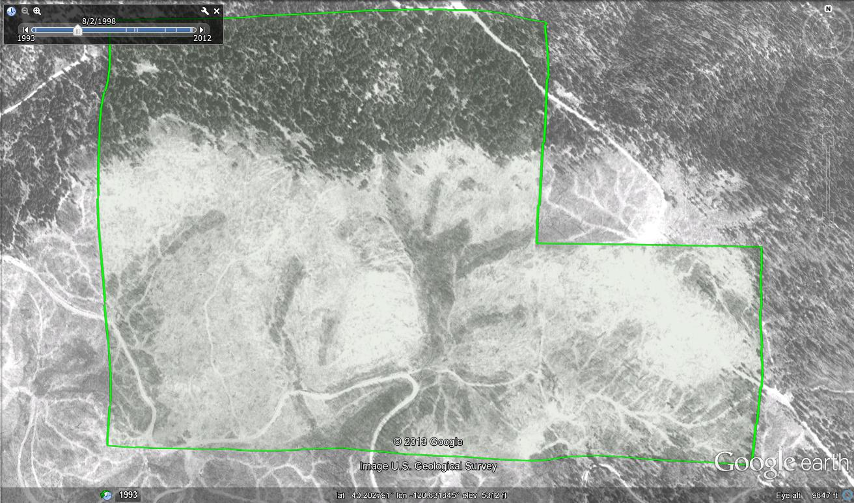
1995: Cooks Fire & salvage
site prep in 1996 & planted 1997 w/ follow-up brush control
Shasta Forests Moonlight Tract 1998

Slide 27
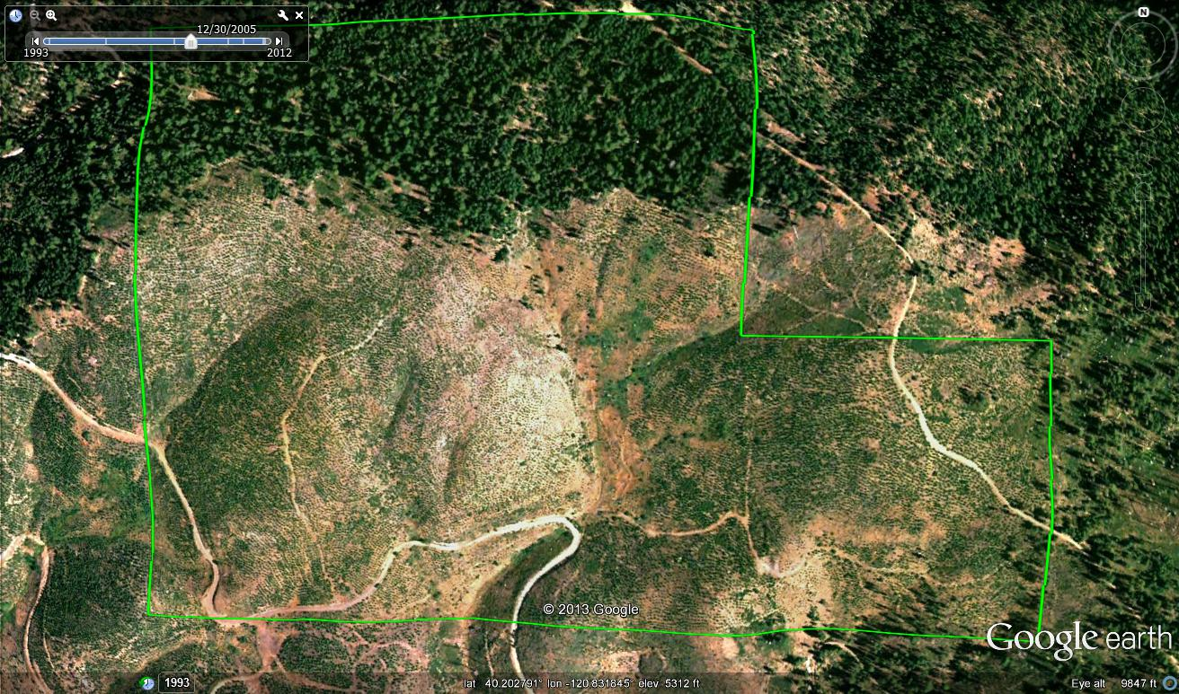
One year before 2006 PCT ….
Cooks Fire Plantation in 2005

Slide 28
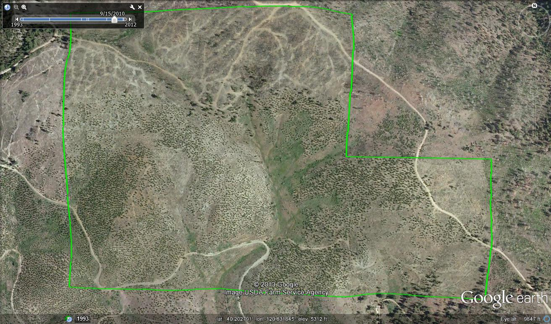
2007: Moonlight Fire
2007 Moonlight Fire
Cooks Fire Plantation
Photo 2010:
Note that adjacent downhill/upwind landowner also removed dead fuels and managed brush and stocking vs. leaving 100 tons dead fuels w/ growing brush

Slide 29
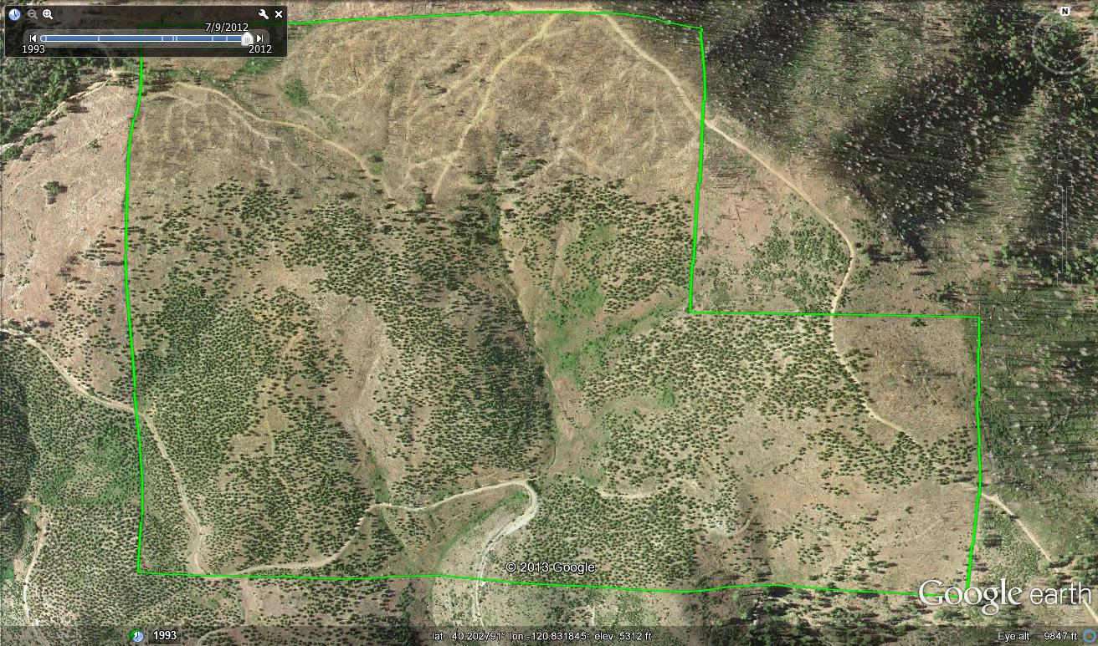
Photo 2012
Where dead wood was salvaged & brush controlled in 10 year-old
Plantation most of the young trees survived the Moonlight Fire
Notes:
Considering adjoining mature timberstand was destroyed by the Moonlight Fire this unit experienced very good survival. Even so more complete brush control and earlier PCT and/or wider initial spacing would have likely increased survival on this part of the Cooks Fire plantation.
The 40-acre unit to the south was not accessible for follow up brush treatment that occurred on this northern unit of the Cooks Fire Plantation and so with heavy brush suffered much more mortality during Moonlight Fire.

Slide 30
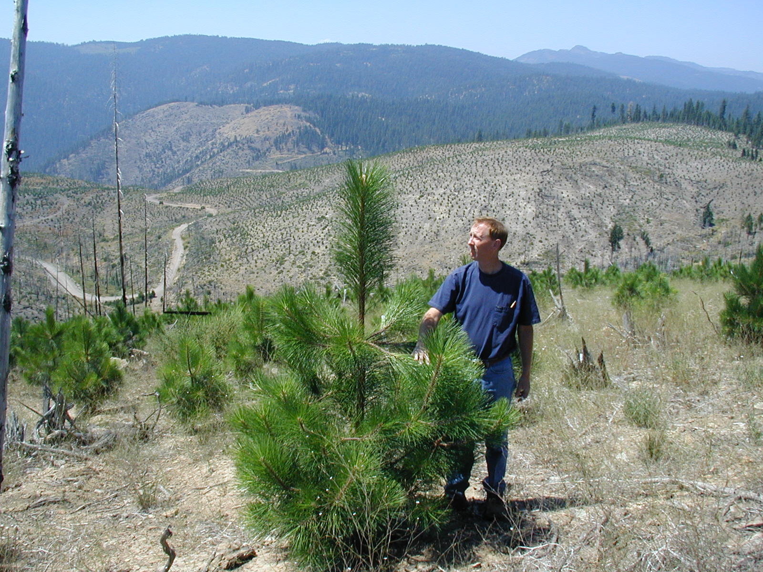
5 year old NSTIA pond pine planted in 1997 after “Cooks Fire” NE Plumas County

Slide 31
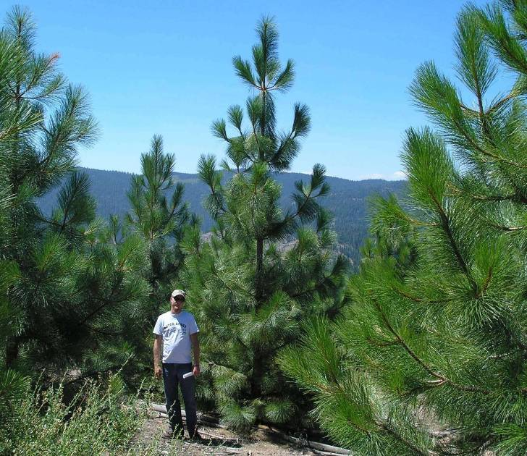
4 years later (9 yrs. old)
@ 300 TPA prior to PCT
Notes:
With current technology and methods seedlings grow very fast to PCT size.
Looking back would have PCT’d at age 7 instead of age 9.
AND every year you wait to PCT the resulting slash increases.......

Slide 32
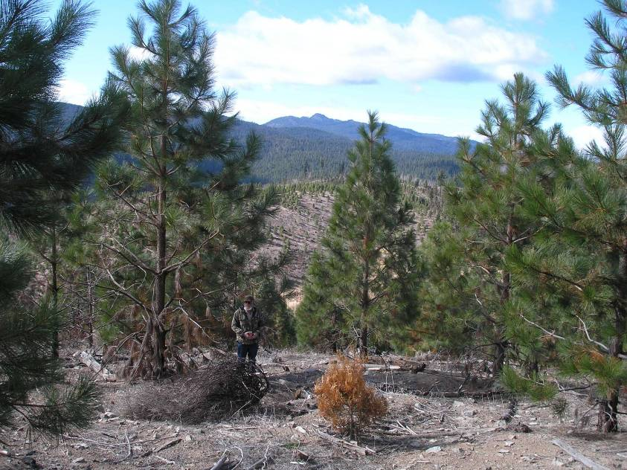
13 yr. old plantation in 2009
(After ’06 PCT & ’07 Moonlight Fire)
Lessons Learned?

Slide 33
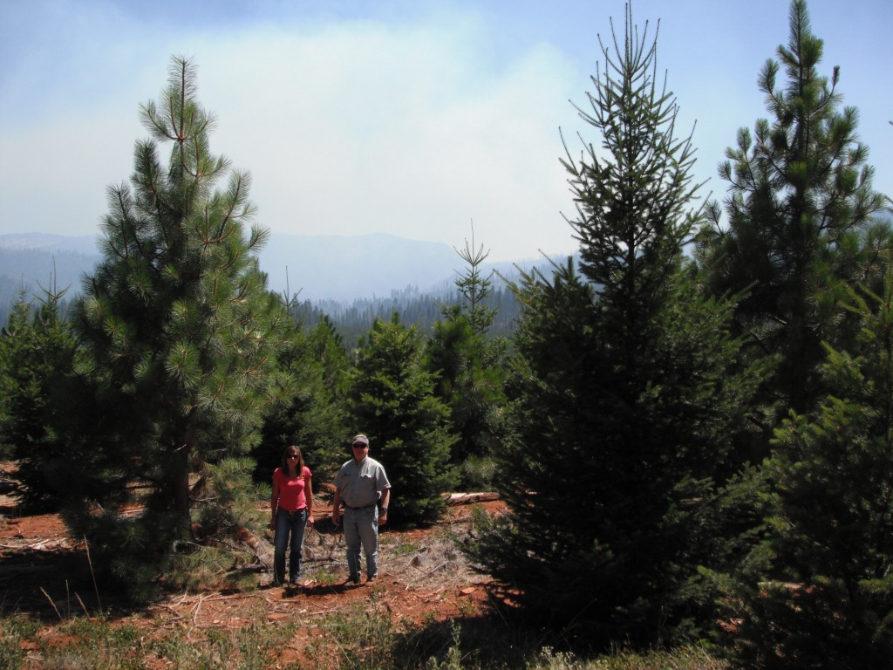
Another example:
2000 Storrie Fire x
2012 Chips Fire
10 year old
Storrie Fire Plantation
2 years after PCT
Notes:
PCT slash has started to break down and within a few more years will be insignificant since PCT was completed at age 7 and initial planting density was not too high.

Slide 34
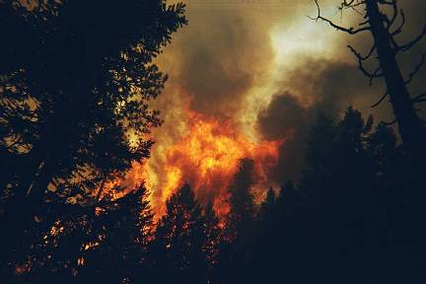
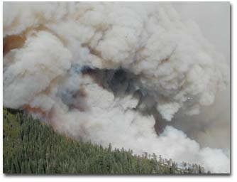
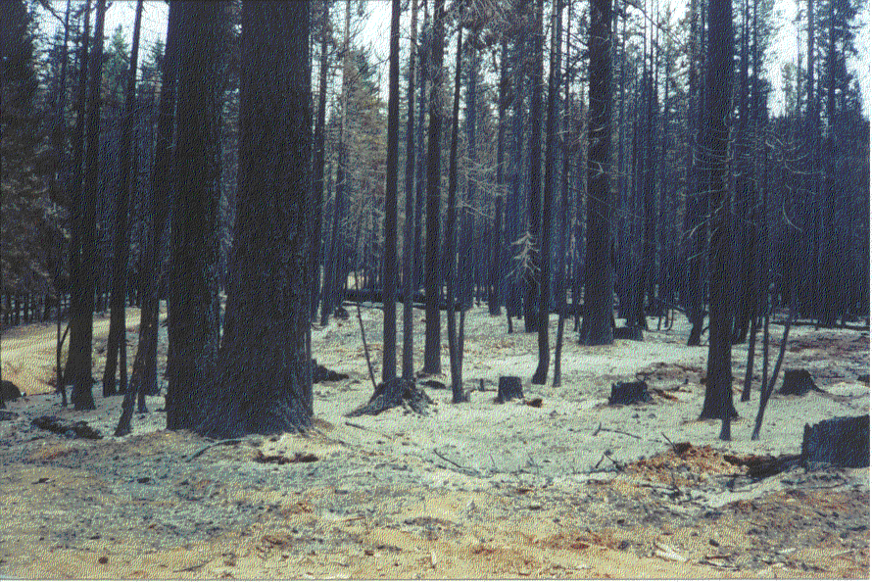
2000 Storrie Fire
Plumas County

Slide 35
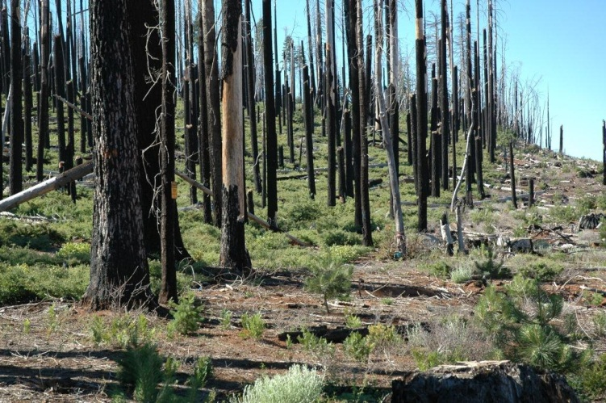
A few years after 2000 Storrie Fire

Slide 36
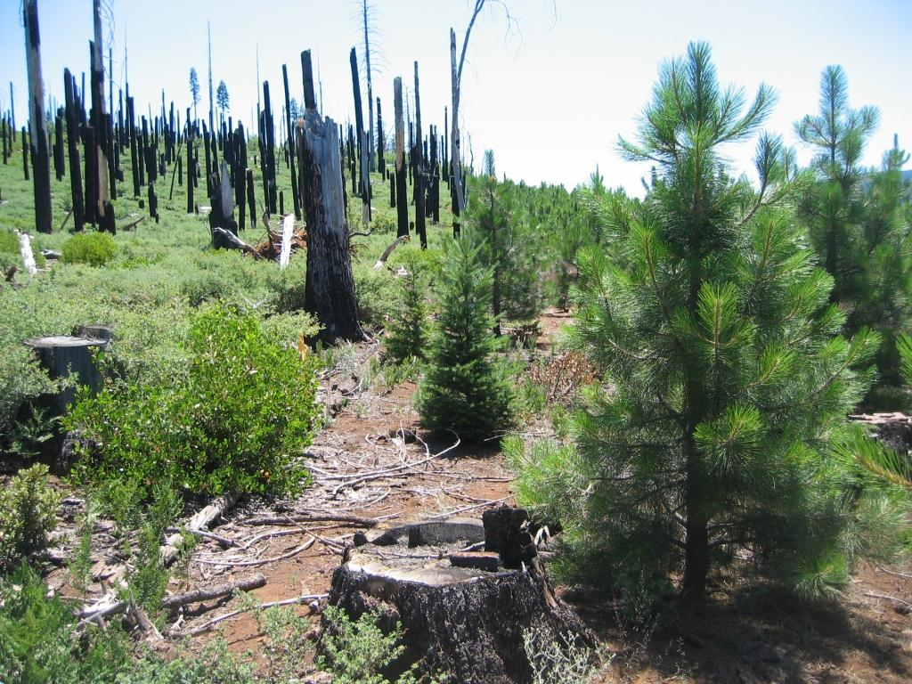
10 years after Storrie Fire
8 year old plantation

Slide 37
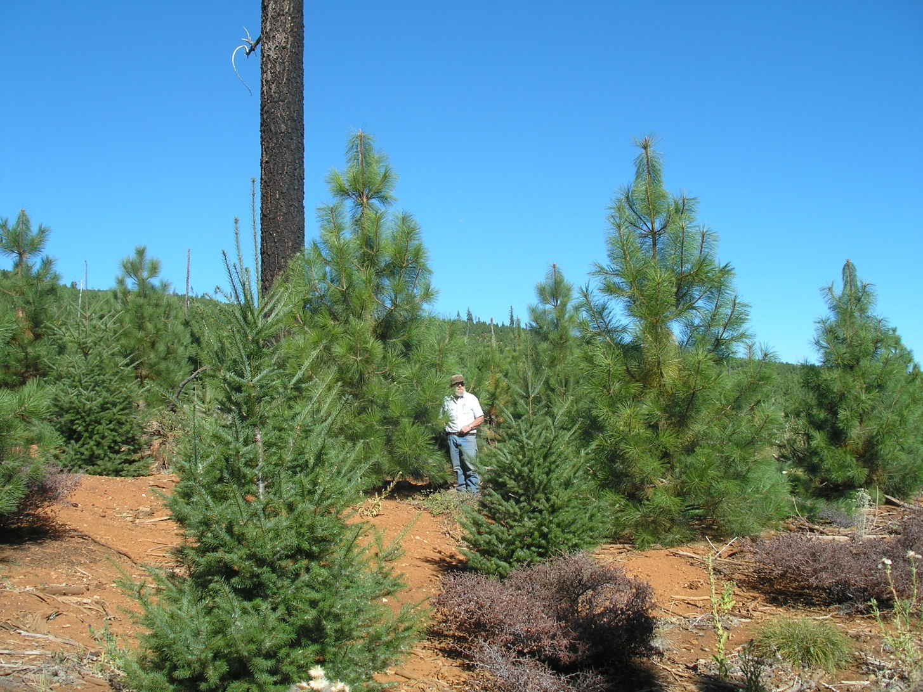
Additional brush treatment recently completed at this age was not to increase conifer growth but to eliminate brushy fuels near the extremely high dead woody & brushy fuel loading on adjacent lands
Notes:
Note that recent brush control treatment was not needed for tree growth but completed to keep brush from growing over time into a fuel hazard in area near USFS “Wall of Shame”.

Slide 38
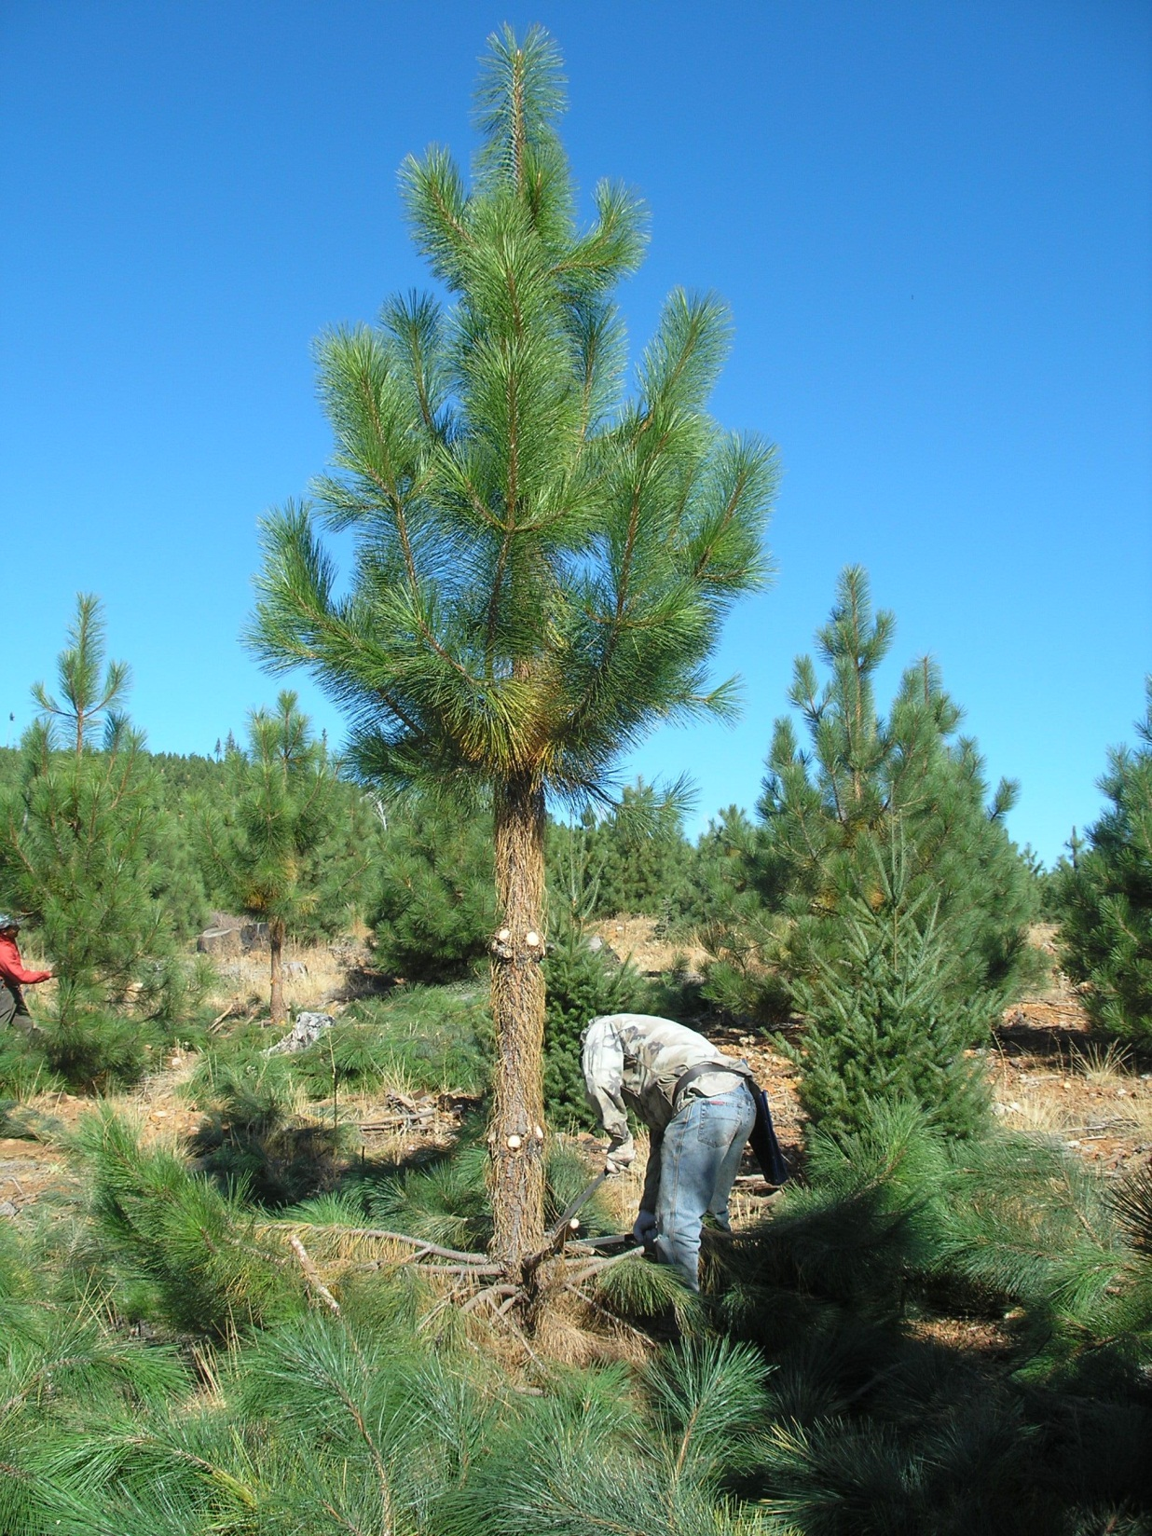
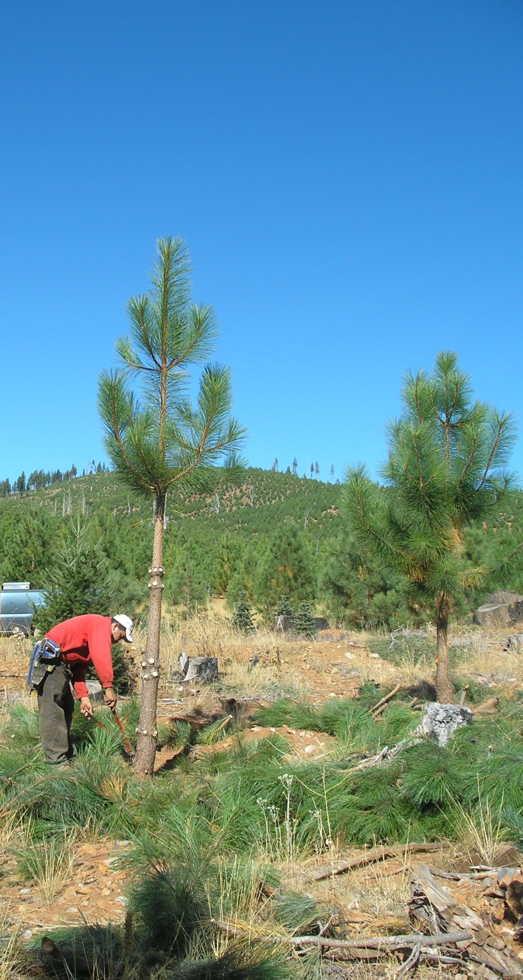
200 ft. width “Shaded Fuel Breaks”
Pruning, thinning & spraying adjacent to main roads

Slide 39
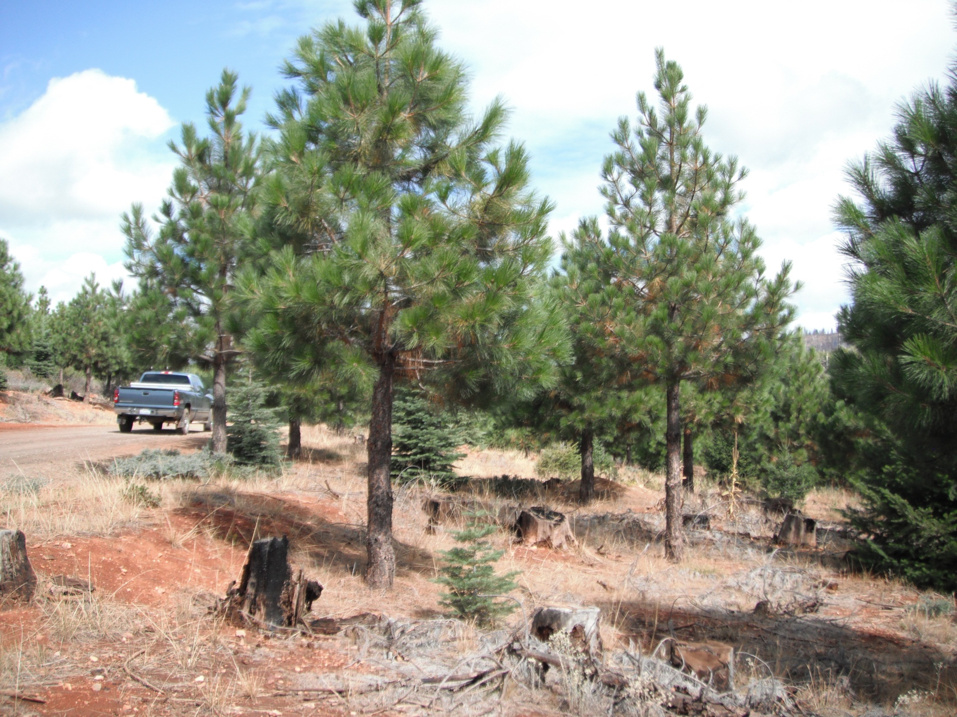
A few years later…

Slide 40
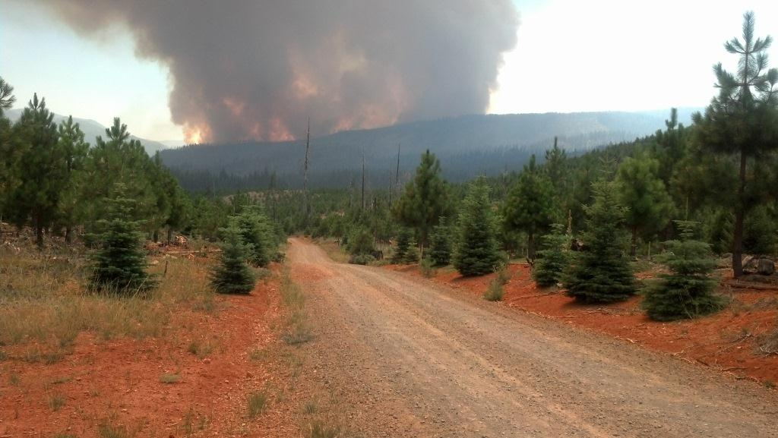
2012 Chips Fire
10 year old Storrie Fire Plantation

Slide 41
2012 Chips Fire burning in footprint of 2000 Storrie Fire
shown in brown shading
Beaty managed Storrie Fire plantations
USFS No management after Storrie Fire:
>100 tons dead fuels & brush
Daily Fire Perimeter:
8/2/12 – 2,541 acres
8/3/12 – 4,352 acres
8/4/12 – 6,034 acres

Slide 42
2012 Chips Fire
started in the 2000 Storrie Fire & burned uncontrollably in heavy dead timber & brush through the entire downwind footprint of Storrie Fire except most of Beaty managed plantations. Unfortunately when it reached mature private & public forests it continued to burn many thousands of more acres.
Chips Fire start

Slide 43
Siege from the south
The battle to save the plantation begins

Slide 44
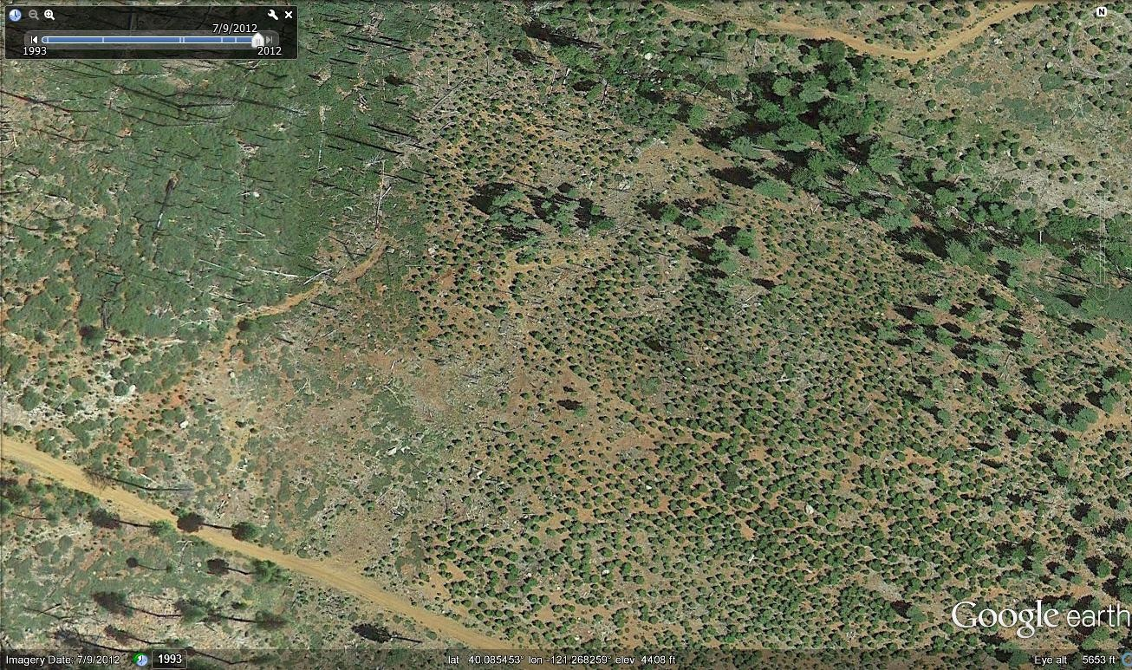
After 2001 Storrie Fire:
Left: Salvage logged, planted 2002, veg management & 2009 PCT
Lower Right: No salvage, no veg management = >100 tons dead fuels & brush

Slide 45
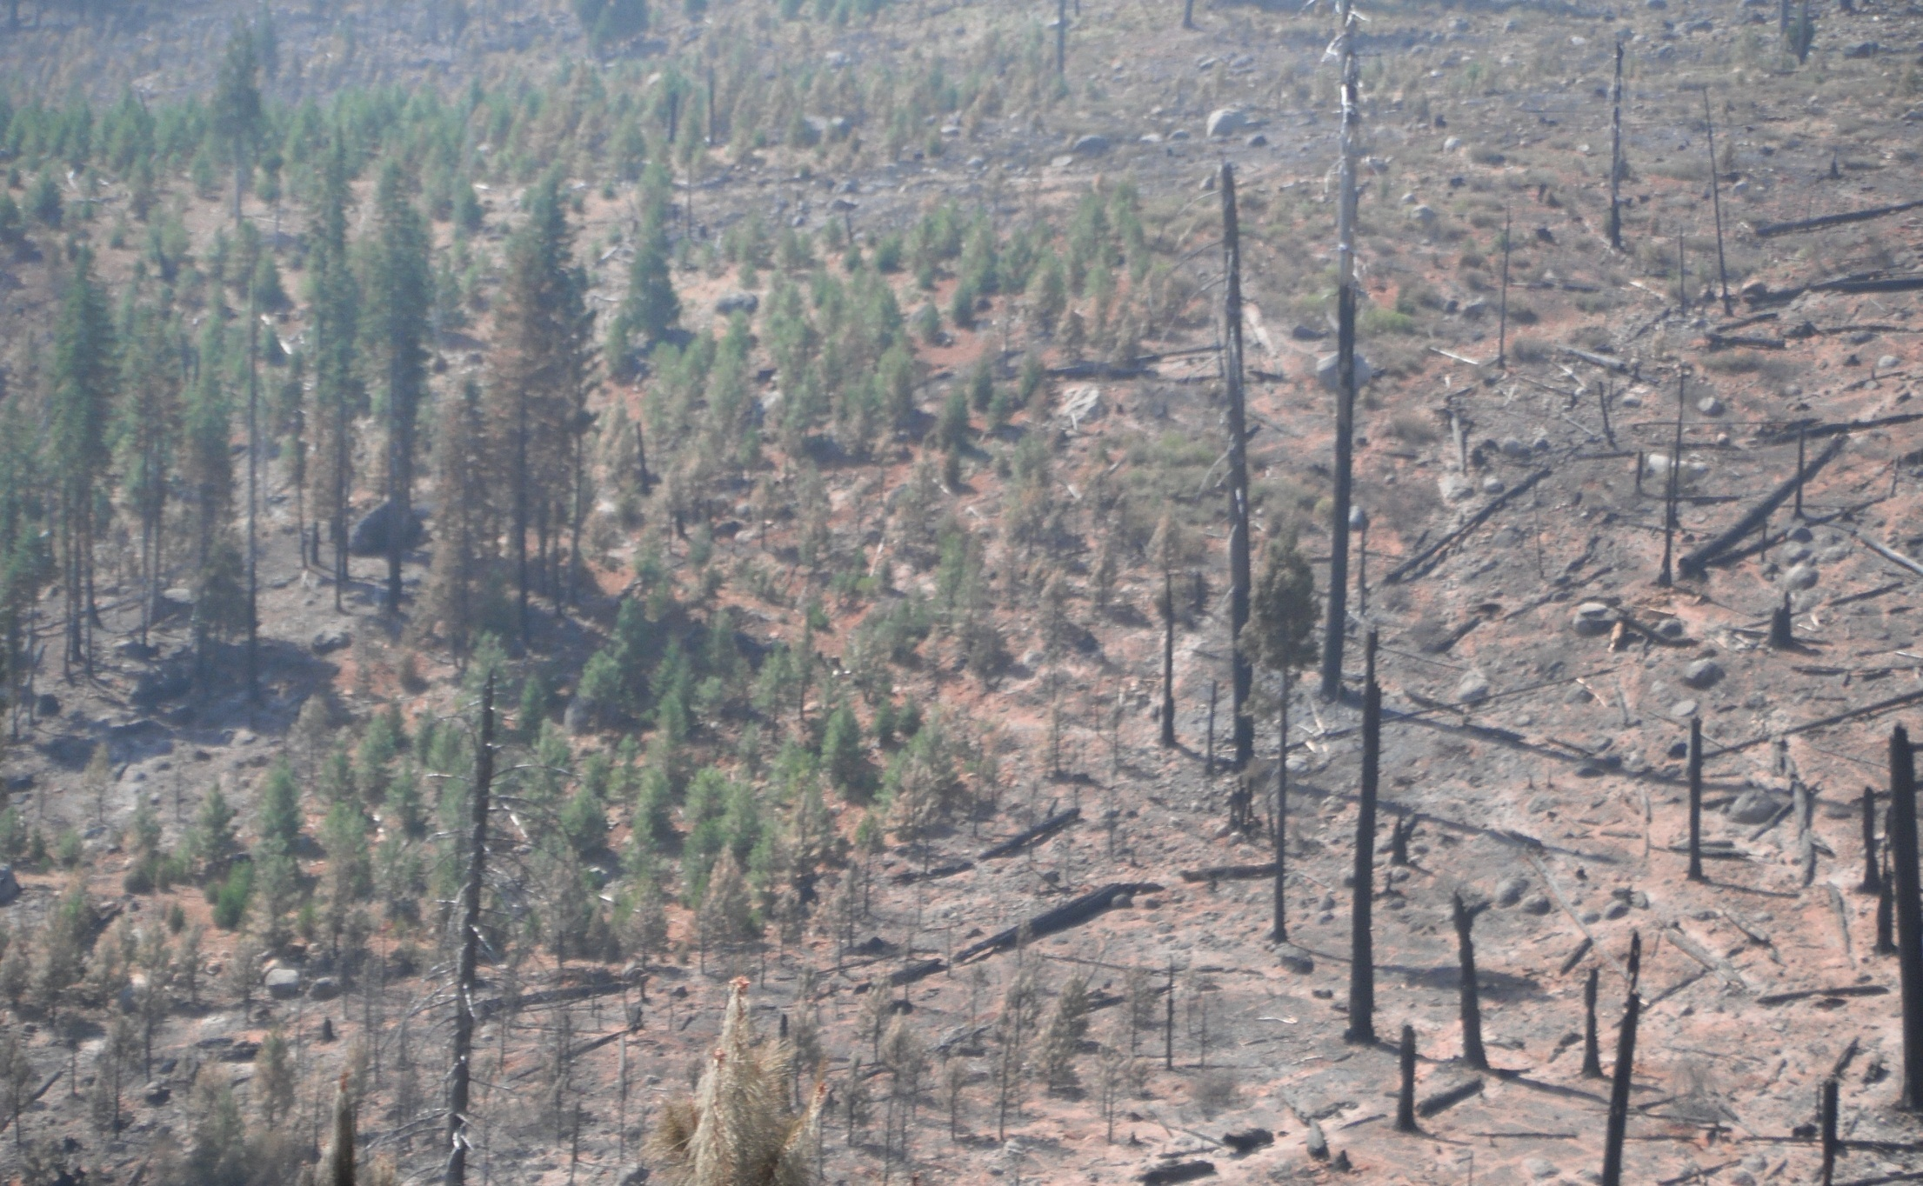
August 2012 Chips Fire
Left: Salvage logged, planted 2002, veg management & 2009 PCT after 2001 Storrie Fire
(note that residual mature trees on left likely survived Chips Fire due to fuel management after Storrie Fire)
Right: No salvage, some planting, no veg management = >100 tons dead fuels & brush

Slide 46
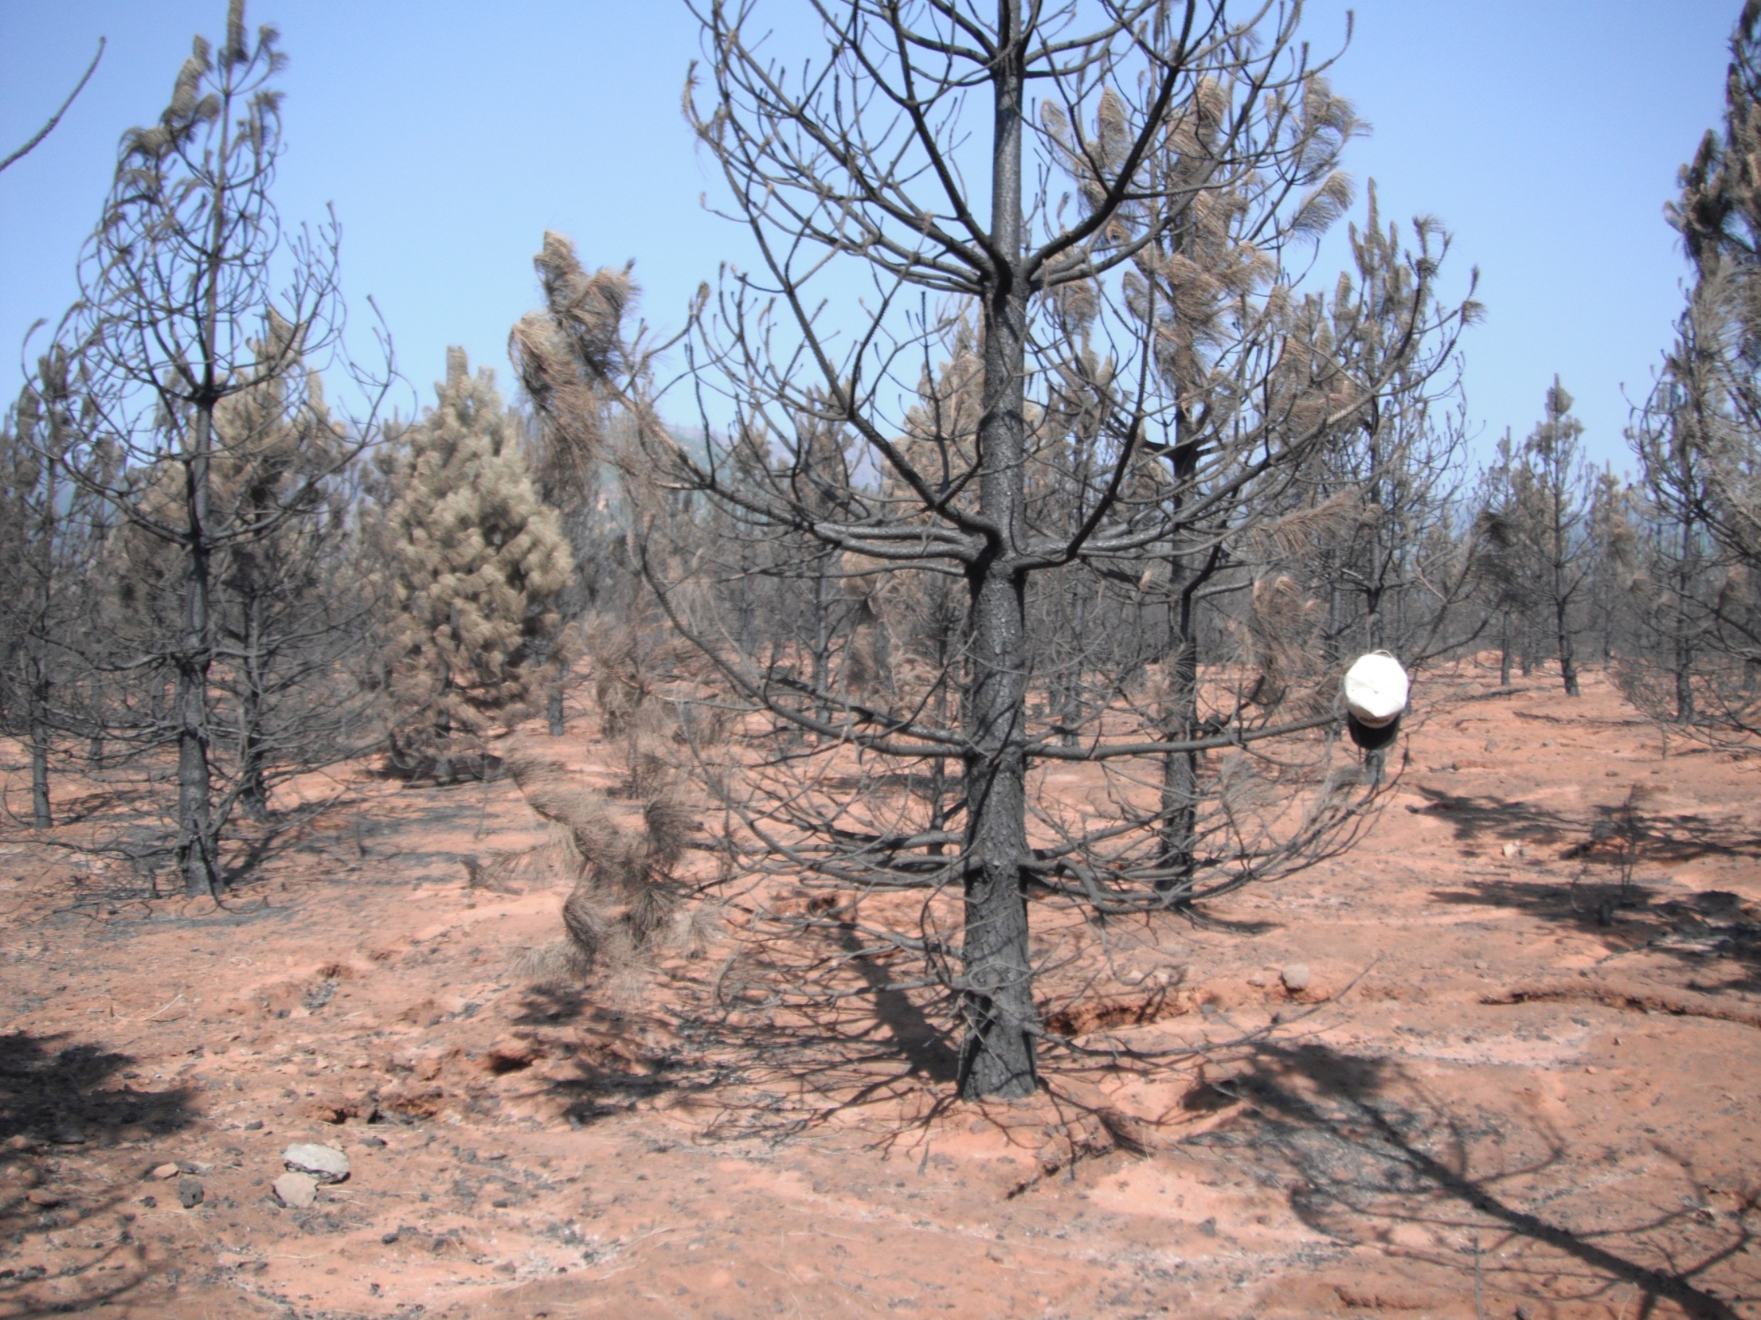
7% or 220 acres of the 3,000 acre Storrie Fire Planation was damaged severely enough by Chips Fire to require replanting

Slide 47
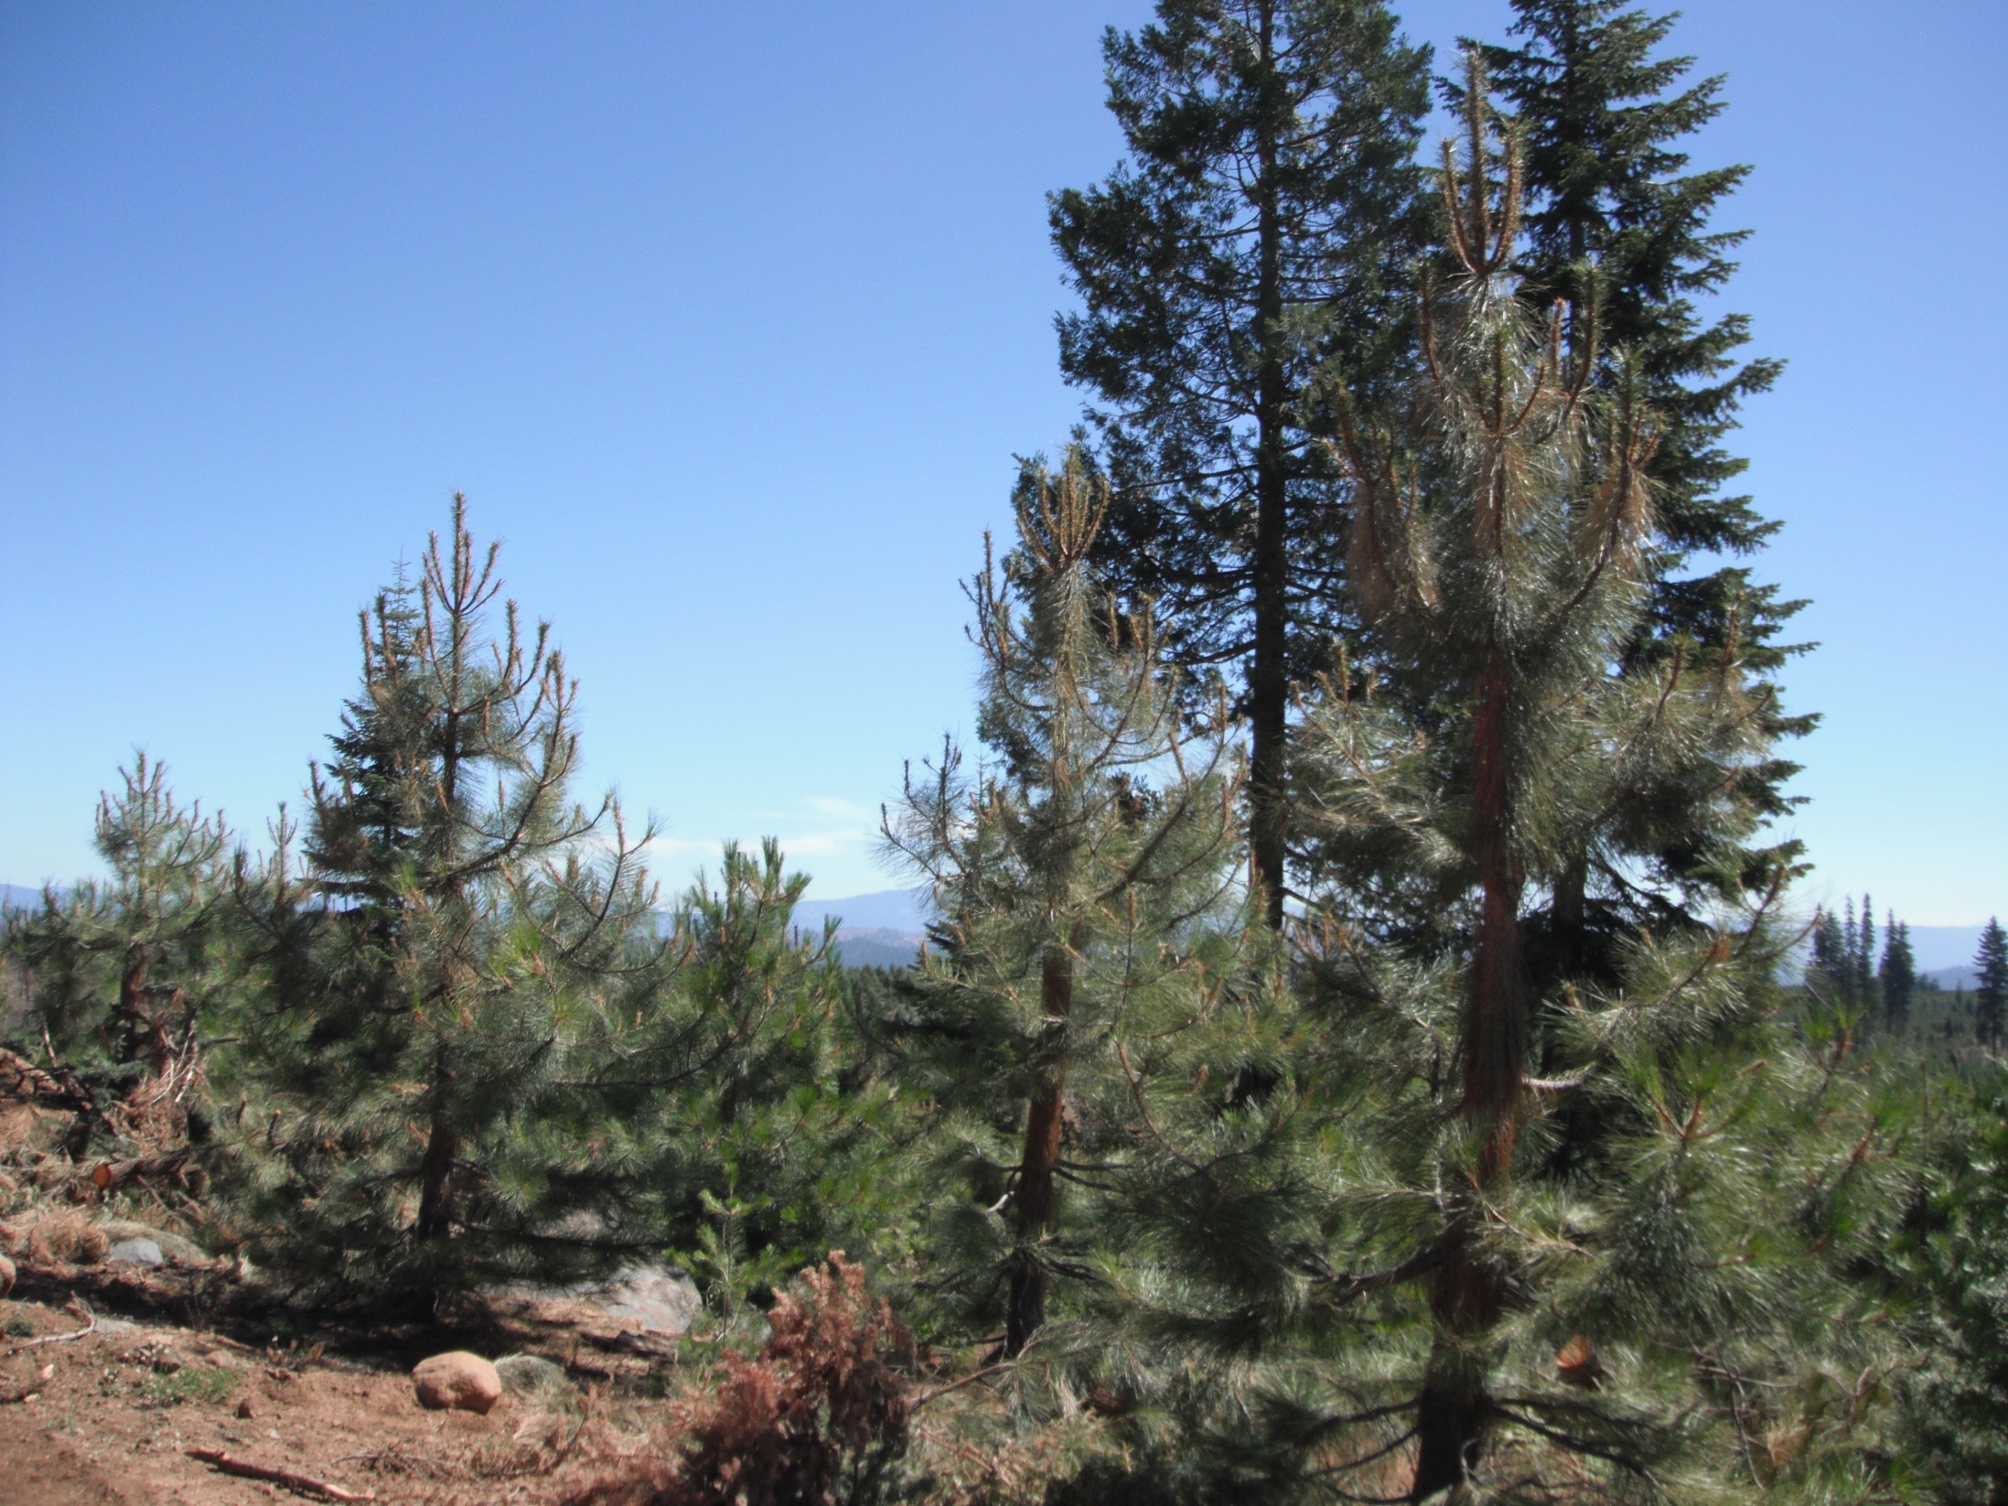
21% of 3,000 acre Storrie Fire Plantation within the Chips Fire line perimeter remained sufficiently stocked after 2012 Chips Fire

Slide 48
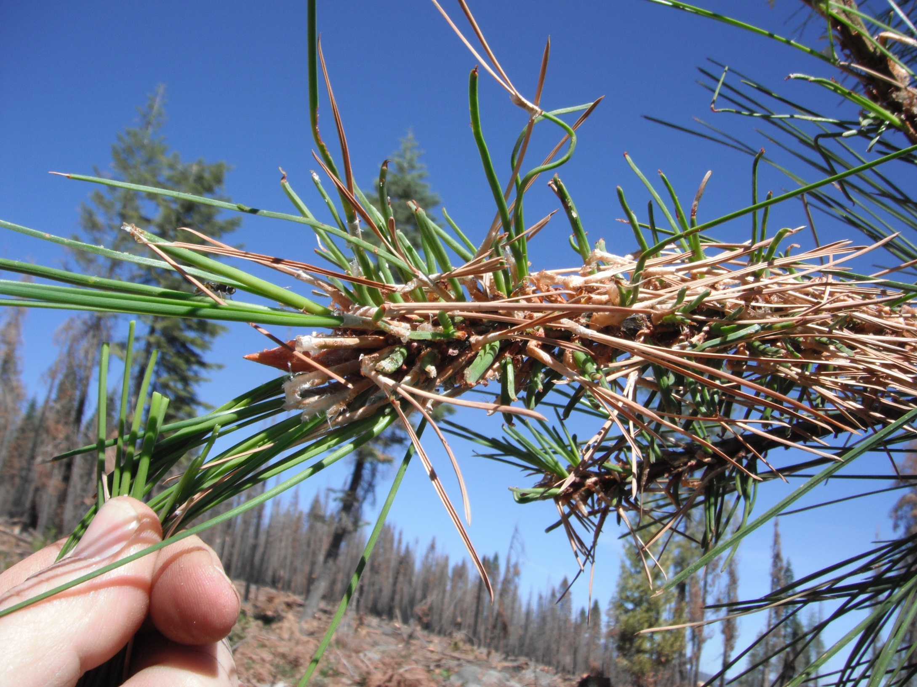
Healthy buds & cambium after Chips Fire due to vigorous growth after Storrie Fire planting & brush control

Slide 49
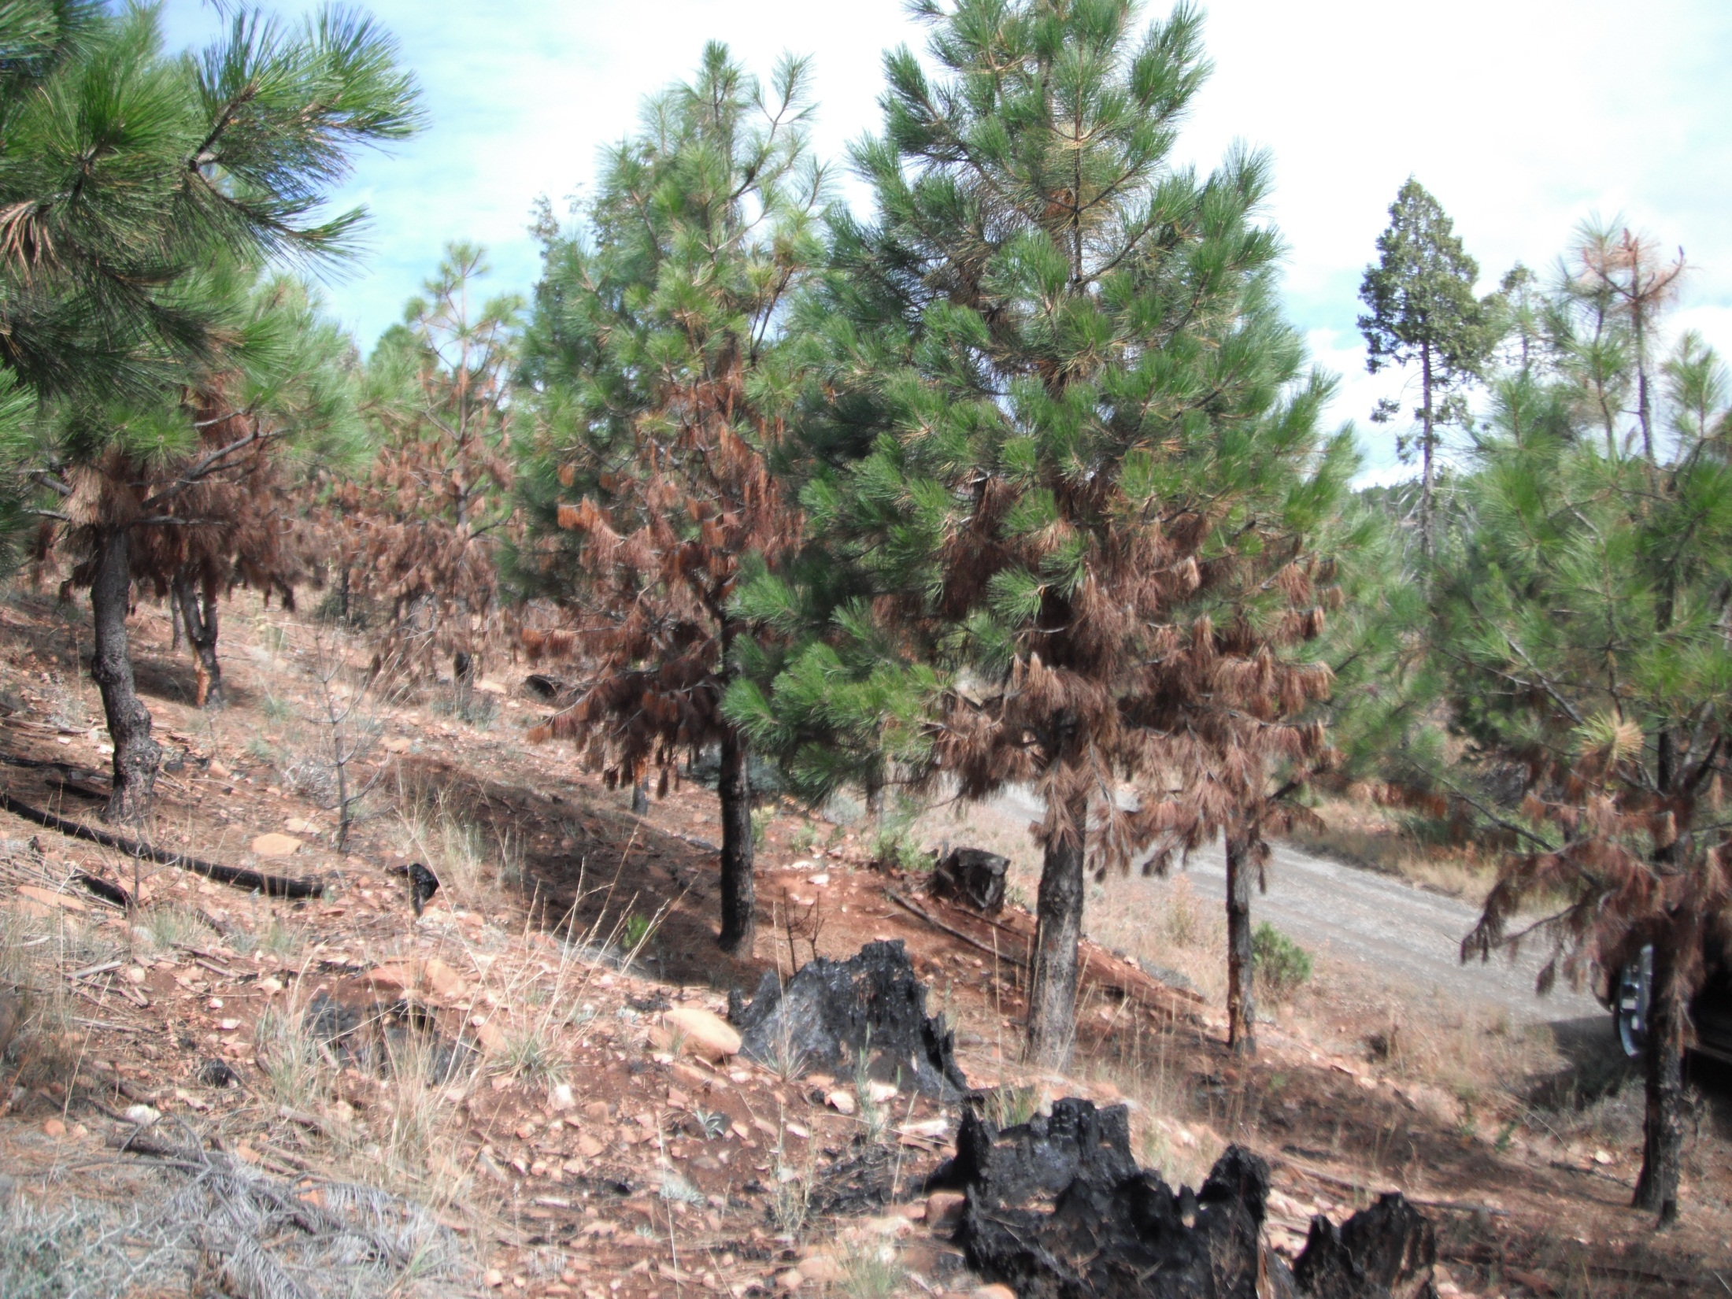

Slide 50
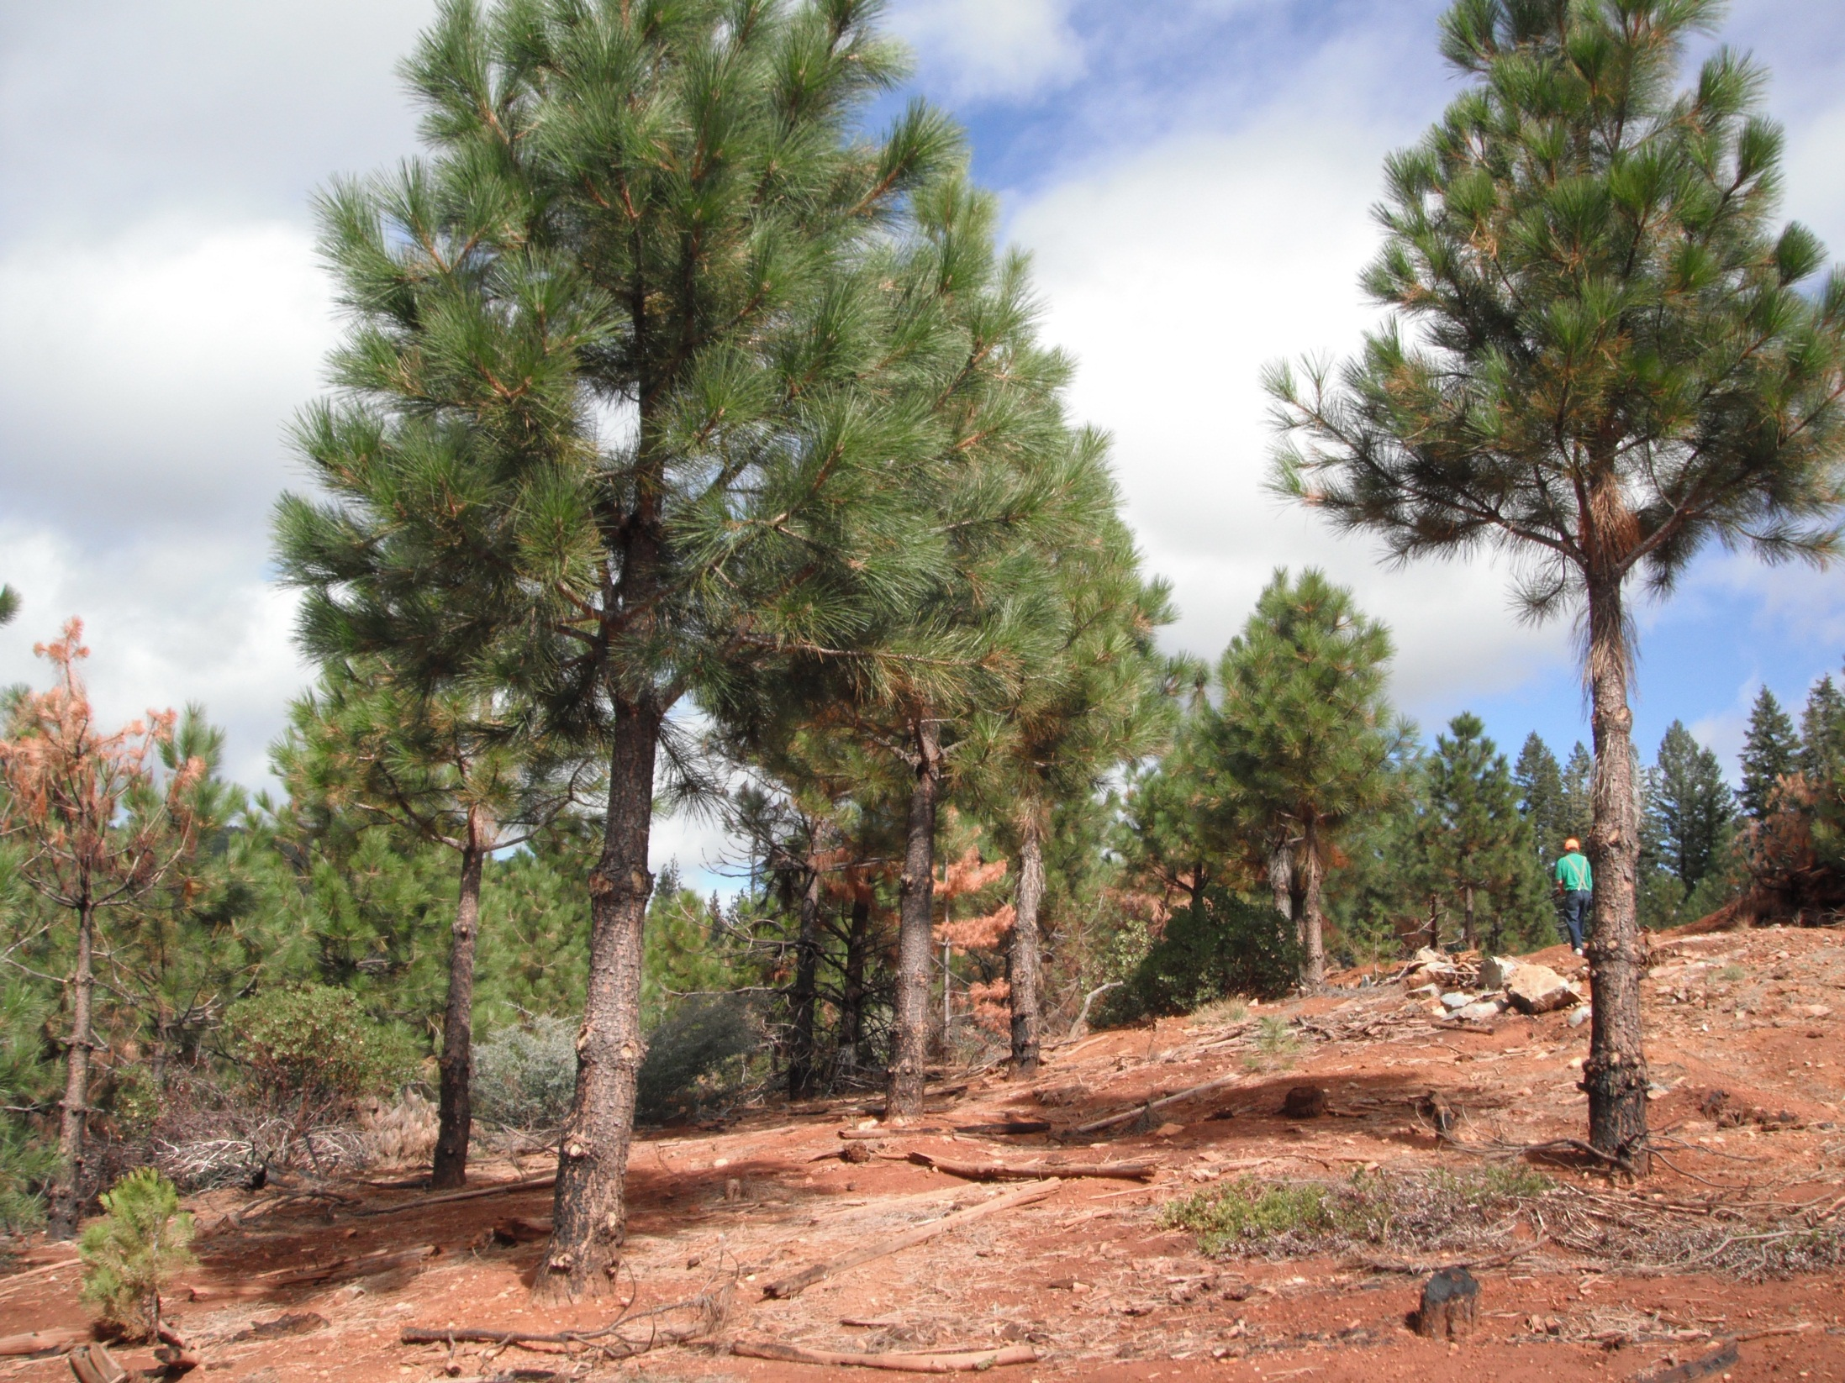

Slide 51
Mature forest is lost but east flank of plantation holds

Slide 52
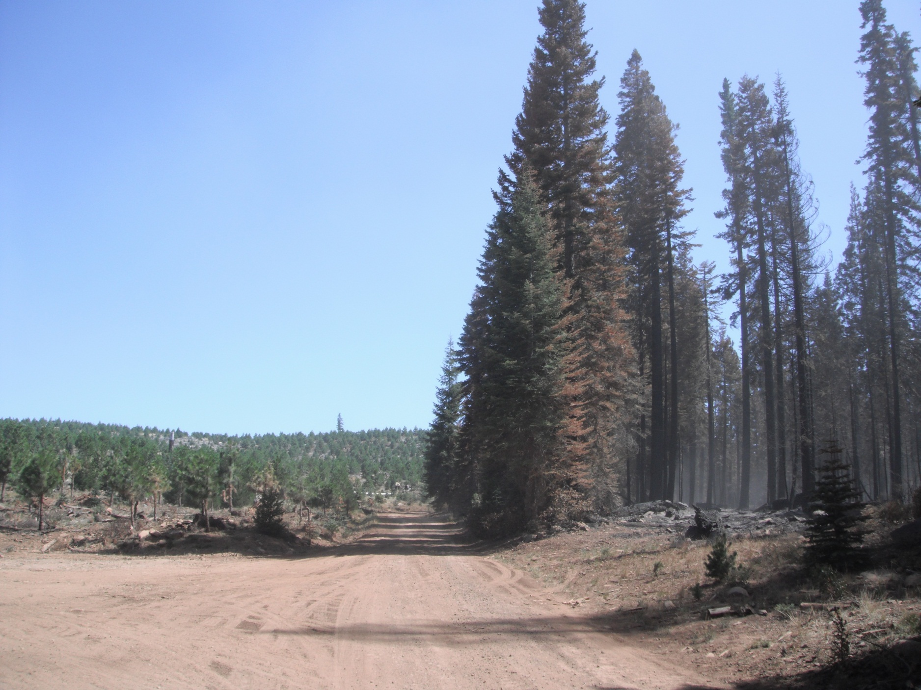

Slide 53
behind the front lines

Slide 54
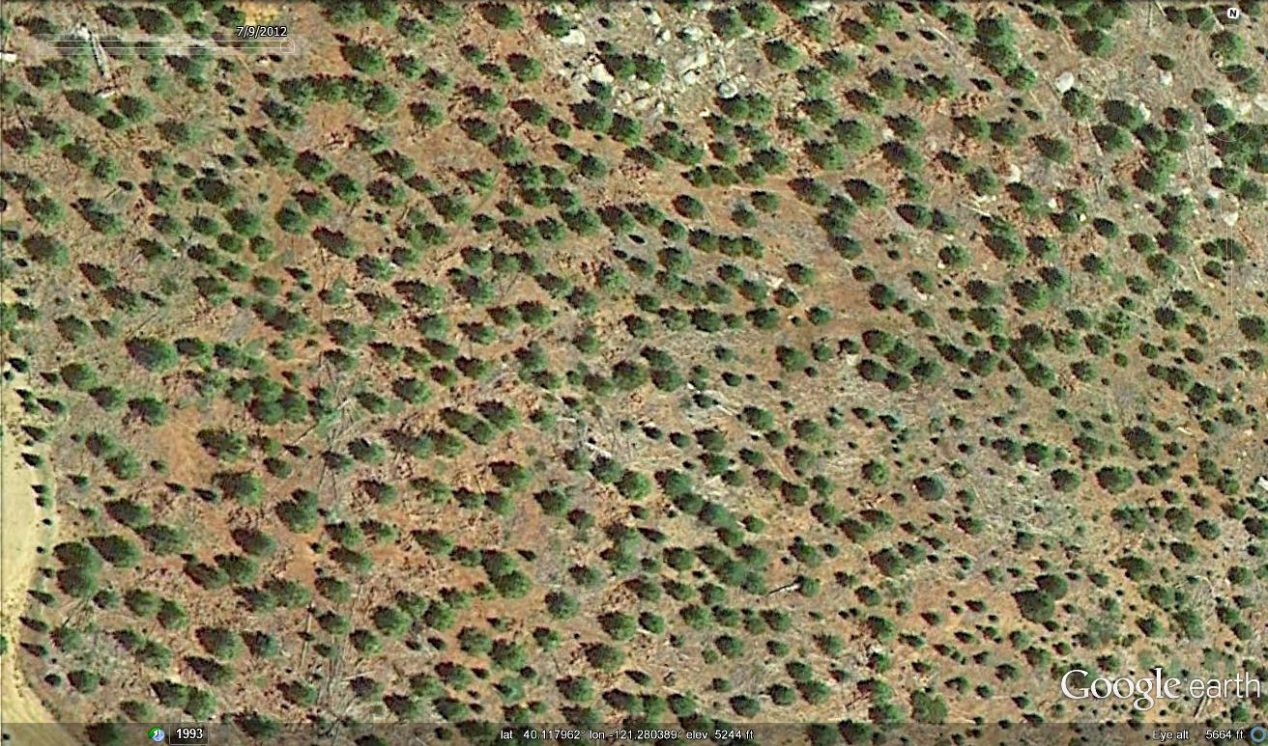
Satellite photo taken one month prior to Chips Fire that surrounded this Storrie Fire Plantation on 3 sides

Slide 55
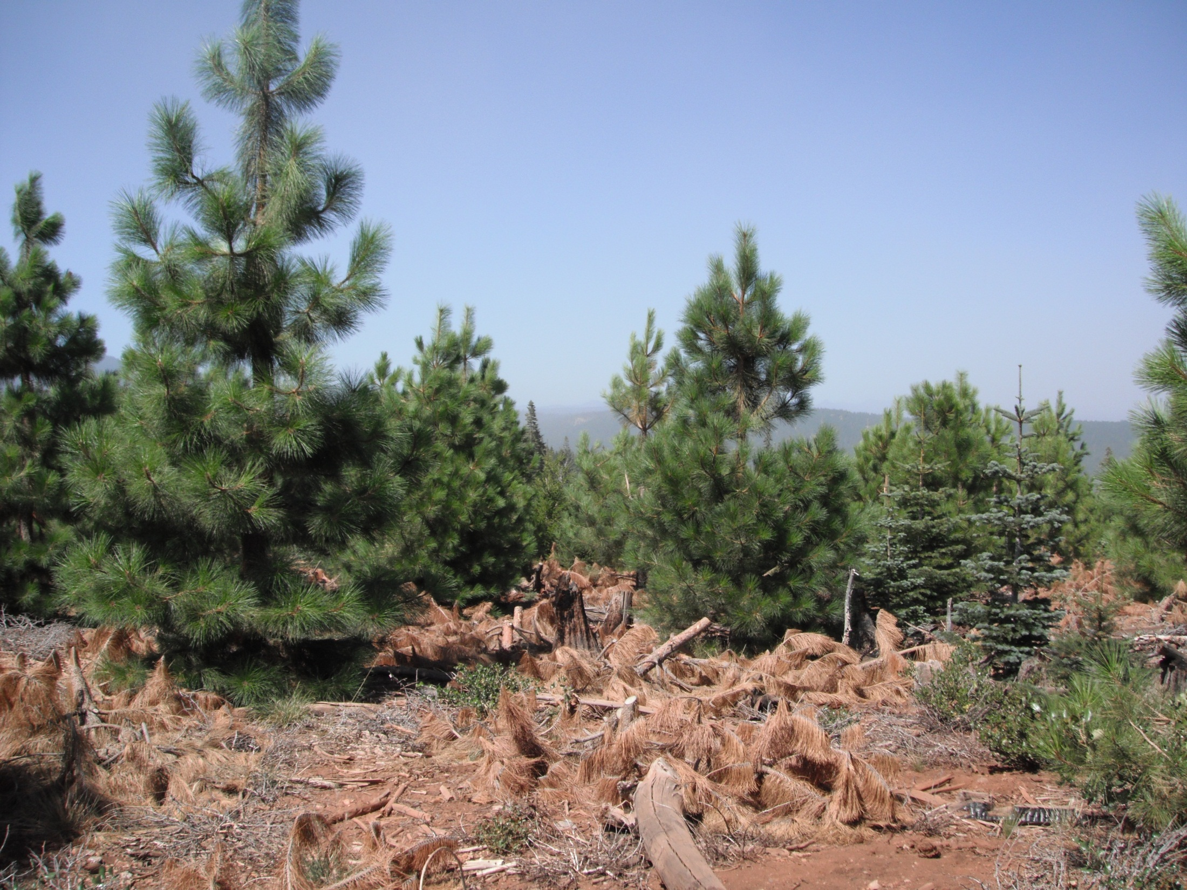
10 yr.-old Storrie Plantation threatened by Chips Fire.
PCT the prior year @ age 9
Possible lessons:
PCT at age 6 or 7
Plant fewer trees/ac
Even more brush control??
Lop more during PCT??
DFZ’s along all roads??
3 to 5 acre safety zones??
Lassen Forest
Chips Fire Survivor
Notes:
We do not cut down a dominant PP (these are NSTIA) that is well spaced from other PP in order to leave a much smaller RF, or cut down the smaller RF even if it is only 8 to 14 feet away from the PP when it likely won’t compete w/ the PP as much as a co-dominant PP would. Total growth to first commercial thin of both, although slowed a bit, would be more than only one of them growing at total free to grow???.
I think this might be a case where overall productivity to first commercial thin might be better if PP are spaced at least 17 to 18’ apart but RF are retained (after thinning out to best of RF) even if it is between the well-spaced PP’s. I think that the RF will grow to commercial size, albeit slower than it would if PP were removed, but that reduced growth to first commercial thin would not compensate for lost potential volume of PP from cutting it. ???
At first we were instructing the crews to ignore the RF completely because of survival rates of initial RF planting, but due to seeding in and better survival for RF (>90% many times now) we have them thin out to leave best RF even if it creates tpa > 150 to 170……

Slide 56
inside the fire perimeter

Slide 57

Storrie Plantation inside the perimeter of Chips Fire line.
PCT one year after fire
Red River Forests
Chips Fire Survivor
Notes:
We do not cut down a dominant PP (these are NSTIA) that is well spaced from other PP in order to leave a much smaller RF, or cut down the smaller RF even if it is only 8 to 14 feet away from the PP when it likely won’t compete w/ the PP as much as a co-dominant PP would. Total growth to first commercial thin of both, although slowed a bit, would be more than only one of them growing at total free to grow???.
I think this might be a case where overall productivity to first commercial thin might be better if PP are spaced at least 17 to 18’ apart but RF are retained (after thinning out to best of RF) even if it is between the well-spaced PP’s. I think that the RF will grow to commercial size, albeit slower than it would if PP were removed, but that reduced growth to first commercial thin would not compensate for lost potential volume of PP from cutting it. ???
At first we were instructing the crews to ignore the RF completely because of survival rates of initial RF planting, but due to seeding in and better survival for RF (>90% many times now) we have them thin out to leave best RF even if it creates tpa > 150 to 170……

Slide 58
2nd attack on east flank
The Final Siege

Slide 59

Brush & dead wood piled/burned one year or two before the 2012 Chips Fire on portions of adjacent ownership!
10 year old Storrie Fire Plantation
Notes:
USFS piles and burned portions of “Wall of Shame” and then planted seedlings.

Slide 60

Storrie Fire 12 years later
USFS
A year after pile & burn brush/dead wood & planting (reduced fuel loading by > 100 tons??)
Red River Forests
3 years after PCT ($50/ac)

Slide 61

North Sierra Tree Improvement Assoc.
Humbug 2nd Gen Progeny Site
12 years after the Storrie Fire
Red River Forests Plantation - 3 years after PCT
Future “Shaded Fuel Break” 3 years after pruning trees etc.

Slide 62



Protecting NSTIA 2nd Gen
Humbug Progeny Test Site
Notes:
USFS piles and burned portions of “Wall of Shame” and then planted seedlings.

Slide 63

12 years of no management after Storrie Fire adjacent to Storrie Fire Plantation pictured shortly before 2012 Chips Fire

Slide 64

……after 2012 Chips Fire

Slide 65
After being threatened on three sides for three weeks, most of the 8-10 yr. old Storrie Fire Plantation survived the 2012 Chips Fire!
ANY QUESTIONS?
Two years after PCT
Notes:
PCT slash has started to break down and within a few more years will be insignificant since PCT was completed at age 7 and initial planting density was not too high.

